Slide 1
كلية المستقبل الجامعة
قسم تقنيات المختبرات الطبية
المرحلة الاولى \الاجهزة الطبية
م.م ساره كامل عبود
الفصل الثاني
اجهزة الطرد المركزي

Slide 2
Separation equipment
Centrifugation

Slide 3
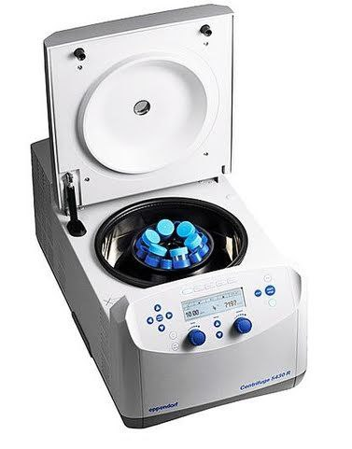

Slide 4
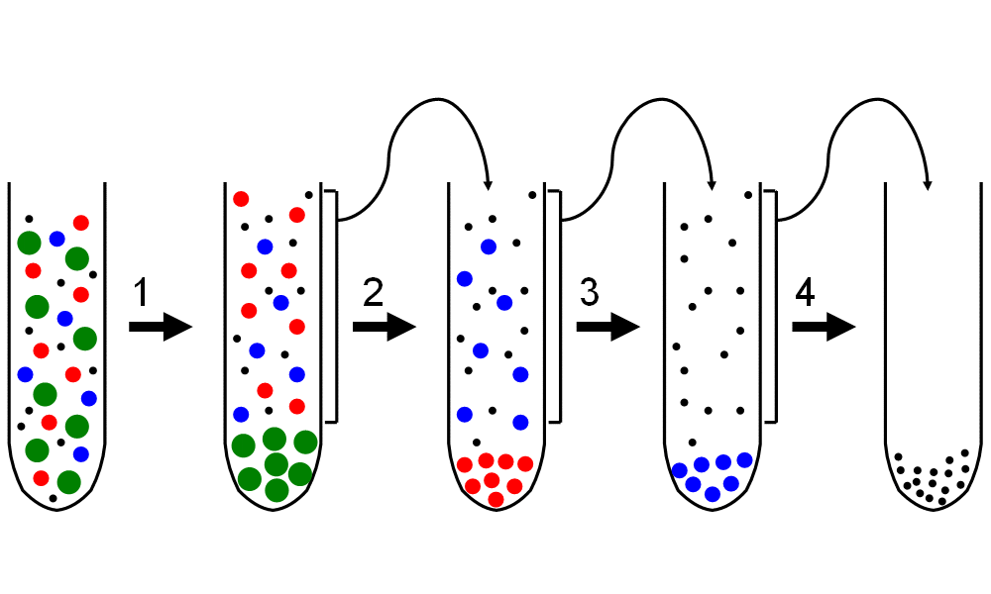

Slide 5
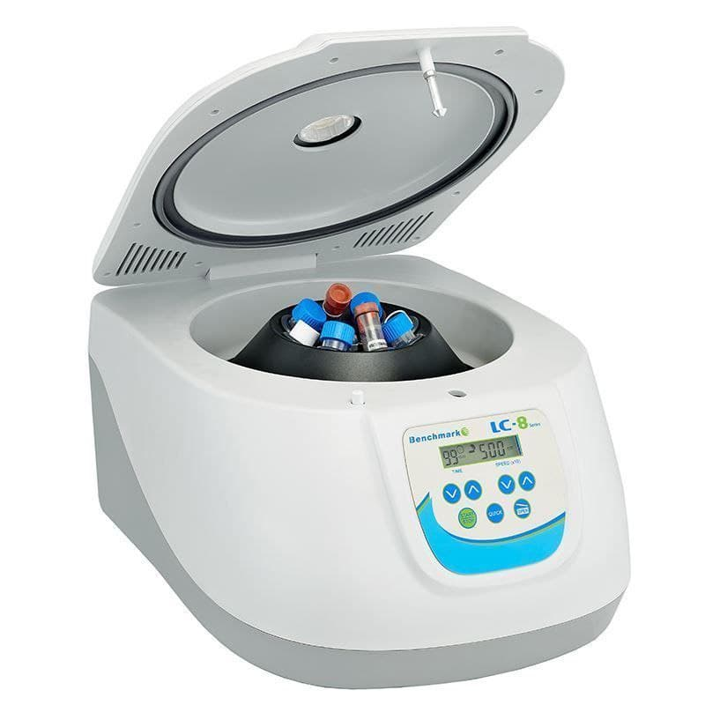
Centrifugation

Slide 6
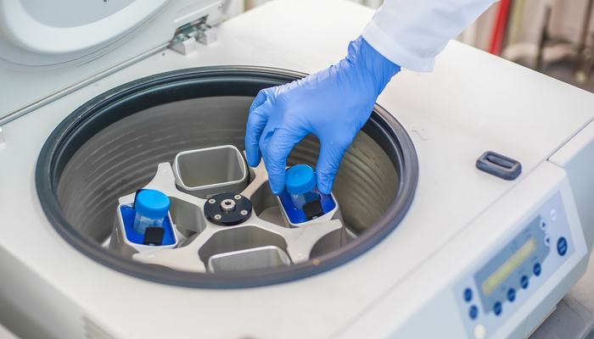

Slide 7
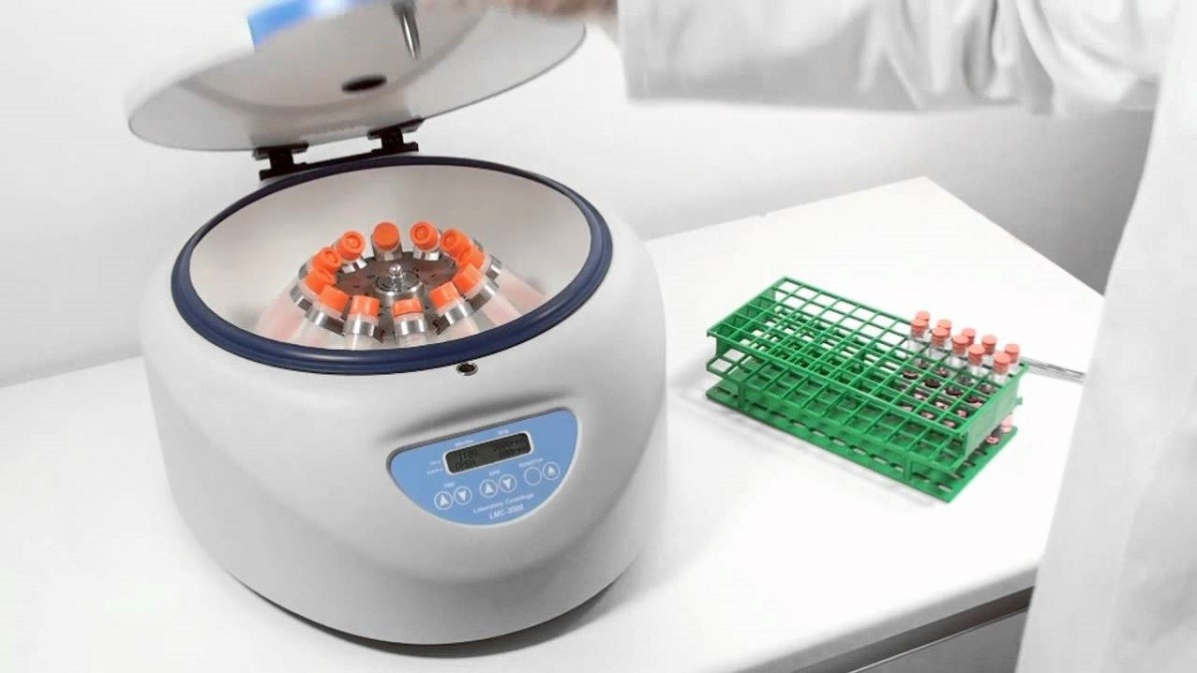

Slide 8
Centrifuges:
An apparatus that rotates at high speed and by centrifugal force separates substances of different densities.
• It is a device to separate and purify a mixture of biological particles in a liquid medium such as proteins and nucleic acids by using centrifugal force.

Slide 9
Centrifugal force (CF):
is the tendency of an object traveling around a central point to continue in a linear motion and fly away from that central point at the same velocity and at the same distance from the common center.

Slide 10
Principles work of centrifuges:
The basic physics work of centrifuges is gravity and generation of the centrifugal force (G) to sediment different fractions. Centrifugal field (G) depends on :
1-Angular velocity (w) in radians/sec.
2-Radial distance (r) in cm of the particle from the axis of rotation.

Slide 11
Rate of sedimentation
: Depends on
- factors other than CF
Mass of particle ---Density & Volume Density of medium Shape of particle Friction

Slide 12
Sedimentation time
Depends on:
1. Size of the particle.
2. Density difference between particle and medium.
3. Radial distance from the axis of rotation to the liquid meniscus (rt).
4. Radial distance from the axis of rotation to the bottom of the tube (rb)

Slide 13
Parts and Functions
: 1-Electric Motor: Head rotation (to spin the sample).
2-Head: A test tube holder
3-Timer: Adjust time for sample separating.
4-Tachometer: Adjust rpm.
5-Brake: For speeding of centrifuge stopping 6-Temperatures Controls Keys: For adjust temperatures degrees
7-Green or red color keys: To work and stope. 8-Cover: Protected

Slide 14
Types of Centrifuges:
1- Desk top centrifuges
2- High speed centrifuges .
3- Ultracentrifuges
.

Slide 15
Applications of centrifuges
1- cell free plasma or serum Remove cellular elements from blood to provide for analysis
2- Isolate chemical precipitated protein from an analytical specimen
3-Separate protein bound from free ligand in immunochemical .
4-Separate lipid components.

Slide 16
Use and care of centrifuges .
1- Reading the manufacturer’s instructions.
2- Placing a centrifuge on a firm level bench out of direct sunlight.
3- Whenever possible using plastic tubes made from polystyrene or autoclavable
4-Closing the centrifuge top before turning it on
5- Always balancing the tubes that are being centrifuged, tubes of the same weight should be placed directly opposite to each other.

