Slide 1
CONVERSION OF AMINO ACIDS TO SPECIALIZED PRODUCTS
Lec. Dr. Shaimaa Munther

Slide 2
CONVERSION OF AMINO ACIDS TO SPECIALIZED PRODUCTS
In addition to serving as building blocks for proteins, amino acids are precursors of many nitrogen-containing compounds that have important physiologic functions.
These molecules include
  porphyrins,
  neurotransmitters,
  hormones,
  purines, and pyrimidines,
  Creatine ,
  Biologically active peptides

Slide 3
Alanine
Alanine serves as a carrier of ammonia and of the carbons of pyruvate from skeletal muscle to liver, and together with glycine & glutamine constitutes a major fraction of the free amino acids in plasma.

Slide 4
Arginine
Serving as a carrier of nitrogen atoms in urea biosynthesis
The guanidino group of arginine is incorporated into creatine.
Following conversion to ornithine, its carbon skeleton becomes that of the polyamines.
Precursore for nitric oxide synthesis

Slide 5
Nitric Oxide NO
Nitric oxide (NO), an intercellular signaling molecule that serves as a neurotransmitter, smooth muscle relaxant, and vasodilator
is produced by vascular endothelium and smooth muscle, cardiac muscle, and many other cell types.
The substrate for NO is L-arginine.
iNOS
L- Arg NO + Citruline
eNOS

Slide 6
Glycine
Glycine is used for Heme, Purine and Creatin synthesis
1. α − carbon and nitrogen atoms of glycine are used for synthesis of porphyrine, prosthetic group of heme.
2. Glycine is incorporated into creatine.
3- The entire glycine molecule becomes atoms 4, 5, and 7of purines .

Slide 7
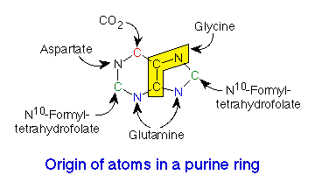
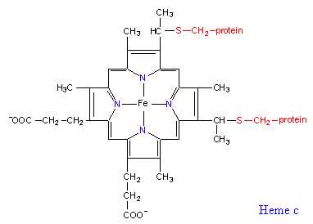

Slide 8
Creatine and Creatinine
Creatine – nitrogenous organic acid - helps to supply energy to muscle.
Creatine phosphate (also called phosphocreatine), the phosphorylated derivative of creatine found in muscle, is a high-energy compound that can reversibly donate a phosphate group to ADP to form ATP.
Creatine phosphate provides a small but rapidly mobilized reserve of high-energy phosphates that can be used to maintain the intracellular level of adenosine triphosphate (ATP) during the first few minutes of intense muscular contraction.
Note:
The amount of creatine phosphate in the body is proportional to the muscle mass.

Slide 9
Synthesis of creatine
Creatine is synthesized from glycine and the guanidino group of arginine, plus a methyl group from S-adenosylmethionine.
Creatine is reversibly phosphorylated to creatine phosphate by creatine kinase, using ATP as the phosphate donor.
[Note: The presence of creatine kinase in the plasma is indicative of tissue damage, and is used in the diagnosis of myocardial infarction]

Slide 10
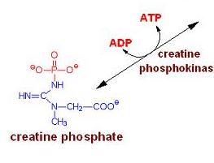
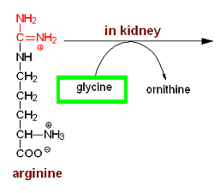
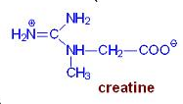
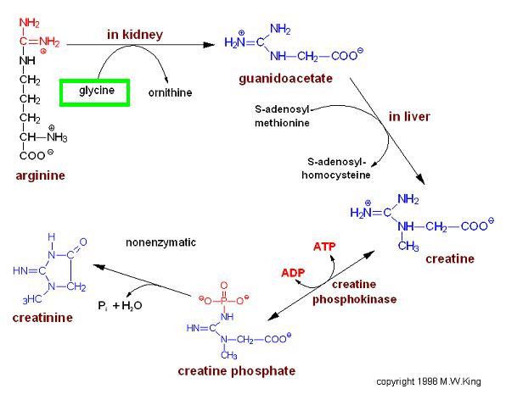
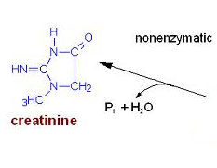
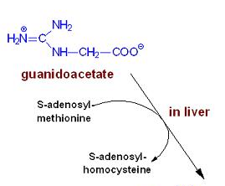

Slide 11
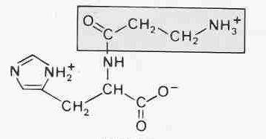
Histidine
Histidin can be used for histamin & carnosine synthesis
Carnosine is the dipeptide of the amino acids β-alanine and histidine.
Carnosine is highly concentrated in muscle and brain tissues.
Scavenger of ROS (radical oxygen species).
Protection of the peroxidation of cell membrane fatty acids during oxidative stress.

Slide 12
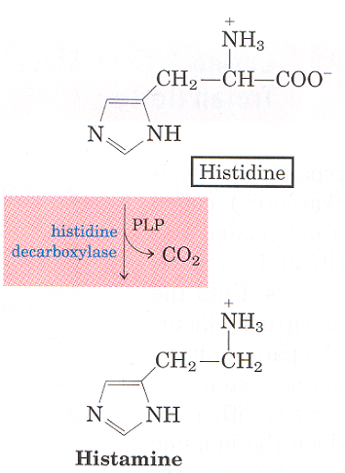
Histamine
Decarboxylation of histidine by the pyridoxal 5'-phosphate-dependent enzyme histidine decarboxylase forms histamine .
Histamine: A biogenic amine that functions in allergic reactions and gastric secretion.
1)It contributes to an inflammatory response.
2) It causes constriction of smooth muscle.
3) Is cause second type of allergic response (one of the major causes for asthma)

Slide 13
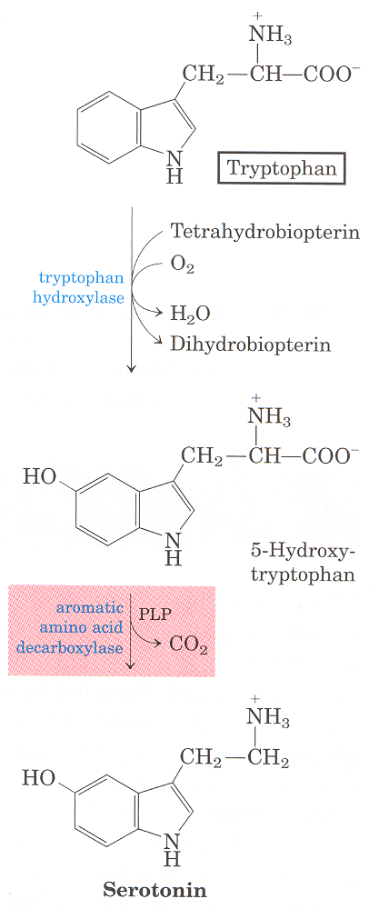
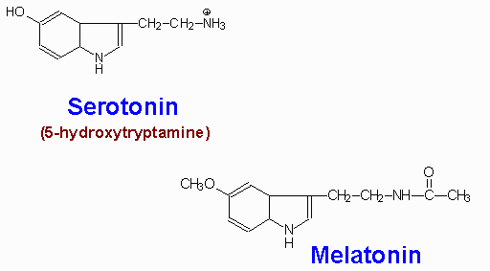
Tryptophan
Tryptopan serves as the precursor for the synthesis of serotonin and melatonin

Slide 14
Serotonin and melatonin
Serotonin, also called 5-hydroxytryptamine, is synthesized and stored at several sites in the body.
The largest amount of serotonin is found in cells of the intestinal mucosa. Smaller amounts occur in the central nervous system, where it functions as a neurotransmitter, and in platelets.
Serotonin is synthesized from tryptophan, in which tryptophan hydroxylated in a reaction analogous to that catalyzed by phenylalanine hydroxylase.The product, 5-hydroxytryptophan, is decarboxylated to serotonin. Conversion to melatonin occure by the enzyme hydroxyindole-O-methyltransferase.
Serotonin has multiple physiologic roles, including pain perception, and regulation of sleep, temperature, and blood pressure, also its precursor to melatonin.

Slide 15
Tyrosine
The majority of tyrosine that does not get incorporated into proteins:
    Is catabolized for energy production.
    Is conversion to the catecholamines.
The catecholamine neurotransmitters are dopamine norepinephrine, and epinephrine.
Norepinephrine is the principal neurotransmitter of sympathetic postganglionic endings.
Catecholamines are stored in synaptic knobs of neurons that secrete it.
Tyrosine is transported into catecholamine-secreting neurons and adrenal medullary cells where catecholamine synthesis takes place.

Slide 16
Synthesis of the Catecholamines from Tyrosine
Using Tyrosine hydroxylase , tyrosine is converted to DOPA (3,4-dihydrophenylalanine). The hydroxylation reaction requires tetrahydrobiopterin as cofactor.
DOPA decarboxylase converts DOPA to dopamine.
Dopamine β-hydroxylase converts dopamine to norepinephrine.
Phenylethanolamine N-methyltransferase converts norepinephrine to epinephrine.

Slide 17
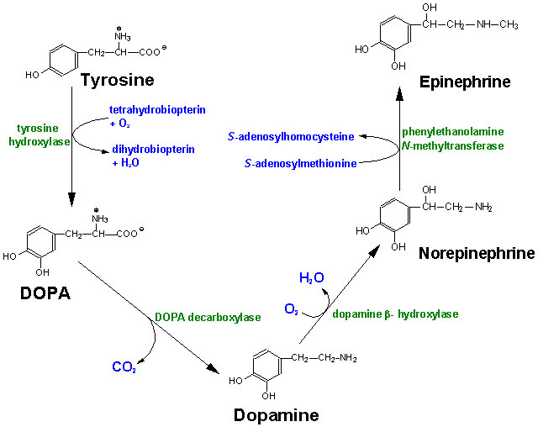

Slide 18
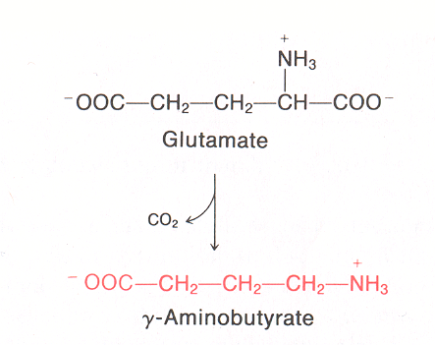
Glutamate
Glutamate is used for the synthesis of γ-aminobutyric acid (GABA)
γ-aminobutyric acid (GABA)is an inhibitory neurotransmitter (CNS).
also its directly regulates muscle tone.
Its lack leads to convulsions, epilepsia.
furthermore, its involved in mechanism of memory.

Slide 19


