Slide 1
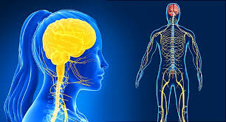
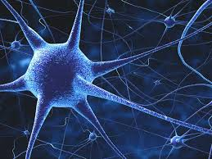
Human Nervous System
Lecture 4
Dr. Shaimaa Munther

Slide 2
Introduction
The human central nervous system (CNS) contains about 10¹¹ (100 billion) neurons.
It also contains 10–50 times this number of glial cells.
The neurons, the basic building blocks of the nervous system, have evolved from primitive neuro effector cells that respond to various stimuli by contracting.
In more complex animals, contraction has become the specialized function of muscle cells, whereas integration and transmission of nerve impulses have become the specialized functions of neurons.
Excitability of neurons: which involves the genesis of electrical signals that enable neurons to integrate and transmit impulses (action potentials, receptor potentials, and synaptic potentials).

Slide 3
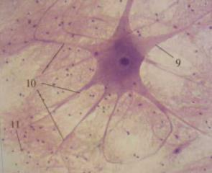
Cellular Elements in The CNS
The functional unit of the nervous system is the nerve cell (Neuron).
Neurons are highly specialized nerve cells , that are capable of transmitting the information in chemical and electrical form from the brain to the body and vice versa.
The nervous system contains Glial cells which provide support and nutrition to the system. These cells help maintain the health of the neurons and also aid in message transmission.

Slide 4
Cellular Elements in The CNS
1- Glial Cells
For many years following their discovery, glial cells (or glia) were viewed as CNS connective tissue. In fact, the word glia is Greek for glue. However, today theses cells are recognized for their role in communication within the CNS in partnership with neurons.
There are two major types of glial cells in the vertebrate nervous system:
  Microglia
  Macroglia.

Slide 5
A. Microglia
Microglia: Are scavenger cells that resemble tissue macrophages and remove debris resulting from injury, infection, and disease (e.g, multiple sclerosis, AIDS-related dementia, Parkinson disease, and Alzheimer disease).
Microglia arise from macrophages outside of the nervous system and are physiologically and embryologically unrelated to other neural cell types.

Slide 6
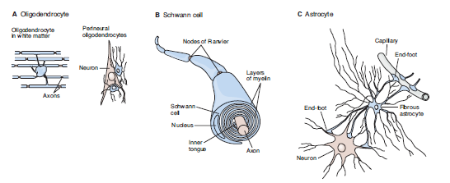
B. Macroglia
There are three types of Macroglia:
Oligodendrocytes
Schwann cells
Astrocytes

Slide 7
B. Macroglia
1- Oligodendrocytes :
Oligodendrocytes are involved in myelin formation around axons in the CNS
These cells are small with relatively few processes.
Those in the white matter provide myelin, and those in the gray matter support neurons
2- Schwann cells :
Schwann cells provide myelin around axons in the peripheral nervous system.
Each cell forms a segment of myelin sheath about 1 mm long.
The sheath assumes its form as the inner tongue of the Schwann cell turns around the axon several times, wrapping in concentric layers.
Intervals between segments of myelin are the nodes of Ranvier

Slide 8
B. Macroglia
Notes:
In the CNS of mammals, most neurons are myelinated, but the cells that form the myelin are oligodendrocytes rather than Schwann cells .
Unlike the Schwann cell, which forms the myelin between two nodes of Ranvier on a single neuron, oligodendrocytes emit multiple processes that form myelin on many neighboring axons.
In multiple sclerosis, a crippling autoimmune disease, patchy destruction of myelin occurs in the CNS.
The loss of myelin is associated with delayed or blocked conduction in the demyelinated axons.

Slide 9
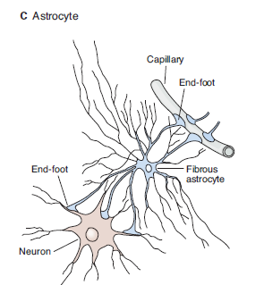
B. Macroglia
3- Astrocytes:
Astrocytes are the most common glia in the CNS and are characterized by their starlike shape.
They contact both capillaries and neurons and are thought to have a nutritive function.
They are also involved in forming the blood–brain barrier

Slide 10
B. Macroglia
Astrocytes are of two subtypes:
  Fibrous astrocytes: which contain many intermediate filaments, are found primarily in white matter.
  Protoplasmic astrocytes: are found in gray matter and have a granular cytoplasm.
Both types send processes to blood vessels, where they induce capillaries to form the tight junctions making up the blood–brain barrier.
They also send processes that envelop synapses and the surface of nerve cells.
Protoplasmic astrocytes have a membrane potential that varies with the external K⁺ concentration but do not generate propagated potentials. They produce substances that are tropic to neurons, and they help maintain the appropriate concentration of ions and neurotransmitters by taking up K⁺ and the neurotransmitters glutamate and gama-aminobutyrate (GABA).

Slide 11
Cellular Elements in The CNS
2- The Neuron
The functional unit of the nervous system is the nerve cell (Neuron).
Nerve cells transmit signals in form of nerve impulses.
Have high metabolic rate.
Do not divide.
The cell body (soma) contains the nucleus and is the metabolic center.
Neurons have several processes called dendrites that extend outward from the cell body and arborize extensively neuron.
A typical neuron also has a long fibrous axon that originates from a somewhat thickened area of the cell body, the axon hillock.
The first portion of the axon is called the initial segment.
The axon divides into presynaptic terminals, Each ending in a number of synaptic knobs which are also called terminal buttons or boutons. They contain granules or vesicles in which the synaptic transmitters secreted by the nerves are stored.

Slide 12
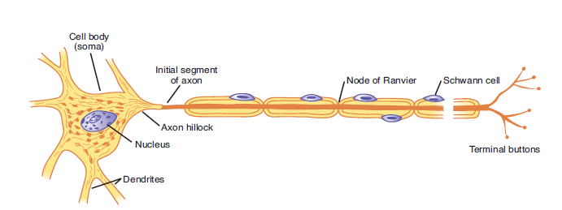
Figure 1 : Typical motor neuron with a myelinated axon.
A motor neuron is comprised of a cell body (soma) with a nucleus, several processes called dendrites, and a long fibrous axon that originates from the axon hillock. The first portion of the axon is called the initial segment. A myelin sheath forms from Schwann cells and surrounds the axon except at its ending and at the nodes of Ranvier. Terminal buttons (boutons) are located at the terminal endings.

Slide 13
Defintions
Cell Body: Most are in CNS , contains the nucleus & organelles.
Dendrites : Processes that extend outward from the cell body , recieve chemical signals from neighboring cells toward cell body .
Axon: Long extension that carries electrical messages away from the body to the terminal axons.
Terminal Axons: Passes the signal to the next cell.
.
Myelin sheath: Fatty sheath that surrounds most nerve fibers considered as Protective covering for axon.
Synapses: Site where neurons communicate.

Slide 14
The Neuron
From a functional point of view, neurons generally have four important zones:
  A receptor, or dendritic zone, where multiple local potential changes generated by synaptic connections are integrated.
  A site where propagated action potentials are generated (The initial segment in spinal motor neurons, The initial node of Ranvier in cutaneous sensory neurons)
  An axonal process that transmits propagated impulses to the nerve endings
  The nerve endings, where action potentials cause the release of synaptic transmitters.
The cell body is often located at the dendritic zone end of the axon, but it can be within the axon (eg, auditory neurons) or attached to the side of the axon (eg, cutaneous neurons).
Its location makes no difference as far as the receptor function of the dendritic zone and the transmission function of the axon are concerned.
Notes:
auditory neurons BIPOLAR
, cutaneous neurons PSEUDOPOLAR

Slide 15
The Neuron
The axons of many neurons are myelinated, that is, they acquire a sheath of myelin, a protein–lipid complex that is wrapped around the axon
In the peripheral nervous system, myelin forms when a Schwann cell wraps its membrane around an axon up to 100 times .
The myelin sheath envelops the axon except at its ending and at the nodes of Ranvier, periodic 1-um constrictions that are about 1 mm apart
In the CNS of mammals, most neurons are myelinated, but the cells that form the myelin are oligodendrocytes rather than Schwann cells
Not all neurons are myelinated; some are unmyelinated, that is, simply surrounded by Schwann cells without the wrapping of the Schwann cell membrane that produces myelin around the axon.

Slide 16
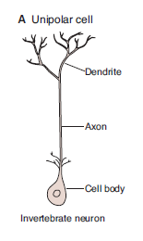
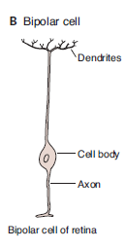
Classification of Neurons
Based on the number of processes that emanate from their cell body, neurons can be classified as unipolar, bipolar, and multipolar:
A) Unipolar neurons :
  Have one process, with different segments, serving as receptive surfaces and releasing terminals.
B) Bipolar neurons:
  Have two specialized processes: a dendrite that carries information to the cell and an axon that transmits information from the cell. E.g. bipolar cell of retina

Slide 17
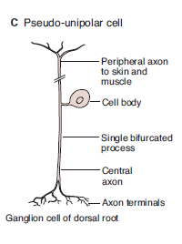
Classification of Neurons
C) Pseudo-unipolar Cells:
  Some sensory neurons are in a subclass of bipolar cells called pseudo-unipolar cells.
  As the cell develops, a single process splits into two, both of which function as axons - one going to skin or muscle and another to the spinal cord.

Slide 18
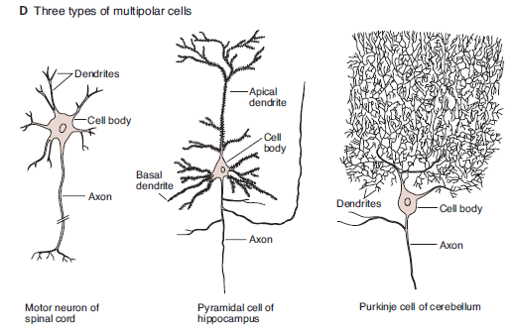
Classification of Neurons
D) Multipolar cells
  Have one axon and many dendrites.
  Examples include:
    Motor neurons,
    Hippocampal pyramidal cells with dendrites in the apex and base
    Cerebellar Purkinje cells with an extensive dendritic tree in a single plane.

Slide 19
Multipolar Cells

Slide 20
Types of Neurons
There are 3 main types of neurons:
    Sensory neuron = Detect stimuli
    Interneurons = Relay sensory signals to brain then return message back to motor neurons. ( cells that make decision)
    Motor neuron = Pass message from brain to rest of body for muscle response

Slide 21
Types of Neurons
The sensory neurons ( Afferent Neurons) :
Receptor AP CNS
Psedo-unipolar shape
Generate and transmit the stimuli received from the sensory organs like the eye, nose or skin, to the CNS , i.e. to the brain and the spinal cord.
Include:
1- Somatic sensory neurons
  Transmit information from skin or skeletal muscle
  Information reach conscious
2- Visceral sensory neurons
  Transmit information from the visceral ( internal organs) to CNS
  Information dose not reach conscious

Slide 22
Types of Neurons
The Interneurons ( Association Neurons) :
Located entirely within the CNS
Transmit AP from one neuron to other
Multipolar shape
These cells processes these stimuli and sends them back to the other parts of the body telling them to react to a particular type of stimulus i.e. integrate and make decision .

Slide 23
Types of Neurons
The Motor Neurons (Efferent Neurons) :
CNS AP Effector .
Multipolar shape
Are responsible for receiving signals from the CNS and transmitting them to the other organs of the body ( Orders or Commands)
These include:
1- Somatic motor neurons :
  Innervate skeletal muscle.
  Under voluntary control.
2- Autonomic (visceral) motor neurons :
  Innervate visceral smooth muscle, cardiac muscle and glands.
  Not under voluntary control.

Slide 24
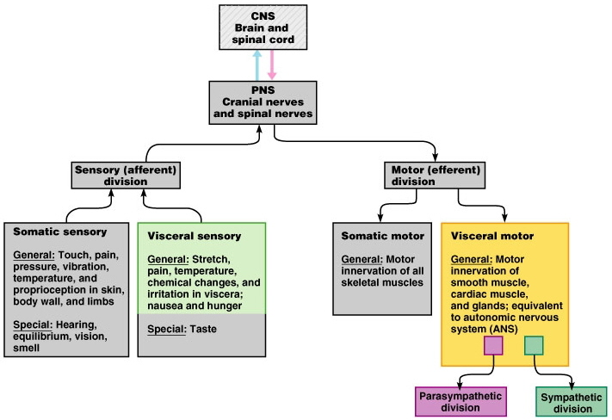
Notes:
Remember: SAME

Slide 25
Now We Need To Return Back to CNS & PNS

Slide 26
Spinal Cord
The spinal cord is a bundle of nerves that run down the back from the brain in the spinal column.
The spinal cord is about 40 cm in length and as wide as the thumb.
The function of the spinal cord is to relay all the impulses, information from all around the body, internally and externally, to the brain.
If the spinal cord gets affected due to an injury, leading to paralysis in different parts of the body like the upper and lower limbs.

Slide 27
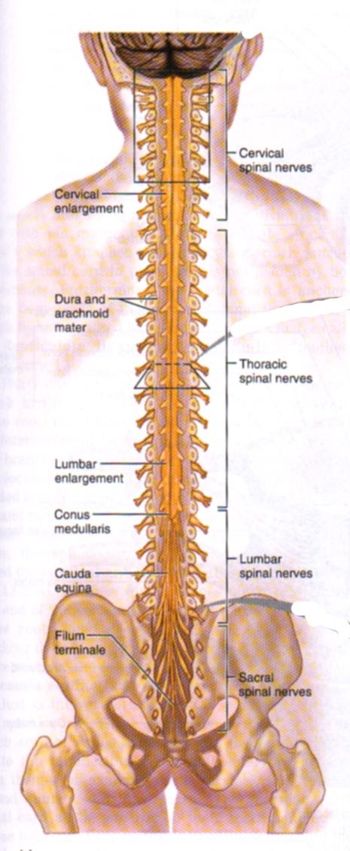
CNS – Spinal Cord
Runs through vertebral canal of the vertebral column
Protected by bone, meninges, and cerebrospinal fluid
Spinal cord made of a core of gray matter surrounded by white matter
31 pairs of spinal nerves branch off spinal cord through inter vertebral foramen
Functions in many ways:
  Involved in sensory and motor innervation of body inferior to the head (through spinal nerves)
  Provides a 2-way conduction pathway for signals between body and brain
  Major center for reflexes
Notes:
Part of the PNS (Somatic)
Lie in intervertebral foramina
Send lateral branches to body
Named according to their point of issue from the vertebral column
8 pairs of cervical spinal nerves; C₁-C₈
12 pairs of thoracic spinal nerves; T₁-T₁₂
5 pairs of lumbar spinal nerves; L₁-L₅
5 pairs of sacral spinal nerves; S₁-S₅
1 pair of coccygeal spinal nerves; C₀₁

Slide 28
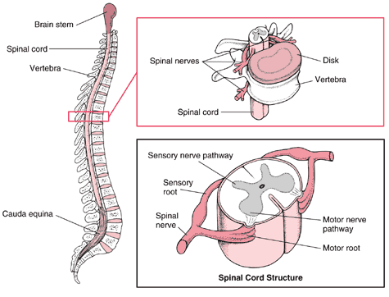

Slide 29
Meninges of Brain and Spinal Cord
1. Dura mater (superficial)
  Spinal dural sheath
  Does not attach to bone
Epidural space
  Fat and veins
  Between dura mater and vertebra
Subdural space
  Between dura mater and arachnoid
2. Arachnoid mater (middle)
  Impermeable layer = barrier
Subarachnoid space
  Between arachnoid and pia mater
  Contains CSF
3. Pia mater (deep)
  Highly vascular
  Adheres to brain/spinal cord tissue

Slide 30
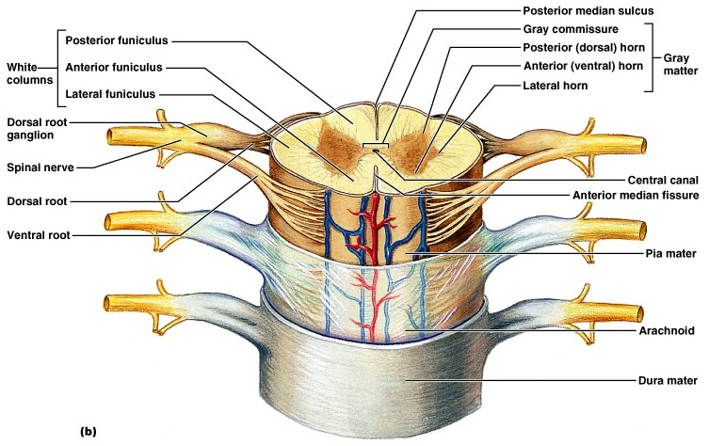
Meninges of Brain and Spinal Cord

Slide 31
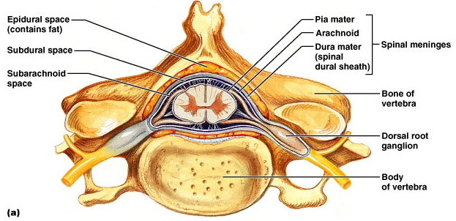

Slide 32
Gray Mater
Consists of neuron cell bodies, unmyelinated axons, dendrites, and neuroglia
Shaped like an “H”
  Gray commissure (crossbar)
  Central canal
Posterior horns
Anterior horns

Slide 33
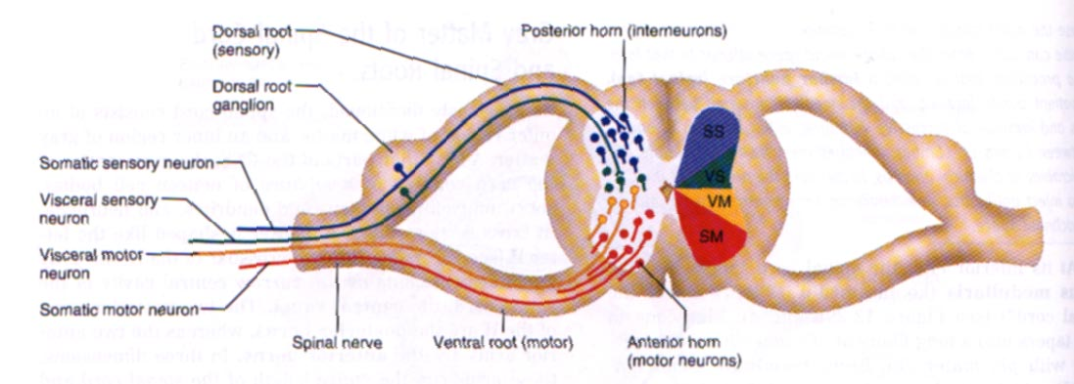
Gray Mater
Posterior horns
  Consist of interneurons that transmit in signals from outside spinal cord into it
  Dorsal root contain sensory fibers
    Somatic Sensory (SS)
    Visceral Sensory (VS)
  Dorsal root ganglia - swelling in dorsal root that these interneurons pass through
Anterior horns
  Cell bodies of motor neurons send info out of spinal cord to muscles and glands
  Ventral Root contains Motor Fibers
    Visceral Motor
    Somatic Motor

Slide 35
White Mater
Surrounds gray matter
Composed of myelinated and unmyelinated axons
Divided into white columns (funiculi)
    Posterior funiculus
    Anterior funiculus
    Lateral funiculus
Allow for communication between
  Parts of the spinal cord
  Spinal cord and brain

Slide 36
White Mater
There are 3 types of nerve fibers:
  Ascending
    Carry sensory informations from sensory neurons of body to brain
    touch, pressure, pain, temperature
  Descending
    Carry motor instructions from brain to spinal cord
    Contraction of muscles and secretion of glands
    control precise, skilled movement = writing, maintain balance, create movement
  Commissural
    Cross from one side of cord to the other

Slide 37
Peripheral Nervous System PNS
Nervous system structures outside the brain and spinal cord
Either somatic or visceral
  Visceral motor portion is the ANS
Structural components:
  Sensory receptors
  Motor endings
  Nerves and ganglia

Slide 38
PNS - Sensory and Motor Signals
Divided by the body regions they serve:
Sensory division
  Somatic sensory
  Visceral sensory
Motor division
  Somatic motor
  Visceral motor
Notes:
Remember: SAME

Slide 40
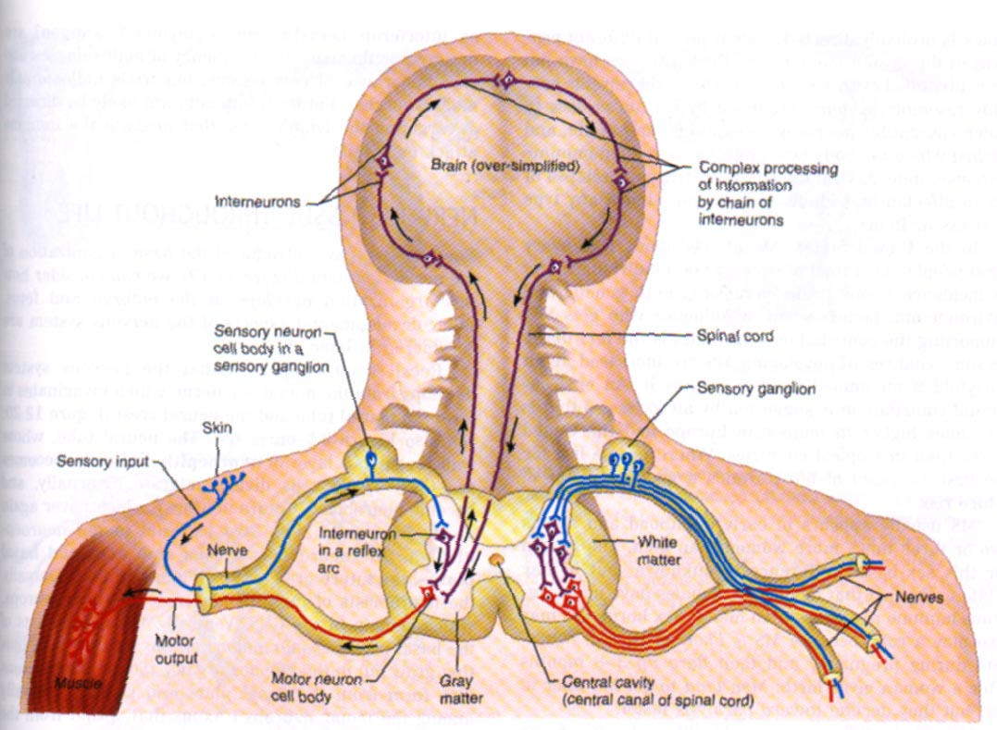

Slide 41
Spinal Nerves
Each spinal nerve connected to spinal cord via dorsal (sensory) and ventral (motor) root
Spinal nerves branch into dorsal ramus and ventral ramus
  Ventral ramus
    Connects to rami communicates, which then lead to sympathetic chain ganglia
    Supply anterior and lateral regions of the neck, trunk, and limbs
  Dorsal ramus
    Supply the dorsum of the neck and trunk (back)

Slide 42
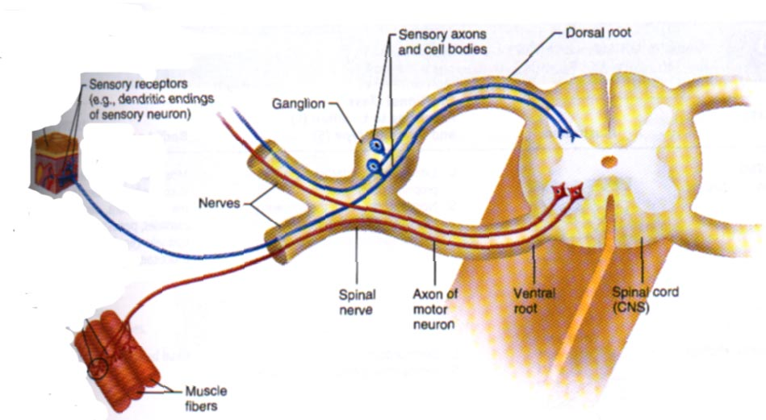

Slide 43
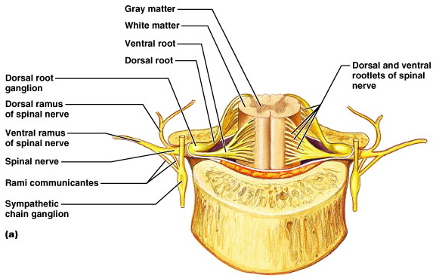
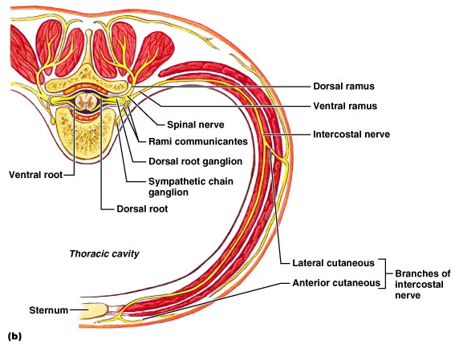
Roots V. Rami
Rami
  Lateral branches of spinal nerves
  Each contains both sensory fibers and motor fibers
Roots
  Lie medial to the spinal nerves
  Strictly sensory (dorsal) or motor (ventral)

Slide 44
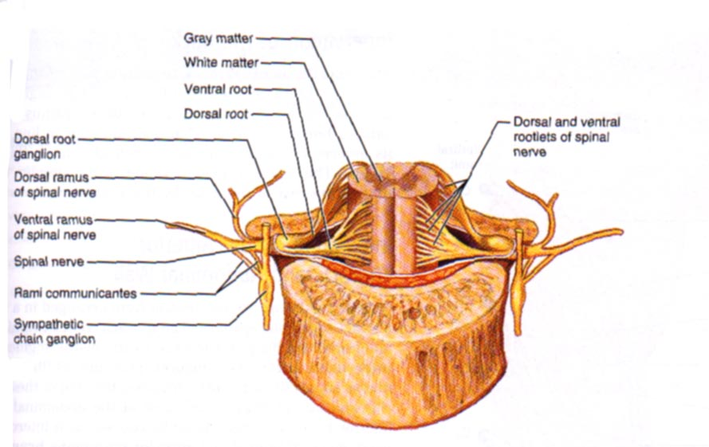
The Big Picture
Just lateral to intervertebral foramen, each spinal nerve then splits in 2
  Dorsal Rami
  Ventral Rami
Contain BOTH Sensory and Motor fibers

Slide 45
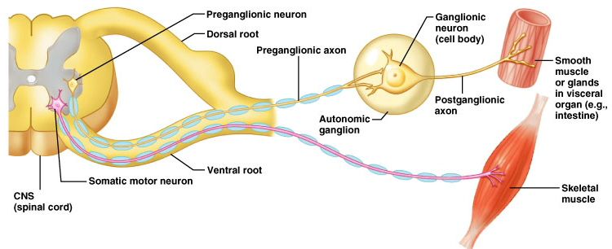
Somatic Nervous System
Innervates skeletal muscle
Neurons runs from CNS directly to muscle
Consists of single neuron plus skeletal muscle cells
Voluntary control
  Running, moving limbs, typing on a computer!

Slide 47
EXCITATION & CONDUCTION
Nerve cells have a low threshold for excitation. The stimulus may be electrical, chemical, or mechanical.
Two types of physicochemical disturbances are produced:
  Local, nonpropagated potentials called, depending on their location, (synaptic, generator, or electrotonic potentials).
  Propagated potentials, the action potentials (or nerve impulses).

Slide 48
Nerve Impulses
These are the only electrical responses of neurons and other excitable tissues, and they are the main language of the nervous system.
They are due to changes in the conduction of ions across the cell membrane that are produced by alterations in ion channels.
The electrical events in neurons are rapid, being measured in milliseconds (ms); and the potential changes are small, being measured in millivolts (mV).

Slide 49
Conduction
The impulse is normally transmitted (conducted) along the axon to its termination.
Conduction is an active, self-propagating process, and the impulse moves along the nerve at a constant amplitude and velocity.
The process is often compared to what happens when a match is applied to one end of a trail of gunpowder; by igniting the powder particles immediately in front of it, the flame moves steadily down the trail to its end as it is extinguished in its progression.
Notes:
Nerves are not “telephone wires” thattransmit impulses passively; conduction of nerve impulses,
although rapid, is much slower than that of electricity. Nerve
tissue is in fact a relatively poor passive conductor, and it
would take a potential of many volts to produce a signal of a
fraction of a volt at the other end of a meter-long axon in the
absence of active processes in the nerve.

Slide 50
Saltatory Conduction
Conduction in myelinated axons involves depolarization in myelinated axons jumps from one node of Ranvier to the next.
This jumping of depolarization from node to node is called saltatory conduction.
It is a rapid process that allows myelinated axons to conduct up to 50 times faster than the unmyelinated fibers.

Slide 51
Nerve Fiber Types & Function
Erlanger and Gasser divided mammalian nerve fibers into A, B, and C groups, further subdividing the A group into ( α , β , ϒ , and delta ) fibers.
In general, the greater the diameter of a given nerve fiber, the greater its speed of conduction.
The large axons are concerned primarily with proprioceptive sensation, somatic motor function, conscious touch, and pressure, while the smaller axons subserve pain and temperature sensations and autonomic function.

Slide 52
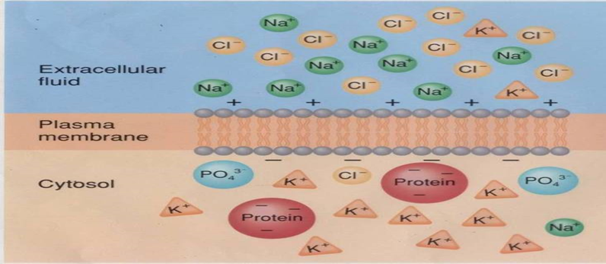
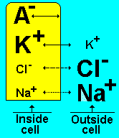
Membrane Ionic Distribution & Membrane Potential
Intracellular fluid and extracellular fluid are electrically neutral solutions, in that each has an equal number of positively and negatively charged ions.
In an unstimulated or resting cell, a slight accumulation of negative charges (–) on the internal surface of the plasma membrane is attracted to an equal number of positive charges (+) that have accumulated on the external surface of the membrane.
Notes:
THISACCUMULATION LIKE BATTRY

Slide 53
Membrane Potential
Therefore, all cells at rest are electrically polarized; that is, the inside of the cell is slightly negative relative to the outside.
This separation of charge across the plasma membrane is referred to as the membrane potential.
the potential is measured in millivolts (mV). Furthermore, the sign (+ve or –ve ) of the potential is defined by the predominant charge on the internal surface of the cell membrane.
Therefore, the membrane potential under resting conditions is negative.
Nerve cells and muscle cells rely on changes in this membrane potential for their functions. In other words, changes in the membrane potential convey information to these types of cells.

Slide 54
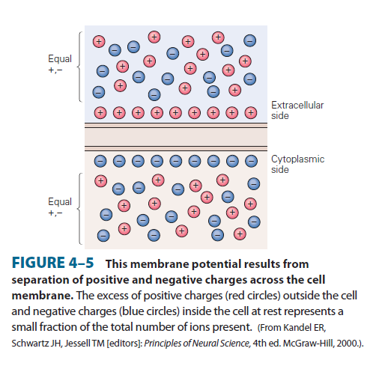

Slide 55
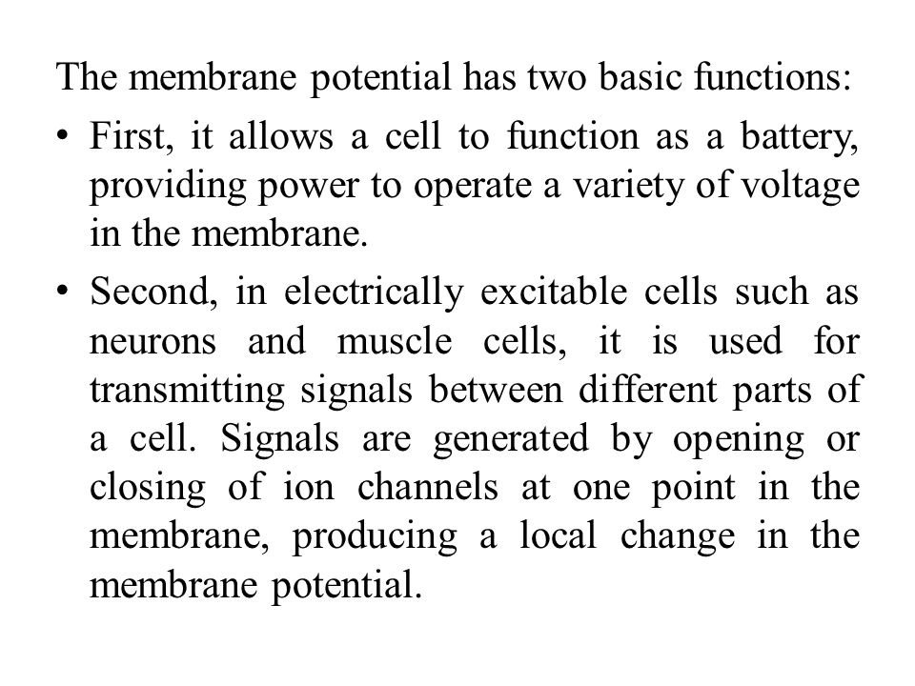
Membrane Potential

Slide 56
Resting Membrane Potential (RMP)
When two electrodes are connected through a suitable amplifier and placed on the surface of a single axon, no potential difference is observed. However, if one electrode is inserted into the interior of the cell, a constant potential difference is observed, with the inside negative relative to the outside of the cell at rest.
RMP is defined as the differences of voltage across the sides of plasma membrane at rest .
A membrane potential results from separation of positive and negative charges across the cell membrane

Slide 57
Resting Membrane Potential (RMP)
In a typical unstimulated neuron, the resting membrane potential is approximately –70 mV. (which is close to the equilibrium potential for K+)
In order for a potential difference to be present across a membrane lipid bilayer, two conditions must be met.
  there must be an unequal distribution of ions of one or more species across the membrane (ie, a concentration gradient).
  the membrane must be permeable to one or more of these ion species.
The permeability is provided by the existence of channels or pores in the bilayer; these channels are usually permeable to a single species of ions.
The resting membrane potential represents an equilibrium situation at which the driving force for the membrane-permeant ions down their concentration gradients across the membrane is equal and opposite to the driving force for these ions down their electrical gradients.

Slide 58
Resting Membrane Potential (RMP)
Thus the development of membrane potential depends on the distribution and permeability of three ions:
  Sodium (Na +)
  Potassium (K+ )
  Anions (A– )
Sodium ions (Na +) : Are found in a greater concentration in the ECF .
Potassium ions (K +) : Are found in a greater concentration in the ICF.
Anions ( A – ) : Refers to large anionic proteins found only within the ICF & ( Cl -) ions which found in a greater concentration in the ECF .

Slide 59
Resting Membrane Potential (RMP)
Under resting conditions, most mammalian plasma membranes are approximately 50 to 75 times more permeable to K+ ions than they are to Na + ions.
The anions are impermeable at all times.
It is due to these underlying conditions that the resting membrane potential is generated and maintained.
When permeable, the movement of Na + and K + ions in and out of the cell depend on two factors:
  • Concentration gradient
  • Electrical gradient
Concentration gradient: movement of a substance down there conc. Gradient
Electrical gradient : movement of ions ( opposite charged ions are attracted to one another and like charged molecules are repelled from one another).

Slide 60
IONIC FLUXES DURING
THE ACTION POTENTIAL
The cell membranes of nerves, like those of other cells, contain many different types of ion channels.
Some of these are voltage- gated and others are ligand-gated.
It is the behavior of these channels, and particularly Na+ and K+ channels, which explains the electrical events in nerves.

Slide 61
Action potential phases
The changes in membrane conductance of Na⁺ and K⁺ that occur during the action potentials are shown in Figure 4–6.
1- Depolariztion: Depolarizing stimulus lead to the voltage-gated Na⁺ channels overwhelm the K⁺ and other channels and an action potential results. but the increase in Na⁺ conductance is short-lived.
2- Inactivated state: Remain in this state for a few milliseconds before returning to the resting state .
3- Repolarization: In this phase the opening of voltage-gated K⁺ channels occurs. This opening is slower and more prolonged than the opening of the Na⁺ channels,. The net movement of positive charge out of the cell due to K⁺ efflux ( outward ) at this time helps complete the process of repolarization

Slide 62
Action potential phases
4- After-hyper polarization: The slow return of the K⁺ channels to the closed followed by a return to the resting membrane potential. Thus, voltage-gated K⁺ channels bring the action potential to an end and cause closure of their gates through a negative feedback process.
Figure 4–7 shows the sequential feedback control in voltage-gated K⁺ and Na⁺ channels during the action potential.

Slide 63
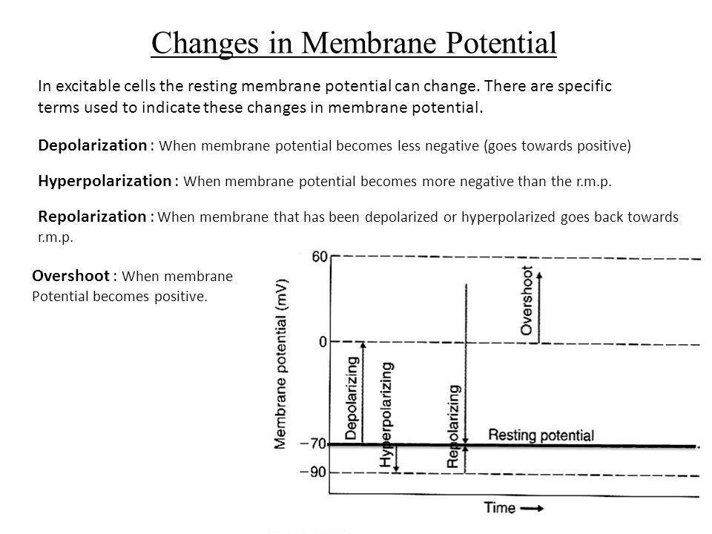

Slide 64
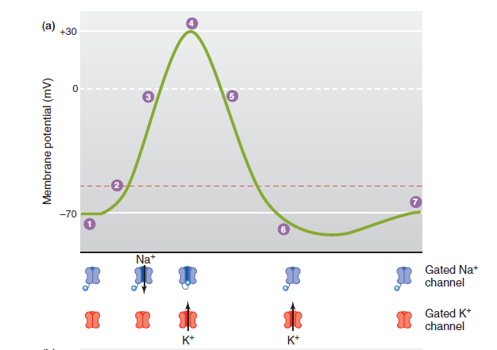
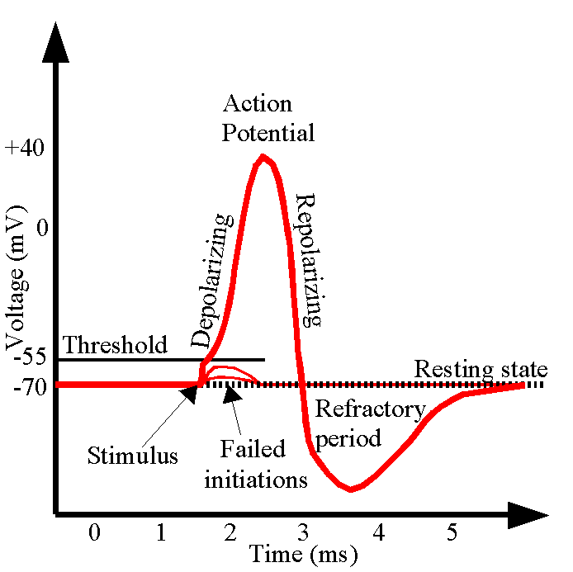
Changes in membrane potential

Slide 65
Thank You

