Slide 1
Protein Structure & Function
Amino Acids
Lecture : 2
Dr. Shaimaa Munther

Slide 2
Aims of The Lecture
The students should be learning about Amino acids:
    The structures and types.
    The importance and functional role.
    Optical properties.
    Acid-Base properties and Buffer characteristic.

Slide 3
Structural Feature of Proteins
Proteins are the most abundant and functionally diverse molecules in living systems.
Virtually every life process depends on this class of molecules.
For example:
  Enzymes and polypeptide hormones.
  Myosin, a contractile protein of muscle.
  Bone, consisted from the protein collagen.
  Blood proteins, such as hemoglobin and plasma albumin and immunoglobulins.
Proteins all share the common structural feature of being linear polymers of amino acids.
Notes:
This chapter describes the properties of amino acids. Chapter 2 explores how these simple building blocks are joined to form proteins that have unique three-dimensional structures, making them capable of performing
specific biologic functions.

Slide 4
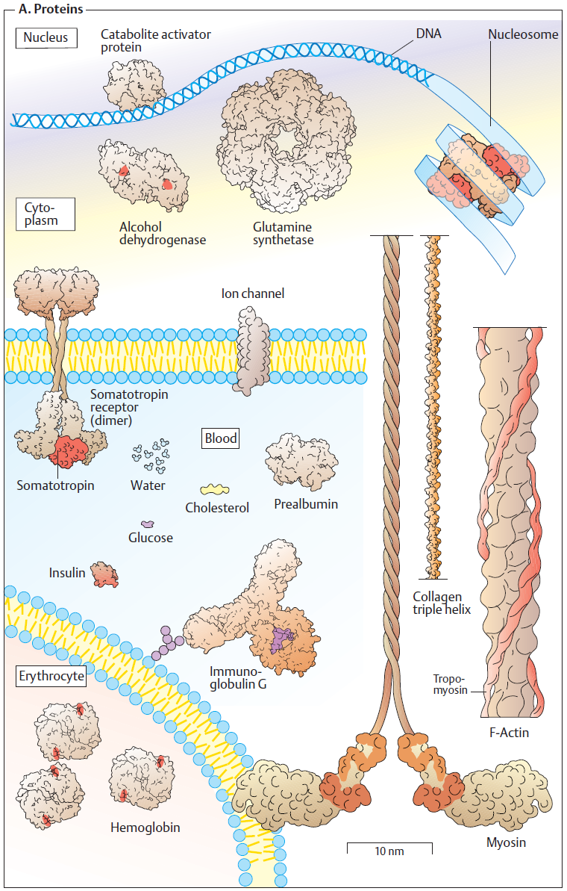

Slide 5
Proteins
Proteins are linear polymers built from monomeric units called amino acids.
Twenty amino acids are commonly found in proteins.
These amino acids contain a variety of different functional groups.
Protein function depends on both
  amino acid content, and
  amino acid sequence
Protein fold into diverse shapes such as spherical, oval, long strands, etc.
All information for 3-D structure is contained in the linear sequence of amino acids.
To understand protein function, we must first understand the nature of amino acids.

Slide 6
STRUCTURE OF THE AMINO ACIDS
Although more than 300 different amino acids have been described in nature, only 20 are commonly found as constituents of mammalian proteins.
Note:
  These are the only amino acids that are coded for by DNA, the genetic material in the cell

Slide 7
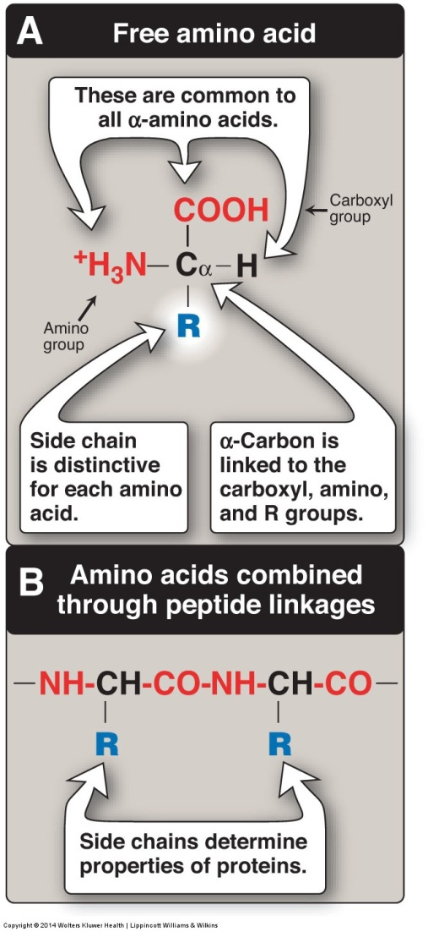
STRUCTURE OF THE AMINO ACIDS
Each amino acid (except for proline) has:
  A carboxyl group
  A primary amino group
  A hydrogen atom
  A distinctive side chain (“R-group”) , all bonded to the α-carbon atom
At physiologic pH (approximately pH 7.4), the carboxyl group is dissociated, forming the negatively charged carboxylate ion (–COO‾), and the amino group is protonated (–NH3‾).

Slide 8
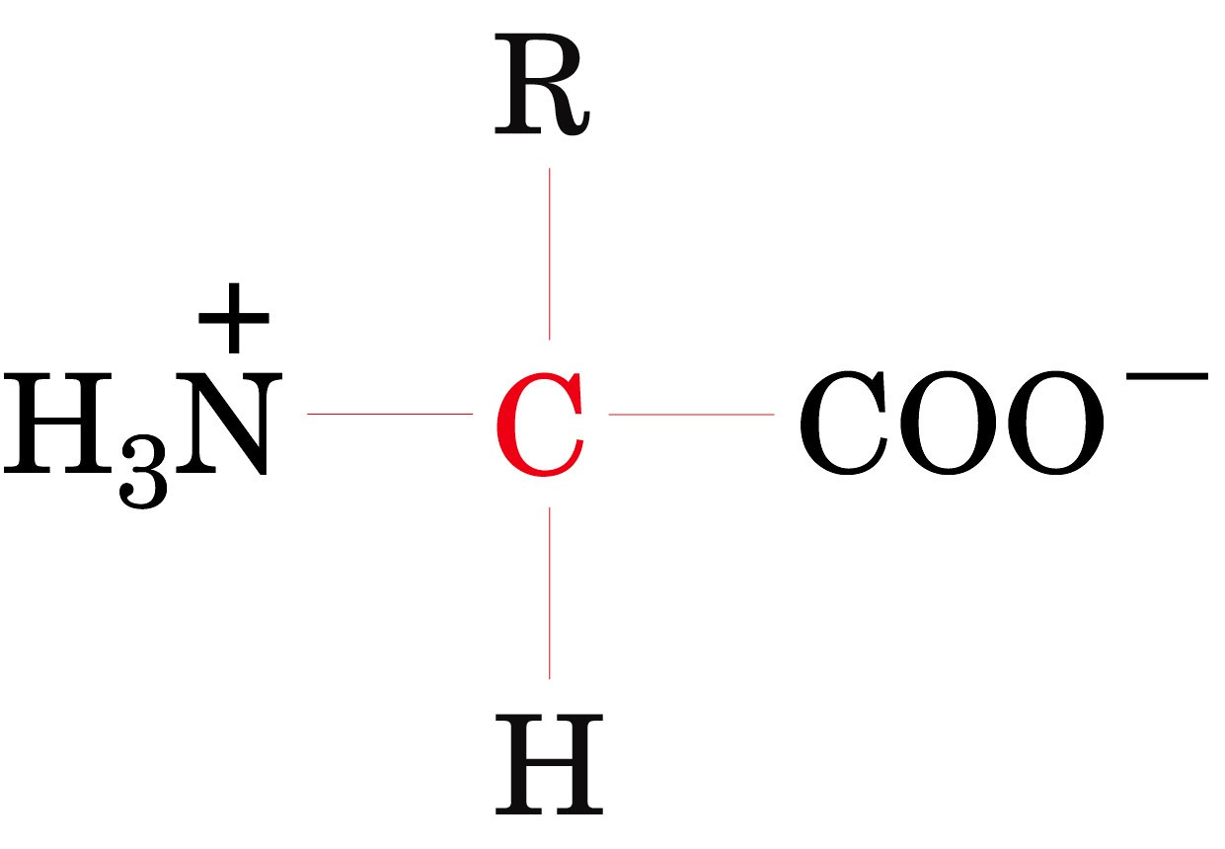
Zwitterionic form of the α-amino acids that occur at physiological pH values

Slide 9
STRUCTURE OF THE AMINO ACIDS
In proteins, almost all of these carboxyl and amino groups are combined through peptide linkage and, in general, are not available for chemical reaction except for hydrogen bond formation .
Thus, it is the nature of the side chains that ultimately dictates the role of an amino acid plays in a protein.
It is, therefore, useful to classify the amino acids according to the properties of their side chains into:
  1. Amino acids with non polar side chains
  2. Amino acids with uncharged polar side chains
  3. Amino acids with acidic side chains
  4. Amino acids with basic side chains
Notes:
whether they are nonpolar (have an even distribution of electrons) or
polar (have an uneven distribution of electrons, such as acids and
bases; Figures 1.2 and 1.3).

Slide 10
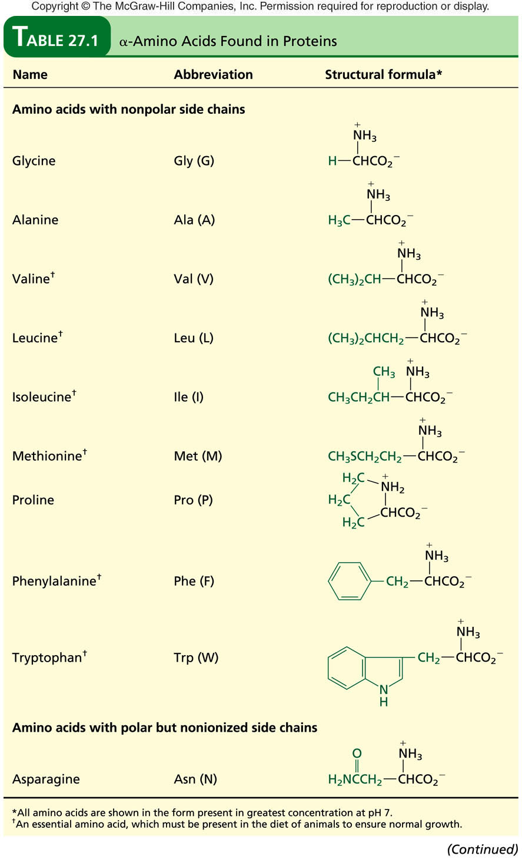
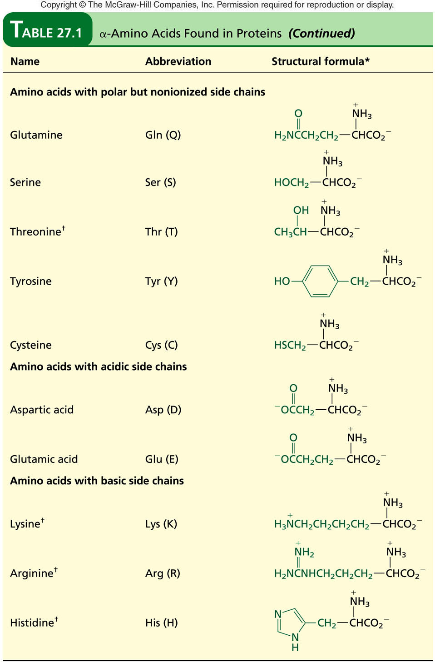

Slide 11
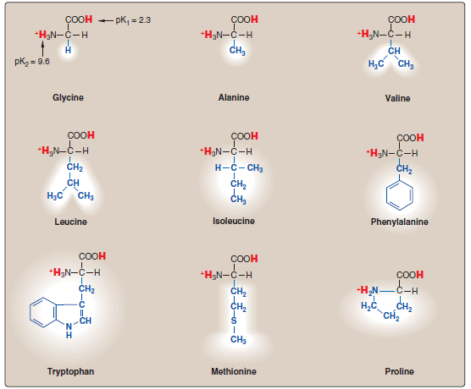
1. Amino acids with non polar side chains
These amino acids are: Glycine, Alanine, Valine, Leucine, Isoleucine, Phenylalanine, Trypyophan, Methionine and Proline.
The side chains cluster in the interior of the protein due to hydrophobicity.
The side chain of proline and its α-amino group form a ring structure.
Proline (The imino acid) gives the fibrous structure of collagen, and interrupts the α-helices found in globular proteins.
Notes:
Each of these amino acids has a non polar side chain that does not gain or lose protons or participate in hydrogen or ionic bonds.
The side chains of these amino acids can be thought of as “oily” or lipid-like, a property that promotes hydrophobic interactions.
These amino acids are: Glycine, Alanine, Valine, Leucine, Isoleucine, Phenylalanine, Trypyophan, Methionine and Proline.
Proline differs from other amino acids in that proline’s side chain and α-amino N form a rigid, five-membered ring structure. Proline, then, has a secondary (rather than a primary) amino group. It is frequently referred to as an imino acid.

Slide 12
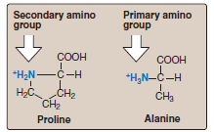

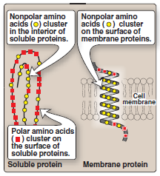
1. Amino acids with non-polar side chains

Slide 13
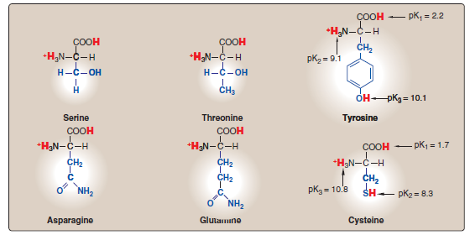
2. Amino acids with uncharged polar side chains
More hydrophilic because they form hydrogen bonds with water.
These include: Serine, Threonine, Cysteine, Tyrosine, asparagine, and glutamine.
These amino acids have zero net charge at neutral pH.
Cysteine contains a sulfhydryl group (-SH), an important component of the active site of many enzymes.

Slide 14
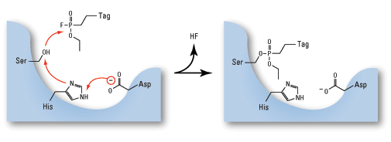
2. Amino acids with uncharged polar side chains
Two cysteines can become oxidized to form a dimmer cystine, which contains a covalent cross-link called a disulfide bond (-S-S-).
Serine and threonine contain a polar hydroxyl group that serve as a site of attachment (in enzymes) for groups such as a phosphate.
Amide group of asparagine, as well as the hydroxyl group of serine or threonine serve as a site of attachment for oligosaccharide chains in glycoproteins.

Slide 15
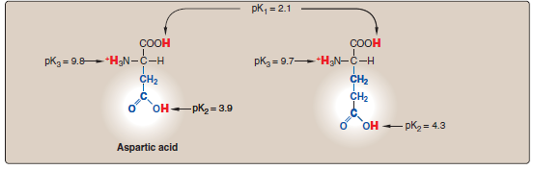
3. Amino acids with acidic side chains
The amino acids aspartic and glutamic acid are proton donors.
At physiologic pH, the side chains of these amino acids are fully ionized, containing a negatively charged carboxylate group (–COO‾).
They are, therefore, called aspartate or glutamate to emphasize that these amino acids are negatively charged at physiologic pH .
Glutamic acid

Slide 16
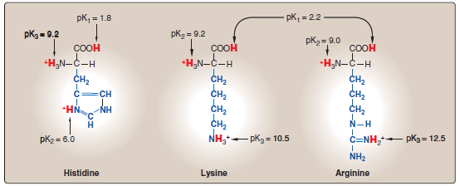
4. Amino acids with basic side chains
These include: Lysine, Arginine & Histidine amino acids.
The R groups have significant positive charge.
Lysine has a second positive amino group at the ε position on its (R) chain.
Arginine has a positively charged guanidino group.
Histidine has a positive imidazole group facilitates the enzyme-catalyzed reaction by serving as a proton donor/acceptor
Notes:
Un common amino acids :
Hydroxylysine and hydroxyproline, are found in the collagen and gelatin proteins.
Thyroxin and 3,3`,5-triiodothyronine, iodinated a.a. are found in thyroglobulin, a protein produced by the thyroid gland.
γ-Carboxyglutamic acid is involved in blood clotting.
Finally, N-methylarginine and N-acetyllysine are found in histone proteins associated with chromosomes.

Slide 17
Nutritional classification of amino acids
Amino acids can be classified into :
1- Essential amino acids:
    These amino acids can’t be formed in the body and so, it is essential to be taken in diet. Their deficiency affects growth, health and protein synthesis.
2- Semiessential amino acids:
    These are formed in the body but not in sufficient amount for body requirements especially in children.
Summary of essential and semiessential amino acids:
    valine, leucin, isoleucin, phenylalanine, tryptophan, methionine, lysine, histidin , threonine and arginine.
    arginine is considered as semiessential amino acids since its synthesized at rates inadequate to support growth in children.
  3- Non essential amino acids:
    These are the rest of amino acids that are formed in the body in amount enough for adults and children.
    These include: alanine, asparagine, aspartic acid, cysteine, glutamic acid, glutamine, glycine, proline, serine, and tyrosine.
    Tyrosine is produced from phenylalanine, so if the diet is deficient in phenylalanine, tyrosine will be required as well.

Slide 19
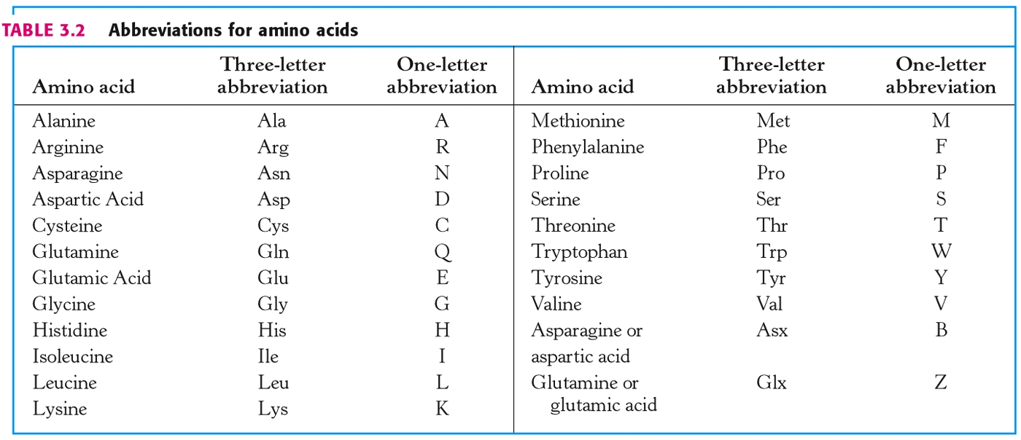
Abbreviations and symbols for commonly occurring amino acids
Notes:
Each amino acid name has an associated three-letter abbreviation
and a one-letter symbol .
The one-letter codes are determined by the following rules:
1. Unique first letter: If only one amino acid begins with a particular letter, then that letter is used as its symbol. For example, I = isoleucine.
2. Most commonly occurring amino acids have priority: If more than one amino acid begins with a particular letter, the most common of these amino acids receives this letter as its symbol. For example, glycine is more common than glutamate, so G = glycine.
3. Similar sounding names: Some one-letter symbols sound like the amino acid they represent. For example, F = phenylalanine, or W = tryptophan (“twyptophan”).
4. Letter close to initial letter: For the remaining amino acids, a oneletter
symbol is assigned that is as close in the alphabet as possible to the initial letter of the amino acid, for example, K = lysine. Furthermore, B is assigned to Asx, signifying either aspartic acid or asparagine, Z is assigned to Glx, signifying either glutamic acid or glutamine, and X is assigned to an unidentified amino acid

Slide 20
Properties of Amino Acids
Optical Properties of Amino Acids
ACIDIC AND BASIC PROPERTIES OF AMINO ACIDS

Slide 21
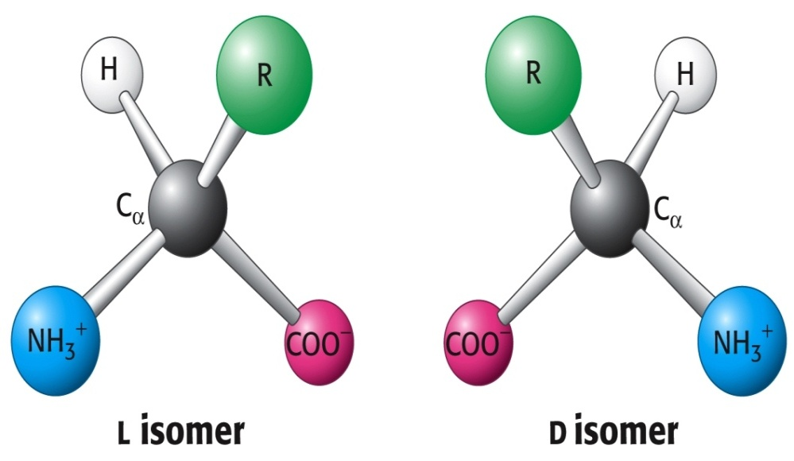
Optical Properties of Amino Acids
The α-carbon of amino acid is attached to four different chemical groups, thus its a chiral or optically active carbon atom. Glycine is the exception.
Amino acids exist in two forms, D and L, that are mirror images of each other.
All amino acids found in proteins are of the L-configuration.
D- and L- amino acids are stereoisomers of each other. Only L-amino acids are found in human proteins. D-amino acids are found in some antibiotics and in bacterial cell walls.

Slide 22
ACIDIC AND BASIC PROPERTIES OF AMINO ACIDS
Amino acids in aqueous solution contain weakly acidic α-carboxyl groups and weakly basic α-amino groups.
Each of the acidic and basic amino acids contains an ionizable group in its side chain.
Thus, both free and some of the combined amino acids in peptide linkages can act as buffers.
The concentration of a weak acid (HA) and its conjugate base(A⁻) is described by the Henderson-Hasselbalch equation.
[A⁻]
pH = pK_{a} + log ───
[HA ]
Notes:
Amphoteric properties of amino acids: that is they have both basic and acidic groups and so can act as base or acid.
Neutral amino acids (monobasic, monocarboxylic) exist in aqueous solution as “ Zwitter ion” i.e. contain both positive and negative charge. Zwitter ion is electrically neutral and can’t migrate into electric field.
Isoelectric point (IEP) = is the pH at which the zwitter ion is formed. e.g IEP of alanine is 6

Slide 23
pH Review
pH = - log [H⁺]
H⁺ is really a proton
pH range is from 0 - 14
If [H⁺] is high, the solution is acidic; pH < 7
If [H⁺] is low, the solution is basic or alkaline ; pH > 7
Notes:
The Solubility of Amino Acids Reflects Their Ionic Character
The charges conferred by the dissociable functional groups of amino acids ensure that they are readily solvated by—and thus soluble in—polar solvents such as water and ethanol but
insoluble in nonpolar solvents such as benzene, hexane, or ether.
Amino acids do not absorb visible light and thus are colorless. However, tyrosine, phenylalanine, and especially tryptophan absorb high-wavelength (250–290 nm) ultraviolet light. Because
it absorbs ultraviolet light about ten times more efficiently than phenylalanine or tyrosine, tryptophan makes the major contribution to the ability of most proteins to absorb light in the
region of 280 nm.

Slide 24
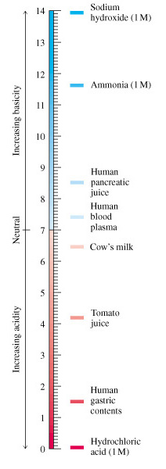
pH Scale
Devised by Sorenson (1902)
[H+] can range from 0.1M and 1 X 10⁻¹⁴M
Using a log scale simplifies notation
pH = -log [H⁺]
Neutral pH = 7.0

Slide 25
Acid/conjugate base pairs
For a weak acid :
HA A⁻ + H⁺
HA = acid ( donates H⁺) (Bronstad Acid)
A⁻ = Conjugate base (accepts H⁺) (Bronstad Base)
K_{a =} [H⁺][A⁻]
[HA]
pK_{a} = - log K_{a}
K_{a} & pK_{a} value describe tendency to loose H⁺
large K_{a} = stronger acid
small K_{a} = weaker acid

Slide 26
pH & pKa
pH is the concentration of protons in aquoas fluids.
pKa is that pH at which the protonated and unprotonated species are in equal concentrations.
Note: The stronger acids have larger ka i.e. a lower pK values.

Slide 27
Henderson-Hasselbalch equation
For the reaction (HA A⁻ + H⁺ )
[H⁺] [A⁻]
K_{a} = ───── ------ (1)
[HA]
By solving for the [H⁺] in the above equation, taking the logarithm of both sides of the equation, multiplying both sides of the equation by -1, and substituting pH = -log [H⁺] and pK_{a} = -log [K_{a}] we obtain:
[A⁻]
pH = pK_{a} + log ─── ------ (2)
[HA]
It is the (Henderson-Hasselbalch equation)
* H-H equation describes the relationship between pH, pKa and buffer concentration

Slide 28
This is Important !!!
If pH = pK_{a}, then [A⁻] = [HA]
then [deprotonated] = [protonated]
If pH < pK_{a}, then [A⁻] < [HA]
then [deprotonated] <[protonated]
If pH > pK_{a}, then [A⁻] > [HA]
then [deprotonated] > [protonated]

Slide 29
Buffers
Buffers are aqueous systems that resist changes in pH when small amounts of a strong acid or base are added.
A buffered system consist of a weak acid and its conjugate base or weak base and its conjugate acid.
The most effective buffering occurs at pHs that are within +/-1 pH unit of the pKa

Slide 30
Buffer
CH₃COOH H⁺ + CH₃COO ⁻
Buffer Solution
CH₃COONa Na + CH₃COO ⁻
CH₃COOH H⁺ + CH₃COO⁻
HCL
Addition
CH₃COONa Na + CH₃COO ⁻
HCI H ⁺ + CL
CH₃COOH H⁺ + CH₃COO⁻
NaOH
Addition
CH₃COONa Na + CH₃COO⁻
NaOH Na + OH ⁻

Slide 31
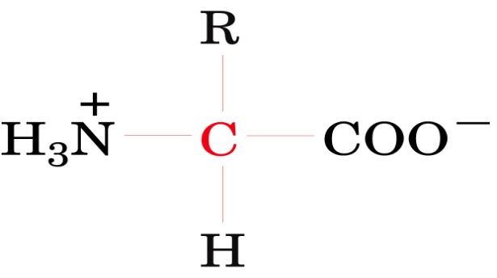

Amino acid may have positive, negative , or zero net charge
Charged and uncharged form of the ionizable –COOH and –NH3⁺ are weak acids that exist in solution in protonic equilibrium :
Note:
While both R–COOH & R–NH3⁺ are weak acids , R–COOH is a far stronger than R–NH3⁺ . Thus , at physiological pH (pH 7.4) , carboxyl group exist entirely as R–COOˉ and amino groups predominantly as R –NH3⁺

Slide 32
Do changes in pH affect amino acids?
C
O
O
-
C
O
O
-
H
N
+
C
H
N
C
H
+
H
+
3
H
2
R
R
Amino acids can act as an acid and donate a H⁺
C
O
O
-
C
O
O
H
+
+
H
N
+
H
N
C
H
+
H
C
H
3
3
R
R
Amino acids can act as a base and accept a H⁺
Notes:
5
6

Slide 33
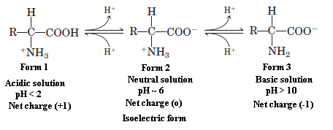
Acid-Base Properties of Amino Acids
Example: the following chemical structures for glycine:
H₂N – CH₂ - COOH
at pH=1: ⁺H₃N – CH₂ - COOH
at pH=7: ⁺H₃N – CH₂ – COO⁻ “ Zwitterions ”
at pH=12: H₂N – CH₂ – COO⁻
Notes:
Amphoteric properties of amino acids: that is they have both basic and acidic groups and so can act as base or acid.
Neutral amino acids (monobasic, monocarboxylic) exist in aqueous solution as “ Zwitter ion” i.e. contain both positive and negative charge. Zwitter ion is electrically neutral and can’t migrate into electric field.
Isoelectric point (IEP) = is the pH at which the zwitter ion is formed. e.g IEP of alanine is 6

Slide 34
Titration Solution of an amino acid
Amino acids have characteristic titration curves
Acid-base titration involves the gradual addition or removal of protons
Informations provided by the titration curve of an amino acid involve: The regions of its buffering power, its zwetterions, and the specified isoelectric point of that amino acids .
Titration curve of glycine

Slide 35
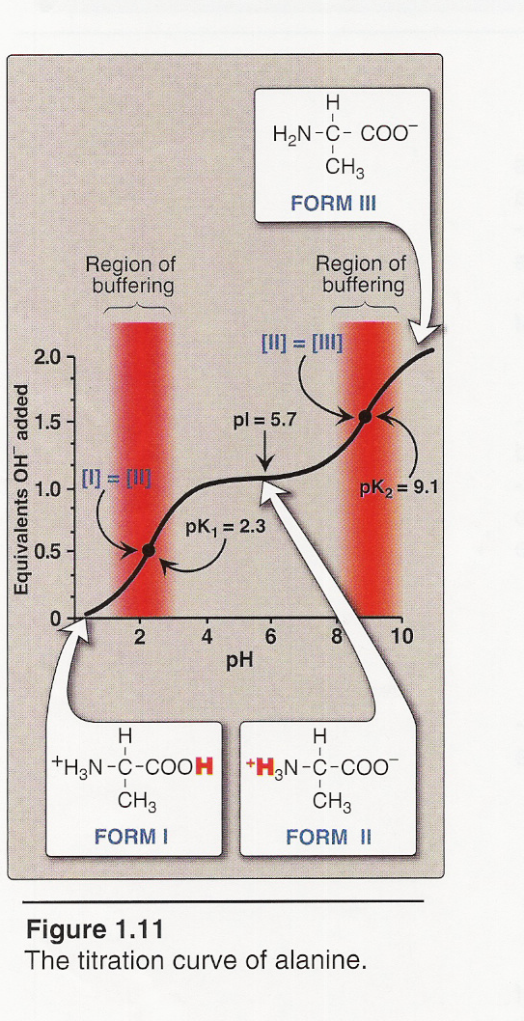
Titration curve of alanine
By applying the Henderson-Hasselbalch equation to each dissociable acidic group, it is possible to calculate the complete titration curve of a weak acid.
Figure 1 shows the change in pH that occurs during the addition of base to the fully protonated form of alanine (I) to produce the completely deprotonated form (III).

Slide 36
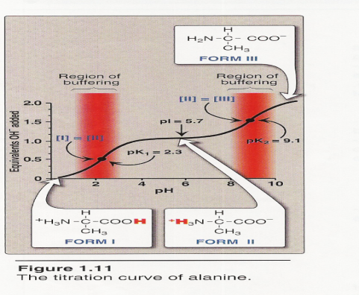
Titration curve of alanine
Note the following:
a. Buffer pairs: The – COOH/– COO– pair can serve as a buffer in the pH region around pK1, and the – NH3+/– NH2 pair can buffer in the region around pK2.
b. When pH = pK: When the pH is equal to pK1 (2.3), equal amounts of forms I and II of alanine exist in solution. When the pH is equal to pK2 (9.1), equal amounts of forms II and III are present in solution.

Slide 37
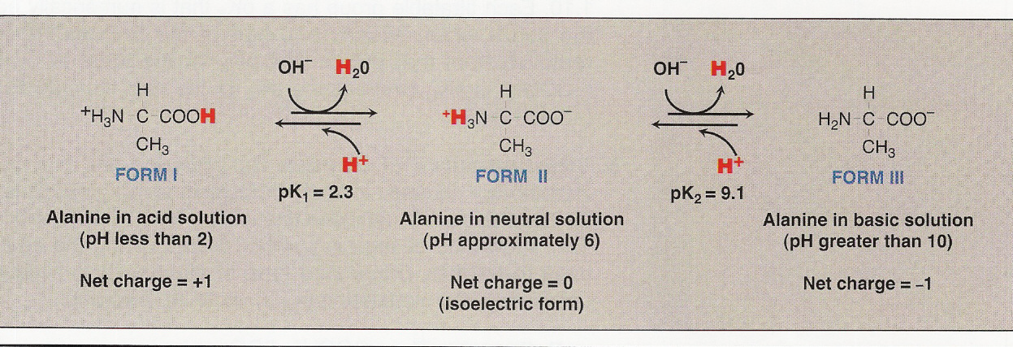
Titration curve of alanine
c. Isoelectric point: At neutral pH, alanine exists predominantly as the dipolar form II in which the amino and carboxyl groups are ionized, but the net charge is zero (Zwetterions). The isoelectric point (pI) is the pH at which an amino acid is electrically neutral, that is, in which the sum of the positive charges equals the sum of the negative charges.
For an amino acid, such as alanine, that has only two dissociable hydrogens (one from the α-carboxyl and one from the α-amino group), the pI is the average of pK1 and pK2
pI = [2.3 + 9.1]/2 = 5.7
The pI is, thus, midway between pK1 (2.3) and pK2 (9.1).
Notes:
pI corresponds to the pH at which the form II (with a net charge of zero) predominates and at which there are also equal amounts of forms I (net charge of +1) and III (net charge of –1).

Slide 38
Zwitterions & The Isoelectric point (PI)
“Zwitterions ” :
  Zwitterions are one example of an isoelectric species : the form of a molecule that has an equal number of positive and negative charges and thus is electrically neutral
  Ions bearing two charges were named zwitter ions by German scientists; the name still applies today, e.g. glycin at neutral pH ⁺H₃N – CH₂ – COO⁻
Isoelectric point (PI) :
Is the pH at which the zwitter ion is formed.
This isoelectric pH, also called the pI, is the pH midway between pKa values for the ionizations on either side of the isoelectric species e.g PI of alanine is about 6

Slide 39


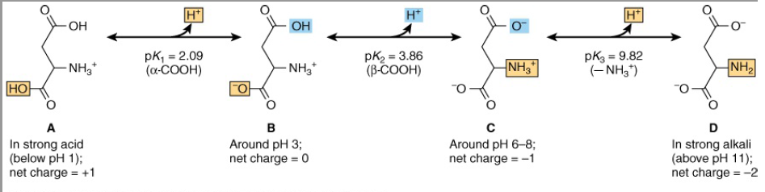
Calculation of the isoelectric point
For an amino acid such as alanine that has only two dissociating groups, there is no ambiguity. The first pKa (R—COOH) is 2.35 and the second pKa (R—NH3+) is 9.69. The isoelectric pH (pI) of alanine thus is
For polyprotic acids, pI is also the pH midway between the pKa values on either side of the isoionic species. For example, the pI for aspartic acid is:

Slide 40
Uncommon Amino Acids Also Have
Important Functions
In addition to the 20 common amino acids, proteins may contain residues created by modification of common residues already incorporated into a polypeptide. Among these uncommon amino acids are:
4-hydroxyproline, a derivative of proline, and 5-hydroxylysine, derived from lysine.The former is found in plant cell wall proteins, and both are found in collagen, a fibrous protein of connective tissues.
Another important uncommon amino acid is γ-carboxyglutamate, found in the bloodclotting protein prothrombin and in certain other proteins that bind Ca2 as part of their biological function.
Desmosine, a derivative of four Lys residues, which is found in the fibrous protein elastin.
Selenocysteine is a special case. This rare amino acid residue is introduced during protein synthesis rather than created through a postsynthetic modification. It contains selenium rather than the sulfur of cysteine. Actually derived from serine, selenocysteine is a constituent of just a few known proteins.
Some 300 additional amino acids have been found in cells. They have a variety of functions but are not constituents of proteins, e.g. Ornithine and citrulline

Slide 41
FUNCTION OF AMINO ACIDS:
FUNCTION OF AMINO ACIDS:
  In addition to providing the monomer units from which the long polypeptide chains of proteins are synthesized, the L-α -amino acids and their derivatives participate in cellular functions in that :
  Several amino acids function as neurotransmitters themselves, while others are precursors of neurotransmitters, mediators, or hormones
  Specific amino acids form precursors for other metabolites e. g., for glucose in gluconeogenesis, also in the biosynthesis of porphyrins, purines, pyrimidines, and urea.
  Short polymers of amino acids called peptides act as hormones, or neuromodulators
  Some form components of lipids e. g., serine in phospholipids and glycine in bile salts.
  Present in polypeptide antibiotics

Slide 42
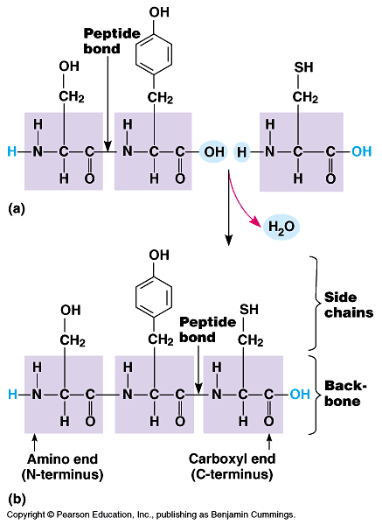
Peptide Chain
Peptide : are biologically occurring short chains of amino acid monomers linked by peptide (amide) bonds.
The covalent chemical bonds are formed when the carboxyl group of one amino acid reacts with the amine group of another.
The shortest peptides are dipeptides, consisting of 2 amino acids joined by a single peptide bond, followed by tripeptides, tetrapeptides, etc.
A polypeptide is a long, continuous, and unbranched peptide chain.
Each polypeptide chain starts on the left side by free amino group of the first amino acid enter in chain formation . It is termed (N- terminus).
Each polypeptide chain ends on the right side by free COOH group of the last amino acid and termed (C-terminus).

Slide 43


