Slide 1


spectrophotometry
Practical Clinical chemistry(3st.)
M.sc. Duaa falah
pharmacology and toxicology
2021

Slide 2
What is a spectrophotometer
A spectrophotometer :is an instrument that measures the amount of light absorbed by a sample.
Spectrophotometer techniques :are mostly used to measure the concentration of solutes in solution by measuring the amount of the light that is absorbed by the solution in a cuvette placed in the spectrophotometer.

Slide 3
classes of spectrophotometers
Single beam specs: measure absolute light intensity .
double beam specs: measures the ratio of light intensities on two separate light paths--the reference standard and the sample.
Type so specs include: microplate spectrophotometers, colorimeters, and florescence microplate readers
Notes:
Most of our ingested carbohydrates are polymers, such as starch and glycogen.
Salivary amylase and pancreatic amylase are responsible for the digestion of these nonabsorbable polymers to dextrins and disaccharides, which are further hydrolyzed to monosaccharides by maltase, an enzyme released by the intestinal mucosa.
Sucrase and lactase are two other important gut-derived enzymes that hydrolyze sucrose to glucose and fructose and lactose to glucose and galactose.
When disaccharides are converted to monosaccharides, they are absorbed by the gut and transported to the liver by the hepatic portal venous blood supply.

Slide 4
Uses of Spectrophotometers
are widely used in various disciplines such as physics, molecular biology, chemistry and biochemistry.
Applications for specs include measurement of substance concentration such as : protein, bilirubin , creatinine, value of blood sugar, DNA or RNA, growth of bacterial cells, and enzymatic reactions .

Slide 5
Parts of the spectrophotometers :
A light source.
The dispersion devices (a prism or grating )
Focusing devices (lenses, slits, mirrors)
A device for holding the sample (cuvettes).
A photoelectric cell for measuring light intensity (detector).
Notes:
Glucose Metabolism
Glucose Metabolic pathways
After glucose enters the cell, it is quickly shunted into one of three possible metabolic pathways, depending on the availability of substrates or the nutritional status of the cell.
The ultimate goal of the cell is
1-to convert glucose to carbon dioxide and water.
2- During this process, the cell obtains the high-energy molecule adenosine triphosphate (ATP) from inorganic phosphate and adenosine diphosphate (ADP).
Note/ The cell requires oxygen for the final steps in the electron transport chain (ETC).
Nicotinamide adenine dinucleotide (NAD) in its reduced form (NADH) will act as an intermediate to couple glucose oxidation to the ETC in the mitochondria where much of the ATP is gained.
The first step for all three pathways requires glucose to be converted to glucose-6-phosphate using the high energy molecule, ATP. This reaction is catalyzed by the enzyme hexokinase (Fig. 13-8).
Glucose metabolic pathways :
1- Hexose monophosphate pathway
2- Hexose monophosphate shunt (HMP shunt)
3- Glucose storage (glycogenesis)

Slide 6
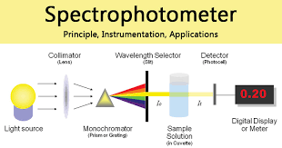

Slide 7
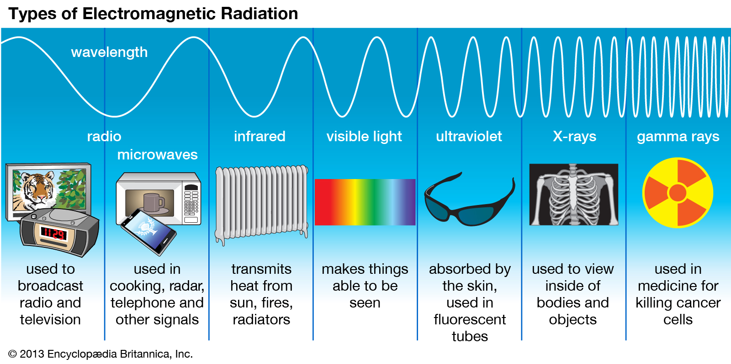

Slide 8
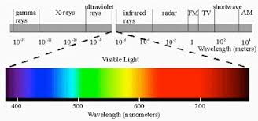
ELECTROMAGNATIC SPECTRUM

Slide 9
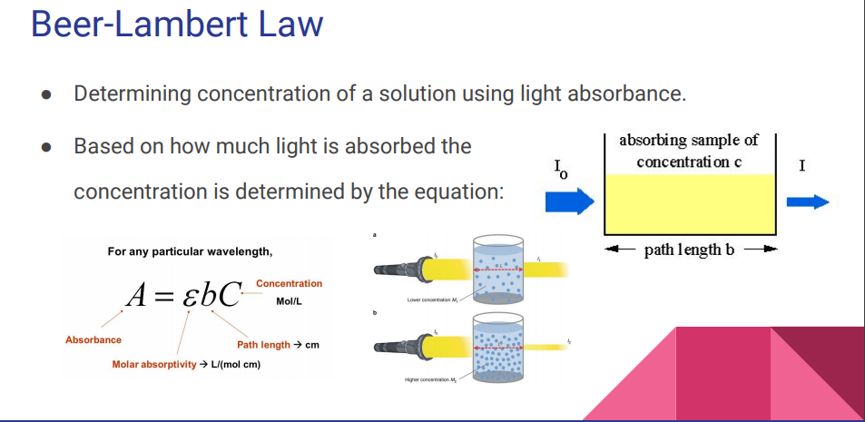

Slide 10
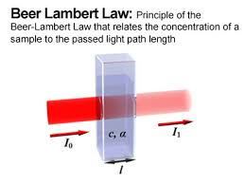

Slide 11
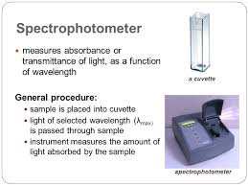

Slide 12
Procedure
Select a blank cuvette and place it in the spectrophotometer andClose the lid.
Click on 0 ABS 100%T button, the instrument now reads 0.00000 A.
Choose a solution with known concentration and measure the absorbance between the wavelengths 350 nm to 700 nm.
Record the wavelength at the maximum absorbance value.
Calculate the value of molar absorption coefficient , using the equation .

Slide 13
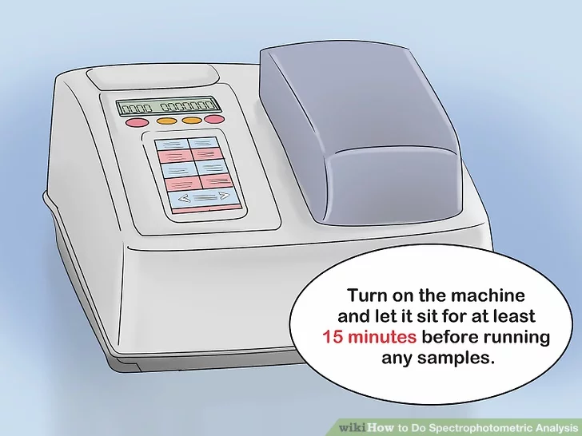

Slide 14
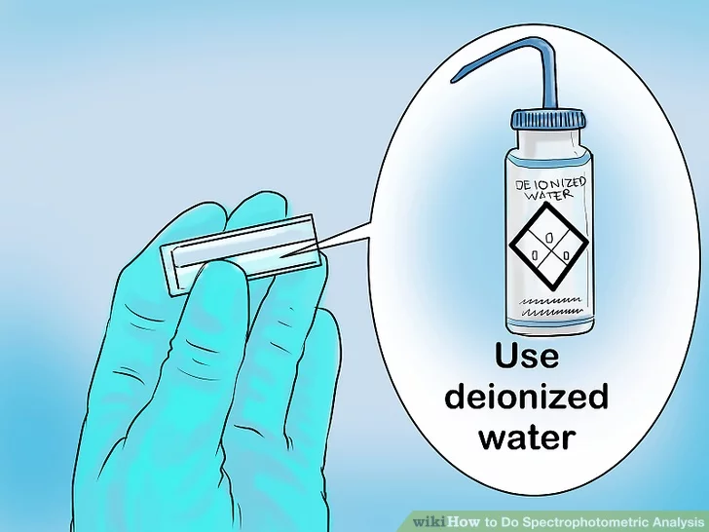

Slide 15
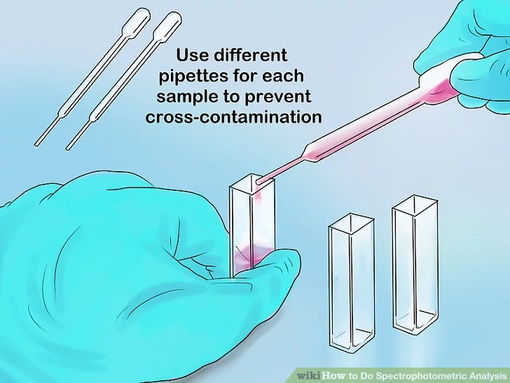

Slide 16
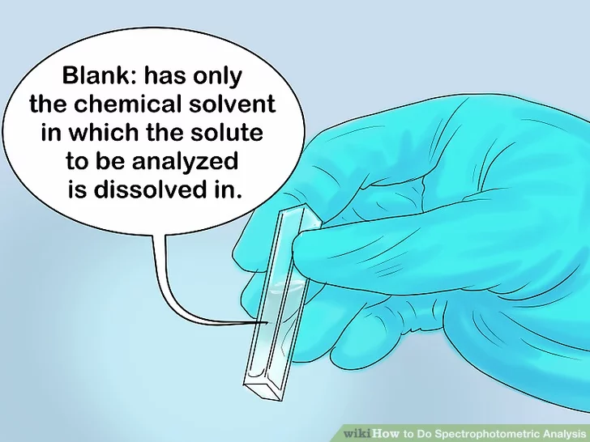

Slide 17
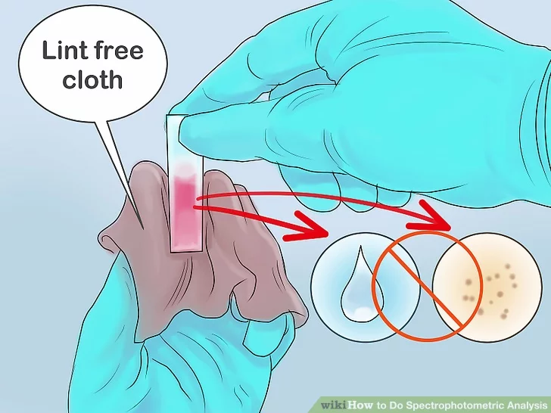

Slide 18
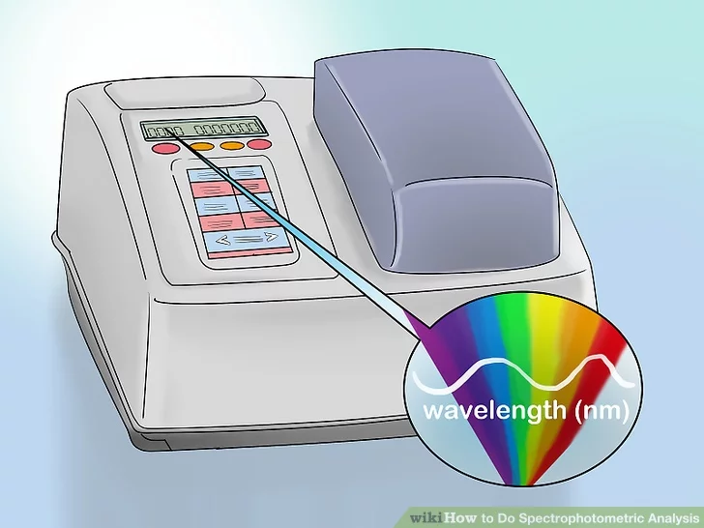

Slide 19
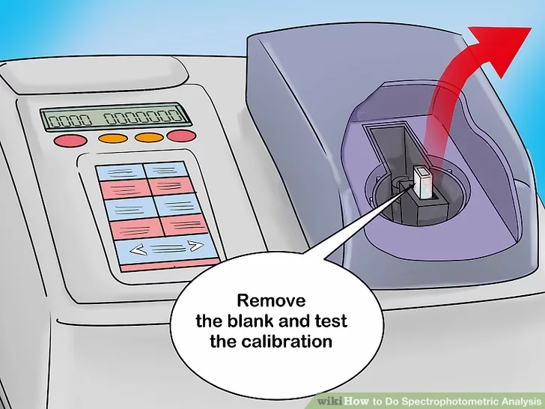

Slide 20
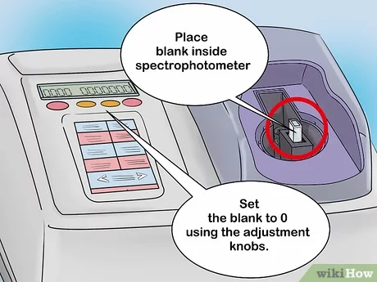

Slide 21
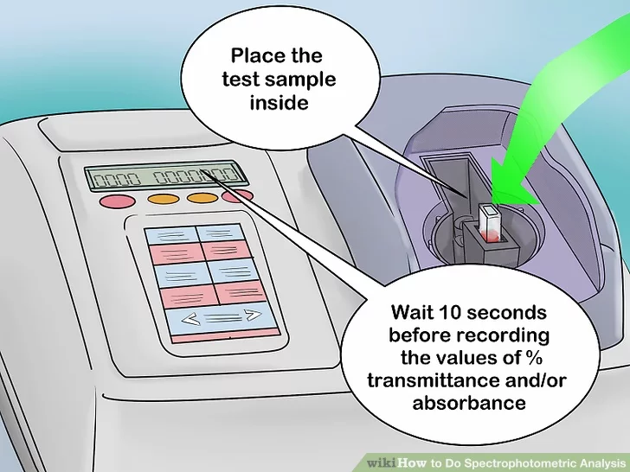

Slide 22


Slide 23
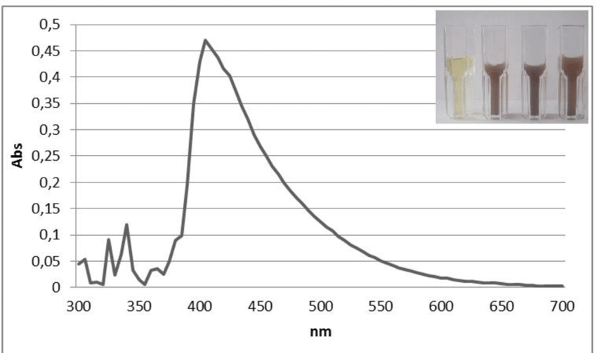

Slide 24
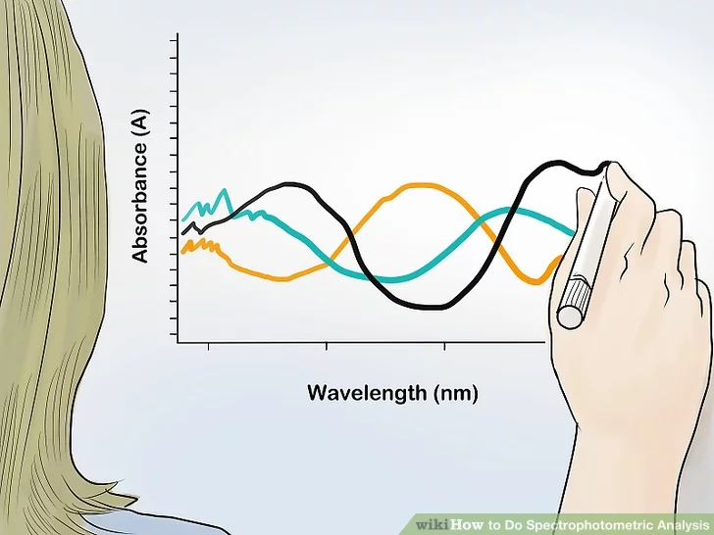

Slide 25
