Slide 1
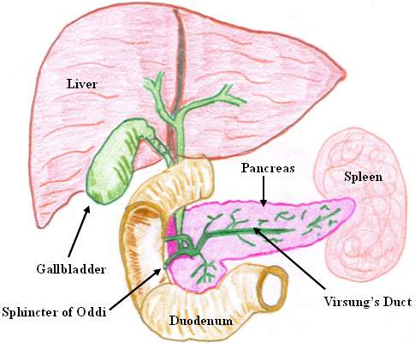
The Digestive System
Lecture : 10
Dr. SHAIMAA MUNTHER

Slide 2
Overview of the Digestive System
The Digestive System Consists of :
  Long hollow muscular tube or canal or tract called gastrointestinal tract or (GIT), that it is about 5 meters long , (other name Alimentary tract or canal)
Accessory glands: include:
    Salivary glands
    Liver and gall bladder
    Pancreas

Slide 3
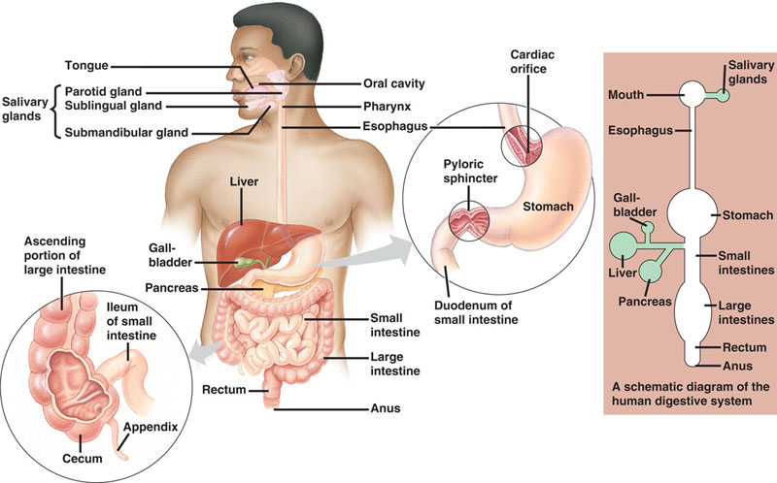

Slide 4
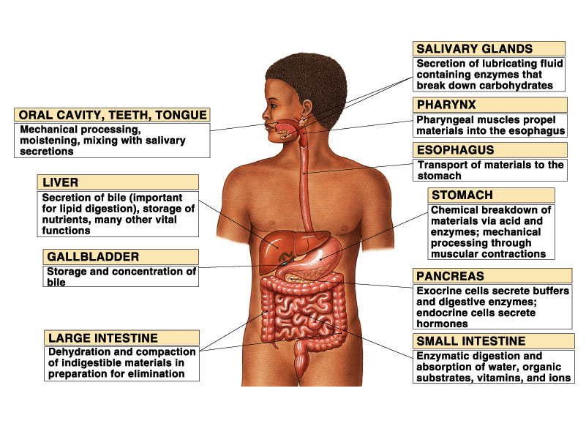

Slide 5
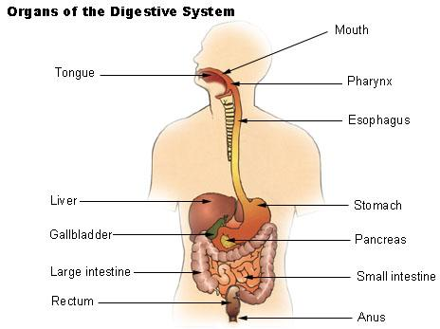
Organs of the GIT
Regions of the GIT consists :
  Oral cavity or mouth
  Pharynx
  Esophagus
  Stomach
  Small intestine
  Large intestine
  Rectum
  Anus

Slide 6
Main Functions of Digestive Tract
4 major activities of GI tract
  Motility
    Propel ingested food from mouth toward rectum
  Secretion of juices e.g. saliva
    Aid in digestion and absorption
  Digestion
    Food broken down into absorbable molecules
  Absorption
    Nutrients, electrolytes, and water are absorbed or transported from lumen of GIT to blood stream

Slide 7
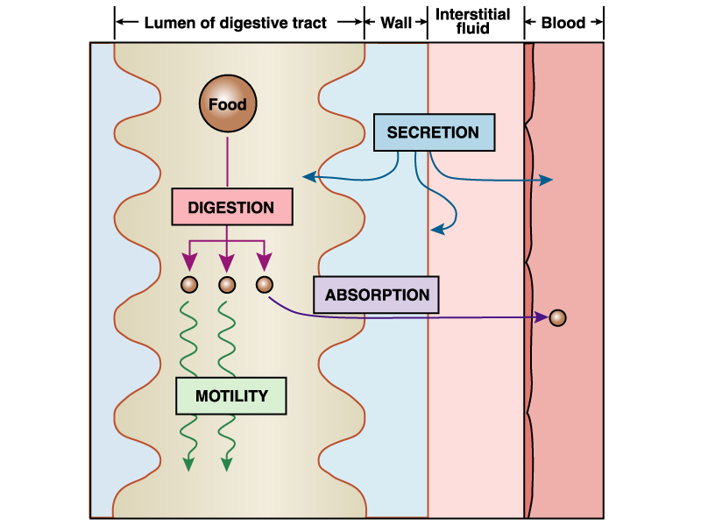

Slide 8
Motor Functions (Motility) of GIT

Slide 9
Motility of the GIT
1. Motility in the mouth: This includes two types
Chewing or Mastication:
It is reflex in nature
Significance:
  Breaks the food into small pieces to be easily swallowed
  Expose food to salivary amylase enzyme, which begins digestion of starch
  Help digestion of all types of food especially cellulose containing food e.g. vegetables
b) Swallowing:
Swallowing is the transport of food from mouth to stomach
Steps: It consists of 3 phases or steps;
  Buccal Phase: food is pushed back into pharynx from mouth
  Pharyngeal Phase: food pass through pharynx to esophagus
  Oesophageal Phase: food pass through esophagus to stomach by peristaltic movements

Slide 10
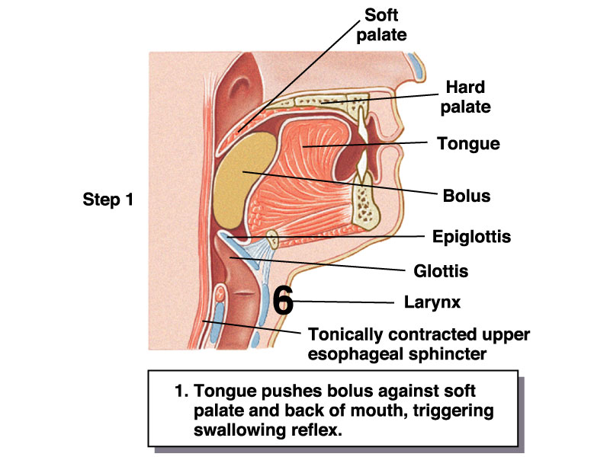
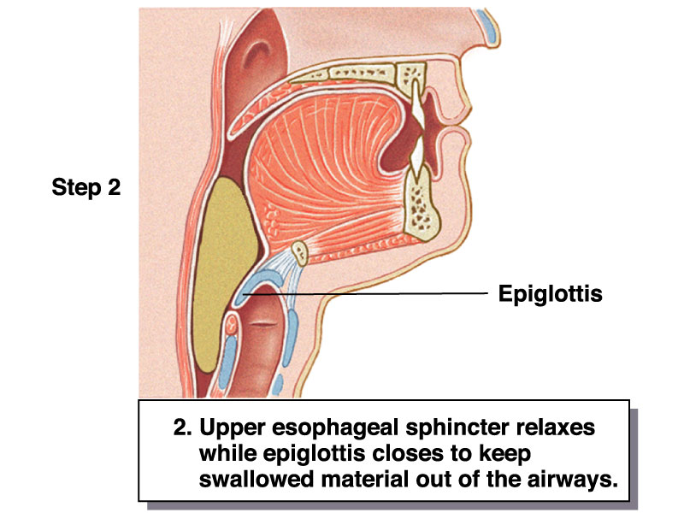
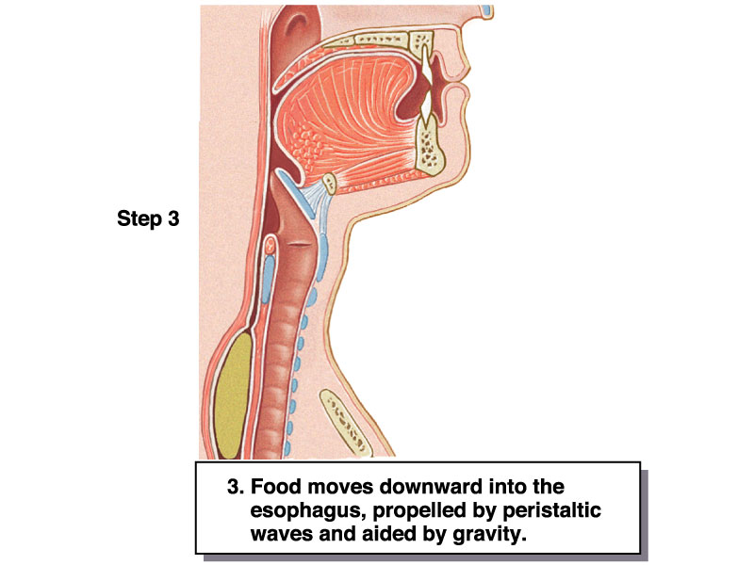
Motility in the mouth

Slide 11
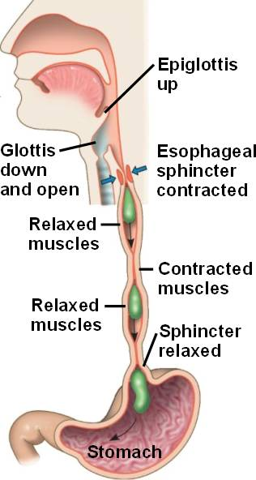
Motility of the GIT
2. Motility of Esophagus
The esophagus is 25 cm ms tube
It is guarded by 2 sphincters;
  Upper esophageal sphincter prevents air from entering the GIT
  Lower esophageal sphincter prevents gastric contents from re-entering the esophagus from the stomach
Esophageal peristalsis sweeps down the esophagus

Slide 12
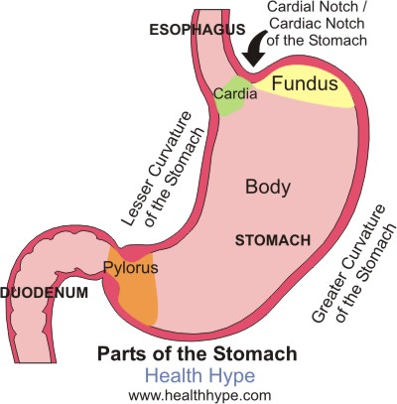
Motility of the GIT
3. Motility of Stomach
The stomach consists of fundus, body and pylorus
Proximal area (fundus and body) has a thin wall and contracts weakly and infrequently → holds large volumes of food (to store food) because of receptive relaxation.
Distal area (pylorus) has thick wall with strong and frequent peristaltic contractions that mix and propel food into the duodenum.
Also, distal area is responsible for gastric emptying into duodenum

Slide 13
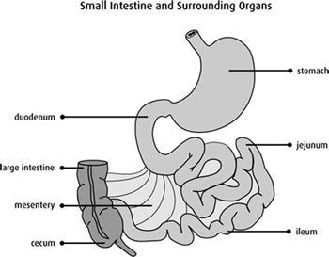
Motility of the GIT
4. Motility of Small intestine
Types:
Two basic motility patterns exist segmentation and peristalsis.
Significance:
Motility of the small intestine serves 3 functions:
Mixing contents with enzymes and other secretions → help digestion
Maximizing exposure of the contents to membranes of intestinal cells → help absorption and digestion.
3. Propulsion of contents into the large intestine.

Slide 14
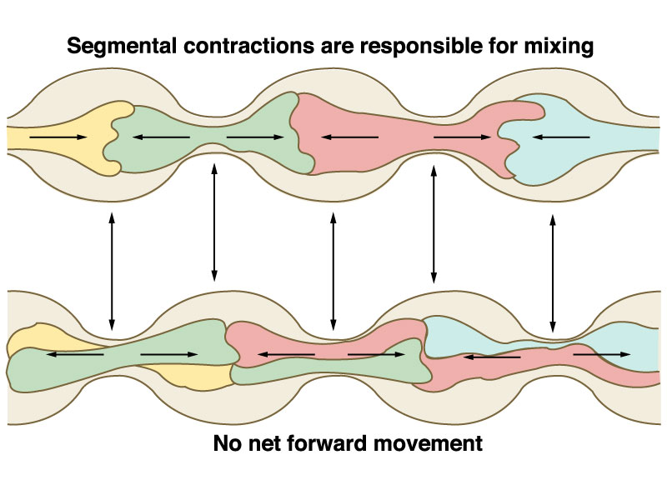
Segmentation movements
1 ~ 5 cm

Slide 15
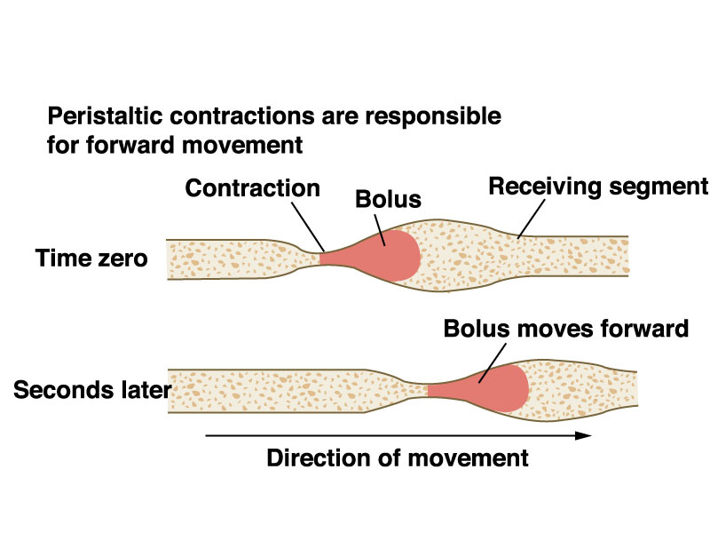
Peristalsis
Orad
caudad

Slide 16
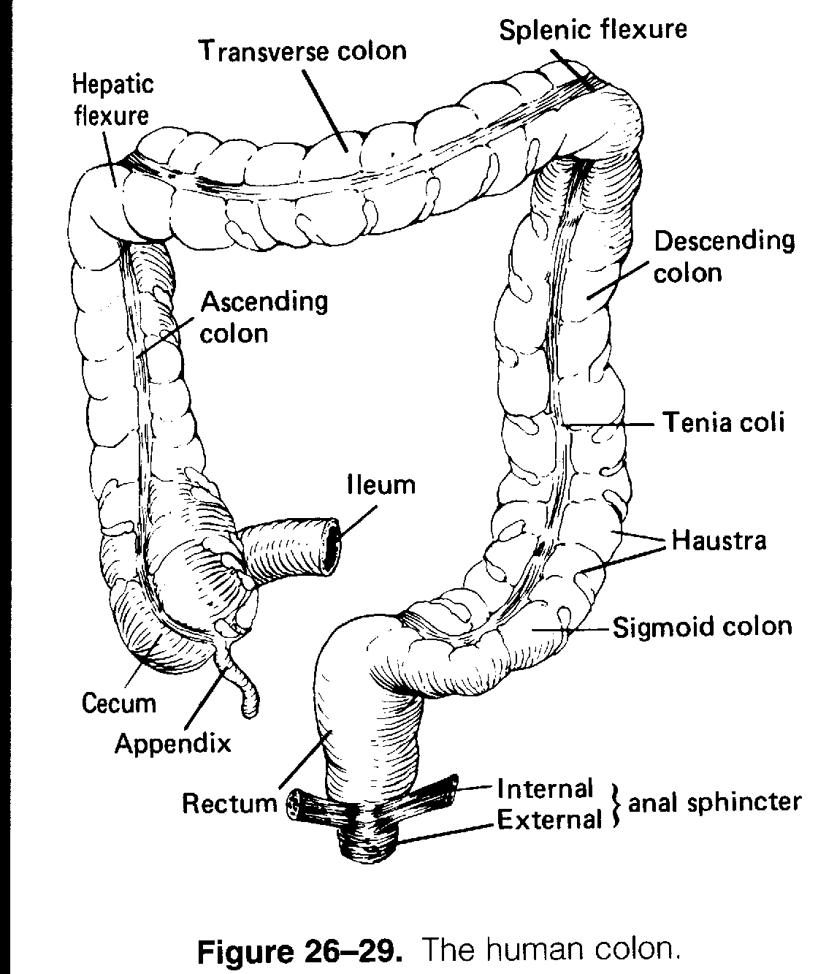
Motility of the GIT
5. Motility of Large intestine or colon
Types Include :
a)Segmentation in the large intestine causes the contents to be continuously mixed
b) Mass movement propels the contents of one segment of the large intestine into the next downstream segment.
c) Defecation involves involuntary reflexes and voluntary reflexes → evacuation of colonic content through anal canal

Slide 17
Secretary Functions (Secretions) of GIT

Slide 18
Secretions of GIT
The total volume of GIT secretions is about 6-8 L/day .
Secretions arise from specialized cells lining the GI tract, the pancreas, liver and gallbladder.
GI secretions function to lubricate (water and mucus), protect (mucus), sterilize (HCl), neutralize (HCO₃⁻), and digest (enzymes).

Slide 19
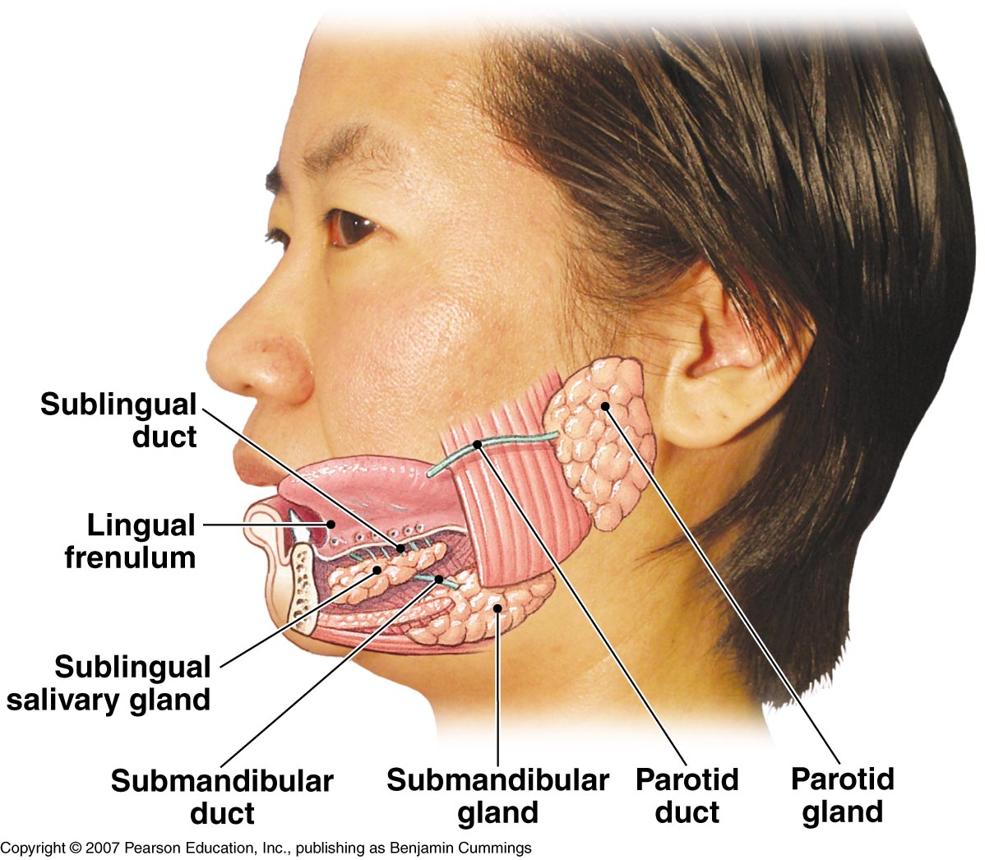
Secretions of GIT in Mouth
Salivary Glands
Three pairs of glands
  Parotid
  Sublingual
  Submandibular
Functions of saliva
Lubricates, cleanes oral cavity
Dissolves chemicals
Suppresses bacterial growth
Digest starch by amylase

Slide 20
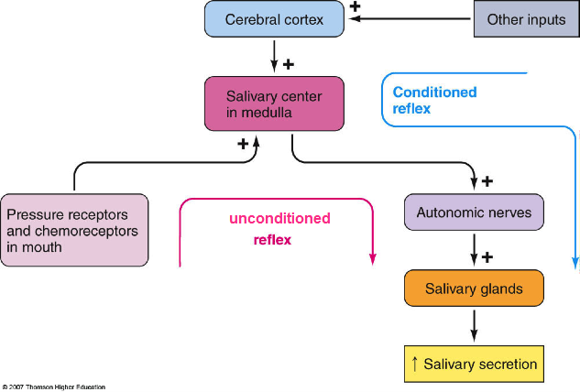
Regulation of salivary secretion

Slide 21
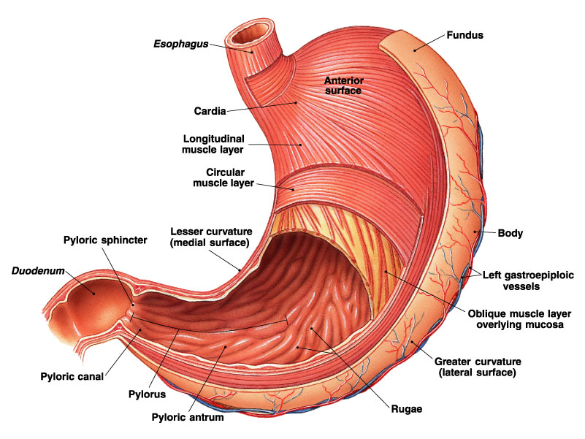
Stomach Anatomy:
Openings
  Gastroesophageal: To esophagus
  Pyloric: To duodenum
Regions
  Cardiac
  Fundus
  Body
  Pyloric

Slide 23
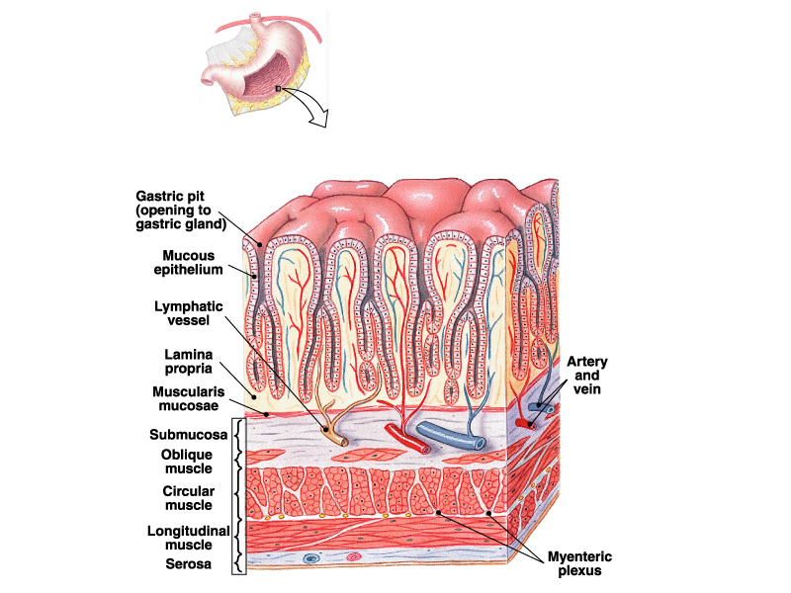
Stomach Histology:
Layers
  Serosa or visceral peritoneum: Outermost
  Muscularis: Three layers
    Outer longitudinal
    Middle circular
    Inner oblique
  Submucosa
  Mucosa

Slide 24
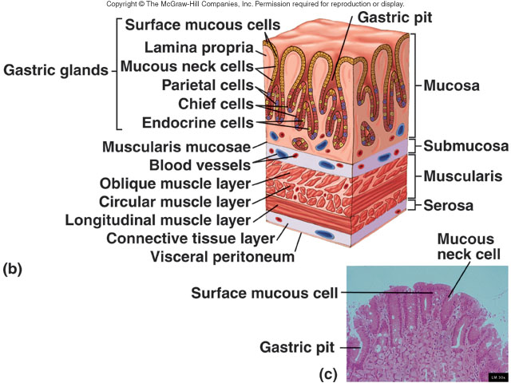

Slide 25
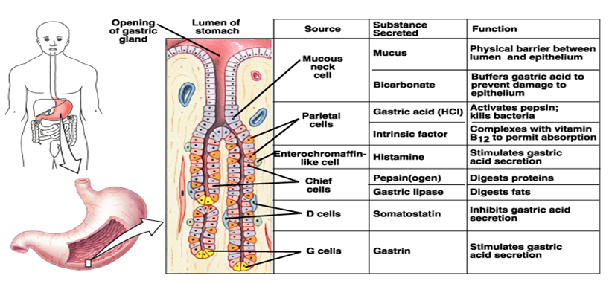
GIT secretions in Stomach

Slide 26
Function of Gastric HCL ( parital cell)
Activates pepsinogen into pepsins
Provides optimum for pH for action of pepsins
Denatures protein (denaturation → help its digestion)
Kills bacteria in food
Help Fe²⁺、Ca²⁺ absorption.
Promotes pancreatic, small intestinal and bile secretion

Slide 27
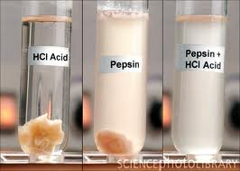

Slide 28
Function of pepsinogen ( chief cell)
protein
Pepsinogen
HCl
Pepsin
pH 2-3.5
peptone

Slide 29
Function of mucous and intrinsic factor
Mucus secretion (mucous neck cell)
Soluble and insoluble mucus are secreted by cells of the stomach.
Soluble mucus mixes with the contents of the stomach and helps to lubricate chyme.
Insoluble mucus forms a protective barrier against the high acidity of the stomach content.
Intrinsic Factor ( chief cell)
Help absorption of vitamin B12

Slide 30
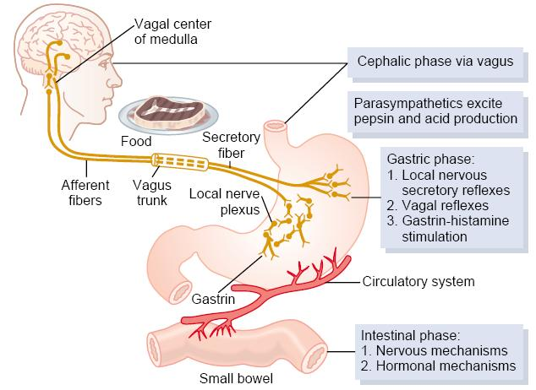
Regulation of Gastric Secretion

Slide 31
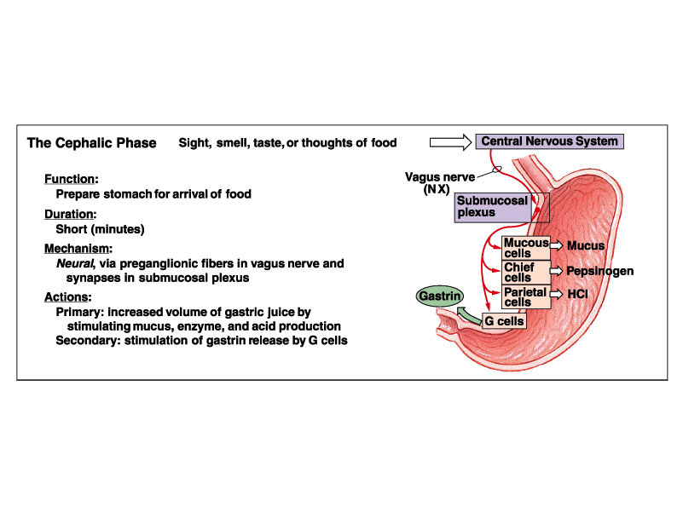

Slide 32
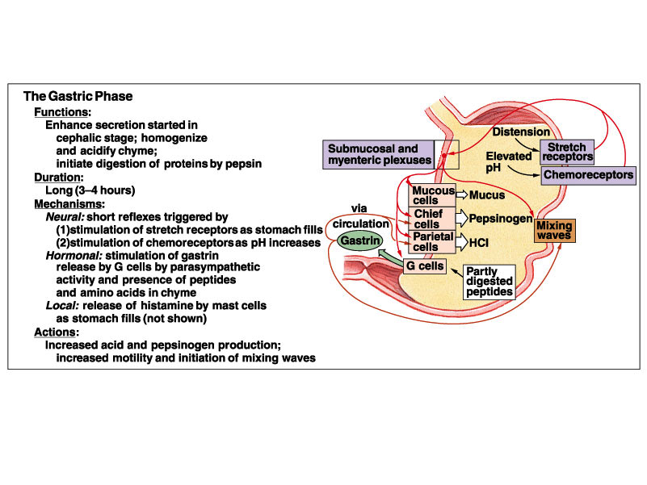

Slide 33
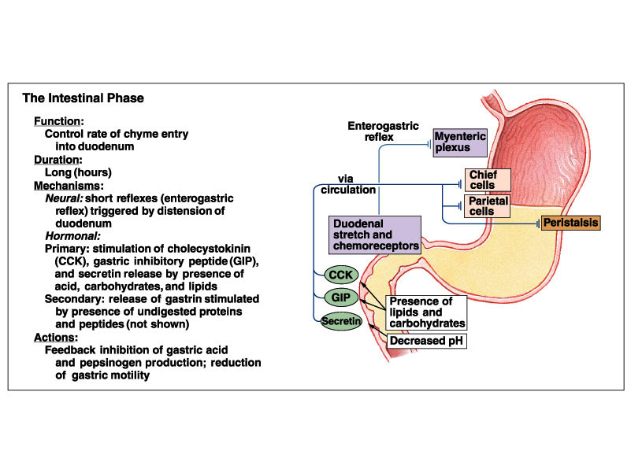

Slide 34
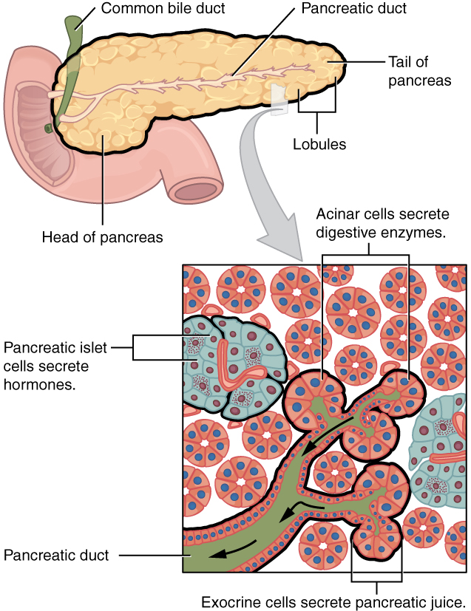
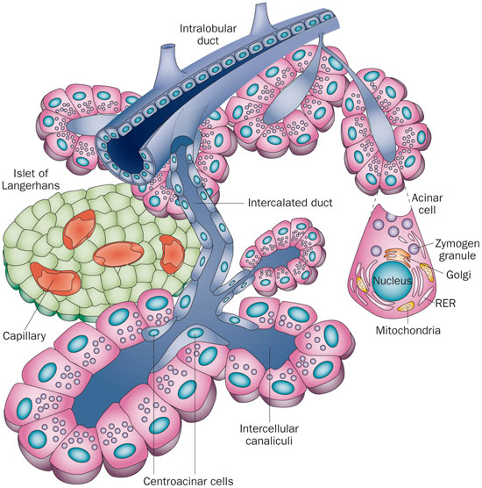
Pancrease

Slide 35
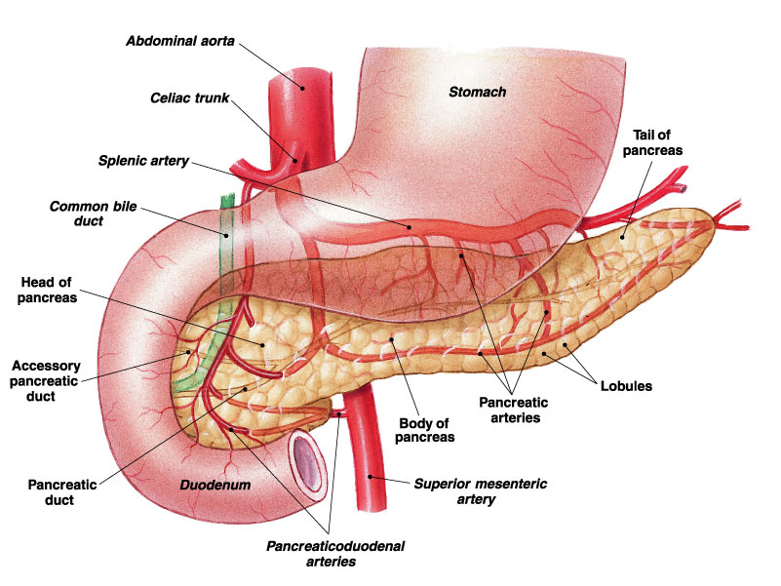
Duodenum and Pancreas

Slide 36
Pancreatic Secretion
Pancreas has 2 functions:
a) Endocrine functions: secretes insulin and glucagon from islets of Langerhans
b) Exocrine function: secretion of pancreatic juice
It has 2 components: aqueous and enzymatic components.
  Aqueous component (contains HCO3) is important for neutralizing stomach acid in the duodenum so pancreatic enzymes can function properly
  Enzymatic component is essential for the proper digestion and absorption of carbohydrates, fats, and proteins
    Pancreatic enzymes include trypsin, chemotrypsin, lipase, carboxypeptidase, pancreatic amylase, enzymes that reduce DNA and ribonucleic acid .

Slide 37
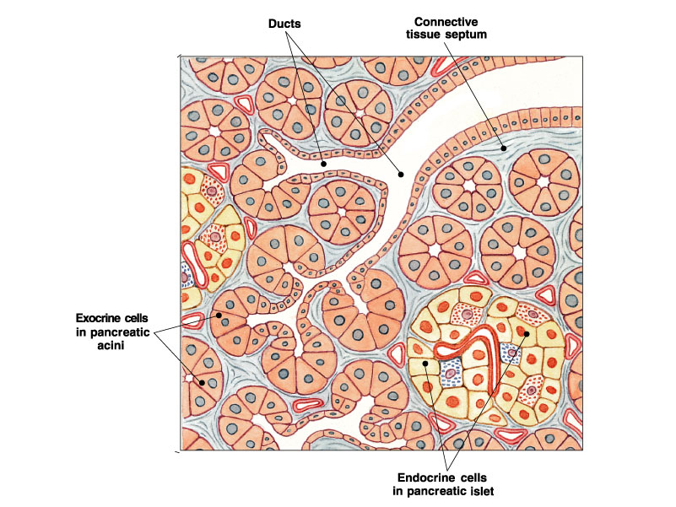

Slide 38
Functions of pancreatic juice enzymes
pancreatic amylase
Starch Maltose + Maltotriose
pH 7.0
Lipase + colipase
Fat（Triglyceride） Monoglyceride + Fatty acids
pH 8.0
protein
Enterokinase
Trypsinogen Trypsin
Chymotrypsinogen
Chymotrypsin
polypeptide
Carboxypeptidase
amino acid

Slide 39
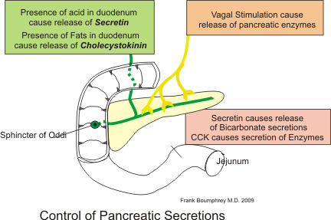
Regulation of pancreatic secretion

Slide 40
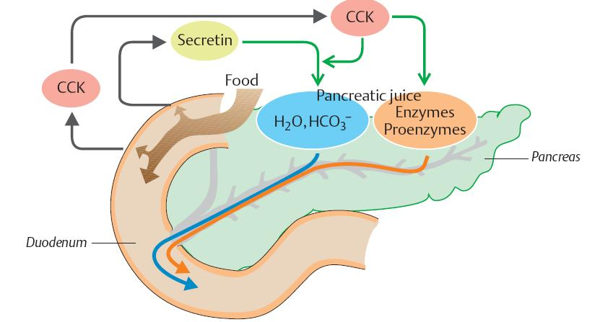
Regulation of pancreatic secretion

Slide 41
Liver and Gallbladder

Slide 42
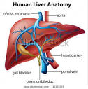
Liver
Lobes
  Major: Left and right
  Minor: Caudate and quadrate
Ducts
  Common hepatic
  Cystic duct
    From gallbladder
  Common bile ducts
    Joins pancreatic duct at hepatopancreatic ampulla

Slide 43
Liver
Functions of the Liver:
1) Metabolic regulation
    Store absorbed nutrients,( Glycogen, fat, vitamins, copper and iron)
    Release nutrients as needed
2) Hematological regulation
    Plasma protein production
    Remove old RBCs
3) Production of bile
    Required for fat digestion and absorption
    Salts emulsify fats, contain pigments as bilirubin
4) Nutrient interconversion
5) Detoxification
    Hepatocytes remove ammonia and convert to urea
6) Phagocytosis
    Kupffer cells phagocytize worn-out and dying red and white blood cells, some bacteria

Slide 44
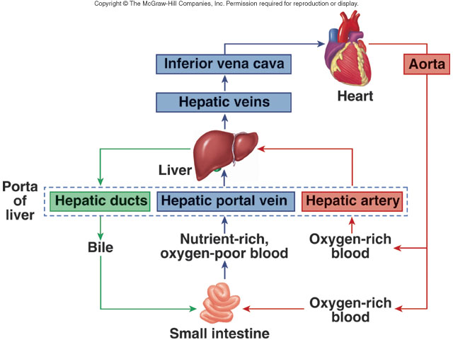
Blood and Bile Flow

Slide 45
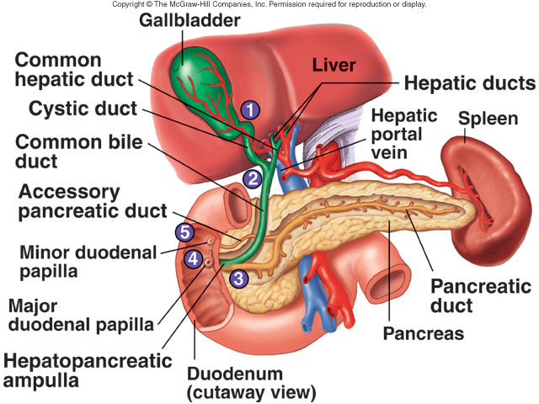
Duct System

Slide 46
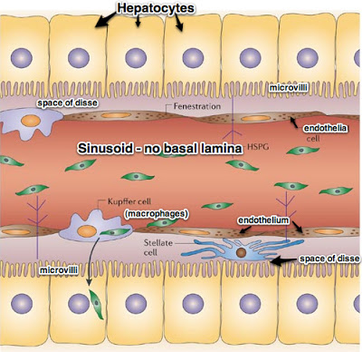
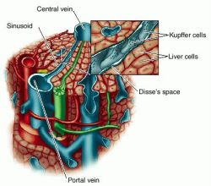
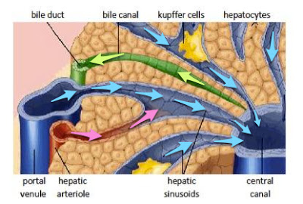

Slide 47
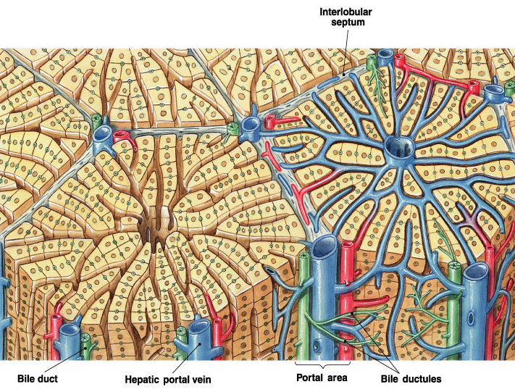

Slide 48
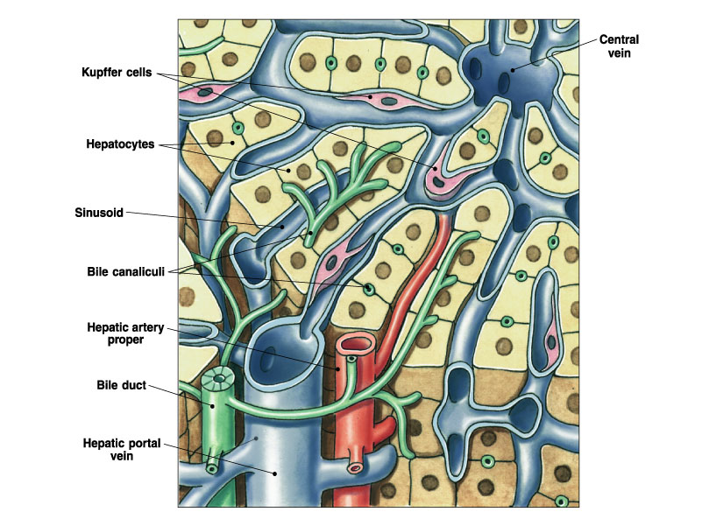

Slide 49
Gallbladder
Bile is stored and concentrated
Stimulated by cholecystokinin and vegal stimulation
Dumps into small intestine
each day around 600 ml of bile is produced…
Bile composition :
Bile acid
Phospholipids
Cholesterol
Bilirubin
Waste products
Electrolytes
Mucin

Slide 50
Small intestine Secretion
Secretion from duodenal gland and intestinal gland
Secretory volume is 1～3L/day
It contains inorganic ion, mucoprotein, IgA, various
enzyme, e.g. enterokinase ,etc
Function:
  Protective effect by mucous
  Digestion by enzymes such as peptidase, sucrase, lipase
  Dilution

Slide 51
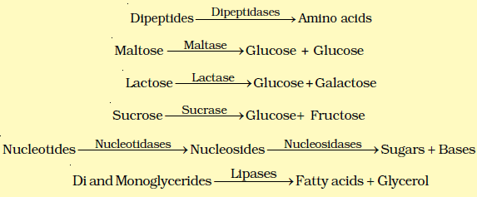
Small intestine Enzymes

Slide 52
Secretion of large intestine
Colonic alkaline secretion to neutralize acids produced by intestinal bacteria
Secretion of mucous for protection, lubrication of fecal matter
Vitamin B and K absorption made from bacterial flora in colon

Slide 53
Digestion and Absorption

Slide 54
Digestion and Absorption
Digestion is a process essential for the conversion of food into a small and simple form.
 Mechanical digestion by mastication and swallowing
 Chemical digestion by enzymes
Absorption is the process of transporting small molecules from the lumen of the gut into blood stream or lymphatic vessel.

Slide 55
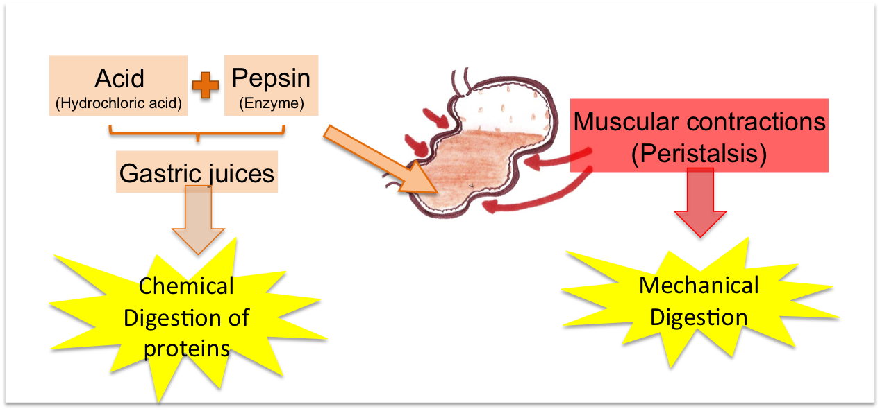
Chemical and Mechanical Digestion

Slide 56
Digestion and Absorption
Small intestine is primary site for digestion and absorption of food.
Digestion occurs in the GI lumen by secreted enzymes and on surface of enterocytes by membrane-bound enzymes.
Absorption occurs by simple diffusion, facilitated diffusion, active transport, endocytosis, and paracellular transport.
Surface area of small intestine is greatly increased by extensive folding and the projection of fingerlike villi covered with microvilli.

Slide 57
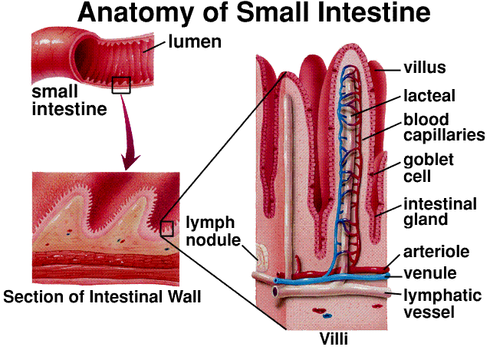
Anatomy of wall of GIT

Slide 58
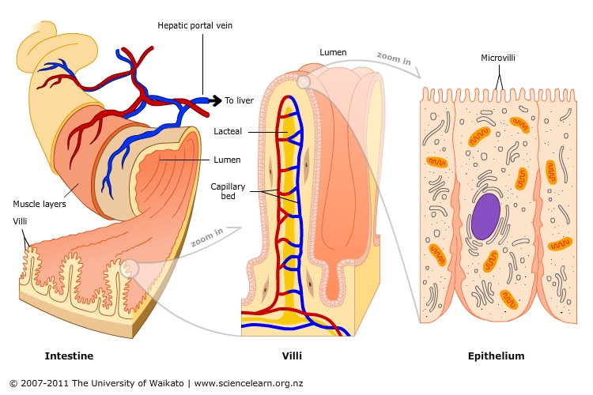
Intestinal Mucosa

Slide 59
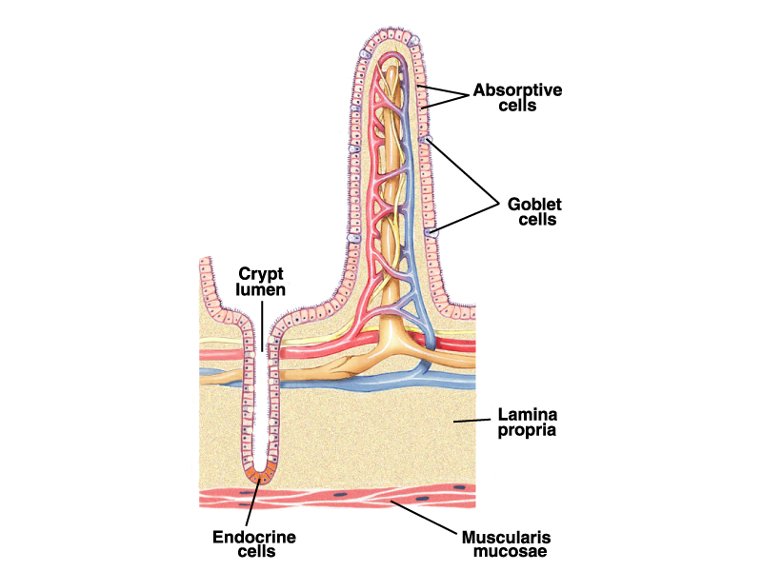
Intestinal Villi

Slide 60
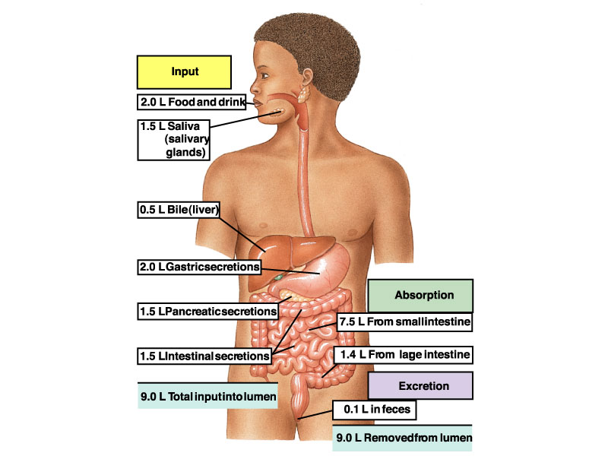
Absorption of Water

Slide 61
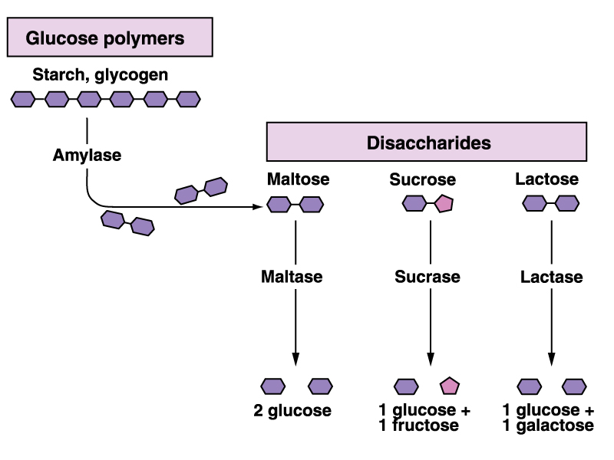
Digestion of CHO
(salivary and pancreatic)

Slide 62
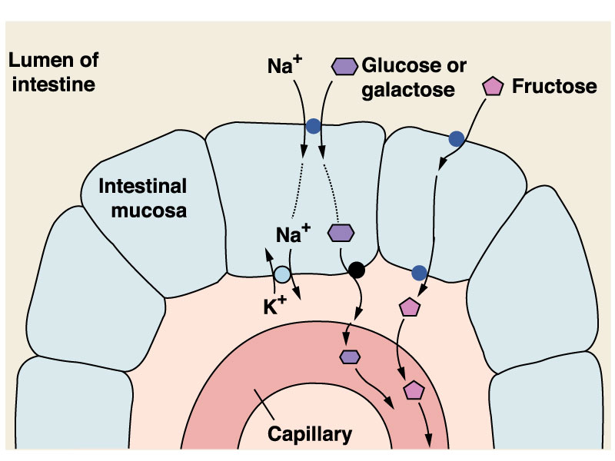
Absorption of CHO
Enterocytes absorb glucose and galactose through an Na-dependent secondary active transport process, while fructose is absorbed by facilitated transport.

Slide 63
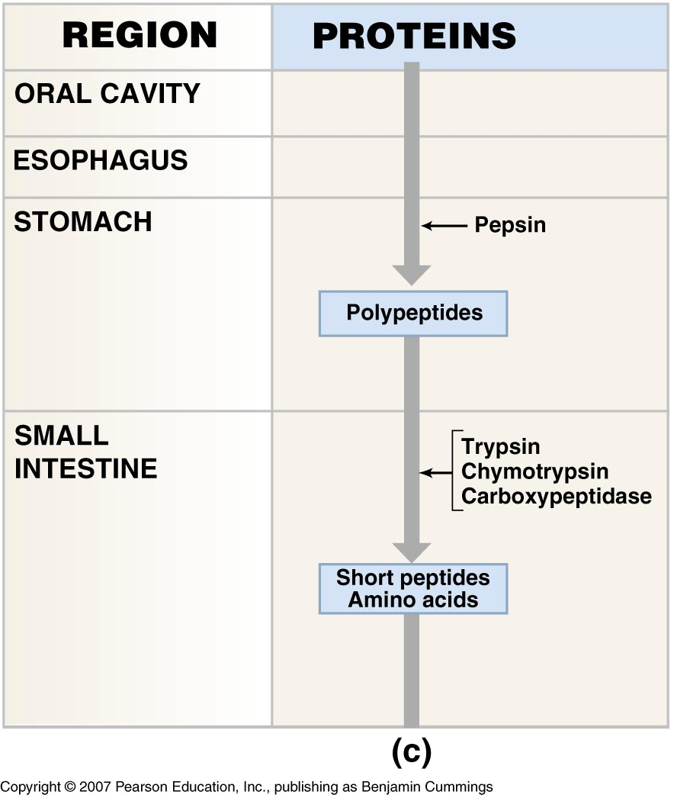
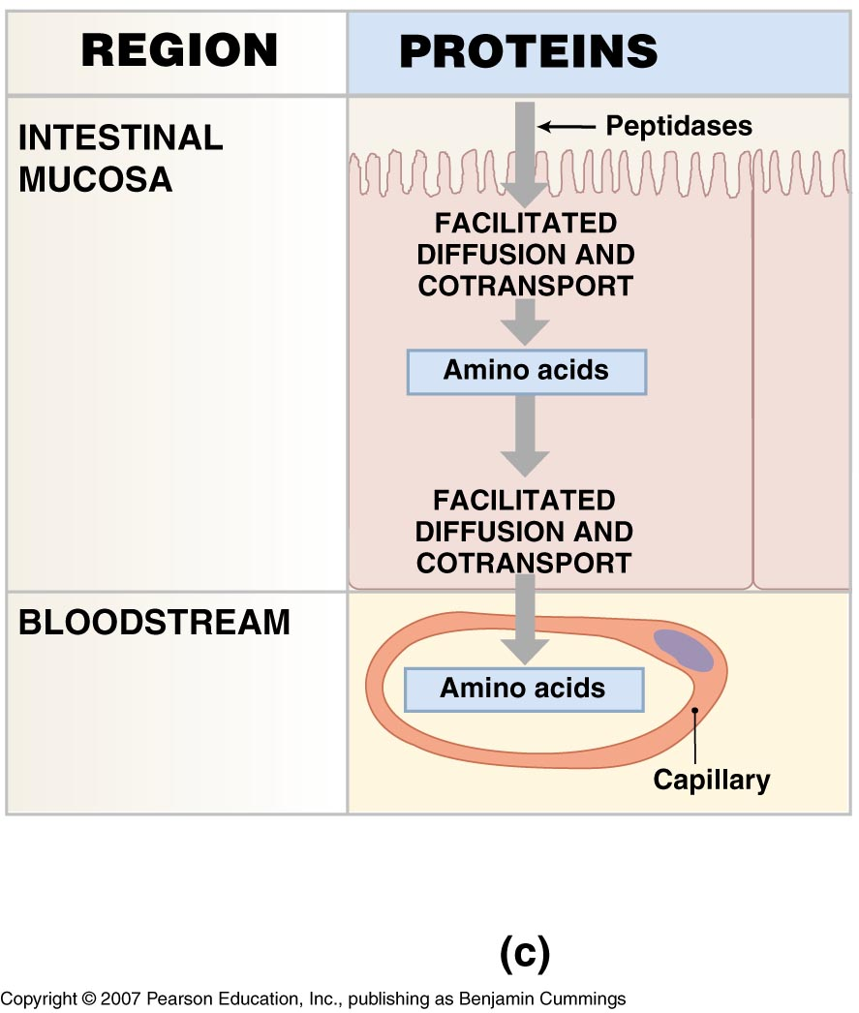
Digestion and absorption of proteins

Slide 64
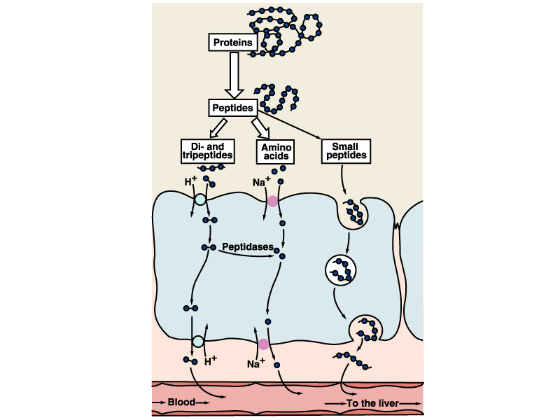
Absorption of proteins
The whole proteins absorbtion is done by endocytosis
Amino acids and di and tripetides absorbtion is done by by Na-dependent 2ry active transport
Lumen
Endocytosis
K⁺
Na⁺
Pump
Exocytosis

Slide 65
Absorption of Lipids
Lumen
Intestinal Epithelia
Vessels
Large fatty
molecule
Chylomicrons (CM) or VLDL particles
Lipase, cholesterol esterase and phospholipase A₂
Bile salts
The smooth
endoplasmic reticulum
Fatty Acids Cholesterol Monoglycerides
Triglycerides Cholesterol esters Phospholipids
(On The Apoprotein B)
In Golgi, they are packaged into chylomicra or very low density lipoprotein (VLDL) particles.
Micelles
porous
porous
Exocytosis
Venous system
Lymph vessel
Absorption of Fats in the Small Intestine

Slide 66

Copyright © The McGraw-Hill Companies, Inc. Permission required for reproduction or display.
Design of the Four Layers in the GI System
#1 Mucosa
Epithelium
changes
Lamina propria
Muscularis
mucosae
#2 Submucosa
Submucosal
nerve plexus
Lumen
#3 Muscularis
Inner circular layer
Myenteric
nerve plexus
Outer longitudinal
layer
Vein, artery,
lymph vessel
(within mesentery)
#4 Serosa or Adventitia
Notes:
Mucosa- wet, (anal, vaginal, oral)
Lamina propria- CT
Muscularis mucosa- thin layer
Submucosa- CT
Muscluaris- movement, inner circular, outer longitundinal
Serosa- CT

Slide 67


