Slide 1


Ministry of Higher Education and Scientific Research AL-Mustaqbal University College of Science Department of medical biotechnology
Biochemistry
Lecture 5
Carbohydrates
^{B}y
Dr. Assel Amer Hadi

Slide 2
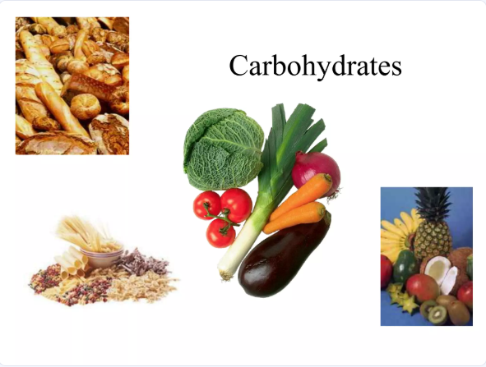

Slide 3
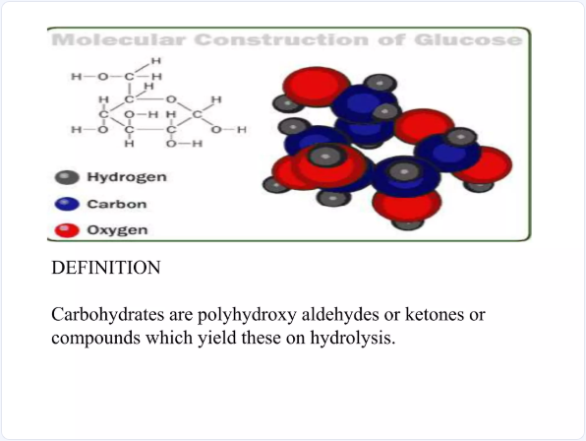
Have the empirical formula ( CH2O)n
like glyceraldehyde , dihydroxyacetone

Slide 4
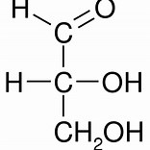
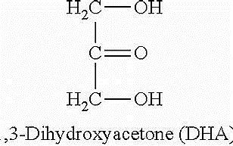
glyceraldehyde
dihydroxyacetone

Slide 5
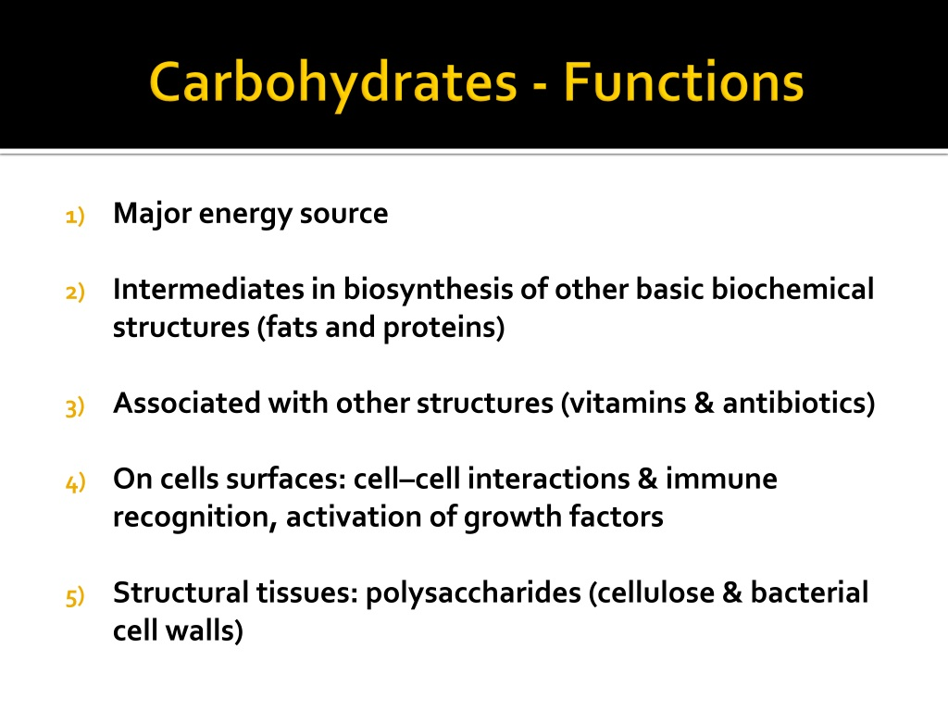

Slide 6
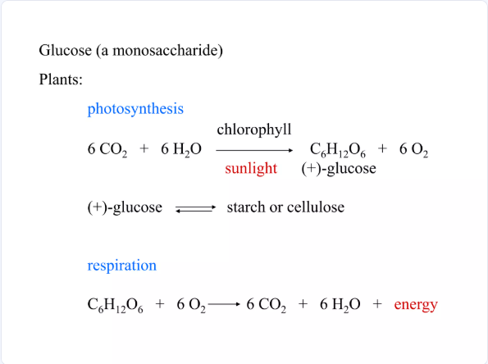

Slide 7
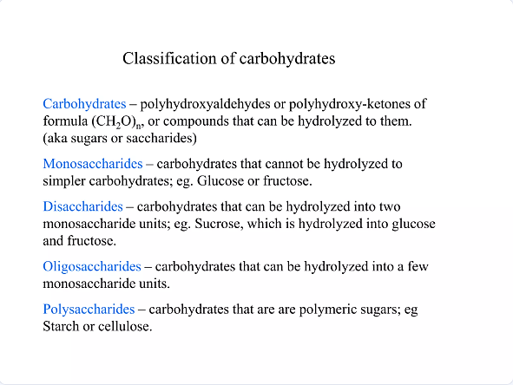
Classification of Carbohydrates

Slide 8
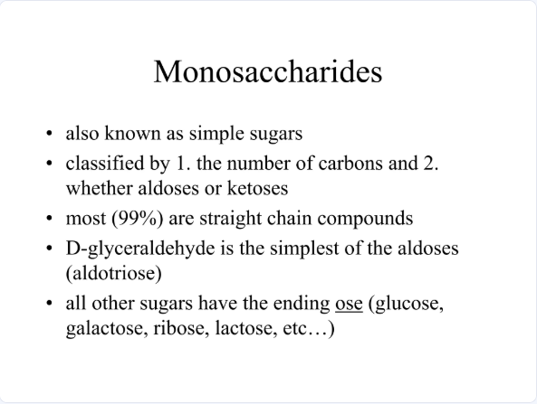

Slide 9
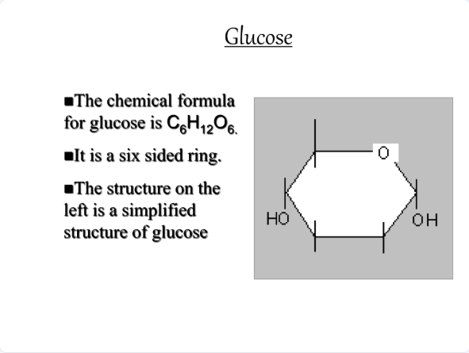

Slide 10
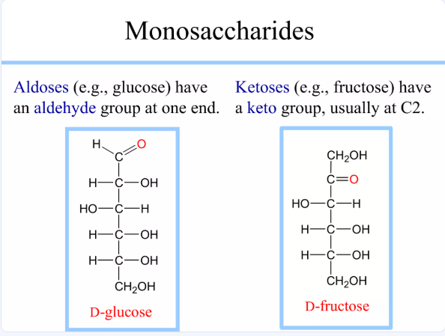

Slide 11
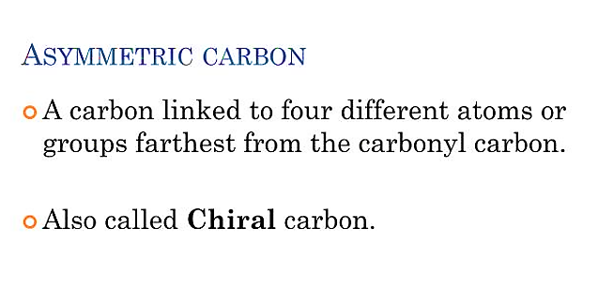

Slide 12
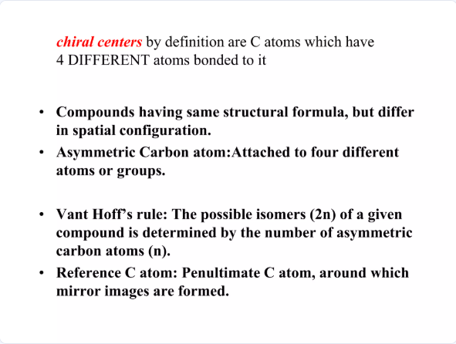

Slide 13
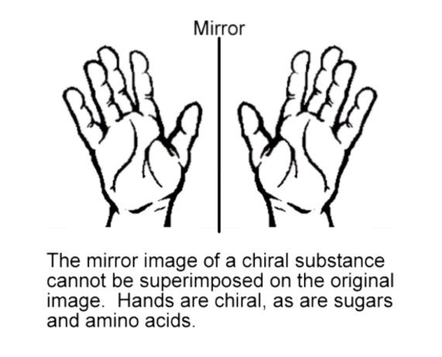

Slide 14
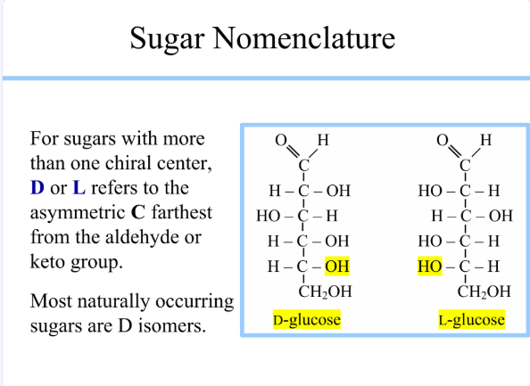

Slide 15
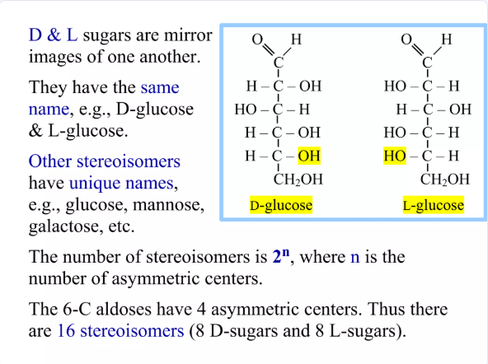

Slide 16
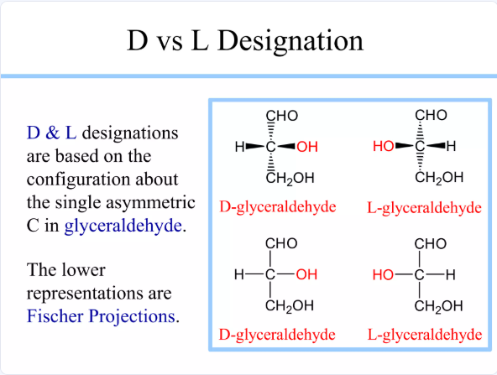

Slide 17
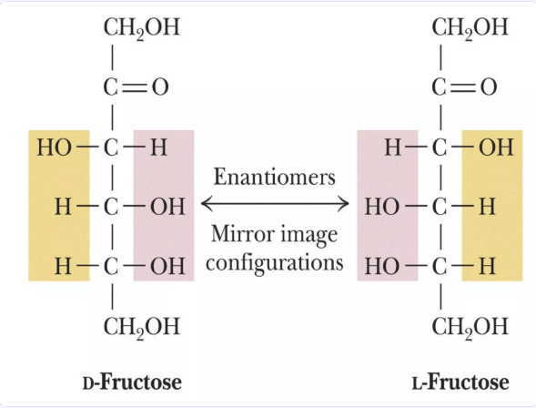

Slide 18
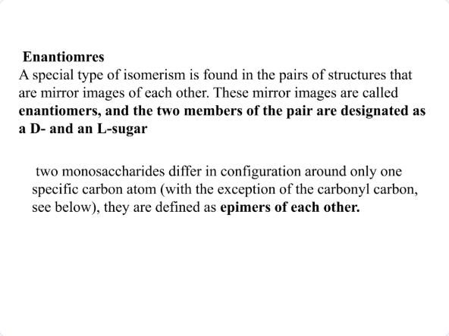

Slide 19
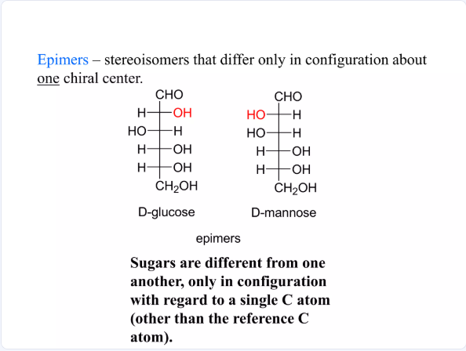

Slide 20
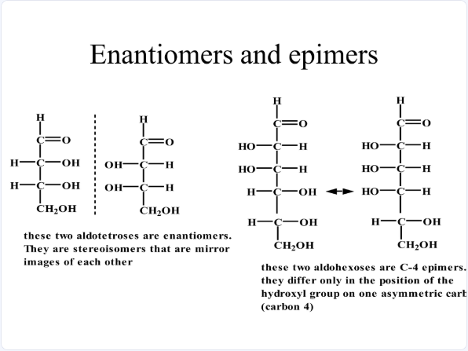

Slide 21
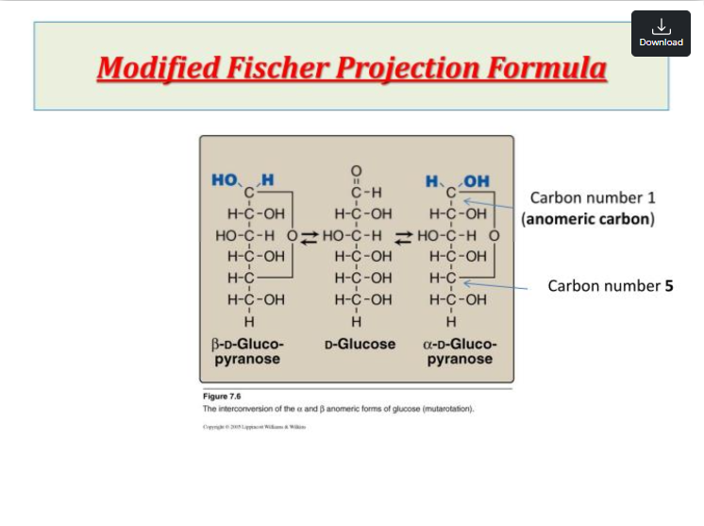

Slide 22
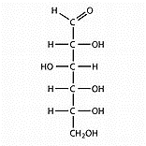
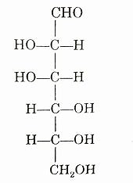
Example:
D-Glucose give two epimers are show projection formulas.
Epimers
D-Glucose
D-Mannose

Slide 23
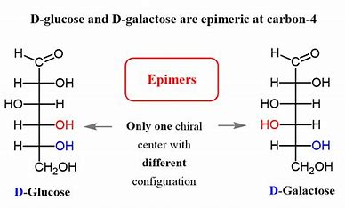

Slide 24
Haworth Formula:
It is the conversion of the open Fisher formula into a ring formula known as Haworth formula. Results from the union of the carbon atom of Carbonyl No. (1) with the OH around carbon atom No.(5) to give two different ring structures: alpha and beta. Haworth relied on the Pyran and Furan ring to form a ring indicating his formula.

Slide 25
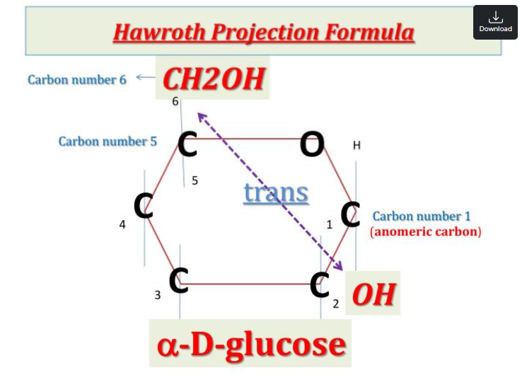

Slide 26
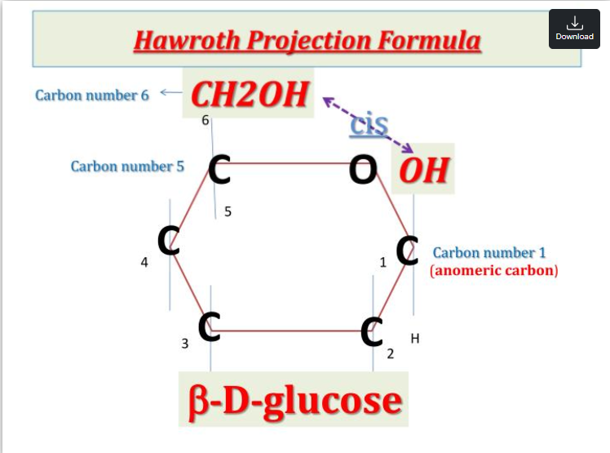

Slide 27
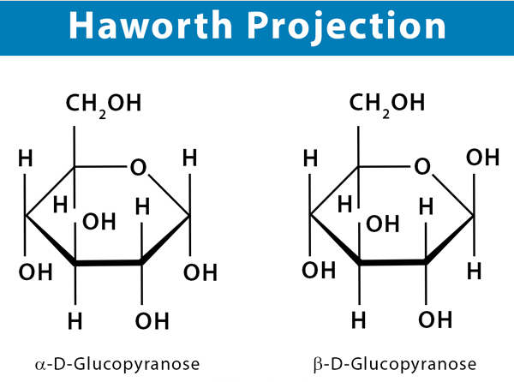

Slide 28
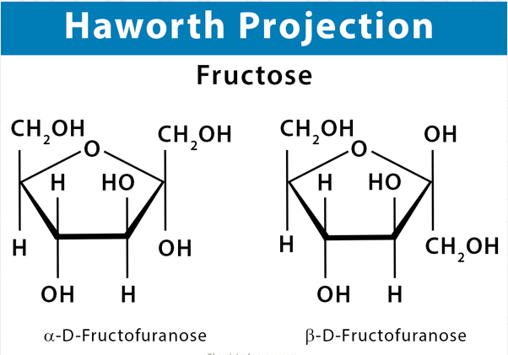

Slide 29
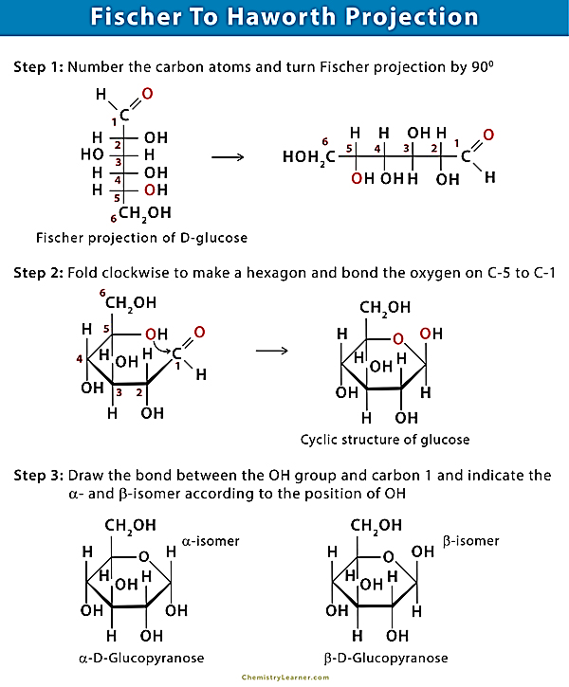
Conversion of Fischer Projection to Haworth Projection

Slide 30
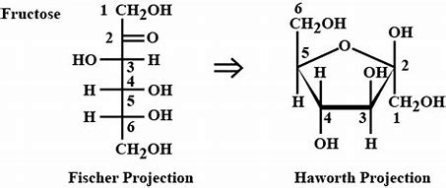
Mutarotations Fructose from Fischer Projection to Haworth Projection.

Slide 31


