Slide 1
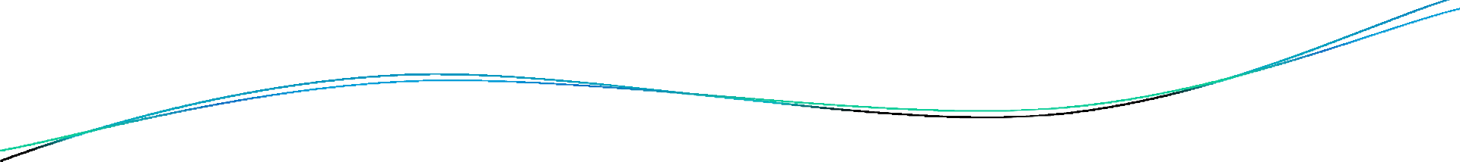


Data Science
Ethics
College of Science
Al-Mustaqbal
University
Stage 2 , Semester 1
@ Department of Intelligent Medical Systems
Prepared by Dr. Samir Badrawi
Code of Data Science Ethics
The majority of this course material is based on Coursera https://www.coursera.org/learn/data-science-ethics
“H.V. Jagadish lectures”, a Professor at the University of Michigan

Slide 2
Code of Data Science Ethics
Professional codes are there in many professions.
Hippocrates, for example, was a Greek doctor who introduced this notion of the Hippocratic oath in medicine. And there are a number of things that this says including, very famously, "First, do no harm."
Many other professions, lawyers, journalists etc., have oaths that they take and codes of conduct that have been established for their behavior.

Slide 3
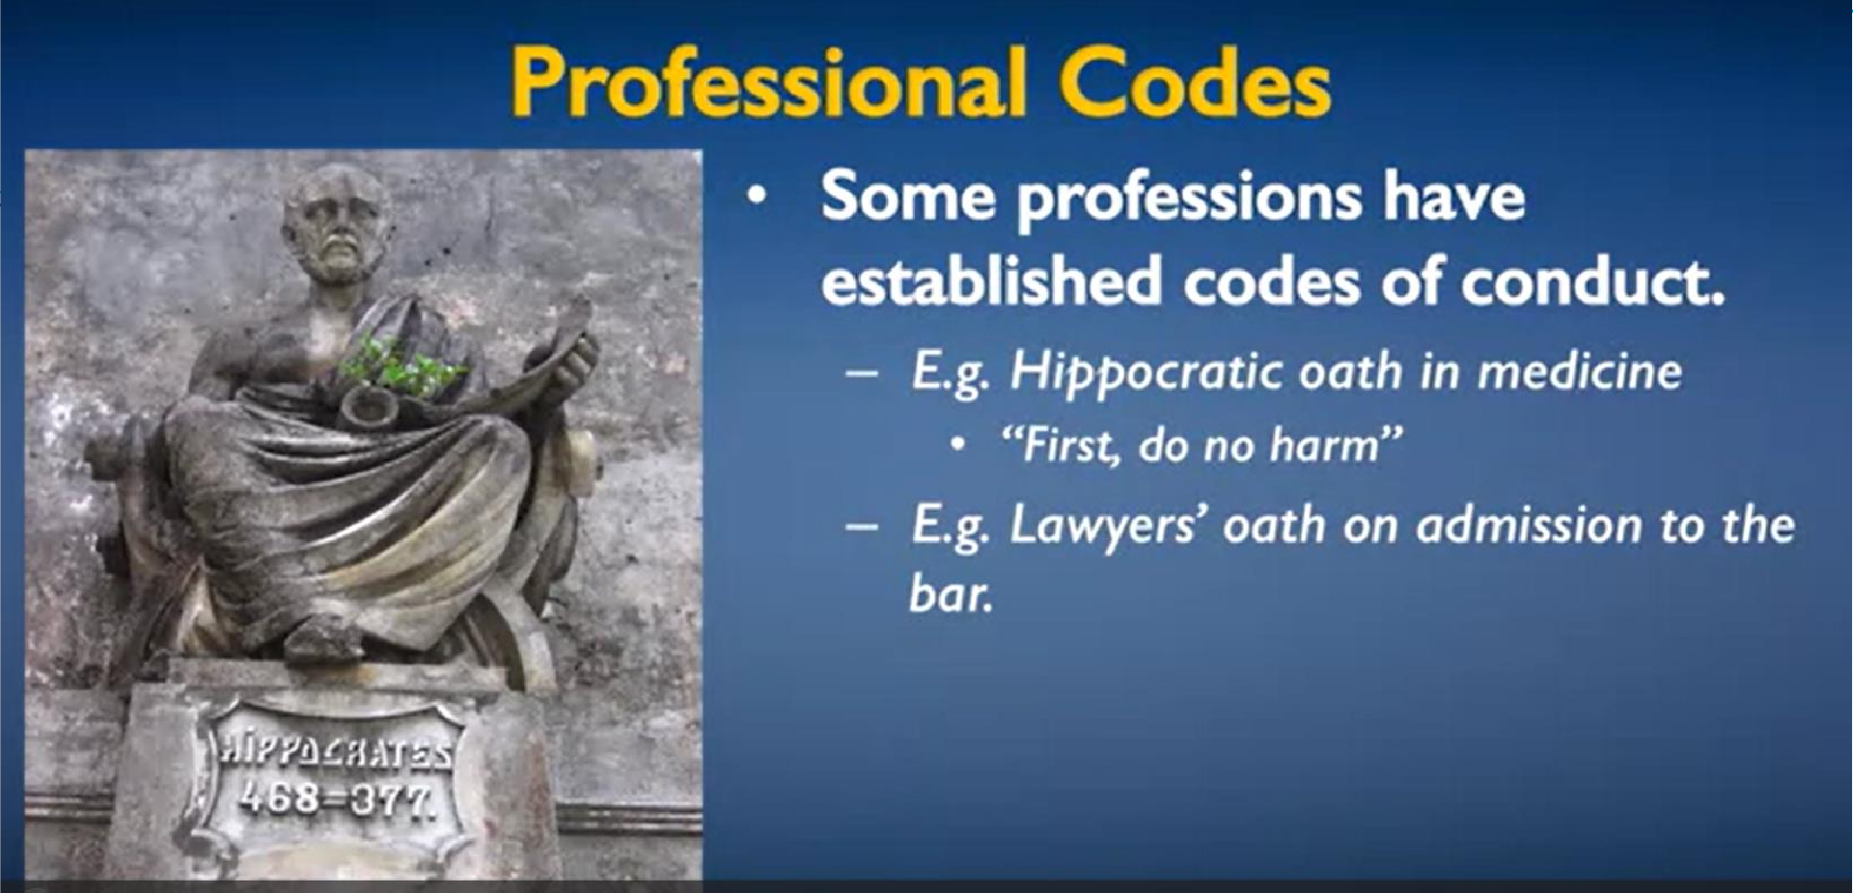
Bar : American Barrister Association
Similar code for data scientists is really needed.

Slide 4
Similar code for data scientists is really needed. Regulation is not the answer. (in Data Science) Why?
Technology advances quickly. Regulation moves slowly. If we rely on regulation, we will be regulating yesterday's technology, and because we're regulating yesterday's technologies, we'll allow many abusers because they comply with outdated regulations.

Slide 5
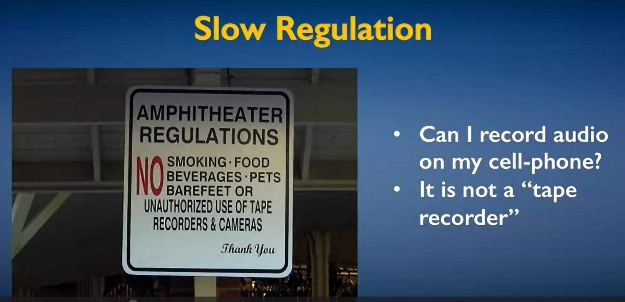
As an example of regulations being slow, here is a sign at an amphitheater. It says unauthorized use of tape recorders and cameras is not allowed. So what they mean, presumably, is an unauthorized recording of any sort is not allowed, but they said tape recorders and cameras.

Slide 6
And the question is, if I want to record a concert and I record it on my cell phone, is that okay? My cell phone is not a tape recorder. And by the letter of the law here, that is probably fine.
Surely, it's this kind of situation that lawyers can have a field day with. And this is an issue of wording laws precisely in a world where the technology shifts fast.
So, we as data scientists should own our own destiny. We shouldn't have corporate lawyers defining this for us.

Slide 7
Professor H.V. Jagadish, of University of Michigan
I am proud of being a data scientist. I'm excited about the good things the data science can do, and I want us as data scientists to act ethically so that I can continue to be proud of what I do, and we as a field can continue to be successful in terms of society appreciating us and valuing the benefits that our work provides to them.

Slide 8
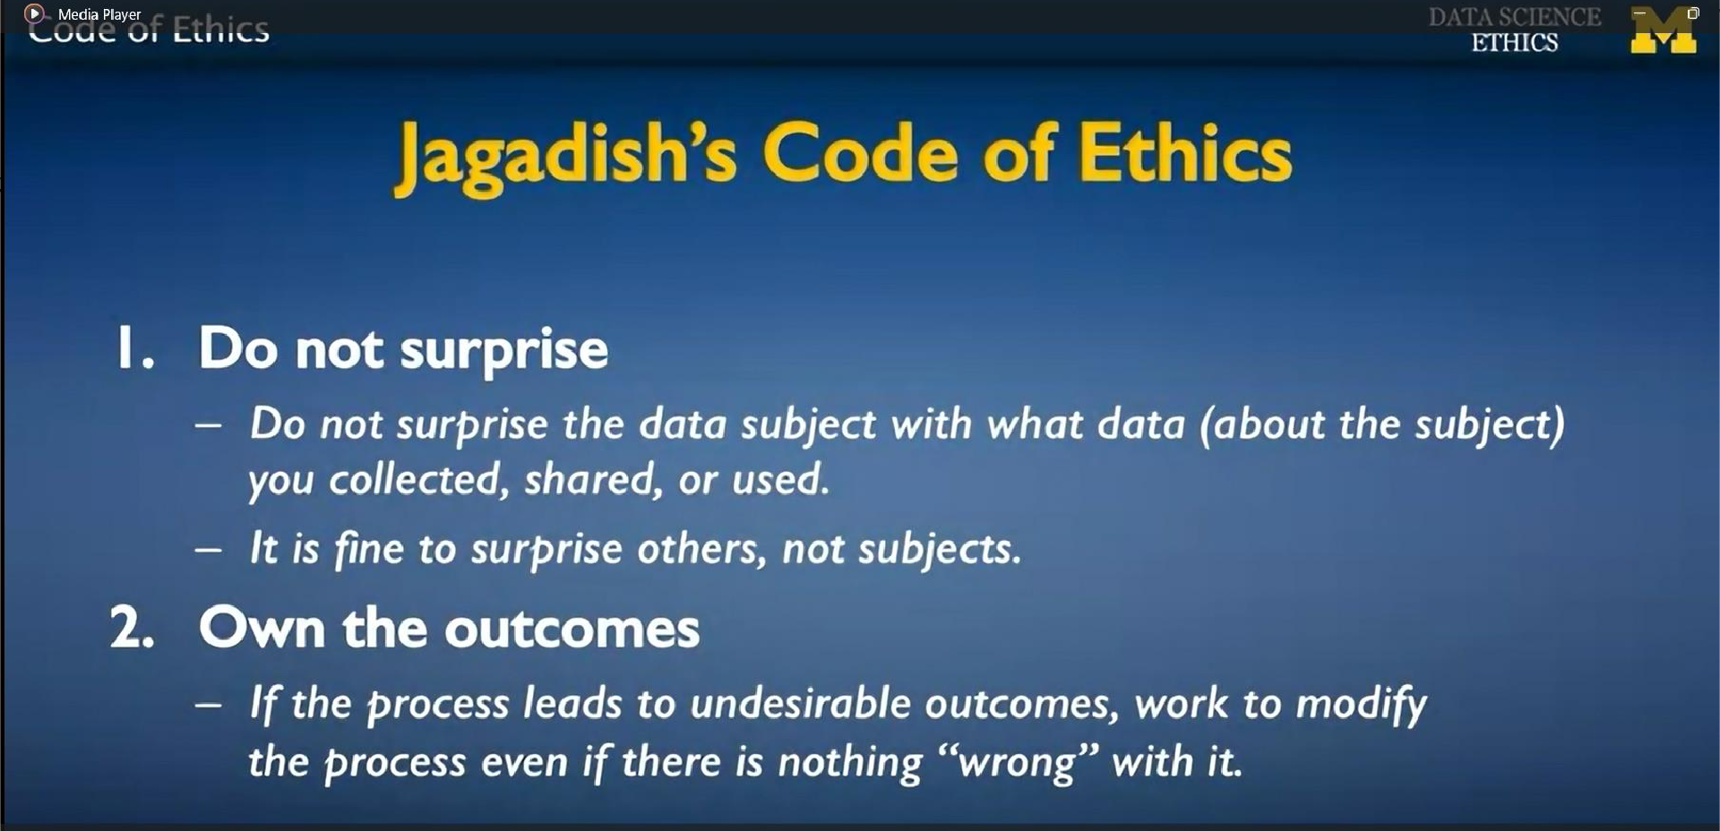
Do not surprise covers things like who owns the data, what the data can be used for, things of this nature.
Own the outcomes includes things like what is valid, what is fair, what are the social .

