Slide 1


Data Science
Ethics
College of Science
Al-Mustaqbal
University
Stage 2 , Semester 1
@ Department of Intelligent Medical Systems
Prepared by Dr. Samir Badrawi
Data Ownership
The majority of this course material is based on Coursera https://www.coursera.org/learn/data-science-ethics
“H.V. Jagadish lectures”, a Professor at the University of Michigan
1

Slide 2
2.
Limits on Recording and Use
we've been talking about the fact that the data are owned by whoever records the data. So, we've got to think about limits on recording and use , and that's what we'll talk about in this part of the lecture.
If you're in a clothing store fitting room, or if you're in a toilet, you really don't want to have cameras in there.
If you have a phone company, you really don't want them to listening in to your phone calls.

Slide 3
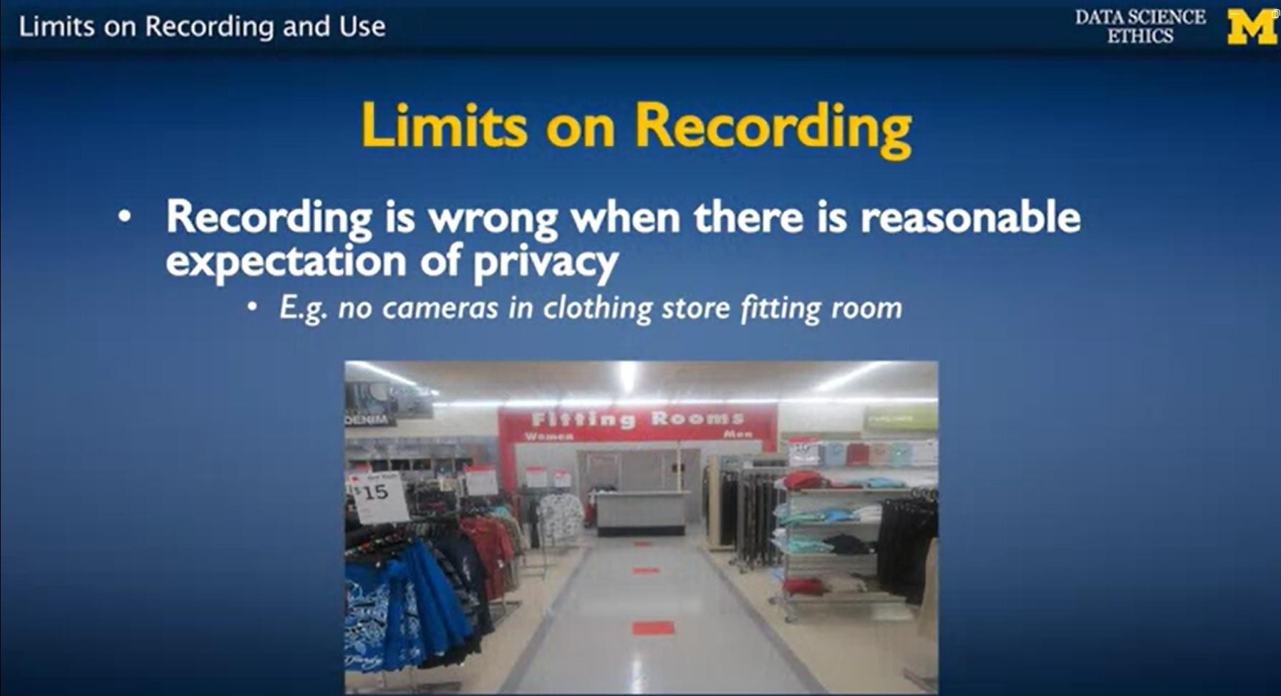
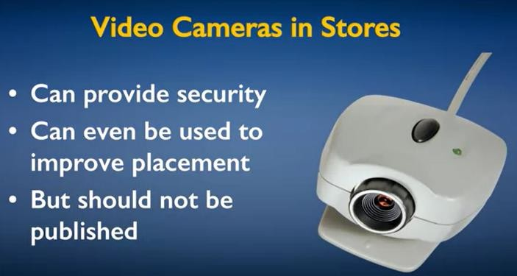
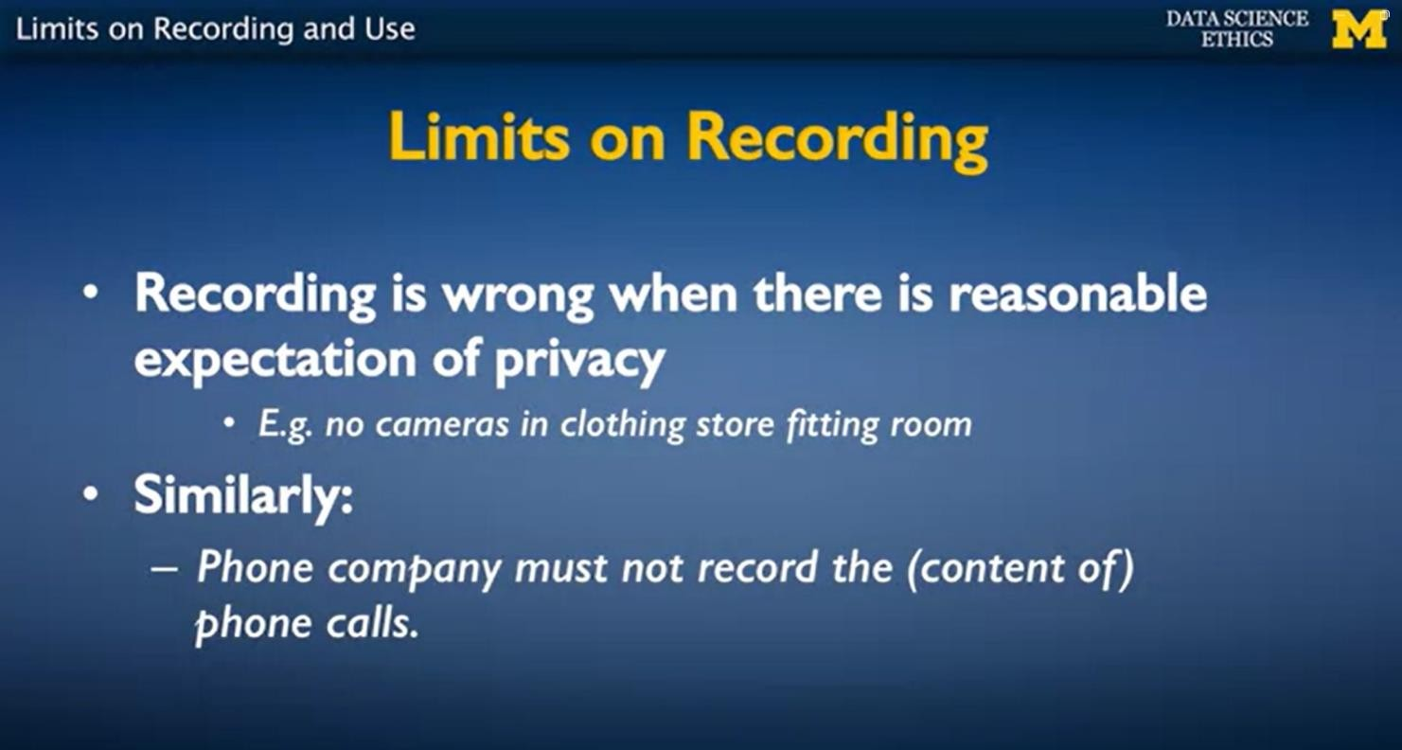
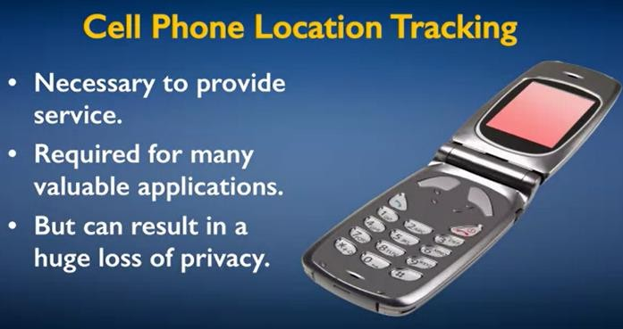

Slide 4
Now given that stores are videotaping movement of customers in the store, if they use the data that they collected from this video to improve product placement or to improve the geography of the aisles so that traffic flows better, that's something that we would consider reasonable.
But if I saw a video of me walking down the aisle in my favorite store on the internet, I would be very unhappy.

Slide 5
So even though there isn't actually a contract between me, as a customer, and the store that I visit, we have an expectation, a shared expectation that they may videotape me but they will not publish this videotape.
If you have a cell phone, to be able to get service, the cell phone providing company has to know where you are. They have to therefore know your location, and if they know your location 24x7, they know a lot about you, and so, it can result in a huge loss of privacy.

Slide 6
But in general, companies know, that customers will get very unhappy if data (collected for one purpose) get used for a different purpose that the users didn't expect them to be used for.
It is possible always to put such understandings (between companies and customers) in writing. And whether they're actually written down or not, these understandings remove barriers to many future transactions between the two parties (the company and the customer).

Slide 7
If indeed people can record information and assure people that this recorded information will not be looked at by anybody either legitimate people because they have the right to look at it or because of security breaches, then we may actually have some intermediate point where we distinguish between data collection and data use.
The whole thinking around this area is still having social conversations, and there isn't a societal consensus yet.

Slide 8
3.
Data Ownership Finale
In this final segment on data ownership, we will touch upon one additional point, that we haven't really talked about thus far, and that's data destruction.
Companies legitimately collect data as part of doing business with us. And by and large, as we've been saying, companies want to retain the goodwill of customers.

Slide 9
Unfortunately, that assurance goes away once the company ceases to do business. So if a company goes bankrupt, then the data is an asset, and assets are up for sale. Their assets will be sold like any other assets, and they will be sold to a third party.
And usually, a third party who intends to misuse the data, is the one who is going to bid the highest.
And so as a contributor of data to companies, when I do business with them, I want collected data to be destroyed and not sold when the company goes bankrupt.

Slide 10
This is not just a theoretical thing.
This has actually happened in the case of a number of companies such as Radioshack, and Borders, and ConnectEDU.
Bankruptcy law actually now has partial protection, basically saying that, whatever is the company's privacy policy, must survive even after the company goes bankrupt.

Slide 11
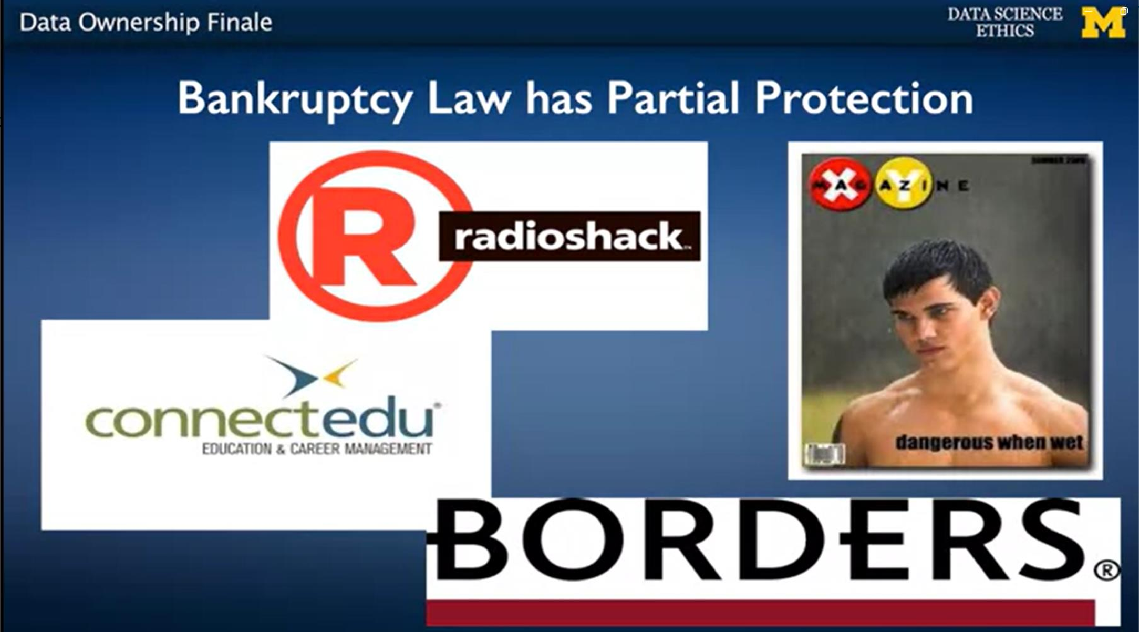



Borders : multinational book and music retailer
Radioshack
: a popular company selling electronic products
ConnectEDU
: a pioneering online education organization

Slide 12
To sum up, data ownership is really complex.
It's much harder to reason through, than intellectual property ownership for other things like works of art. And this ownership is complex even for things that you actually want to share.
A thing that we have to recognize is that, for the most part we don't own data about us.
Data about us that somebody else has collected, is owned by whoever collected it.

Slide 13
Nevertheless, we may have some control over these data that aren't ours, because they're about us.
And we need to create the principles to reason about this control. And that is really the main concern of a discussion about the right to privacy.

Slide 14
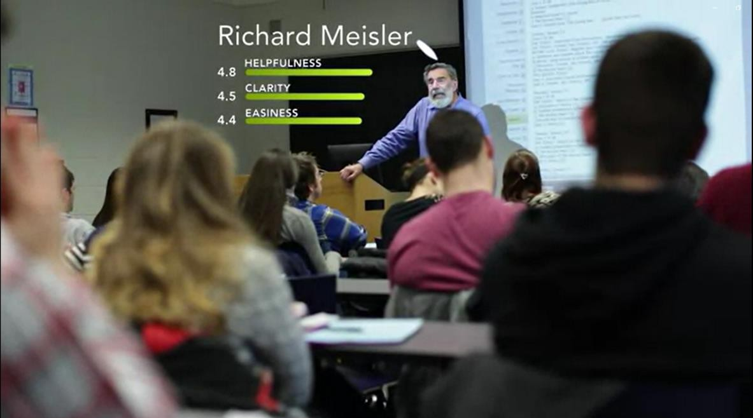
4.
Case Study: Rate My Professor
Students care about how well professors teach. And when enrolling for a class, they would naturally like to find out a little bit about how good the professor is. To meet this need, there are several websites that have emerged, for example, ratemyprofessors.com.

Slide 15
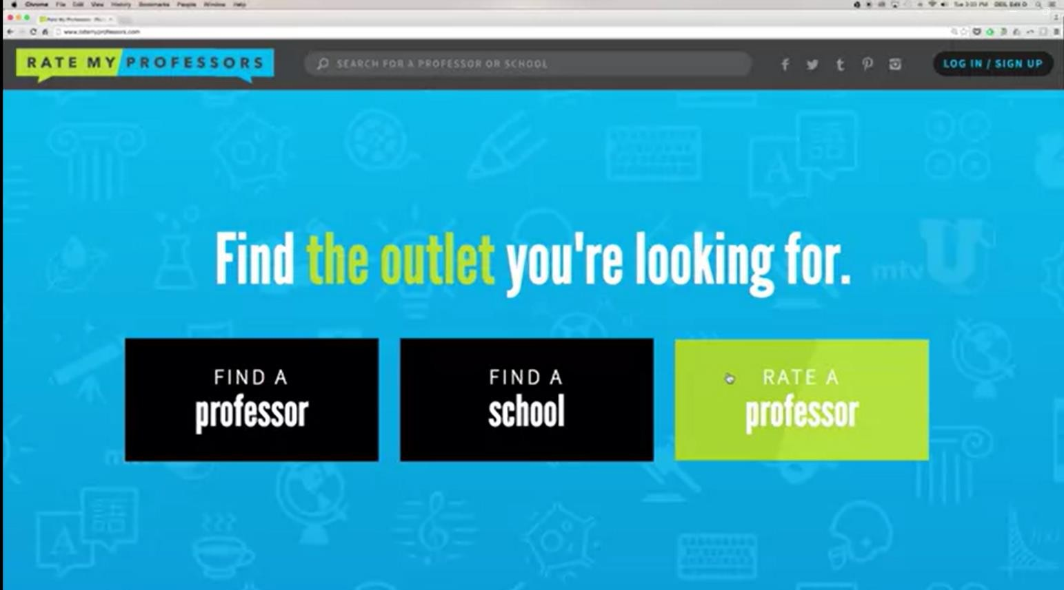
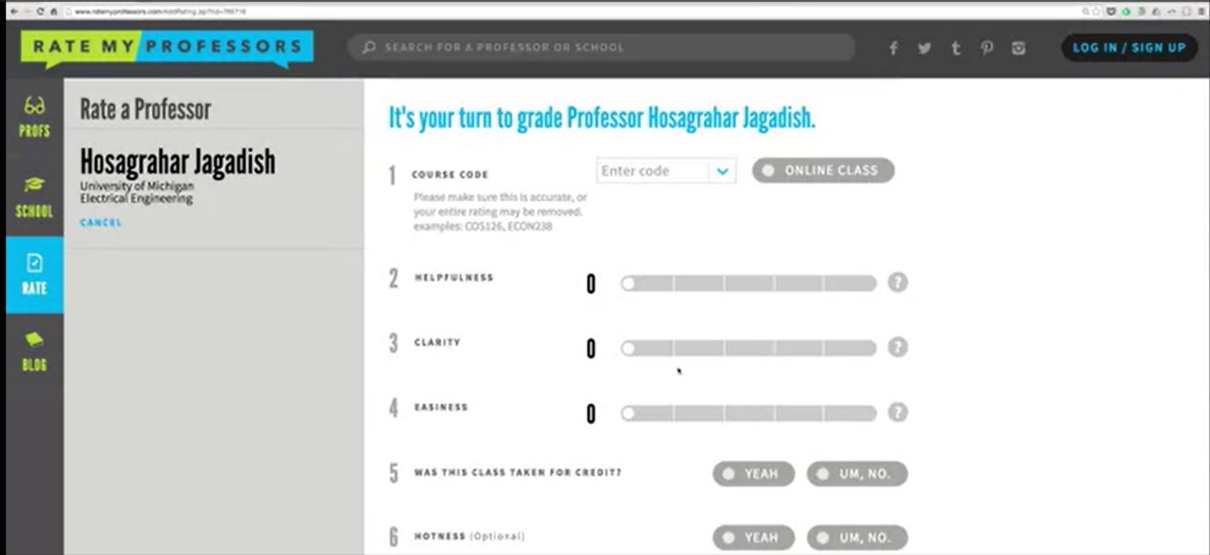
On this website, students go in and enter their comments and their rating about their professors.

Slide 16
what happens on this website and the data that's on this website has an impact on enrollments in my class, and therefore, potentially, on my career as a professor.
The thing is, this is intensely personal information about me. But, it is about me said by somebody else and recorded on a third party website that I have no control over.

Slide 17
Now, the question is, what happens if there's data about me (as a professor) said on this website that I (as a professor) object to?
For example, suppose there is some student who's disgruntled, let's say I caught some student cheating; then they could go in and put a really nasty comment about me and rate me very low.
Even worse, there isn't much that prevents them
from getting 50 of their closest friends, to go in and do the same thing.

Slide 18
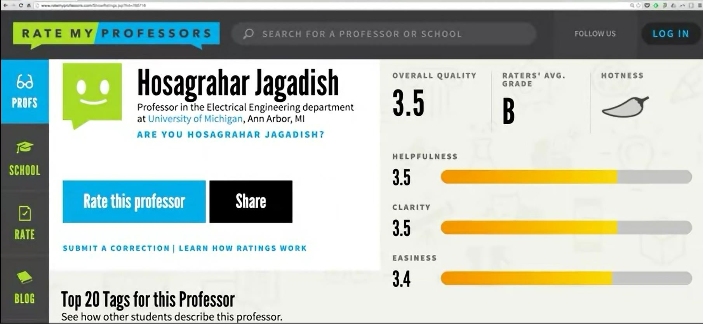
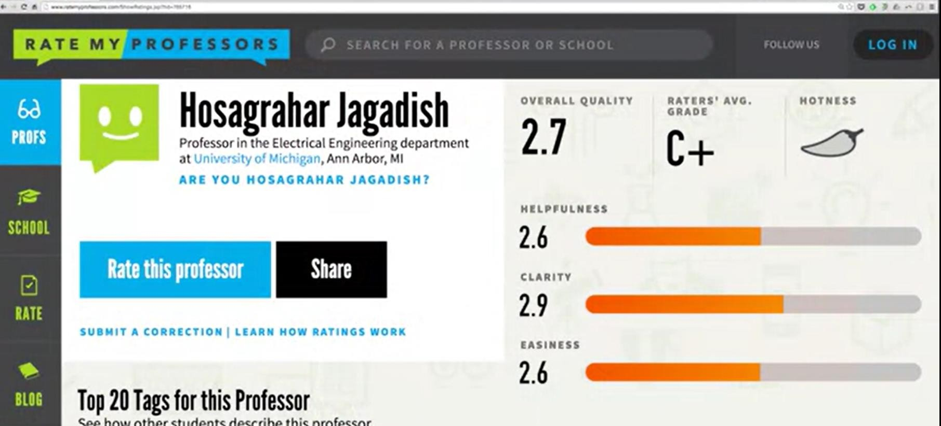

Slide 19
And the net result of this kind of mass movement would be that my ratings on the site would plummet.
If such a thing were to happen, I could, presumably, go and complain to the website and possibly, they would investigate. And possibly, they might do something. But, it's really totally up to them and their processes and I have no real recourse.

Slide 20
The data that a site like ratemyprofessors.com gathers, is information that they could sell or rent to third parties that they could do what they wish to with.
It is about me but it isn't mine. And keeping this distinction between who the data is about and who owns that data, is important as we go through our discussions of privacy.

Slide 21
5.
Case Study: Privacy After Bankruptcy
RadioShack was a popular company selling electronic products, and they went out of business.
When they were in bankruptcy, their assets were being sold. While they were in business, they had collected information about millions of customers.
When they entered bankruptcy, they wanted to sell the assessment information. Thirty-six attorney generals of states sued to stop that sale.

Slide 22
The question is, when a company enters bankruptcy, how does any privacy agreement they may have made while they were in business still apply?
Well, it turns out this was actually not the first time that this question had come up.
A few years earlier, a company called Toysmart, which was one of the dot com bubble companies on the web, had gone out of business and the very same question had been raised and addressed.

Slide 23
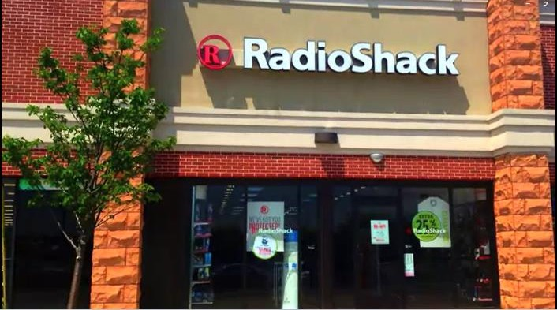
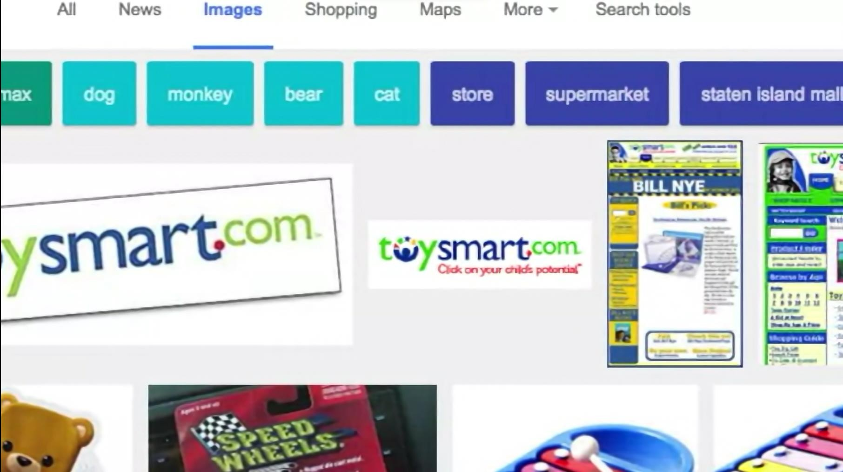

Slide 24
There is in the US, actually law in terms of how bankruptcy proceedings should be conducted, in light of the Toysmart case, which says that there is an ombudsperson appointed, whose job is to make sure that the way in which data assets are sold is compliant with whatever privacy agreements have been made by the company while it was in business.

Slide 25
Based on the above case (Toysmart case ), the creditors of RadioShack entered into an agreement with the attorney general who sued them, and there was a deal, where there was a complicated opt-in, opt-out arrangement made with respect to the customers having their data transferred to a new company that was buying this information asset.

Slide 26
The important point from this conclusion is, as a matter of social consensus and as a matter of
ethics, we believe that things that we enter into as
agreements when a company is in business, should survive even when the company ceases being in business and enters into bankruptcy.
At least, in some circumstances and in some countries, there are now laws that support this social expectation.

