Slide 1


Data Science
Ethics
College of Health and Medical
Techniques
Al-Mustaqbal
University
Stage 2 , Semester 1
@ Department of Intelligent Medical Systems
Prepared by Dr. Samir Badrawi
Data Ownership
The majority of this course material is based on Coursera https://www.coursera.org/learn/data-science-ethics
“H.V. Jagadish lectures”, a Professor at the University of Michigan

Slide 2
Data ownership
Who owns data about you? We'll explore that question in this Lecture.
A few examples of personal data include copyrights for biographies; ownership of photos posted online, and companies like Yelp, Trip Advisor, public data capture, and data sale. We'll also explore the limits on recording and use of data.

Slide 3
1.
Data Ownerships
This lecture is about data ownership.
Let's begin by talking about who owns the data.
The issue is, the data is about you, and so you might think you own the data, but is it really yours?

Slide 4
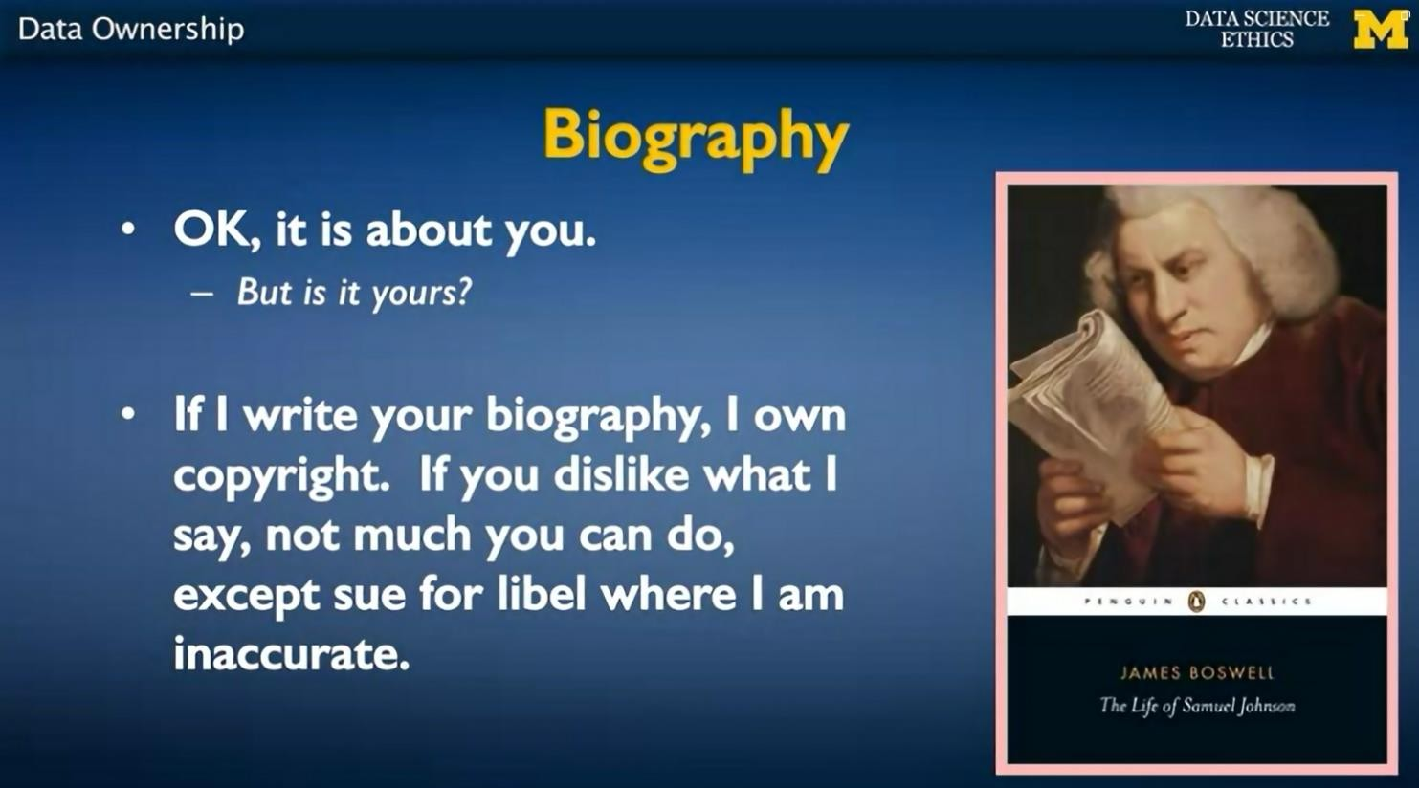
If I write your biography, I own copyright on what I've written. If you dislike what I say, there's actually not much you can do, unless I've been inaccurate and I've lied in ways in which it harms you, in which case you could sue me for libel.

Slide 5
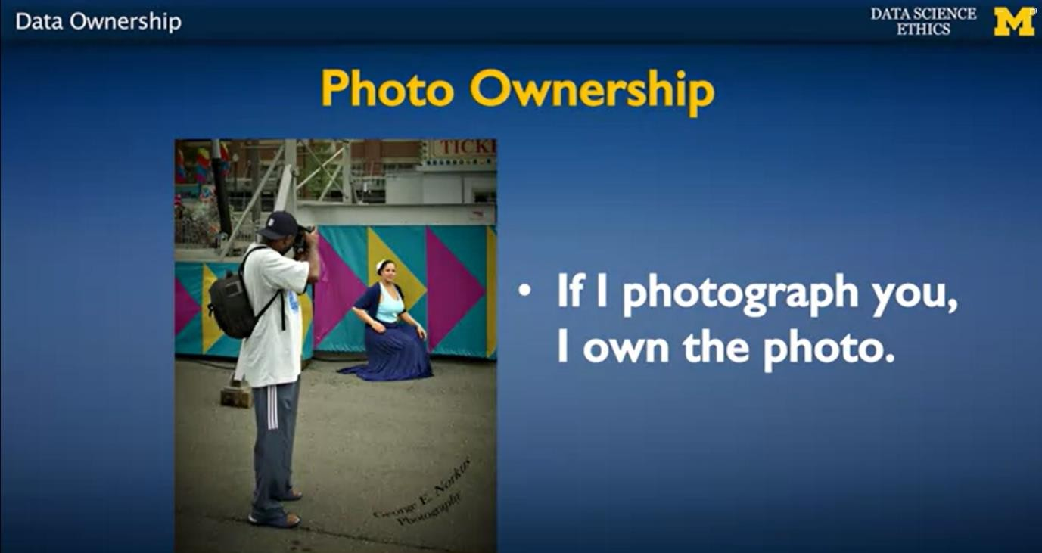
If I photograph you, I own the photo. There are some limits on things that I can do. There may be private areas in which I cannot take the photo.
There might be ways in which I cannot use the
photo. I can't use the photo as an implied endorsement or as implied libel.
What does
Implied libel
mean?

Slide 6
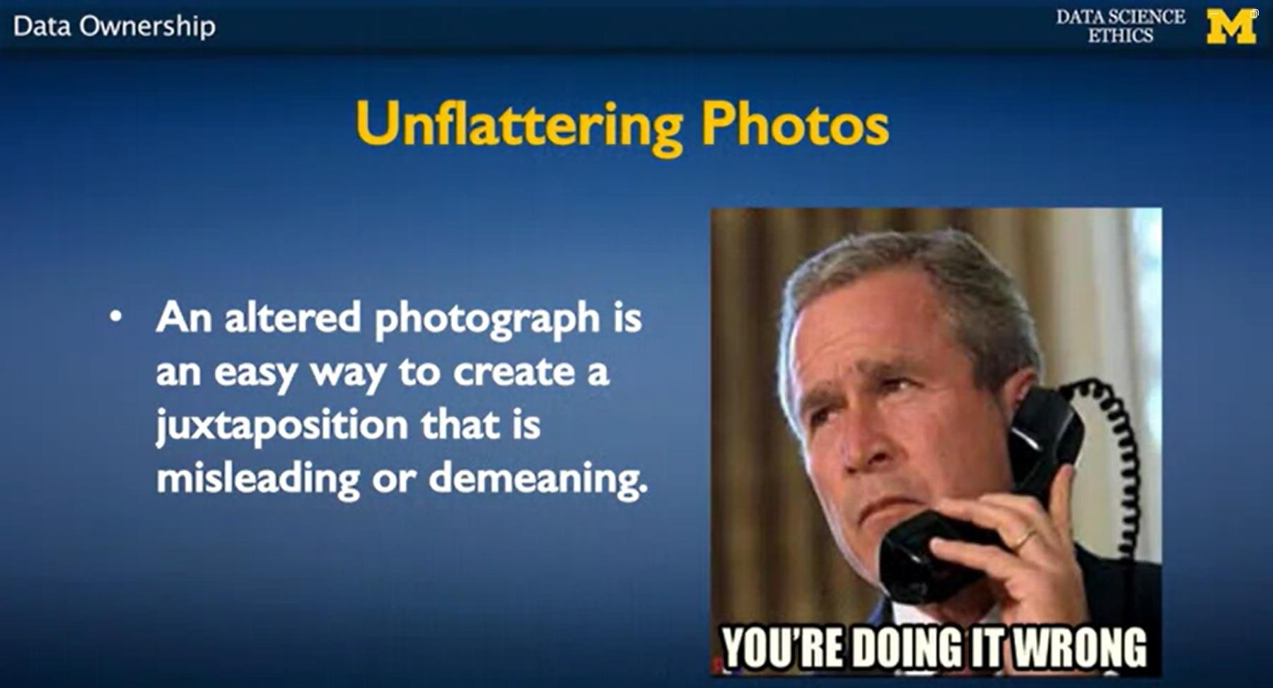
For example, here's this photograph that is presumably not what President George W. Bush actually did, but somebody thought it would be very funny to create this kind of photoshopped image.

Slide 7
And one can see that if this weren't a public figure, this kind of photograph is something that could be demeaning and could harm somebody's career or reputation and they might sue.
And so this is libel through altered images.

Slide 8
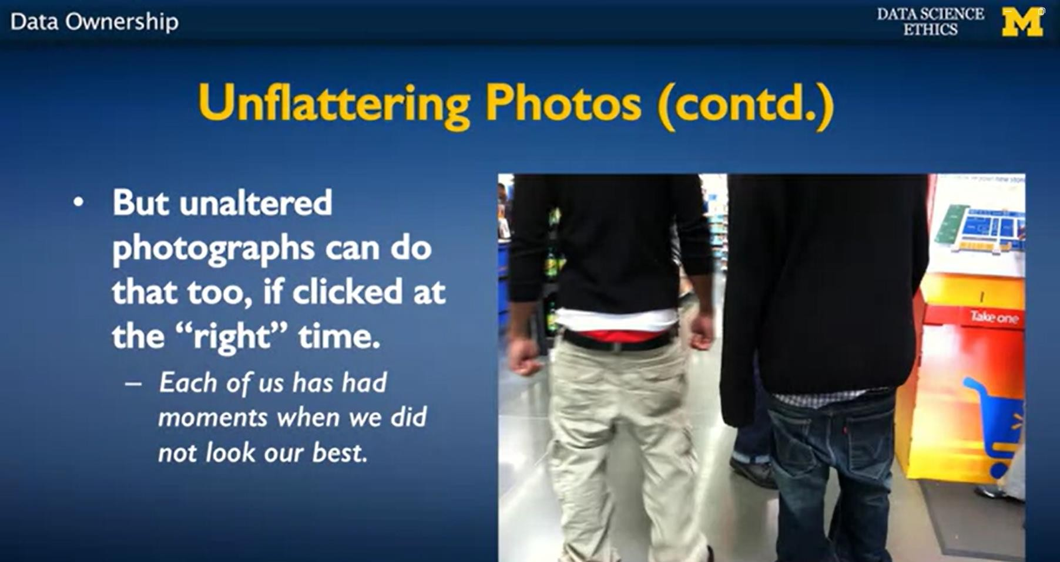
You don't actually have to alter an image. We all have moments where we didn't look our best. And if somebody just happens to capture such a moment and then makes it public, this is something that we might feel very embarrassed about.

Slide 9
So, we have an issue of possibly creating an environment where our careers and reputations are hurt because somebody took a picture of an unflattering moment and used that to characterize who we are.

Slide 10
When one thinks about data ownership ..
the history of what one does with things like books and photographs are things that might help.
I can record things about you, and if I've recorded things about you, I can do whatever I want to with it.
There might be some reasonable limits on the kinds of things that I can record about you and the kinds of things I can do with it, but my records are my records.

Slide 11
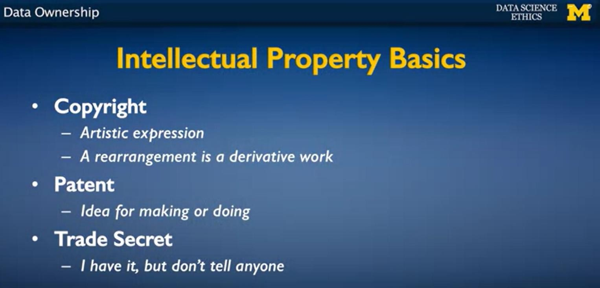
To try to understand how this would work, in terms of intellectual property, the way that our society thinks about them. There are three main types of intellectual property. The thing that we've been talking about is copyright. Copyright is something where we own a particular artistic expression

Slide 12
If you take my copyrighted work and then you rearrange it, let's say you take my book and you translate it, then the translation is a derivative work.
It's not completely original because you didn't write it from scratch but it's not the same as what I wrote either.
You've applied your own creativity and you've put in your own effort in creating that translation.

Slide 13
What happens with derivative works is a more complex rule with regard to how copyright works.
You can create derivative works only with the permission of the owner of the original work.
But then, once that permission is there, you can do what you want to. The derivative work is yours.

Slide 14
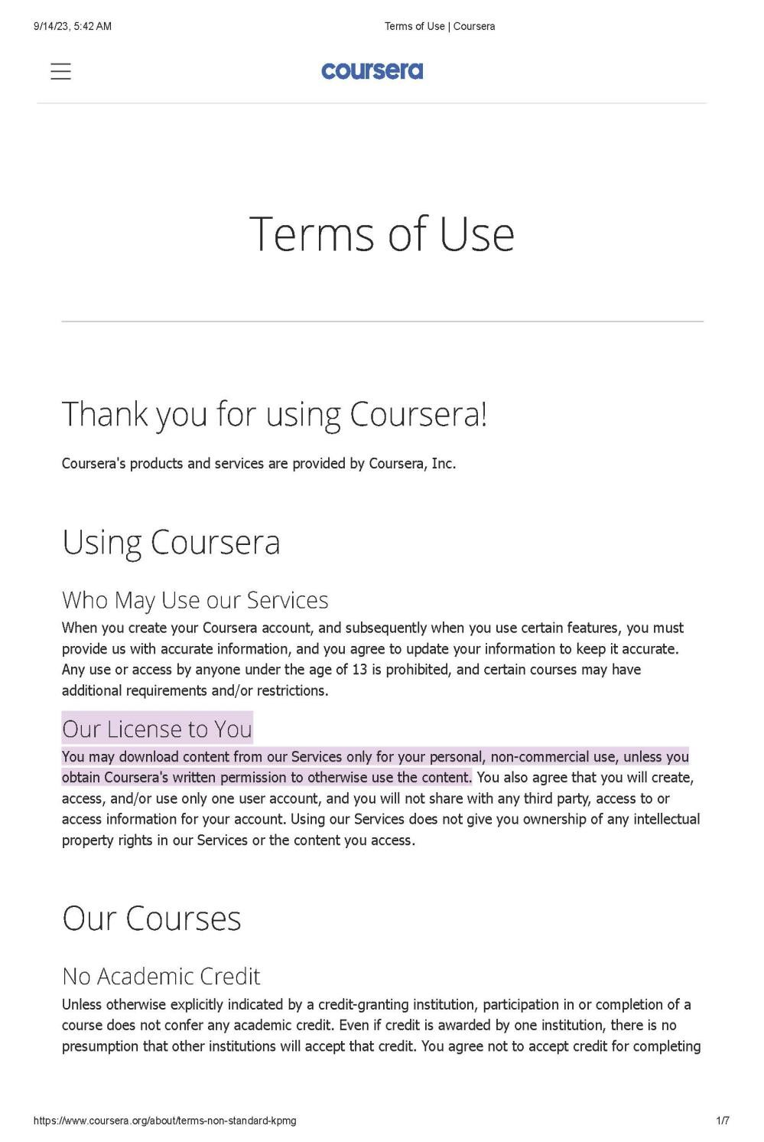
Our License to You
You may download content from our Services only for your personal, non-commercial use, unless you obtain Coursera's written permission to otherwise use the content.
14

