Slide 1


Data Science Ethics
College of Health and Medical
Techniques
Al-Mustaqbal
University
Stage 2 , Semester 1
@ Department of Intelligent Medical Systems
Prepared by Dr. Samir Badrawi
History, Concept of Informed Consent
The majority of this course material is based on Coursera https://www.coursera.org/learn/data-science-ethics
“H.V. Jagadish lectures”, a Professor at the University of Michigan
1

Slide 2
Human Subjects Research and Informed Consent:
1.
Part 1
The reason that ethics matter in data science is usually because there is impact on humans of whatever things we're doing when we practice data science.
To understand how people have thought about this, in this module, we're going to look at human subject’s research and the concept of informed consent.
Let's begin by talking about what human subjects research means.
2

Slide 3
Cont.
There is an infamous study conducted at Tuskegee University and funded by the Centers for Disease Control, where the idea was to try to understand the development of untreated syphilis.
In 1932, syphilis didn't have good treatments. And so understanding the kind of debilitation it caused was possibly a reasonable thing to do from a medical investigation point of view.

Slide 4
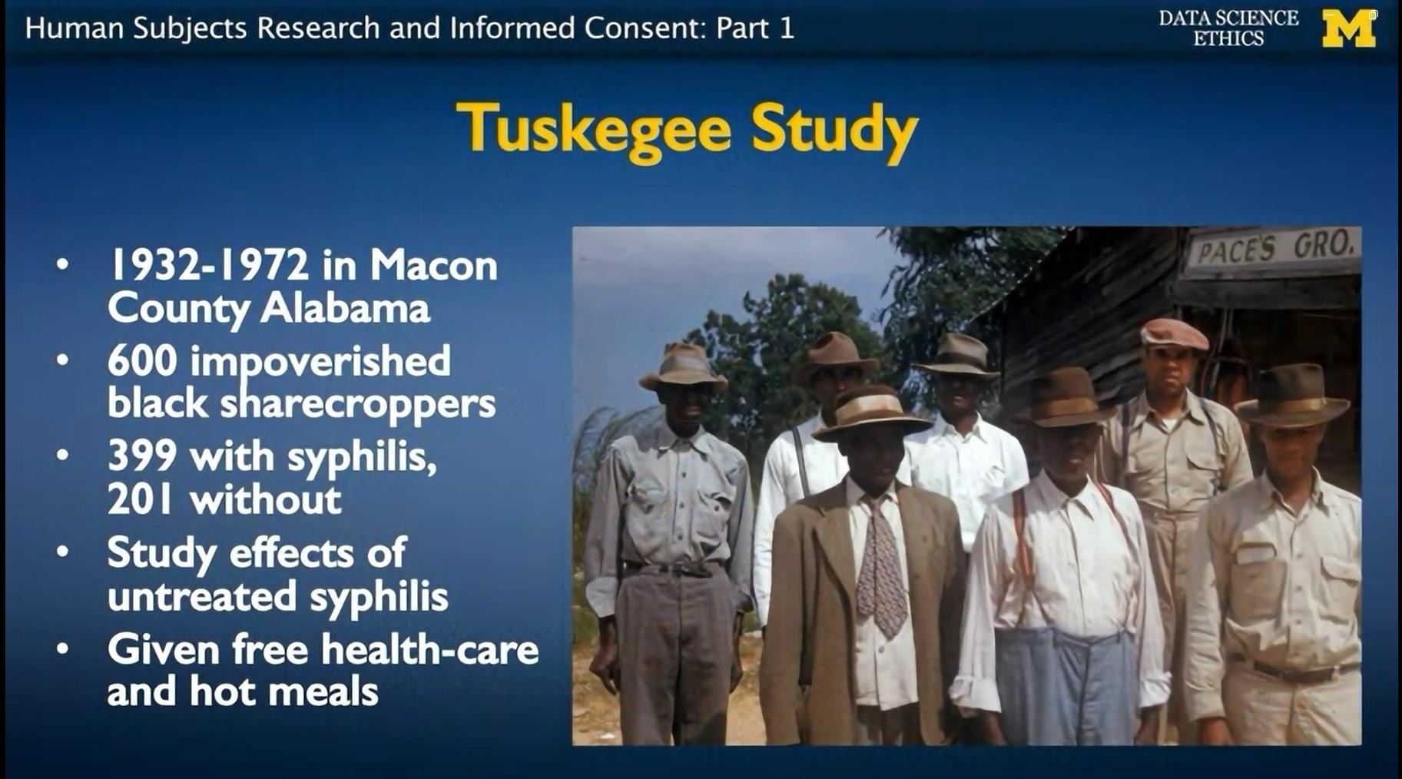
Cont.
To be able to conduct the study the study organizers recruited 600 black sharecroppers in Alabama and setup a fairly conventional looking study.

Slide 5
Cont.
There were 399 participants who had syphilis, 201 who didn't. And what the participants were required to do was to show up at the clinic on a regular basis where they'd be given a health exam, they would be given health care.
They'd get hot meals, and so they participated.

Slide 6
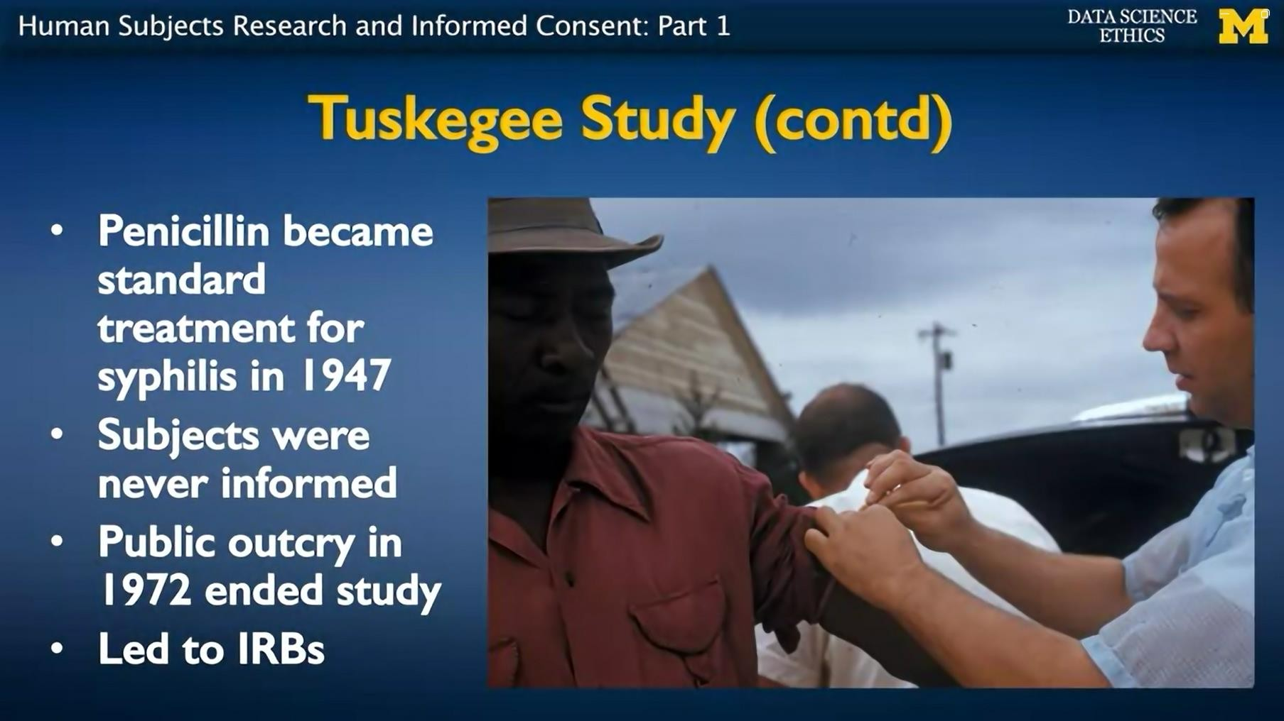
Cont.
Now these visits, they could also have things like blood drives, and these things like the blood specimens would then get analyzed as part of the study.

Slide 7
Cont.
The problem is, antibiotics were invented. Penicillin became the standard treatment for syphilis by 1947, but
nobody ever bothered to tell the subjects of the study,
nobody treated the subjects of the study with penicillin,
and the study just went on, and on, and on! .
Until in 1972 there was a public outcry driven by some whistleblowers.

Slide 8
Cont.
And there was a general strong feeling at that point that whatever medical value the study may have had, the harm that was being done, in terms of having several hundred poor people not being treated for syphilis when treatment was available, was just not an acceptable thing to do.
The result is the creation of what is called an IRB. Which we'll talk about in a minute. The thing that these IRBs, these review boards will monitor is a process called informed consent.

Slide 9
Cont.
informed consent
if any research is conducted on a human subject, then this human subject:
must be informed about the experiment,
must consent to the experiment voluntarily without any coercion, and
- must have the right to withdraw consent at any time.
So, even if they agreed to participate in the experiment and serve as a subject, if after a while they change their mind and they wish to drop out, they should have the right to do so.

Slide 10
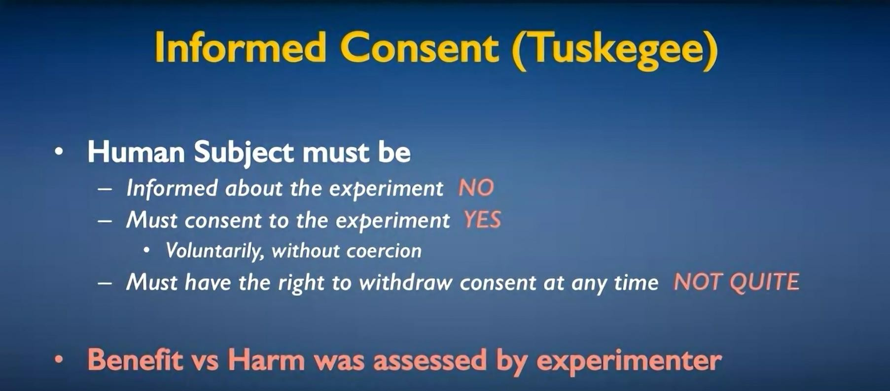
Cont.
informed consent principals :-

Slide 11
Cont.
These principles of informed consent were not met
at Tuskegee because the subjects were not informed about the experiment.
They were misinformed, they were not told about possible treatments.
They were not told that their syphilis would not be treated.
And with this incorrect information, they did voluntarily consent to the experiment.
And maybe they had a right to withdraw consent at any time but it's not clear that anybody ever told
them that they had that right.
11

Slide 12
Cont.
The big issue here is that the experimenter was assessing the benefit versus the harm.
And usually in these sorts of situations, the harm is to the individual subject, and the benefit is to society or to science (i.e., the benefit is to one party and the harm is to another party)
The assessment is sometimes different than if the harm is to the same party as to the one that benefits.
12

Slide 13
Cont.
A key principle of informed consent is that:
the party that might potentially be harmed (that is the human subject) is the one who has to decide that ((on balance as benefit to society and possibly the way that's reflected in terms of payments or free food or whatever it is that the human subjects were getting)) was worth it in terms of the risk to them.
Since the full details of the benefits and harm are difficult for the human subject to be fully informed
about, there is this notion of an Institutional
13
Review Board, or an IRB.

Slide 14
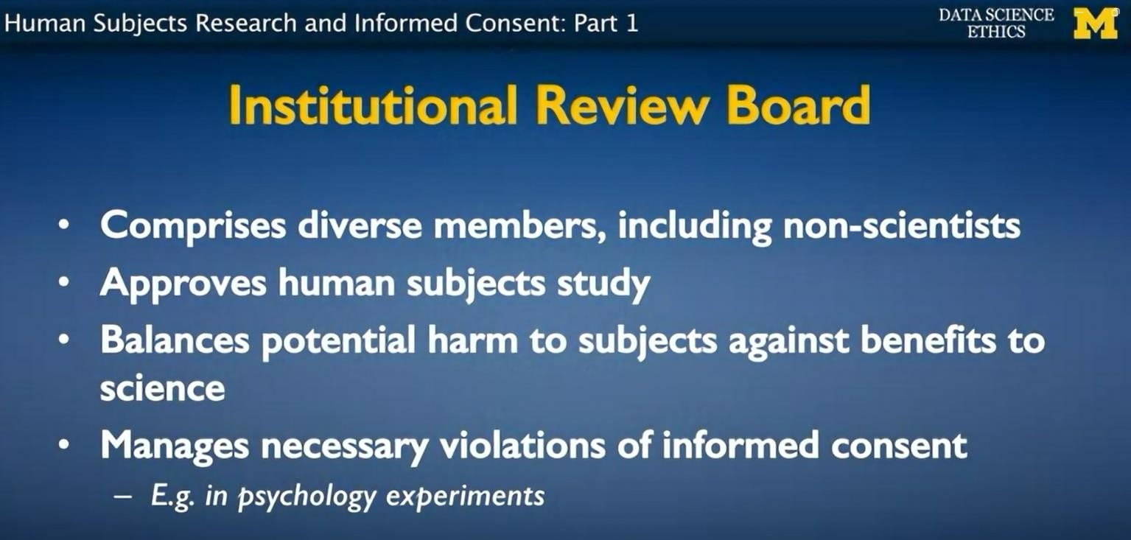
Cont.
And what this IRB is supposed to do is:
look at the human subject study.
Try to weigh the harm versus the benefits.
Make sure that the informed consent principles are appropriately followed.

Slide 15
Cont.
And this board has a diversity of membership including non-scientists.
It's supposed to include some scientists who can make a pitch for what the science value is, but also non-scientists would represent society in broad terms.
The institution review board has to approve the study. And in particular, they approve the informed consent that the human subjects will actually sign before they can participate in the study.

