Slide 1
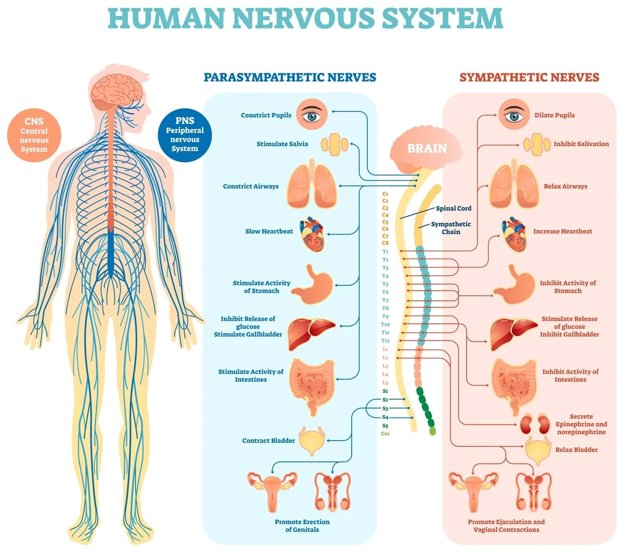

Slide 2
Central nervous system
Brain
  Cerebrum
  Brain stem
  Diencephalon
  Cerebellum
Spinal cord

Slide 3
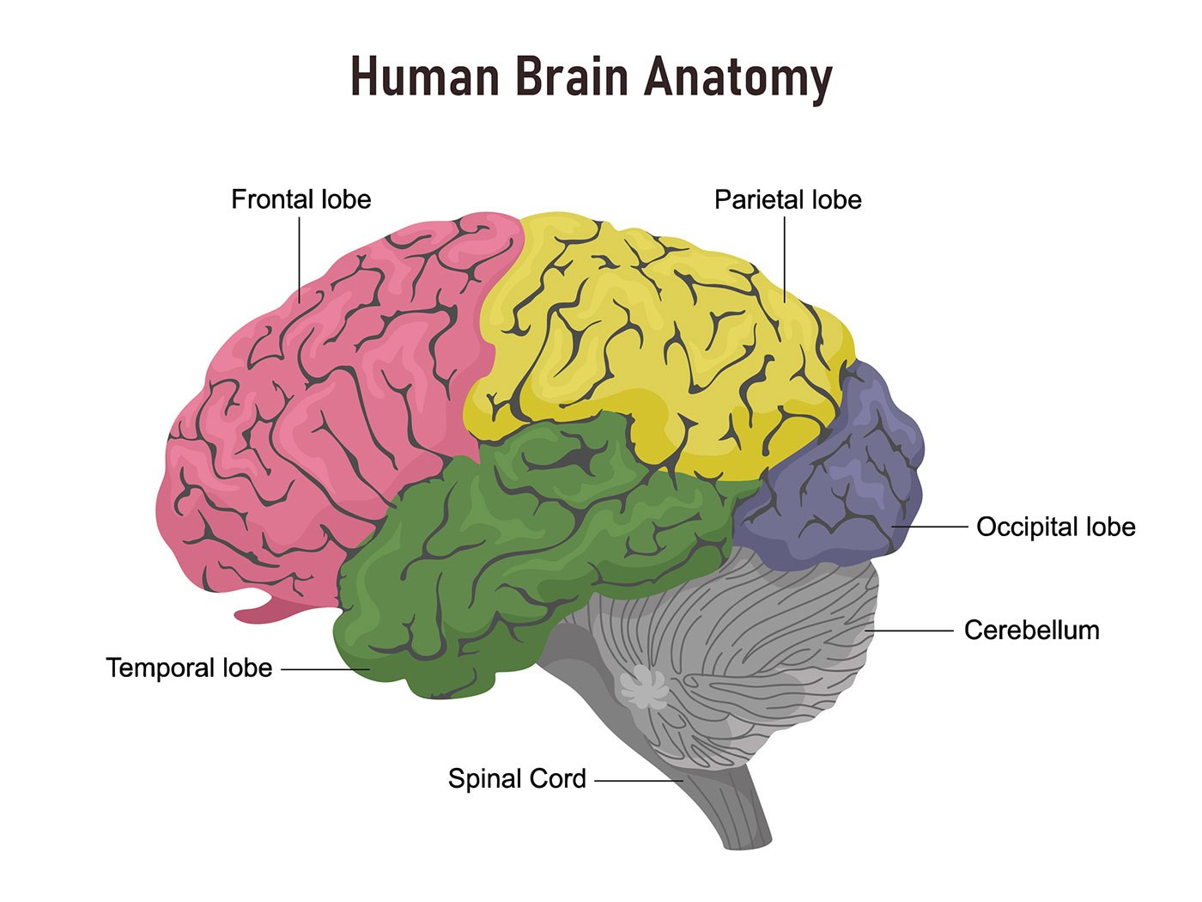
Cerebrum

Slide 4
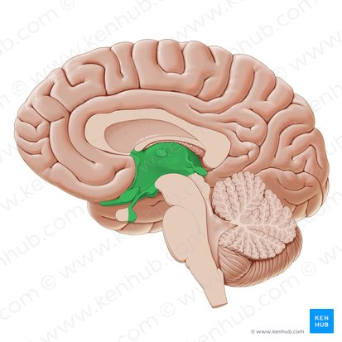
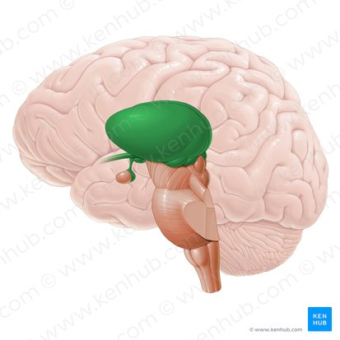
Diencephalon

Slide 5
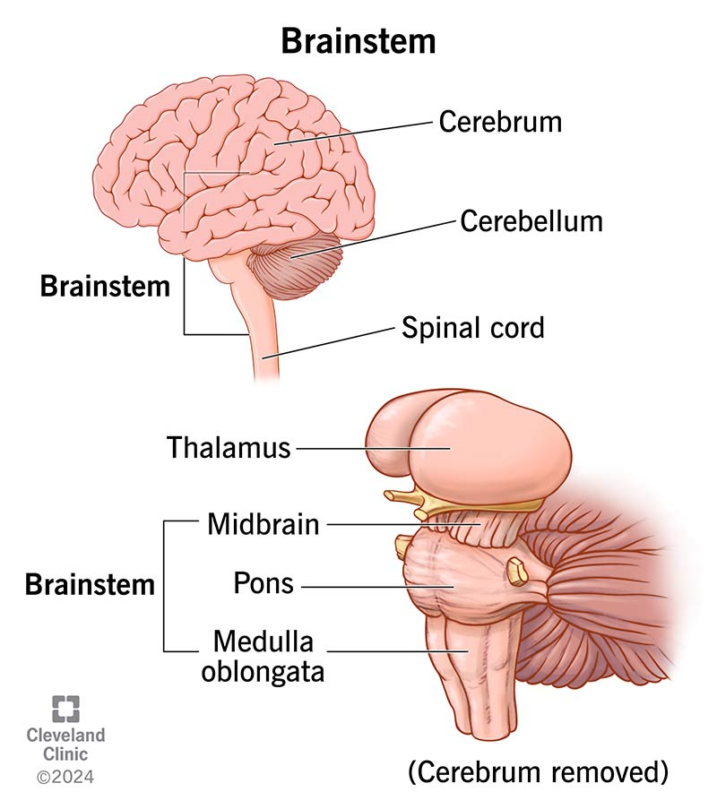

Slide 6
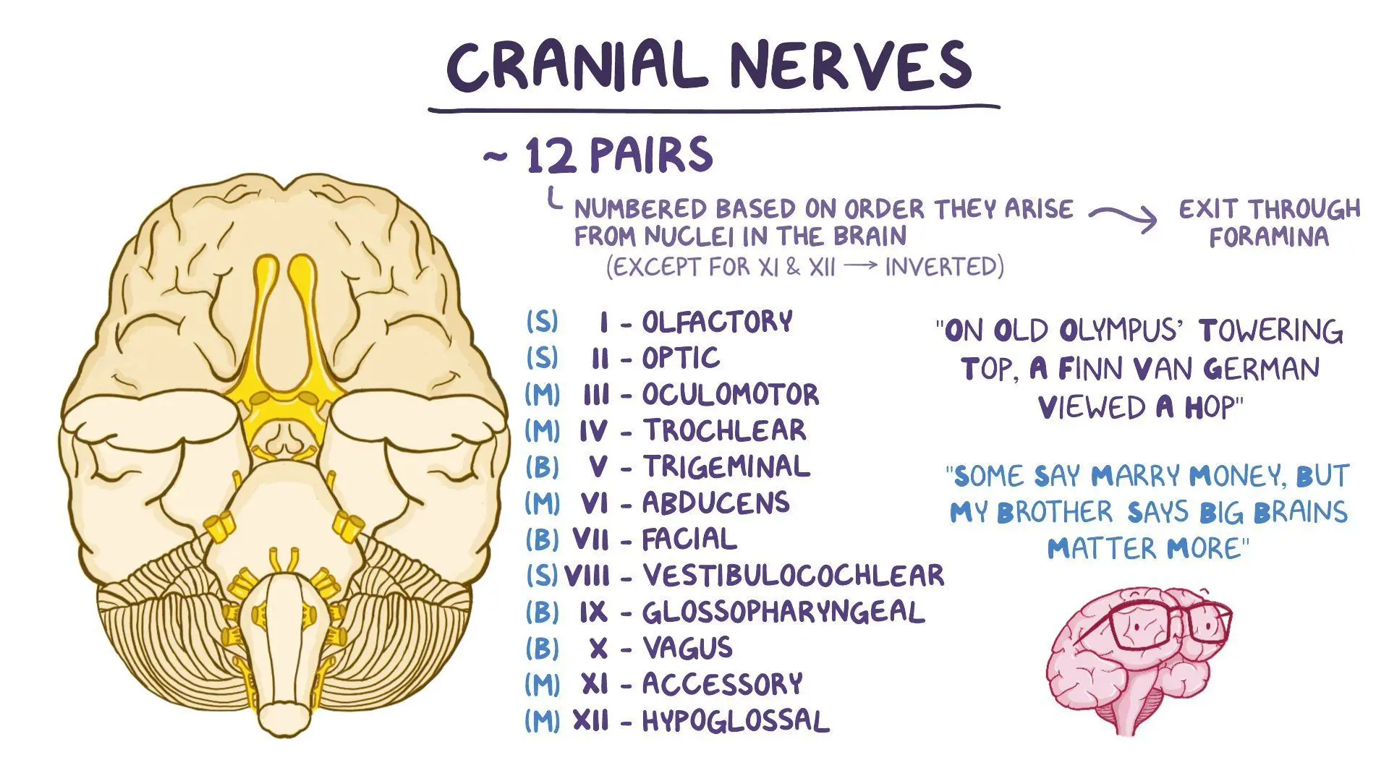

Slide 7
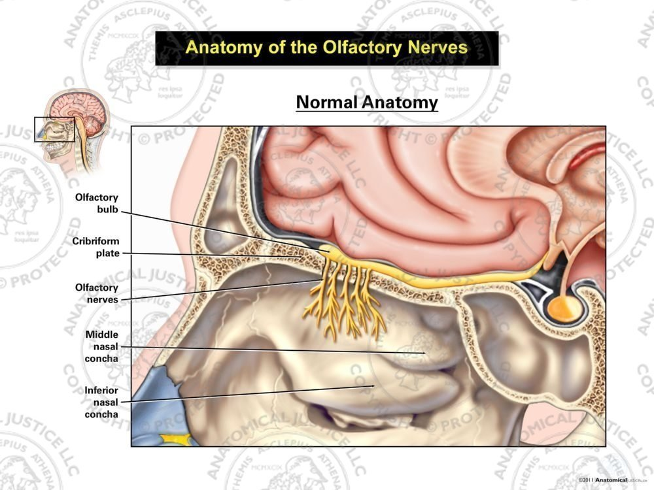

Slide 8
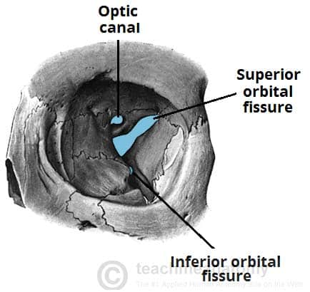
Optic canal :
Contain the second cranial nerve ( optic nerve)
Superior orbital fissure :
Contain the third, forth and sixth cranial nerves (oculomotor, trochlear and abducens)

Slide 9
