Slide 1
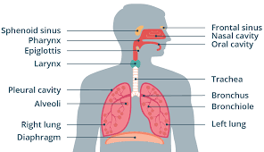
Respiratory system

Slide 2
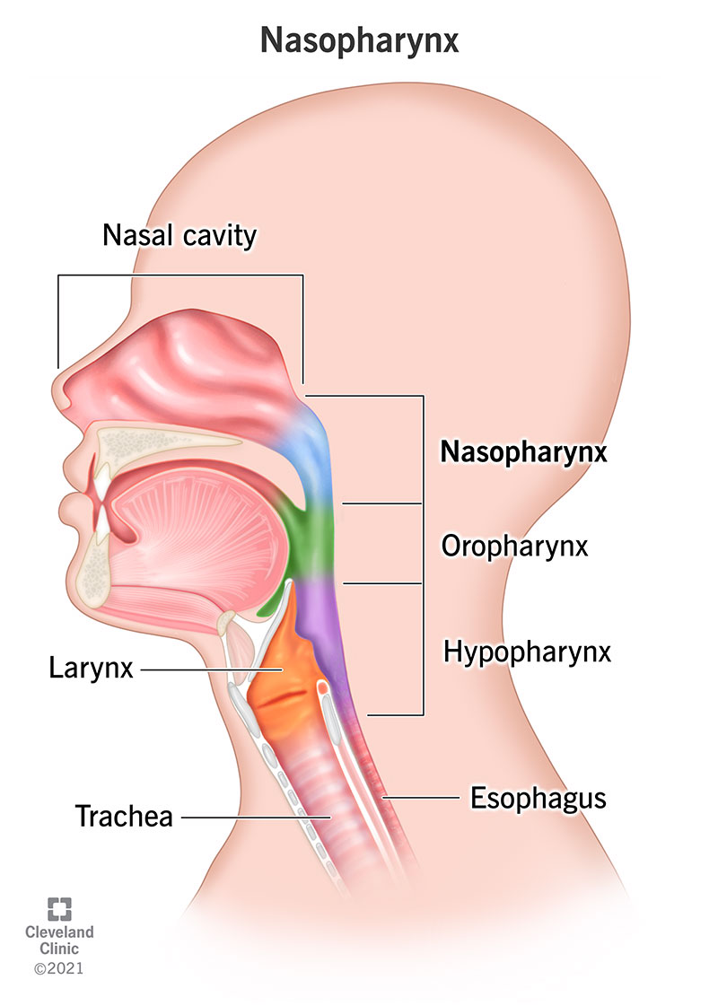
The main job of the nasal cavity is to warm, humidify, and filter (through the hairs and mucus) air before it enters the body. The oral cavity, or mouth, is the first step of the digestive system but can be used as a secondary source to bring air into the body.

Slide 3
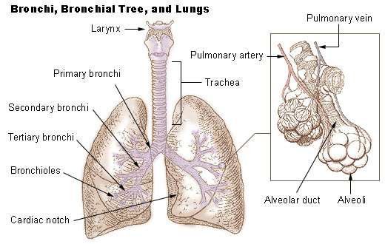

Slide 4
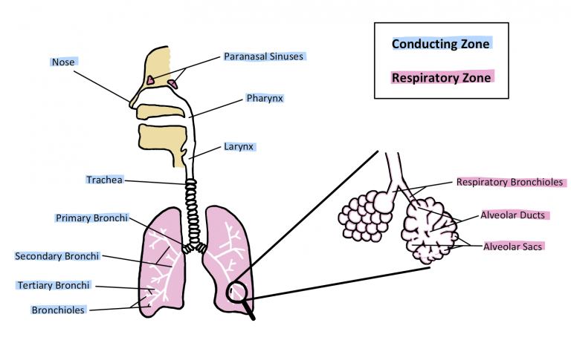

Slide 5
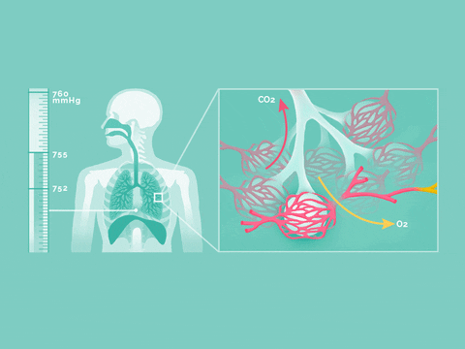

Slide 6
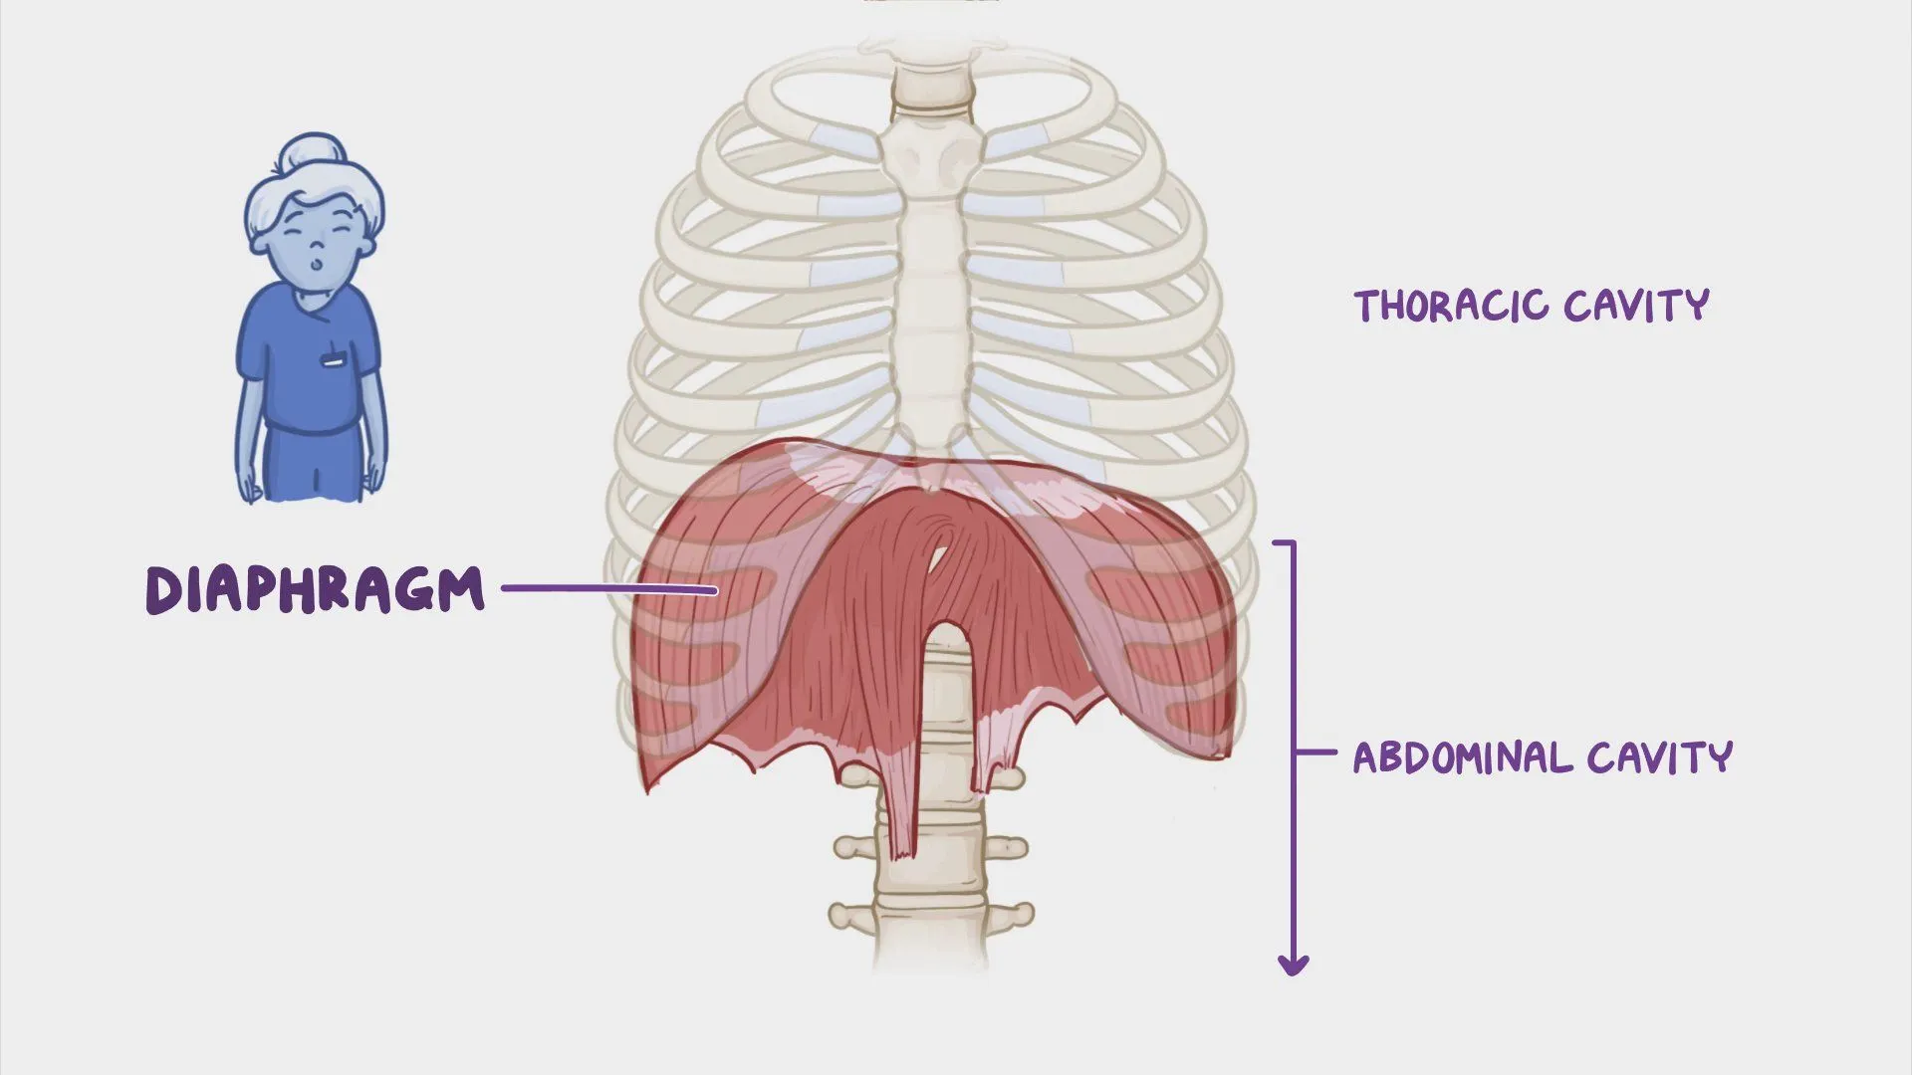
Diaphragm

Slide 7
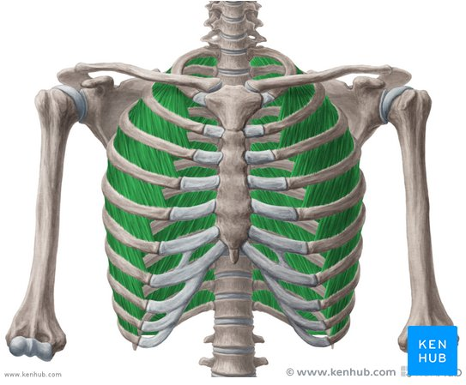
Intercostal muscles

