Slide 1

كلية العلوم
قــســــــــــم الانـــظــــمــــة الــــطـبـيـة الـــذكــــــيـــة
Intelligent Medical Systems Department
Subject: English Language
Class: Second
Lecturer: MSC. Sakina Hussain Alsuwaydi
Lecture: ( 8)
(Practical Applications)
Study Year: 2024-2025

Slide 2
Daily Routines:
Conversation 1:
A: What do you do every day?
B: I wake up at 7 AM, have breakfast, and go to work. What about you?
A: I wake up at 6 AM and go for a run. Do you exercise?
B: No, I don’t. I prefer reading in the morning.
… Complete …

Slide 3
Conversation 2:
A: What do you do every day?
B: I wake up at 7 AM, have breakfast, and go to work. What about you?
A: I wake up at 6 AM and go for a run.
Conversation 3 (Prepositions Focus):
A: Where is your book?
B: It’s on the table, next to my bag.
A: And where is your pen?
B: It’s inside my pencil case.

Slide 5
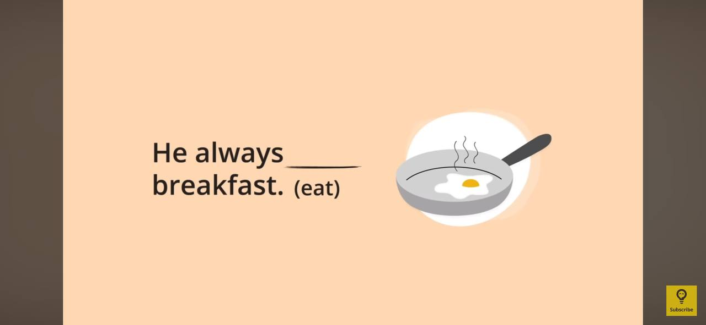
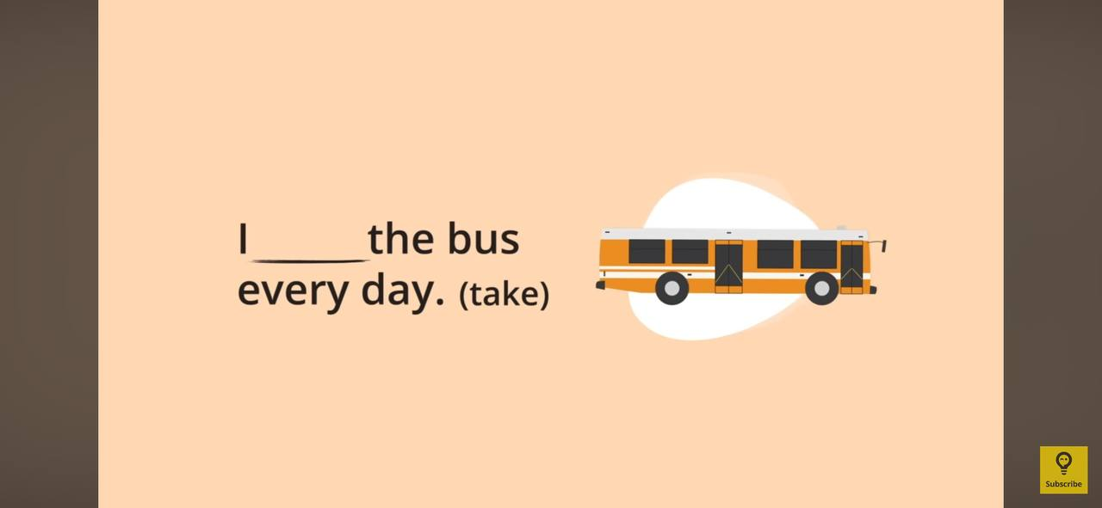

Slide 6
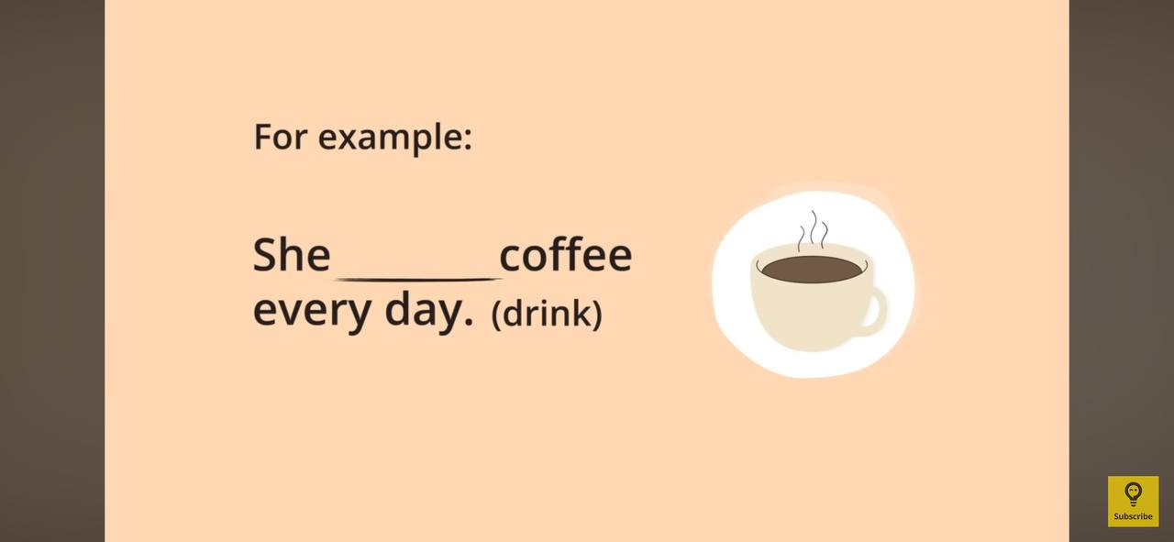
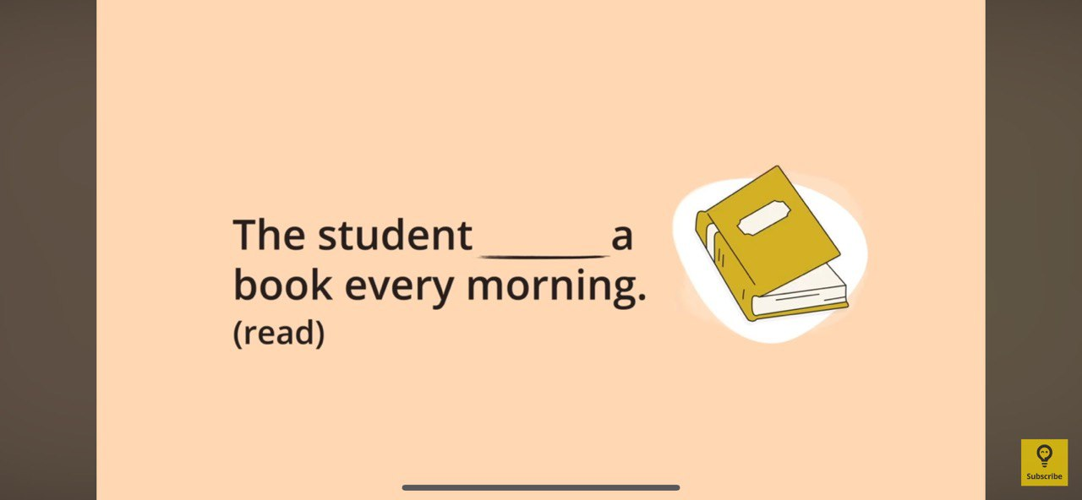

Slide 7
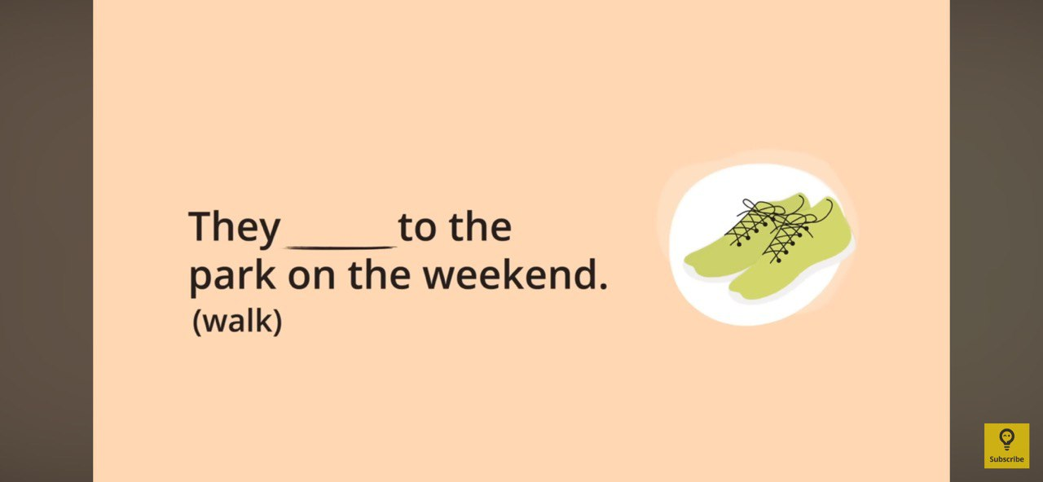
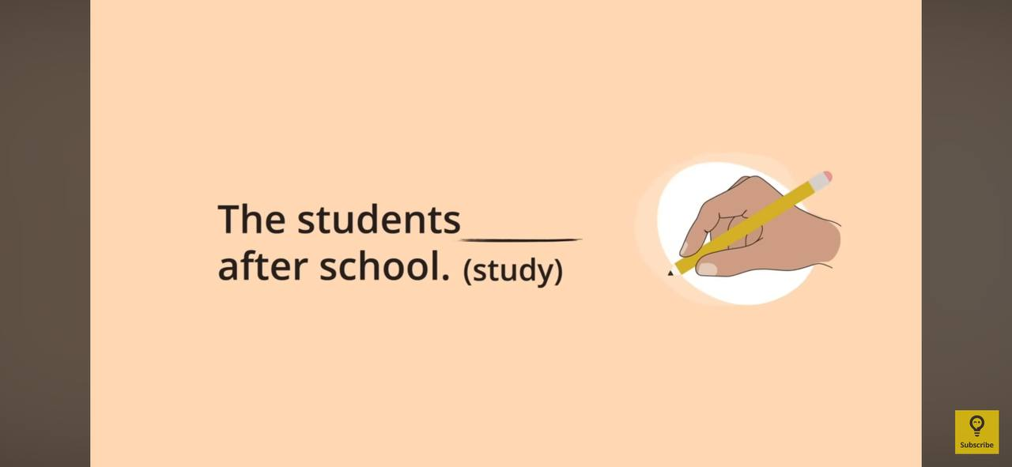

Slide 8
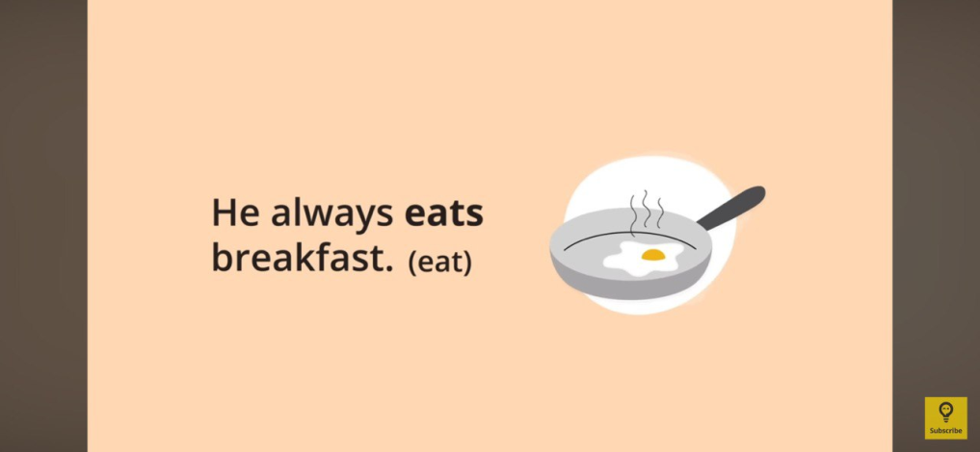
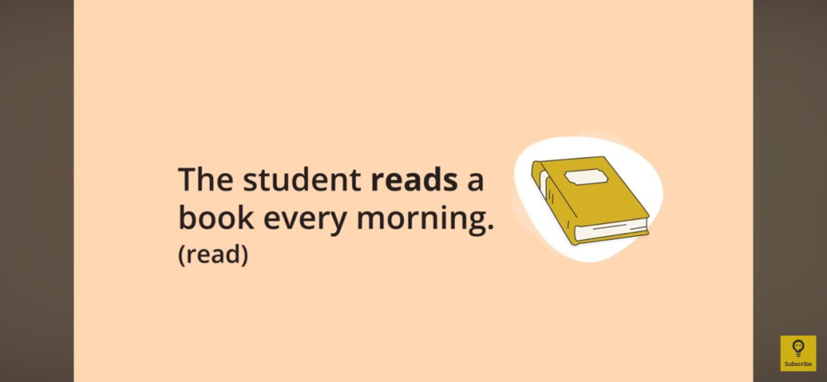
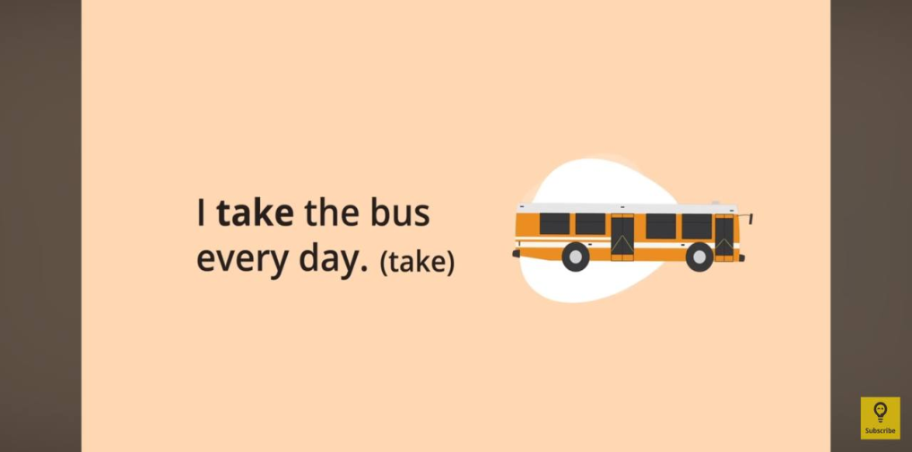
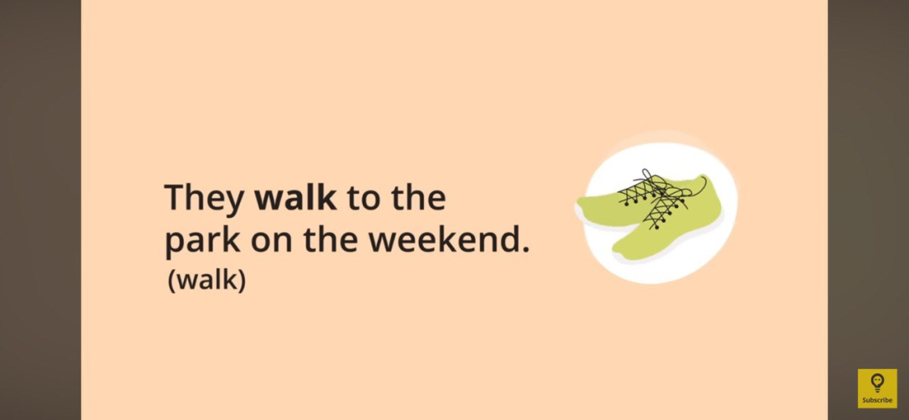
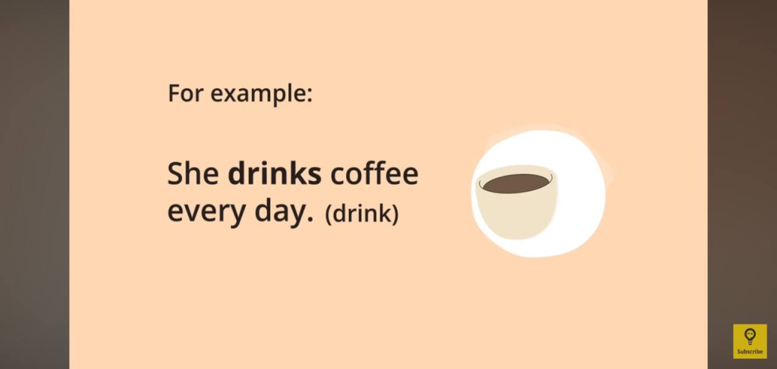
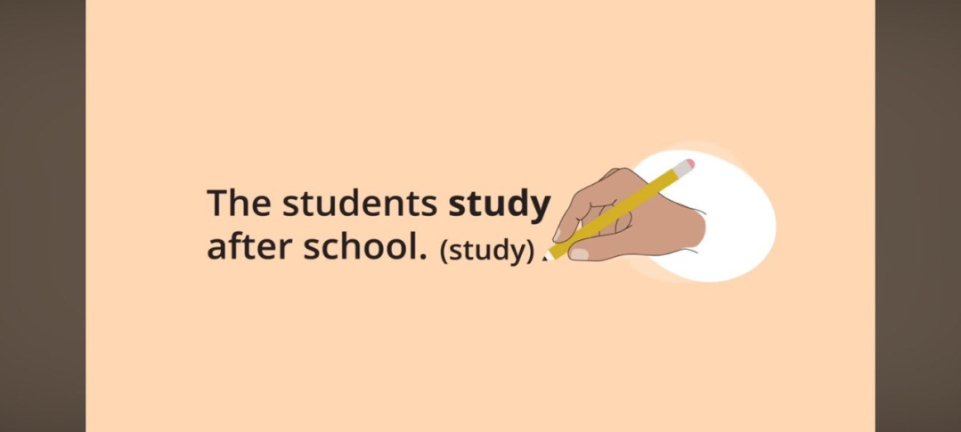

Slide 9
Where is it? (Prepositions Focus)
4. Example dialogue:
A: Where is your book?
B: It’s on the table, next to my bag.
A: And where is your pen?
B: It’s inside my pencil case.

Slide 10


Slide 11
-The watch is next to the board.
-The board is on the wall.
-The books is on the floating shelf.
-The bookshelf is under the floating shelf.
-The chairs are next to each other.

Slide 12
The book is in the table. → Correction: The book is on the table.
She goes to school in bus. → Correction: She goes to school by bus.
I live at London. → Correction: I live in London.

Slide 13
Example statements:
“The sun rises in the west.” (False)
“A cat is usually smaller than a dog.” (True)
“The teacher’s desk is in front of the classroom.” (True)

Slide 14
Thank You

