Slide 1


Medical laboratories instruments
water bath
Dr. Ahmed Jamil Al- Taie
Laboratory: 6
First stage

Slide 2
The water bath
The water bath is an essential laboratory equipment used to heat the samples over a while at a constant temperature in research or clinical laboratories. The main distinguishing feature of the water bath is it uses water as media of heat transmission.
Types of water bath:
A shaking water bath in action
Circulating water baths

Slide 3
The parts of water bath
A. Mechanical part.
B. Electric part.
A. Mechanical part:
1. The Coat (cover).
2. Fiber glass.
3. The external form.
4. The container.
5. The shelves (mesh).

Slide 4
parts of water bath
B. Electric part:
1. The power supply.
2. The heater.
3. Thermostat.
4. Temperature indicator (thermometer).
5. Timer.
6. Fuses.
7. Control panel.

Slide 5
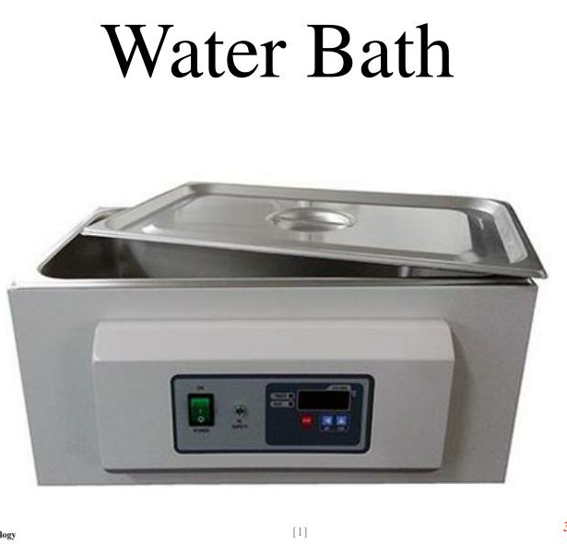
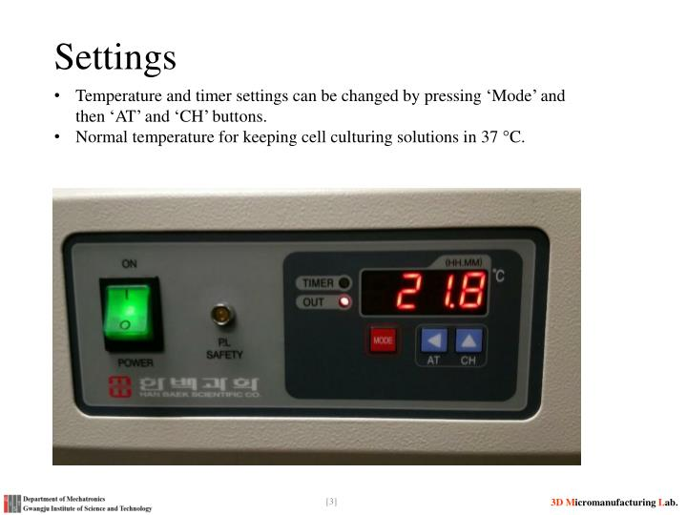
Water bath

Slide 6
parts of water bath
1. Power supply:
The used supply in dry sterilized bath is 220v — 50Hz the step down transformer
and rectifying circuit (AC to DC convert) to run the control panel if the parameters,
numeric or other departments in the modern fashion.
2. The Heater:
The electric heating system is the system in which heating produce

Slide 7
parts of water bath
3. Thermostat :
Is a sensor of heat connecting directly with heater and the separation of heater in certain degrees
4. Temperature indicator:
Tows way are used in temperature indicator there are thermometer (used to measure temperature of material)
5. Timer: There are two type of timer electrical or mechanical at range 5-60 min given period of time required for sterilization.

Slide 8
parts of water bath
6. Fuse: To protect the circuit from high current, high loads, short circuits..
7. Control panel: Contains several elements and the most important about
indicator power lamp usually green & indicator heater lamp usually red & contain switch on-off and timer & knob.

Slide 9
Operating the Water Bath:
Connect the power supply.
Ensure the water level in water bath is sufficient to pour the heating element.
Switch “ON” the main power supply and instrument mains.
For temperature settings, Press SET key to set the required temperature. press ↑ to increase the temperature and ↓ to reduce the temperature
The temp. Sensor will maintain the set temp. During use of water bath.
Switch “OFF” the instrument mains & main power supply after use.

Slide 10
Procedure for running water bath:
1- Open the lid and fill the container with water up to 3/4th height of the bath and close it.
2- Switch ‘ON’ the mains and also the instrument.
3- Red light and yellow light will glare on mains and heating, respectively.
4- Then set the temperature with the help of a temperature control knob and allow the temperature to rise to the pre-set value.

Slide 11
Procedure for running water bath:
5- Monitor the temperature with the help of a thermometer, and after obtaining
the required temperature, open the lid and place the sample in it over a
necessary period.
6- On completion, remove the sample and switch ‘OFF’ the main and
instrument.
7- Lastly, drain all the water from the container by the valve and dry the
instrument before closing the container with a lid.

Slide 12
Applications of water bath
1- It helps to improve the solubility of a poorly soluble substance.
2- It is the best choice for heat-flammable substances that might ignite under an open flame.
3- It is used for heating laboratory reagents.
4- The water bath is also used for melting substances.
5- It is used to heat the smear during acid-fast staining and spore staining.
6- It is also used for cell culture incubation for various purposes in laboratories

