Slide 1


Lecture (10 )
Lipids
Ministry of Higher Education and Scientific Research
Al- Mustabal University
College of Science
M.S.c Saja Jawad Obaid
Biochemistry

Slide 2
Definition of Lipids
Lipids are hydrophobic or amphipathic organic molecules, insoluble in water but soluble in nonpolar solvents.
Biological significance: Energy storage, membrane structure, insulation, signaling.

Slide 3
Classification of Lipids
- Fatty acids: Energy metabolism
- Triglycerides: Long-term energy storage
- Phospholipids: Membrane structure
- Steroids: Hormone synthesis
- Waxes: Protection

Slide 4
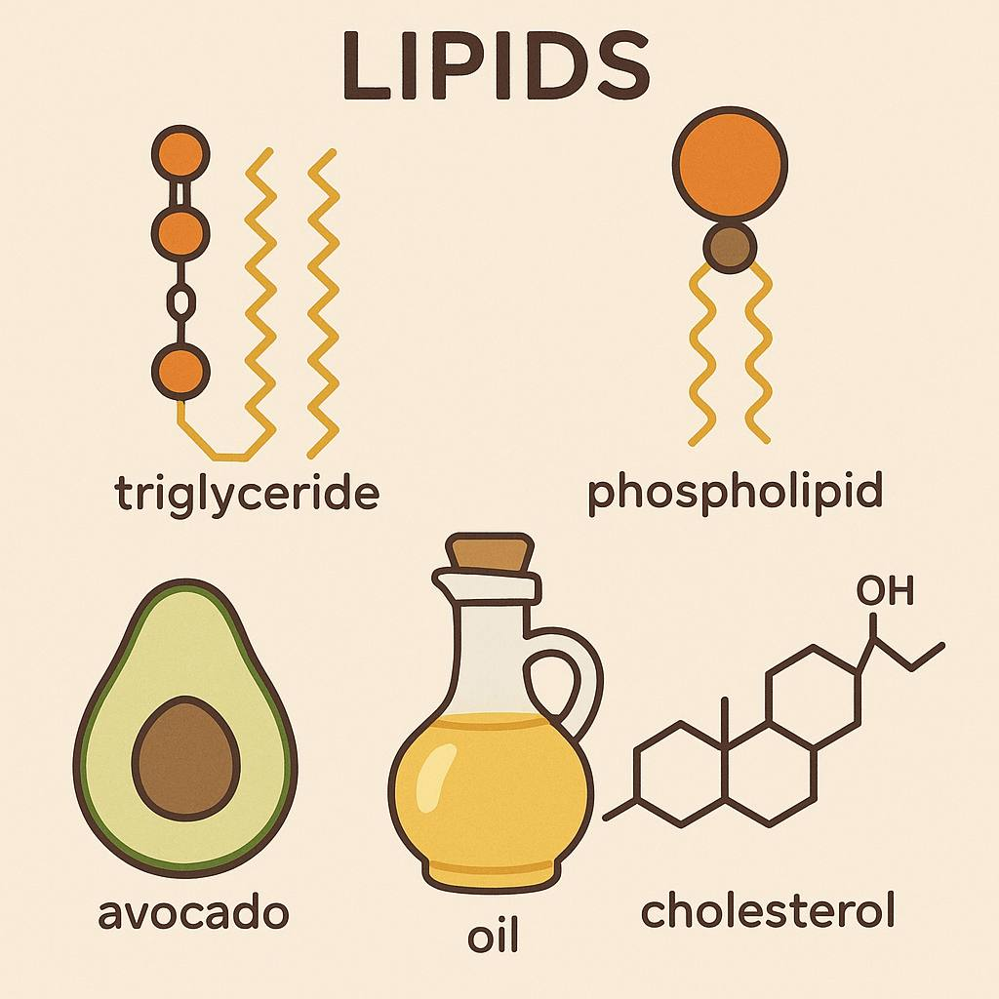

Slide 5
Fatty Acids
- Hydrocarbon chains with carboxylic acid
- Saturated: No double bonds
- Unsaturated: One or more double bonds
- Effect on melting point and membrane fluidity.

Slide 6
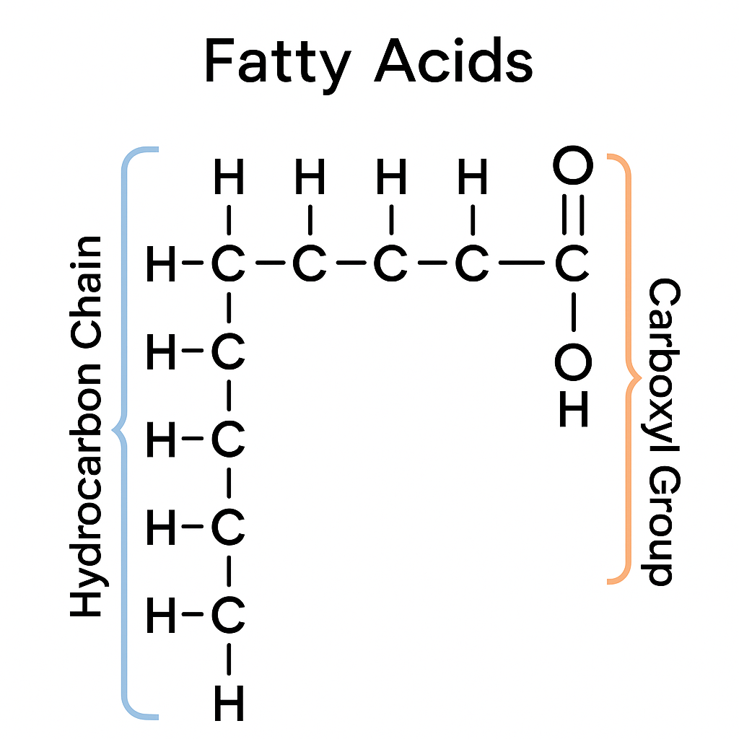

Slide 7
Triacylglycerols
- Glycerol esterified to three fatty acids
- Main energy storage in adipose tissue
- High ATP yield

Slide 8
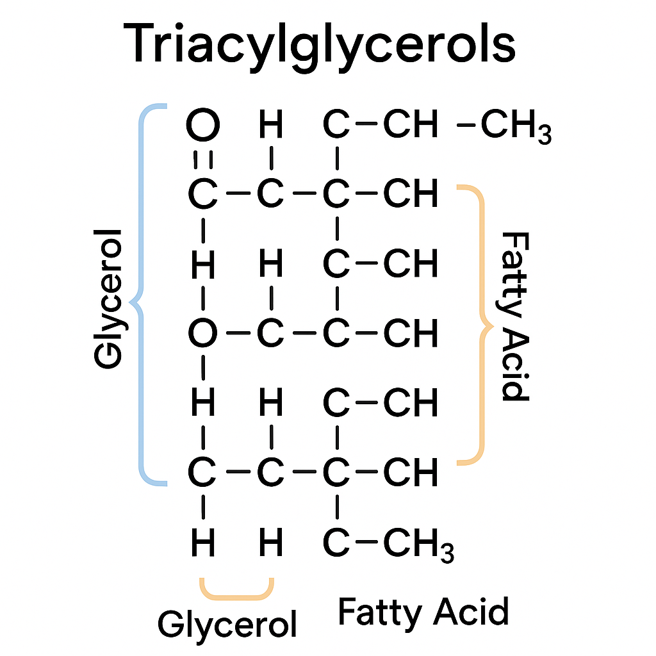

Slide 9
Phospholipids
- Amphipathic: Hydrophilic head, hydrophobic tails
- Form cell membrane bilayers

Slide 10
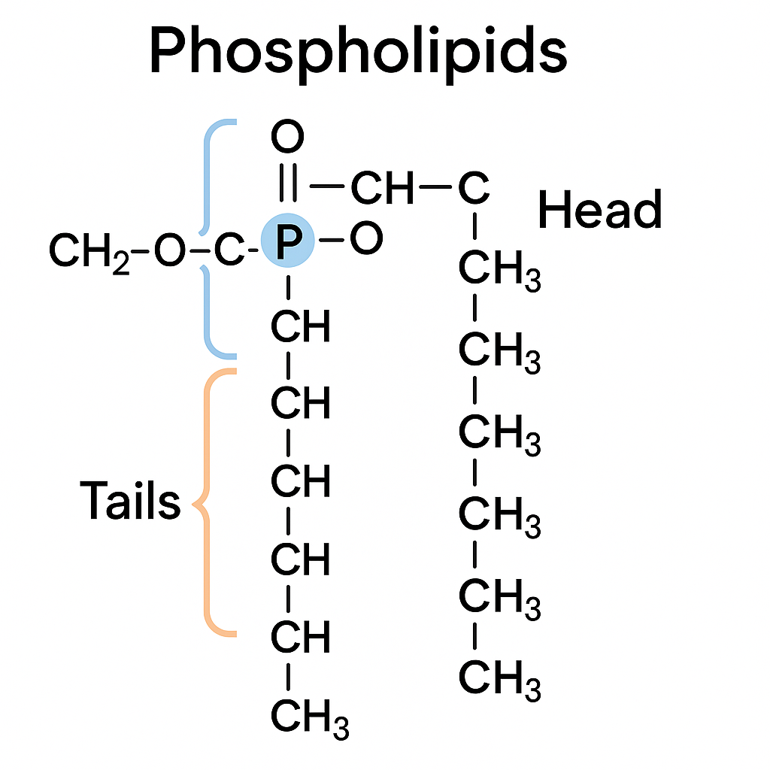

Slide 11
Steroids
- Four fused hydrocarbon rings
- Cholesterol: Membranes, hormones, vitamin D

Slide 12
Waxes
- Long-chain fatty acids + alcohols
- Waterproofing and protection in nature

Slide 13
Biological Functions of Lipids
- Energy storage, structural roles
- Insulation and protection
- Signaling molecules

Slide 14
Clinical Correlations
- Hyperlipidemia, lipid storage diseases (e.g., Tay-Sachs)
- Essential fatty acid deficiency

Slide 15
The End
Thank You

