Slide 1



Slide 2
Medical Terminology of the Nervous System
The nervous system is divided structurally into two parts:
▪ The central nervous system (CNS) is consisting of the of brain and spinal cord.
▪ The peripheral nervous system (PNS), consisting of all nervous tissues outside the brain and the spinal cord.(nerves and ganglia),31pairs of nerves
.(8Cervical,12Thoracic,5Lumber,5Sacral,1coccygeal)
Functionally, the nervous system can be divided into the:
▪ Somatic nervous system, which controls skeletal muscles
▪ Visceral or autonomic nervous system (ANS), which controls smooth
muscle, cardiac muscle, and glands. It regulates responses to stress and help to maintain hemostasis.
Two types of cells are found in the nervous system:
1- neuron (nerve cell) makeup the conductive tissue of nervous system
2-neurolagia cells (glial cells) support and protect nervous tissue
Galangia: groups of nerves cells bodies lying outside C.N.S

Slide 3
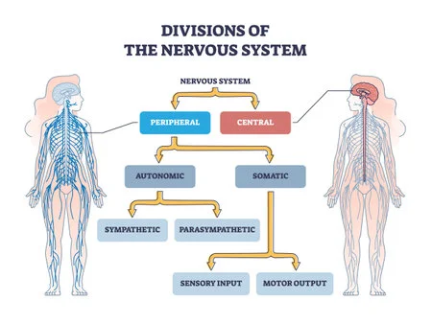

Slide 4
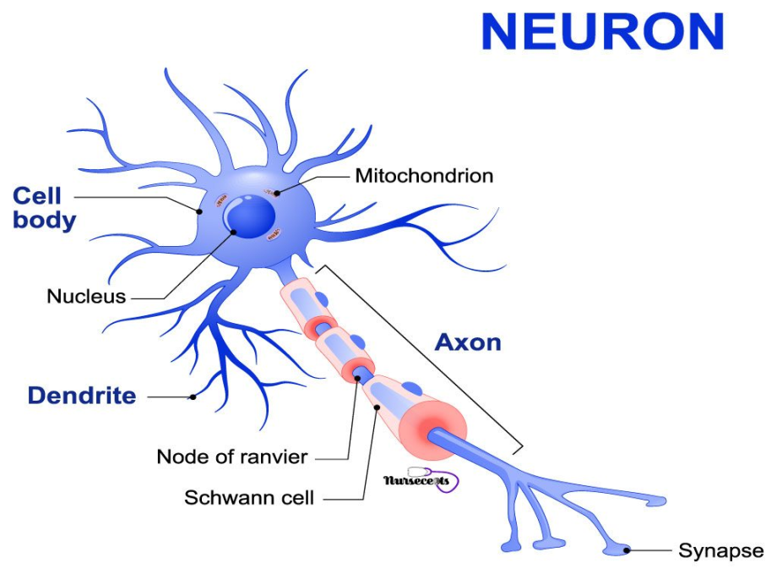
Neuron is composed of:
1- soma(cell body)
2-
3-Dendrites are short, thick processes which branch out of the soma in a tree like manor. They conduct nerve impulses to the soma.
synapse
contains the nucleus which acts as the cell's control center, these contain many small neurofibril s which project from the nucleus into the dendrites.
Axons are long nerve processes which carry nerve impulses from the Soma to other neurons, they vary in length.
A synapse is the point of contact between two neurons. At the
energy is passed from one cell to another, usually by means of neurotransmitter
and sometimes by direct transfer of electric current.
They are three types of neurons functionally:
1- Afferent (Sensory)Neuron: have the dendrites connected to receptors such as the eye ,ear ,ect. This transmit impulses toward C.N.S .

Slide 5
2-Efferent (Motor) Neurons have the dendrites connected to other neuron its axons are connected to effecters such as gland muscle cells .After excitation by nerve these react as( movement , contraction , secret , ect).So it transmit impulses away from C.N.S.
3- have both the dendrites and axons are connected to other neuron .Also are called connectors which are found through the body specially spinal and brain.
Gray matter: region in C.N.S contain many cell bodies and dendrites and its color may be due to blood content.it locates on the surface of the brain
White matter :region in C.N.S contain many axons and color due to Insulation by lipid rich substance called Myelin and this lipid appear white (fatty) material.
This matter protects the axon and speeds electric coeducation.it locates inside the
parts of brain.
.Sulcus :it is groove or depression or fissure specially on the surface of the brain.
Cyrus :Abridge on the cerebral cortex surrounds by one more sulci.
Schwanncells: That form the myelin sheath around the peripheral fibers.
Node of Ranvier : are gaps along myelin sheath that facilitate and speeds the transimmition.
interneurons

Slide 6
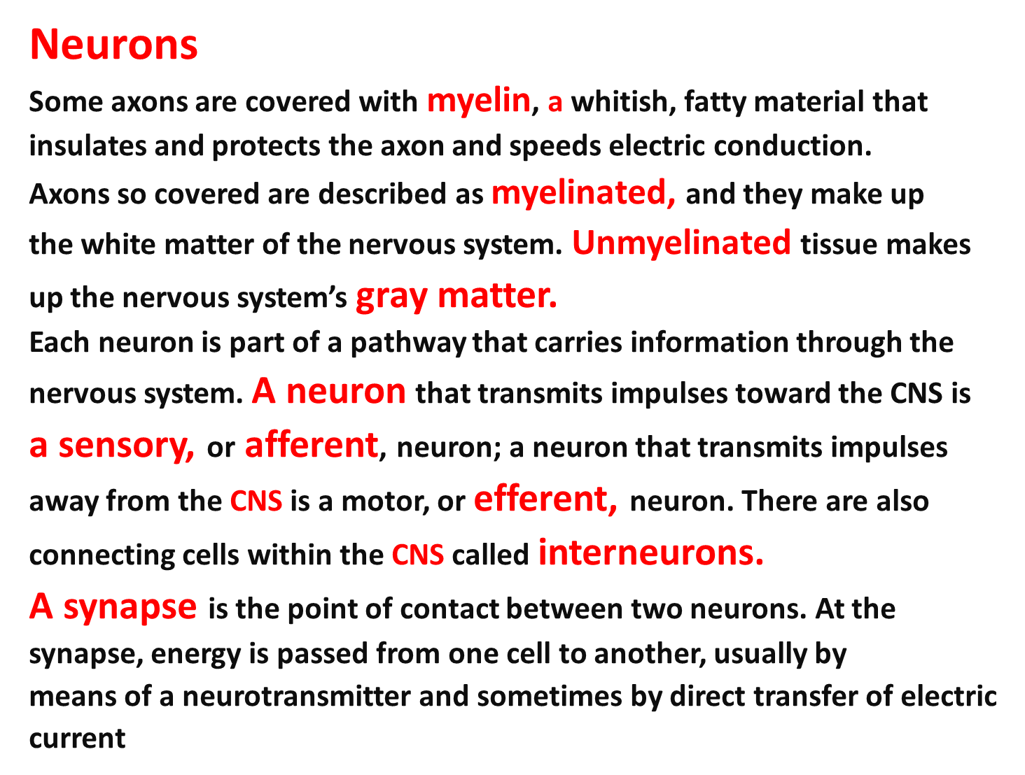

Slide 7
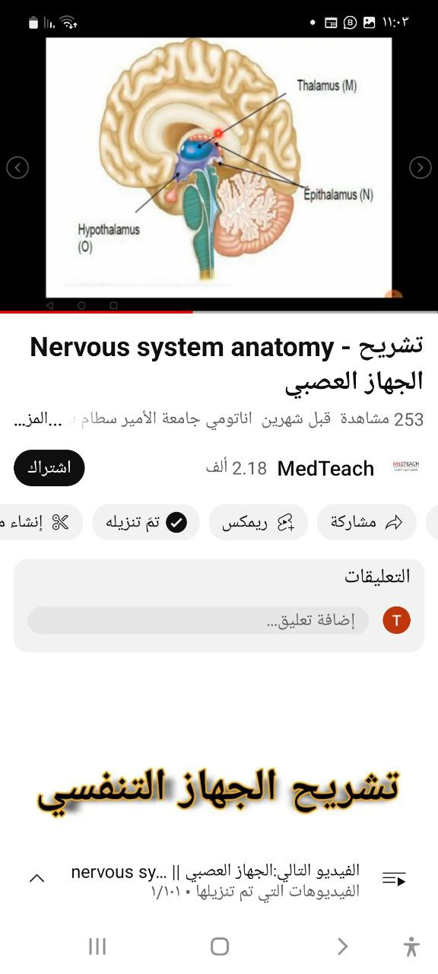
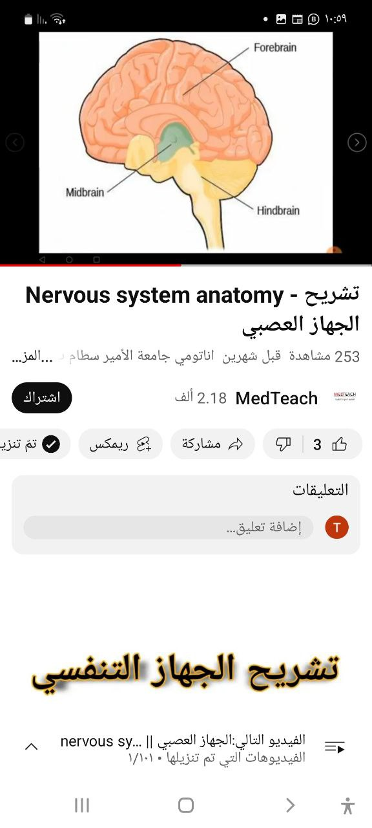
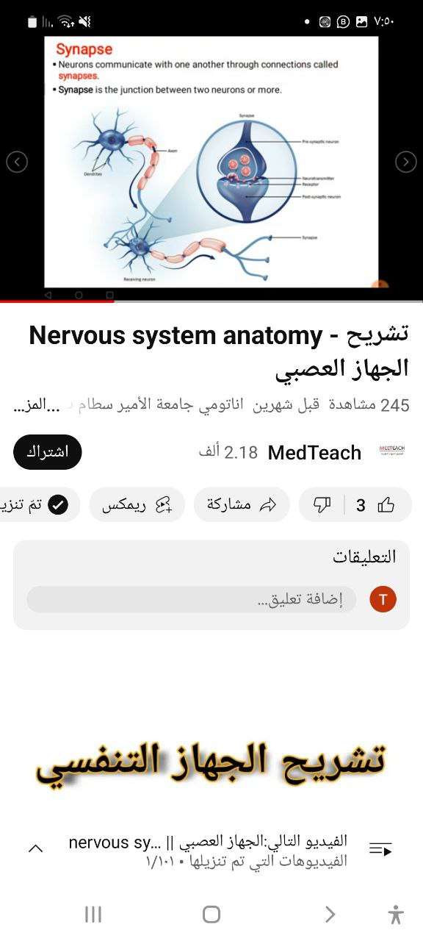
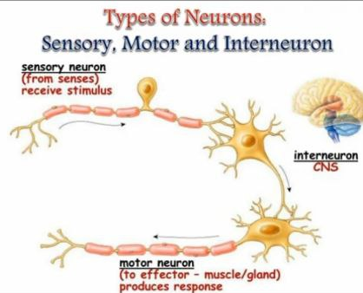

Slide 8
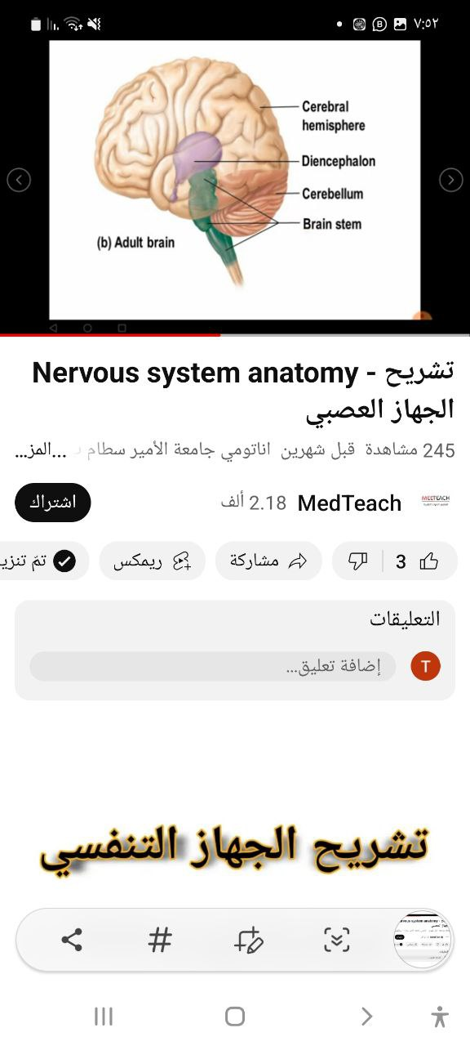
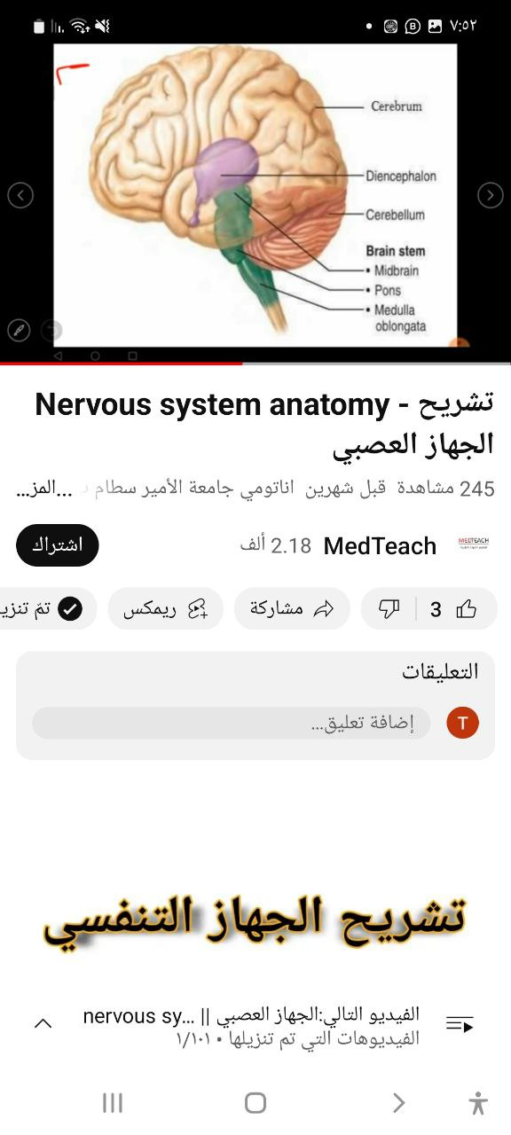
Major parts of the brain :its weight 1.3 kg
The brain consist of 4 parts: 75./. water
1-The cerebrum 2- The cerebellum
3- The diencephalon (Thalamus Hypo thalamus
Epithalamium ) 4-The brain stem (mid brain or,
Mesencephalon ,Pons and medulla oblongata).
          The cerebrum(Telencephalon)+
          Diencephalon =fore brain
          Mid brain =Mesencephalon
          Hind brain =Medulla oblongata + oblongata+Pons Pons + Cerebellum
          Cranial nerves: are 12 pairs from the from brain within cranium to
          organs of body

Slide 9

…..رمضان كريم
شكرا لكم

