Slide 1
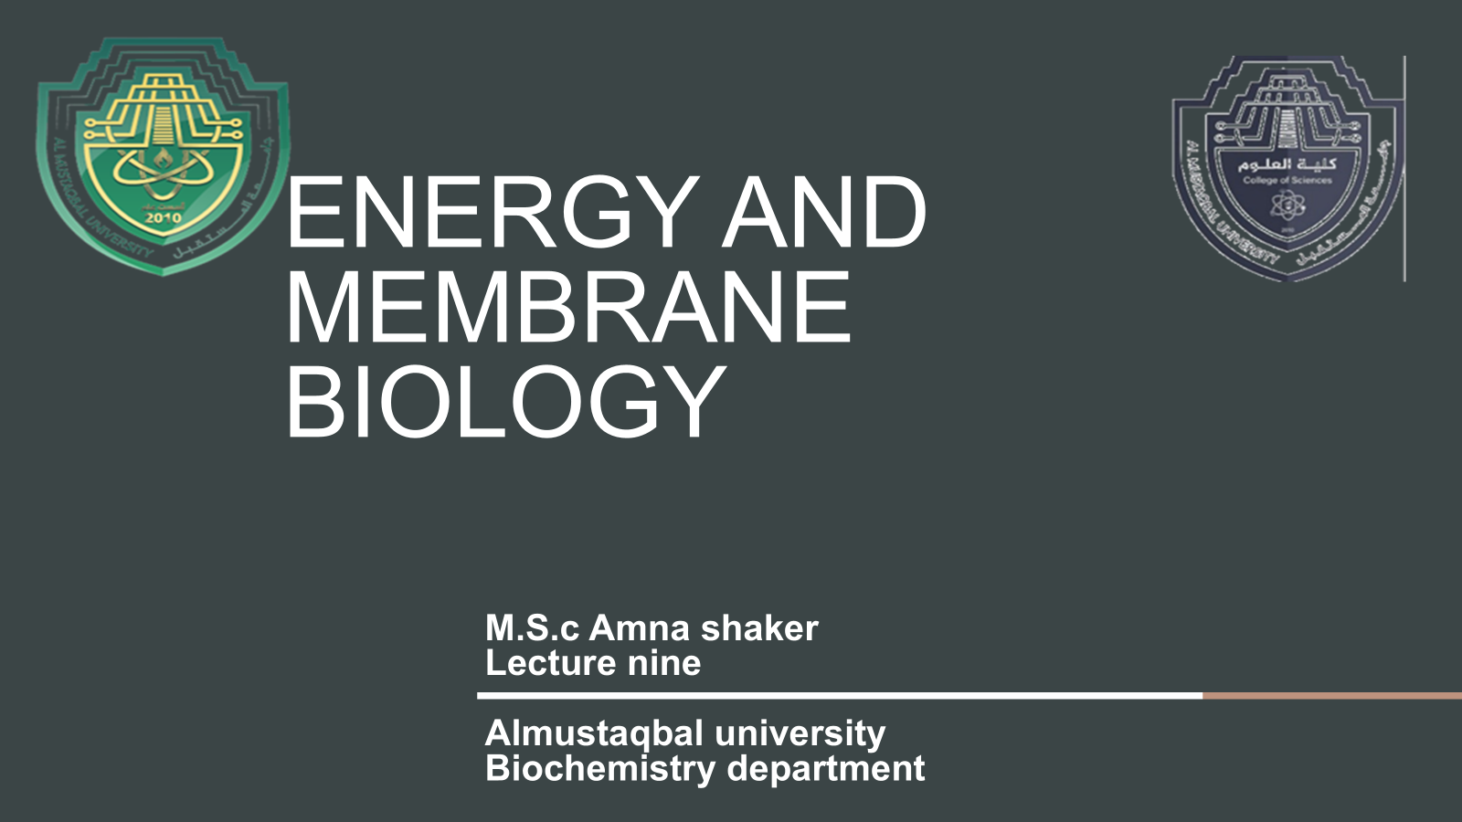

Slide 2
Membrane Trafficking and Vesicular Transport
Membrane trafficking meaning the wide variety of processes that go into the movement (typically proteins, pathogens and other macromolecules) using membrane bound transport vesicles.
This transport can take place?
within different organelles in the same cell
across the cell membrane from the extracellular environment. Much like a parcel sorting office, the cell uses a complex, highly regulated system to make sure that the right product is delivered to the correct location

Slide 3
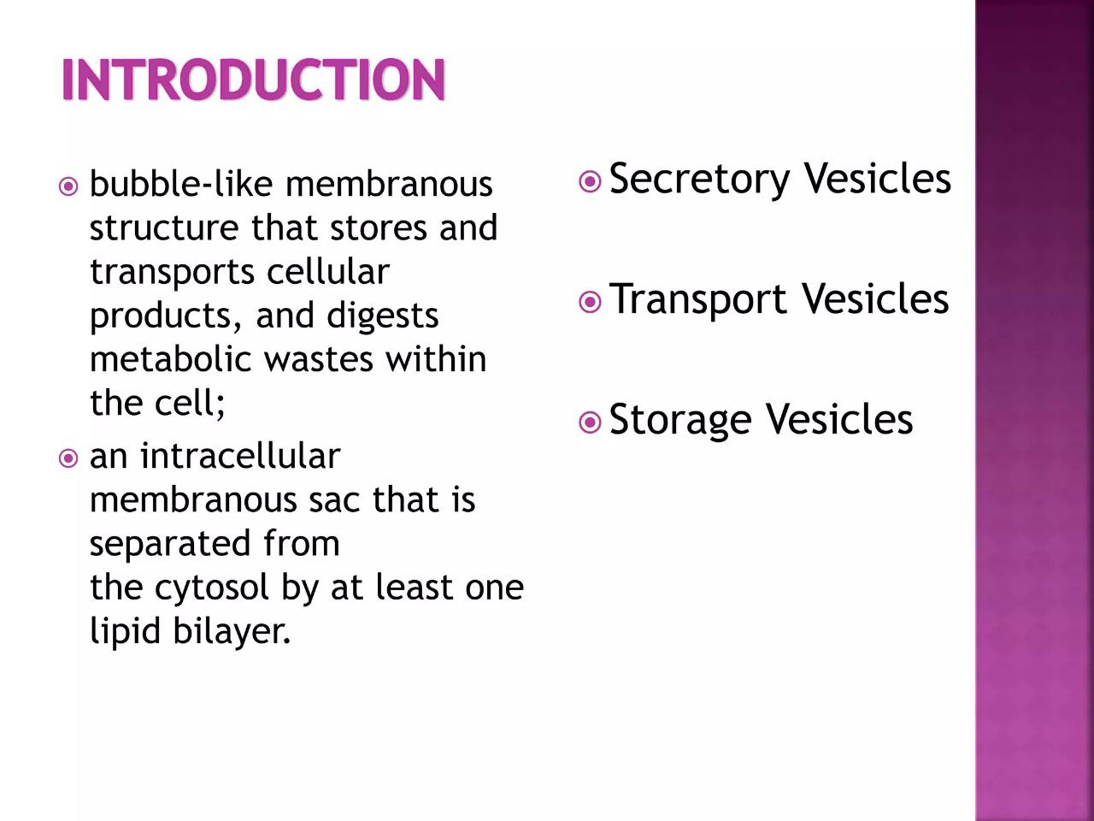

Slide 4
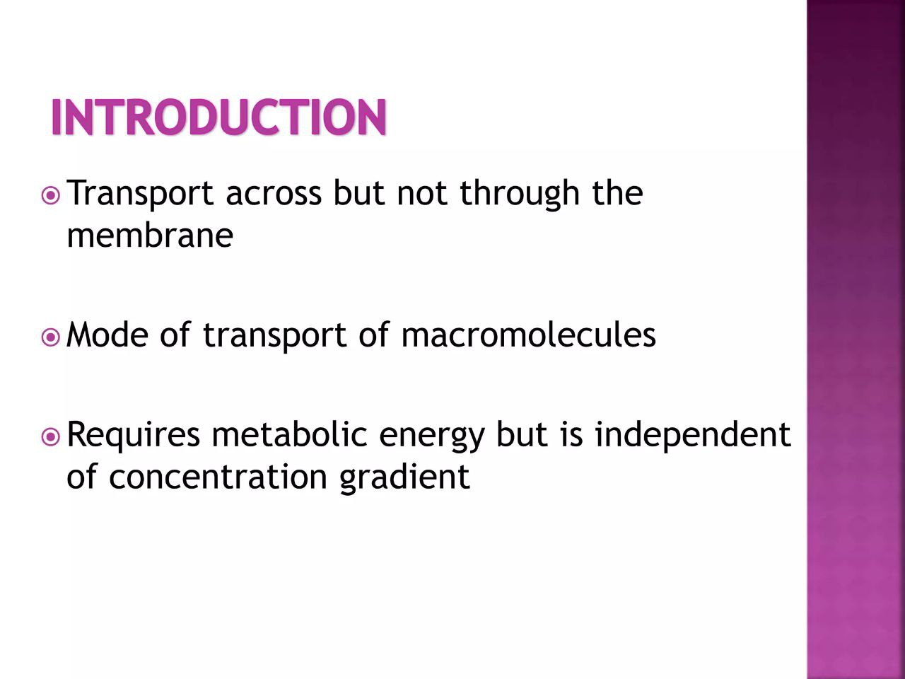

Slide 5
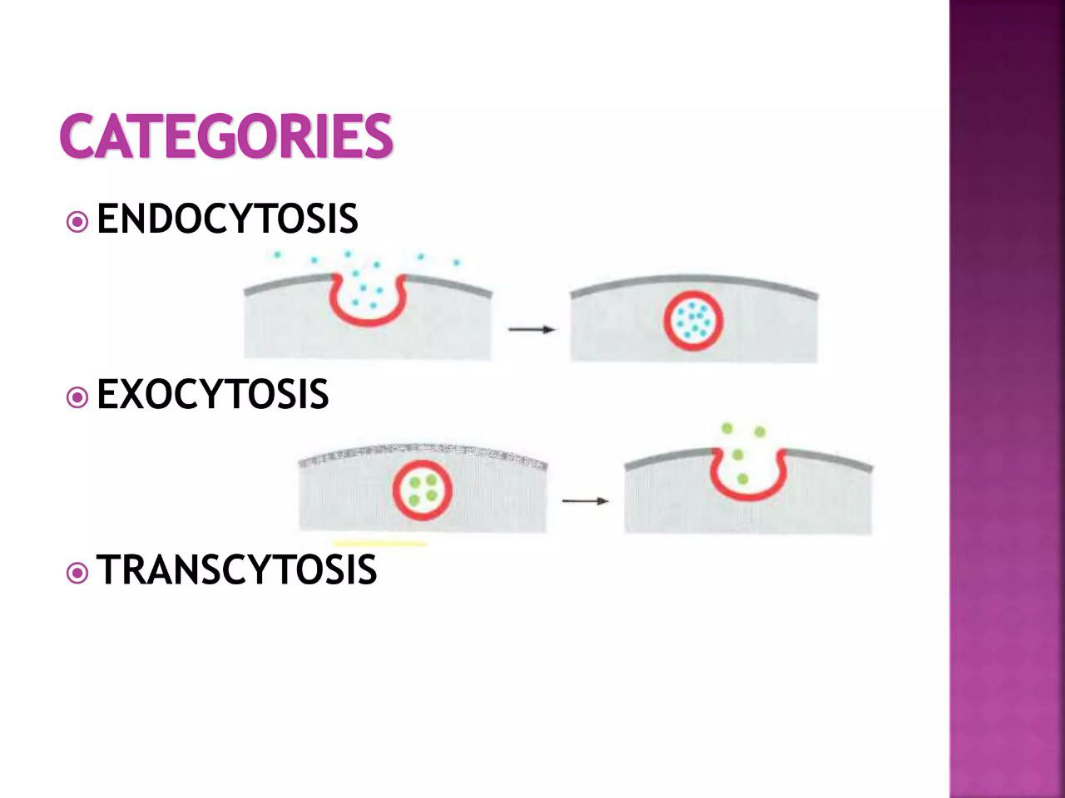

Slide 6
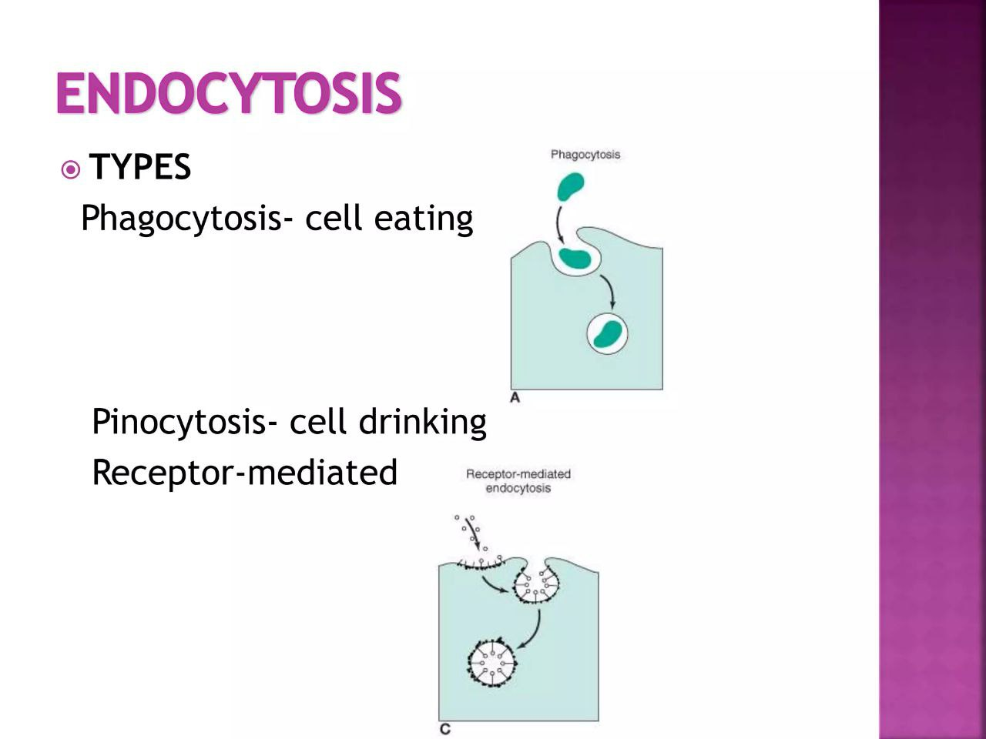

Slide 7
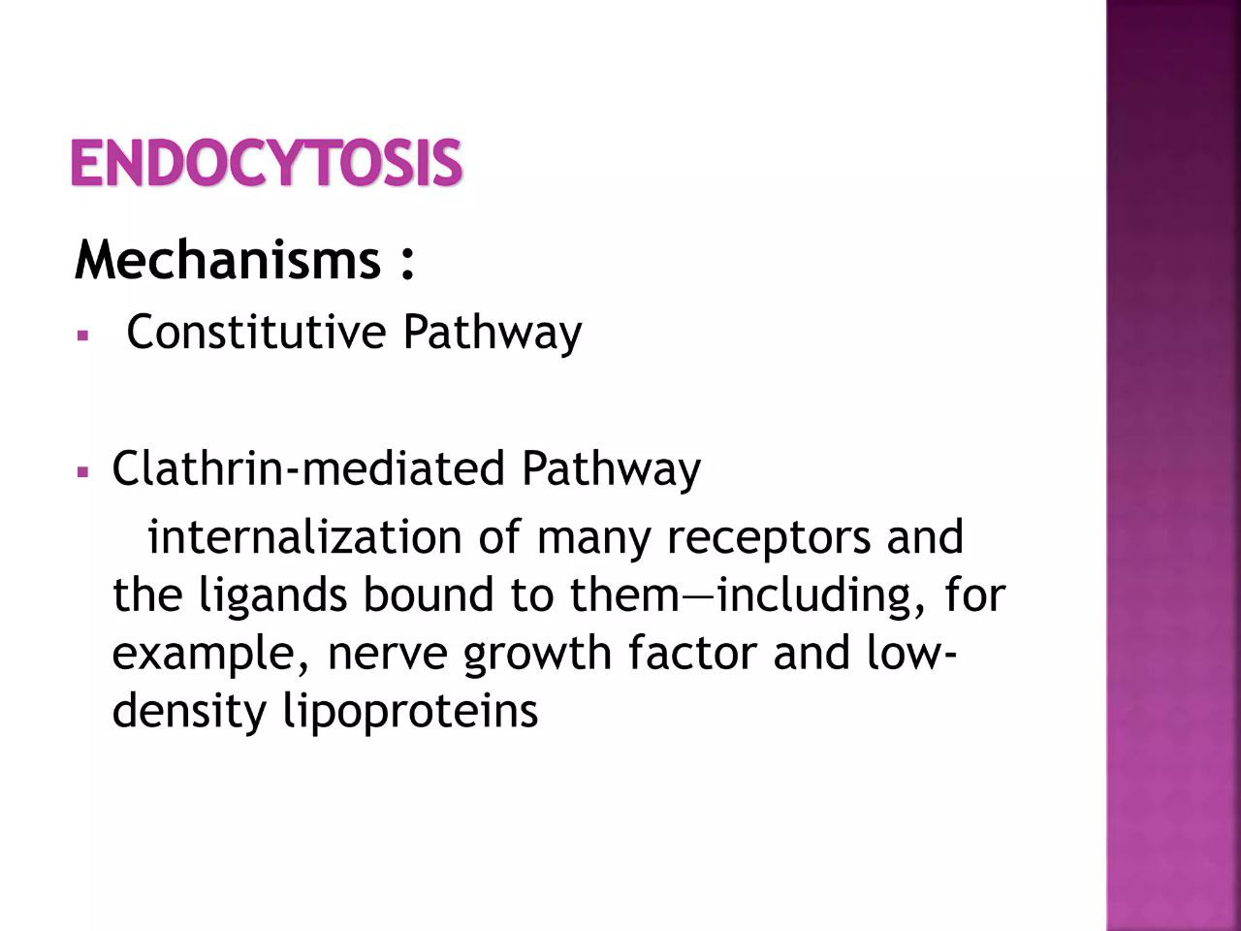

Slide 8
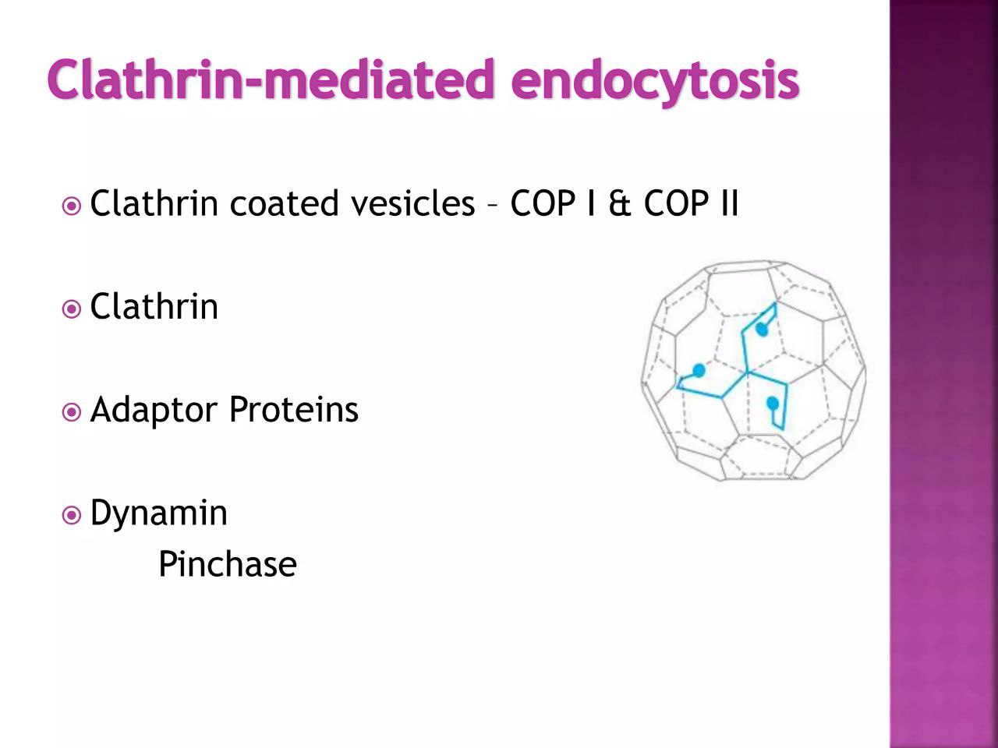

Slide 9
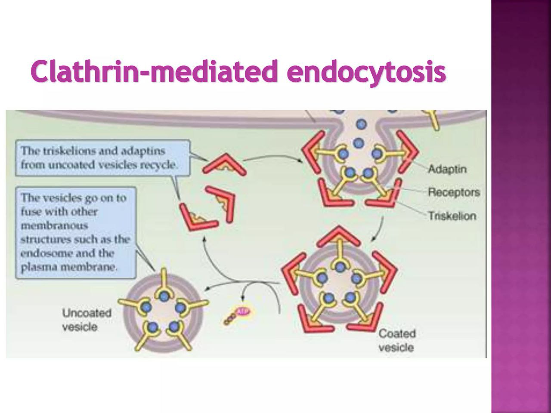

Slide 10
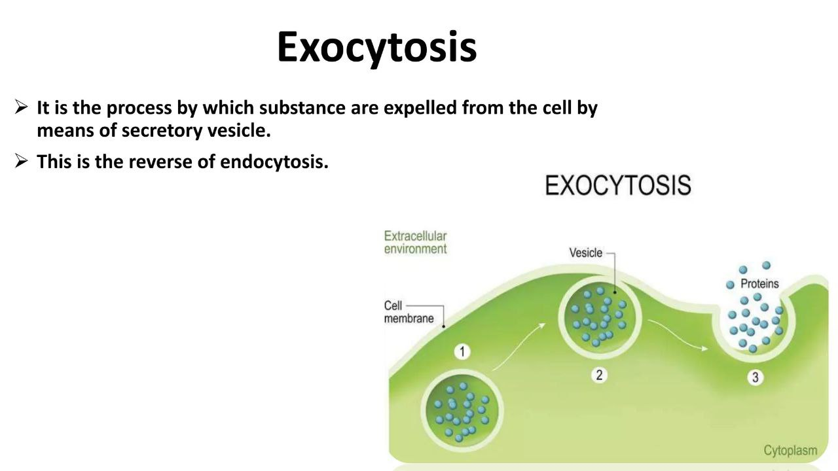

Slide 11
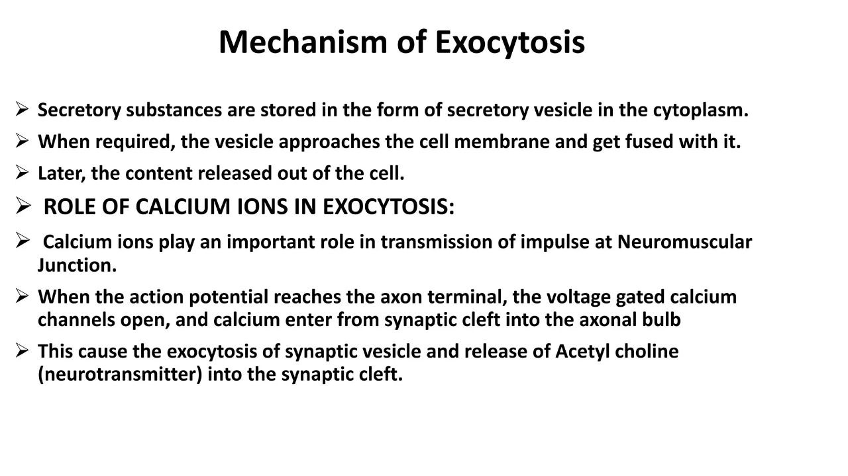

Slide 12
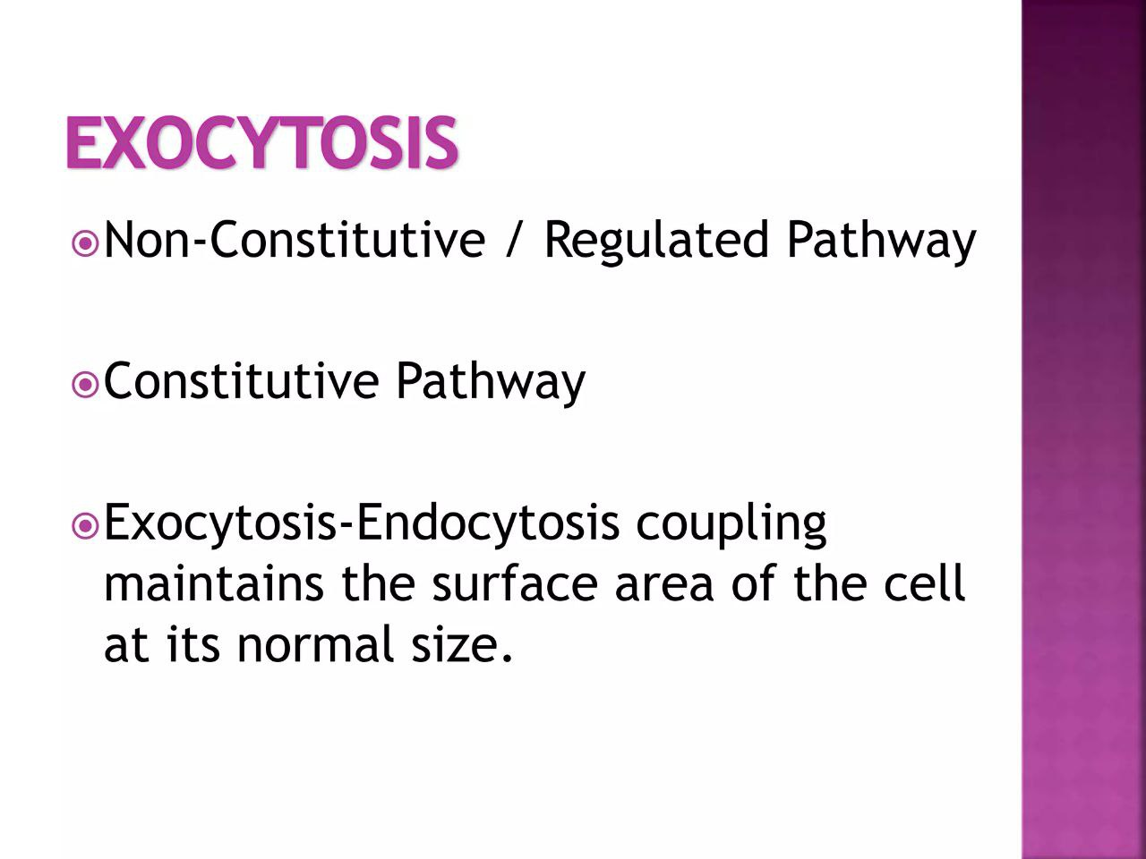

Slide 13
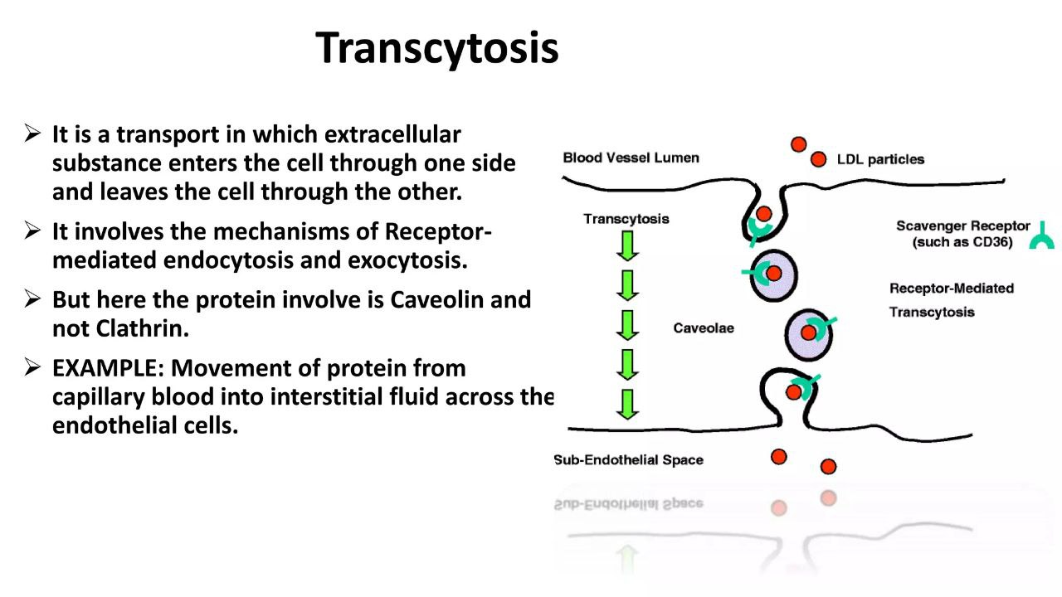

Slide 14
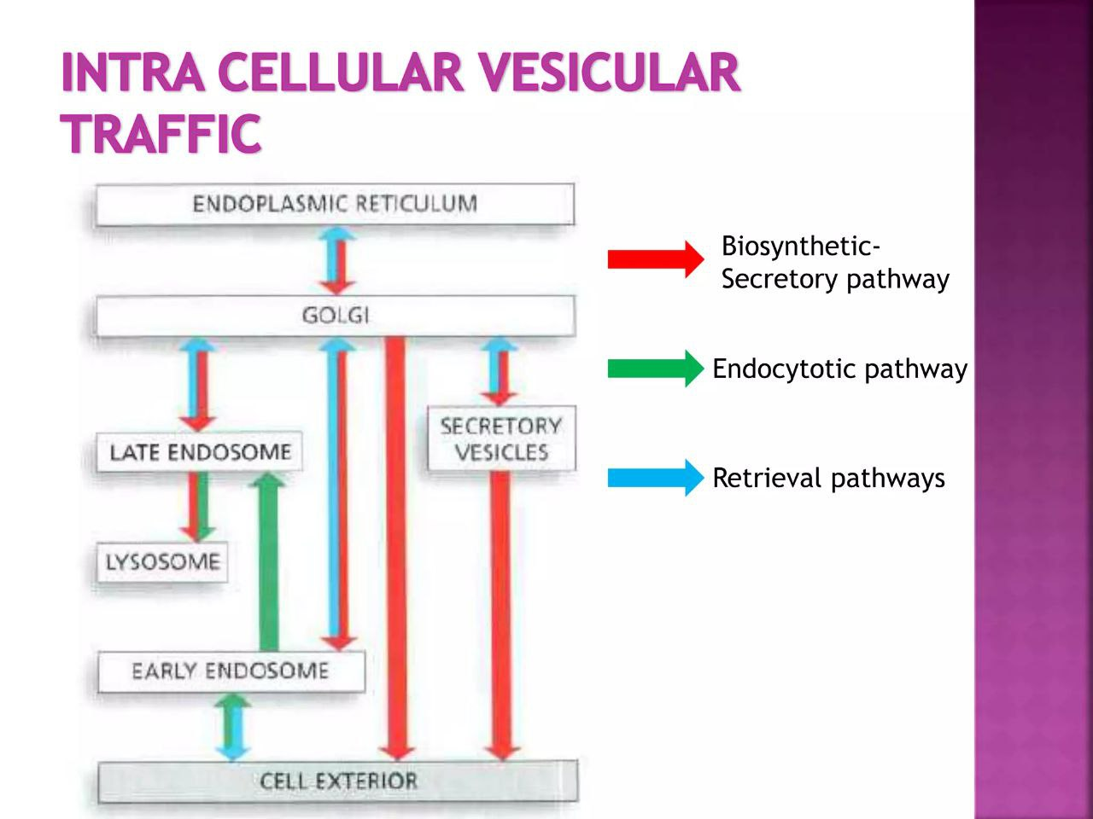

Slide 15
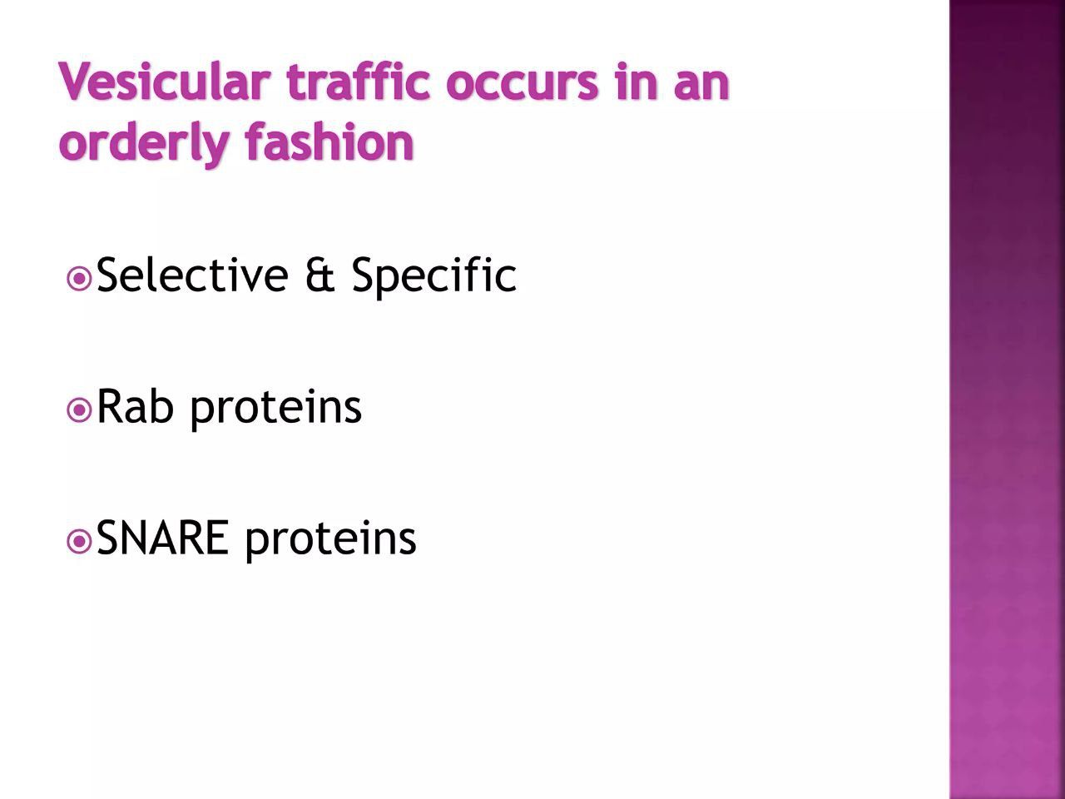

Slide 16
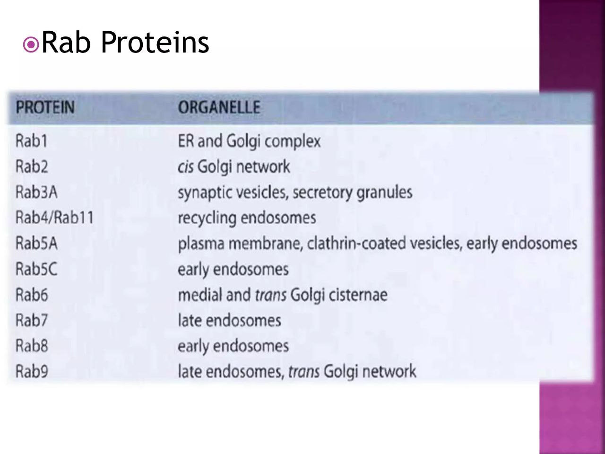

Slide 17
