Slide 1
Nursing Collage
Lec: 5
Fundamental of Nursing
Management of PAIN
Lecturer :
Dr. Mahdi Hamzah Al-Taee

Slide 2
Introduction
The pain history is the key to assess it & includes patient description of pain intensity, quality, location, timing, duration and aggravating and relieving factors.
Diagnosis and assessment of Acute pain requires frequent and consistent assessment as a part of daily clinical care to ensure rapid titration of therapy & preemptive intervention.
Chronic pain is often more diagnostically challenging. Structured history and clinical examination will define treatable problems.

Slide 3
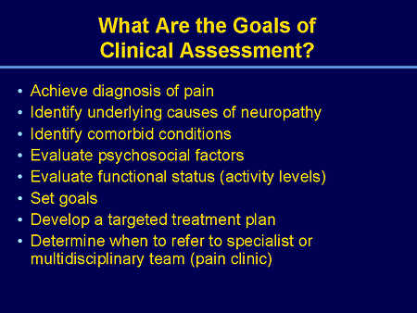
Definition
Pain is an unpleasant sensory and emotional experience associated with actual or potential tissue damage or described in terms of such damage..

Slide 4
Classification of pain
Duration and etiology:
1.Acute pain
2.Chronic nonmalignant pain.
3.Cancer pain.
Location-I:
1.cutaneous pain(skin, subcutaneous tissue)
2.visceral pain(abdominal cavity, thorax, cranium).
3.deep somatic pain (bones, blood vessels and nerve).

Slide 5
Location-II: (radiating pain ,referred pain , phantom pain , neuropathic pain , intractable pain
Intensity:(mild , moderate , severe, very sever , worst possible) pain.
Physiological responses to pain
Anxiety ,fear , hopelessness , thoughts of suicide.
Decrease cognitive ,function mental confusion .
Increase high rate , blood pressure.
Increase respiratory rate .
Decrease gastric and intestinal motility.
Decrease urinary output ,urinary retention.
Muscle spasm.

Slide 6
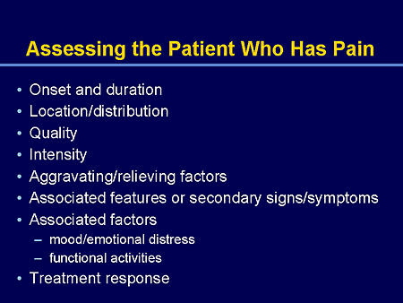
Pain Etiology: By
1.Asking complete history and if pain is –super facial/peripheral/visceral
2. localized/referred. Cause can be known.

Slide 7
Pain Assessment:
Good pain assessment is necessary for good pain management. The American pain society created the pain is the fifth vital sign to increase awareness of pain assessment the rational is that is the pain if assessed seriously as other vital signs it will be more likely to be treated.
One approach to pain assessment is (Baker and Wong, 1987)
Q—Question the patient
U— Use pain rating scales
E—Evaluate behavior and physiological changes.
S ----Secure patient involvement.
T—Take cause of pain into account,
T— Take action and evaluate scale.

Slide 8
Pain assessment tool and methods:
Pain assessment consists of two major components: -
Subjective data:
Take pain history to obtain facts from the patient.
Ask the following questions:
1. Pain location: ask patient to paint the site of discomfort on a chart consisting of drawing of the body
2.Intensity of pain: by using of the pain intensity scale (0-10) or (0-5) for adult face scale include a number scale in relation to each expression "for child".

Slide 9
Pain Assessment Tools
Numerical scale: These scales are used only with conscious directed adults. An expert nurse can use face scale with children includes a number scale in relation to each expression.
No pain 0 1 2 3 4 5 6 7 8 9 10 worst pain

Slide 10
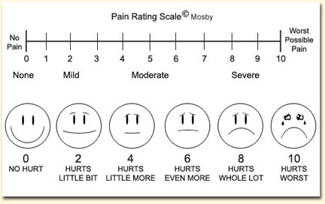
2.Visual analogue scale (vas): It is a continuum horizontal line used to qualify.
No pain the worst pain

Slide 11
Note: don’t use more than scale to the same patient and select which of these scales is adequate and appropriate.
3.Quality : some patients able to describe their pain quality as
(Throbbingخفقان , Shooting, stabbingطعن , sharp, hot burning, aching, heavy)
4.Pattern: onset, duration and recurrence. تكرار
5.Duration: ask about the time of onset (how long the patient's dose feels the pain?
Frequency: ask if the pain is frequently or continuous stable constant.

Slide 12
Ask also for:
Precipitating factorsتزيد تعجل:
Physical activity before chest pain
Abdominal ache after meals
Alleviating factorsمخففه:
Ask about anything can alleviate pain as (medication- rest application-o2therapy)
Associated symptoms:
Like nausea- vomiting – diarrhea

Slide 13
Objective data :
(1) Physiological assessment: -
The nurse most carefully observes the patient and keep in mind that some patients suffer the pain without tell anyone you can explore the patient under pain through physical assessment and body examinations and the nurse should be familiar with the most common skills at least how to exam the major organs and to distinguish abnormal signs and symptoms as well as the nurse has to know diagnostic test procedures.

Slide 14
(2) Diagnostic test procedures:-
AS, ECG important when patient complain from chest pain it differs angina from myocardial infarction or the pain caused by respiratory disturbances or to distinguish stomachache from Sevier interior MI.
Identify specific pain source

Slide 15
Pain Management:
Pain management is the alleviation of pain or reduction in pain to level of comfort that is acceptable to the patients.
It includes two basic types of nursing interventions:
Pharmacologic intervention.
Non-pharmacologic intervention.

Slide 16
I. Pharmacologic Interventions
There are many pharmacologic interventions (Analgesics) to give pain relief pain by acting on peripheral nerve endings or narcotic, CNS-acting at the injury site to decreasing the perception of pain.

Slide 17
II. Non pharmacologic Interventions
There are many non-pharmacologic interventions to give pain relief, especially when used in conjunction with pharmacologic measures. Described as physical and cognitive-behavioral interventions, many of these approaches are noninvasive, low-risk, inexpensive, easily performed and taught, and within the scope of nursing practice:
Comfort measures.
2) Position change and movement.
3) Massage:
4) Applications of hot and cold:
5) Relaxation:

Slide 18
Thank you

