Slide 1
Cell Structure and Function

Slide 2
Cell : the basic structural and functional units of an organism.
Eukaryotic cells cell membrane membrane-enclosed nucleus cytoplasm, containing organelles and cytoskeleton.
In contrast, the smaller prokaryotic cells of bacteria typically have a cell wall and lack nuclei and membranous cytoplasmic structures.

Slide 3
PLASMA MEMBRANE (CELL MEMBRANE)
• It separates intracellular compartment from extra cellular compartment of the tissue.
•It consists of a lipid bilayer, membrane proteins, and carbohydrates.
Plasma membrane has three types of lipids: phospholipids, cholesterol, and glycolipids.
• Phospholipid molecules have polar hydrophilic head and nonpolar hydrophobic tail.

Slide 4
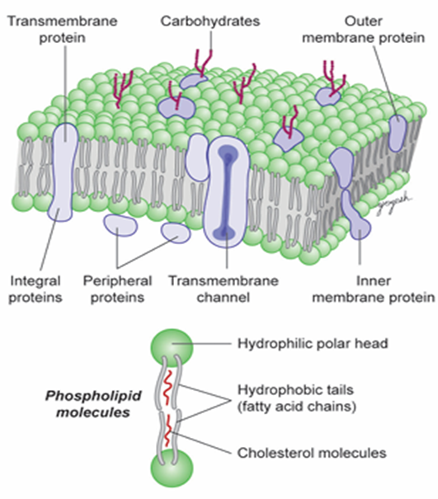
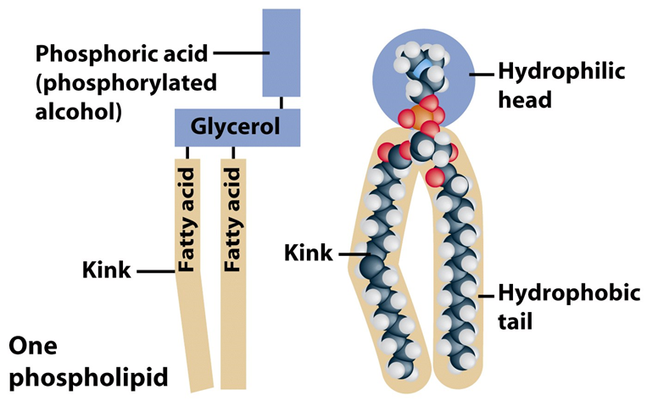

Slide 5
Plasma membrane proteins:
integral membrane proteins
peripheral membrane proteins.
Carbohydrates of plasma membrane
attached to proteins > glycoproteins
to lipids of the bilayer > glycolipids.
FLUID MOSAIC MODEL FOR MEMBRANE STRUCTURE
Membrane proteins comprise a moveable mosaic within the fluid lipid bilayer.

Slide 6
Movement of molecules through the plasma membrane.
  Lipid-soluble and uncharged molecules, ( oxygen, carbon dioxide, glycerol, water, ammonia) cross plasma membrane freely from higher to lower concentration.
  Water-soluble molecules require membrane transport proteins .
  If the process requires energy, it is called active transport (e.g., transport of H ions )
  If energy is not required, the process is called passive transport (e.g., glucose transport).

Slide 7
Movement of molecules through the plasma membrane
Ions and other small charged molecules are transported through the plasma membrane by ion-selective channel proteins.
Vesicular Transport
Large molecules
Endocytosis and exocytosis.

Slide 8
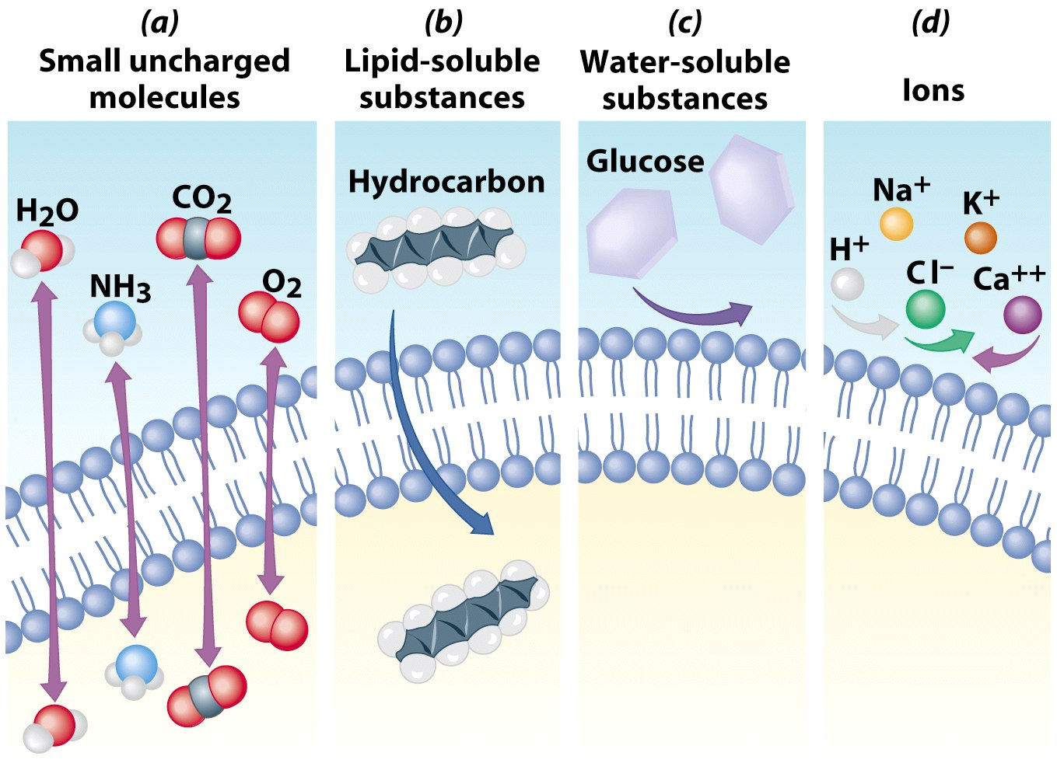

Slide 9
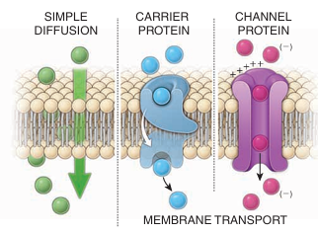
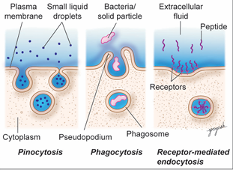

Slide 10
Membrane Proteins
pumps (Na+ pump)
channels (passage of small ions, molecules, and water across the plasma membrane in either direction).
receptor proteins) recognize certain molecules (hormones, antibody).

Slide 11
Membrane Proteins
linker proteins (anchor cytoskeleton).
enzymes (ATPase, ATP synthase and digestive enzymes).
structural proteins (cell-to-cell junctions).

Slide 12
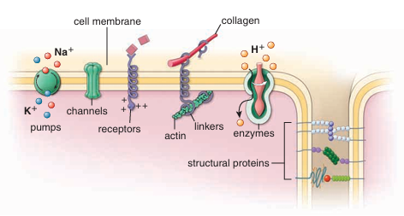
Membrane Proteins

Slide 13
Cytoplasm
is the part of the cell located out side the nucleus, consists of gel-like matrix called cytosol
contains organelles
cytoskeleton
The matrix consists of solutes, including inorganic ions (Na+, K+, Ca+2) and organic molecules such as lipids, proteins, and RNAs.

Slide 14
Cell Organelles
Structures that perform various functions.
Within cytoplasm
rough endoplasmic reticulum (rER), smooth-surfaced endoplasmic reticulum (sER), Golgi apparatus, lysosomes, pinocytic vesicles, endocytic vesicles, and mitochondria.
microtubules, filaments (actin and intermediate filaments), centrioles, ribosomes, and proteasomes.

Slide 15
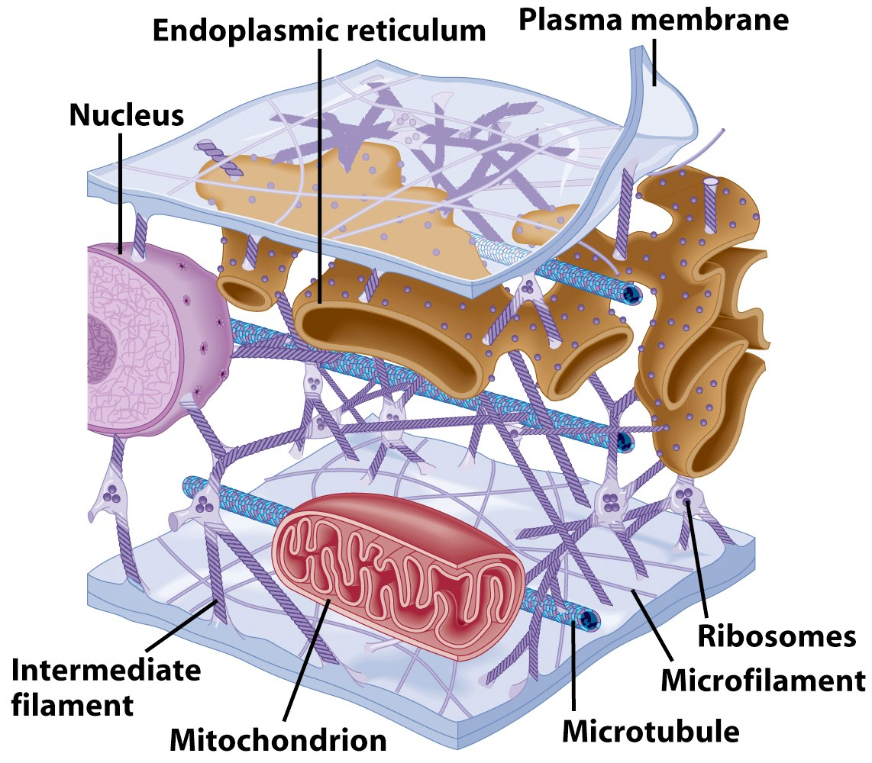

Slide 16
Endoplasmic Reticulum
Network of interconnected membranes
Two types
  Rough endoplasmic reticulum
  Smooth endoplasmic reticulum

Slide 17
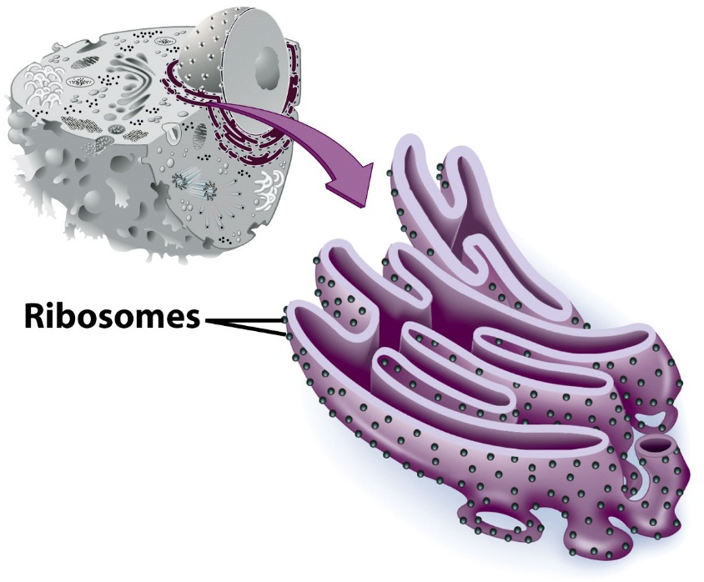
Rough Endoplasmic Reticulum
Ribosomes attached to surface
  Modifies, transports, and stores proteins produced by attached ribosomes.
  Free ribosomes synthesize cytoplasmic structural and functional elements( hemoglobin synthesis in precursor cells of RBCs).

Slide 18
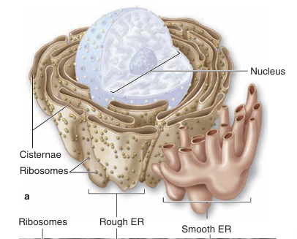
Smooth Endoplasmic Reticulum
No attached ribosomes
Synthesizes, transports, and stores lipids (eg, steroids).
Carbohydrates metabolism.
Detoxification of drugs,
alcohol.

Slide 19

Ribosomes
Small cytoplasmic particles (protein and ribosomal RNA ,rRNA)
Ribosomes lie in association with rER or in free in the cytoplasm.
Free ribosomes produce structural proteins of a cell
Membrane-bound ribosomes (rER) produce secretory proteins.

Slide 20
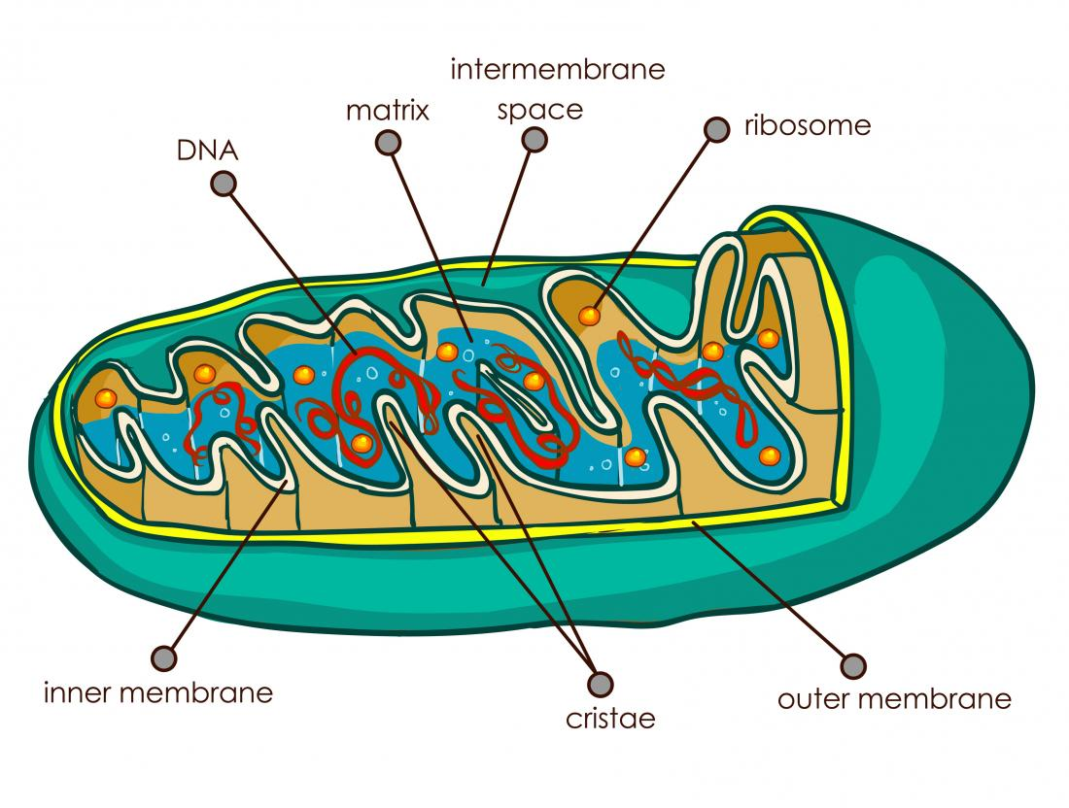
Mitochondria powerhouse
Double membrane-bound organelles containing a circular strand of DNA (mitochondrial DNA)
Generate ATP during aerobic cellular respiration
contains enzymes for β-oxidation
of fatty acids and the citric acid
(Krebs) cycle.
Mitochondria of stressed cells
may release cytochrome c
(cell death (apoptosis).

Slide 21
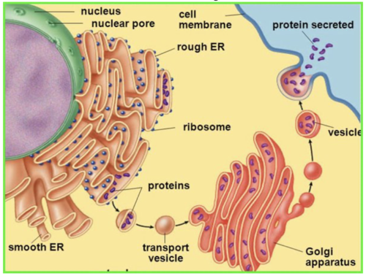
Golgi apparatus
Saclike membranous structures, in most cells located near the nucleus.
Receives proteins from rER for
posttranslational modification
and packaging.
Delivers enzymes to lysosomes

Slide 22
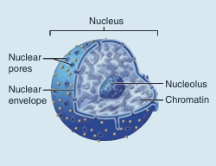
Nucleus
Large rounded or oval structure
double membrane
contains chromatin, nucleolus, nuclear membrane, and nucleoplasm
Nuclear envelope
Double membrane
Separates nucleus from cytoplasm
Nuclear pores

Slide 23
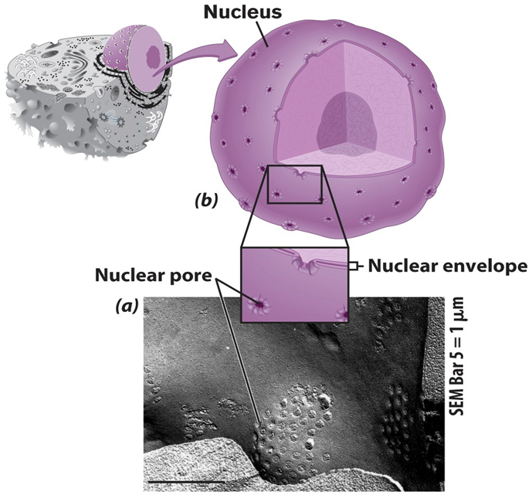
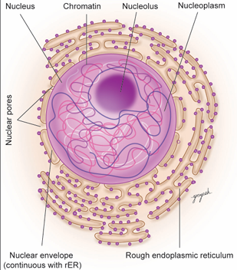
Chromatin: Genetic material consist of:
DNA
46 chromosomes
billions base pairs of nucleotides
protein-coding genes

Slide 24
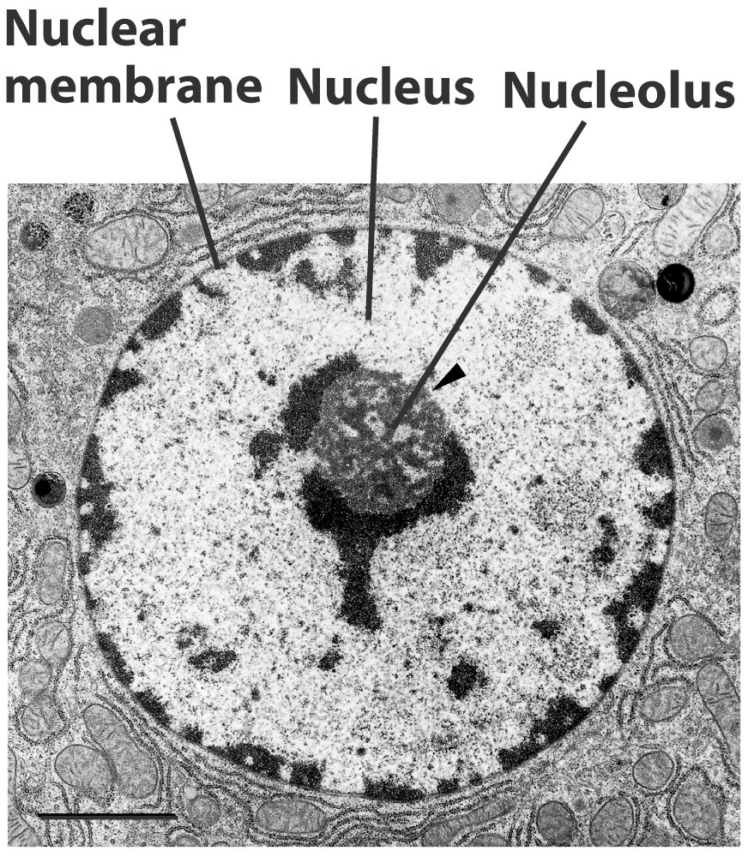
Nucleolus
Generally spherical
Most cells have 2 or more
Directs synthesis of rRNA
Forms ribosomes

Slide 25
Cytoskeleton
Supporting network of protein filaments in cytoplasm.
Components of cytoskeleton:
1. Microtubules
2. Microfilaments (Actin Filaments)
3. Intermediate filaments

Slide 26
Cytoskeleton
Functions
Determine the shapes of cells.
Cellular mobility
Movements of organelles and materials throughout cell.
Movement of cilia, microvilli, tail of sperms
Movement of chromosomes during cell division.
Structural support ,stabilizes junctions between cells.

Slide 27
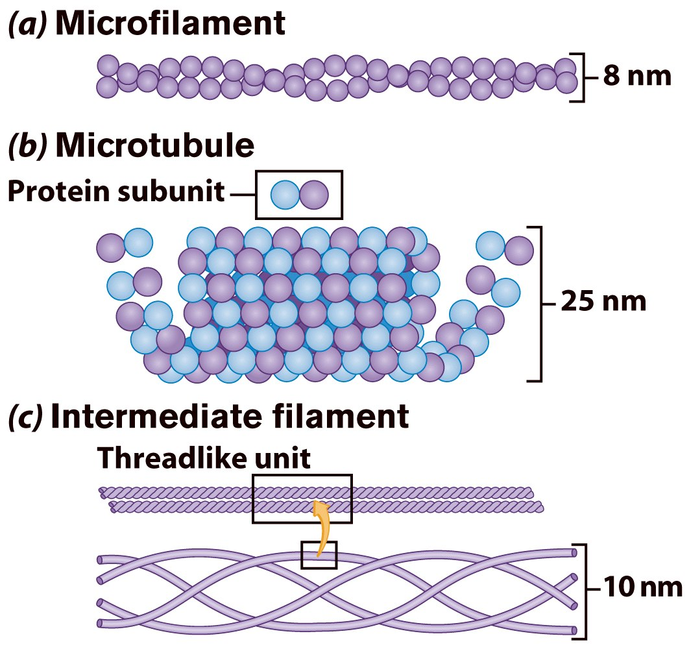
Cytoskeleton

Slide 28
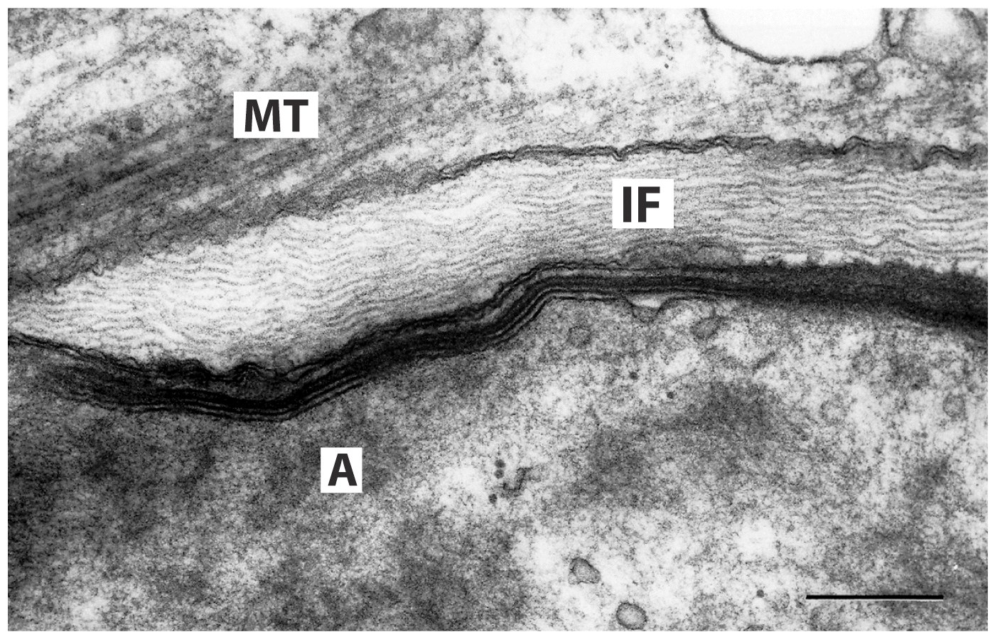
Cytoskeleton
A = actin, IF = intermediate filament, MT = microtubule

Slide 29
Cilia
Short, numerous membrane extensions
Move substances over the cell surface(mucus)
Flagellum
Long, singular membrane extension
present on sperm cells

Slide 30
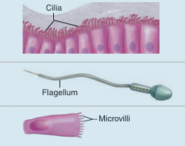
Microvilli
Numerous membrane folds projecting from the cell surface;
supported by microfilaments
Increase membrane surface area for absorption

Slide 31
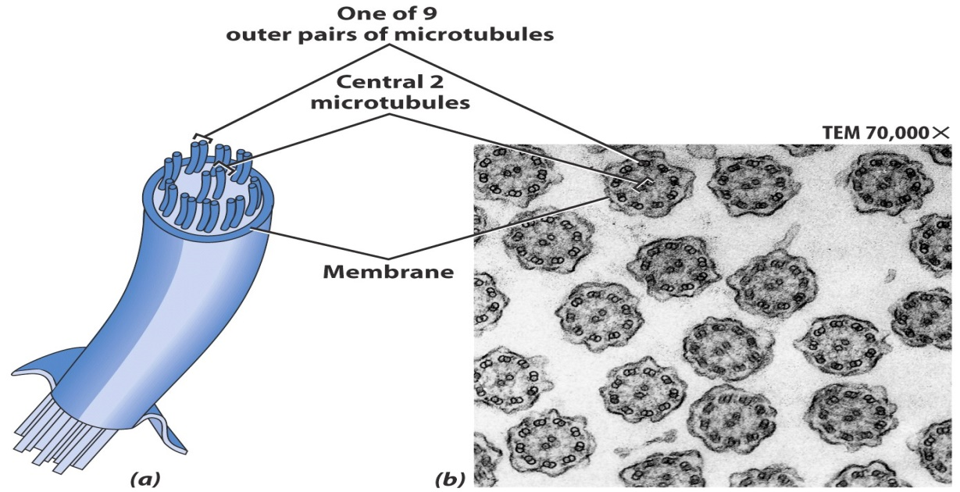
Cilia & Flagella Structure
Bundles of microtubules
With plasma membrane

Slide 32
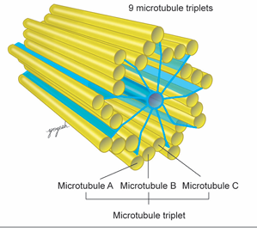
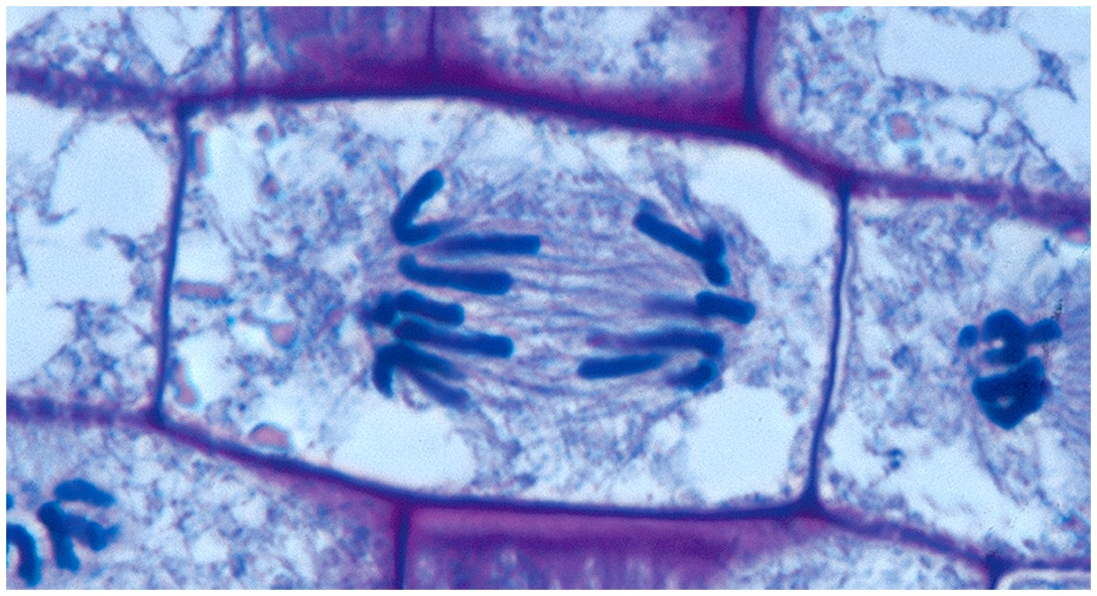
Centrioles
Two centrioles in a cell near the nucleus.
Forms mitotic spindle.
basal bodies for cilia and flagella.

Slide 33
Thank You

