Slide 1
Leg
Dr.Zaid Saad Madhi
Trauma and Orthopedics surgery
Al-Mustaqbal university college

Slide 2
Diphyses
Metaphses
Epiphyses

Slide 3
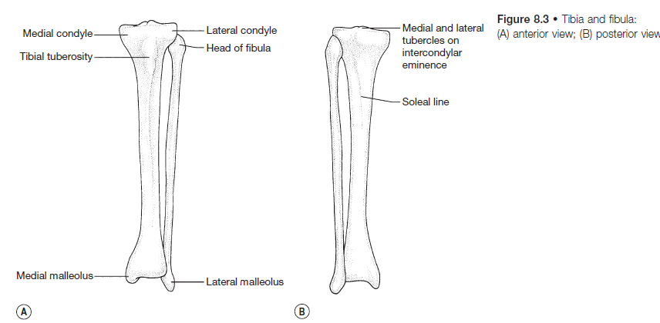

Slide 4
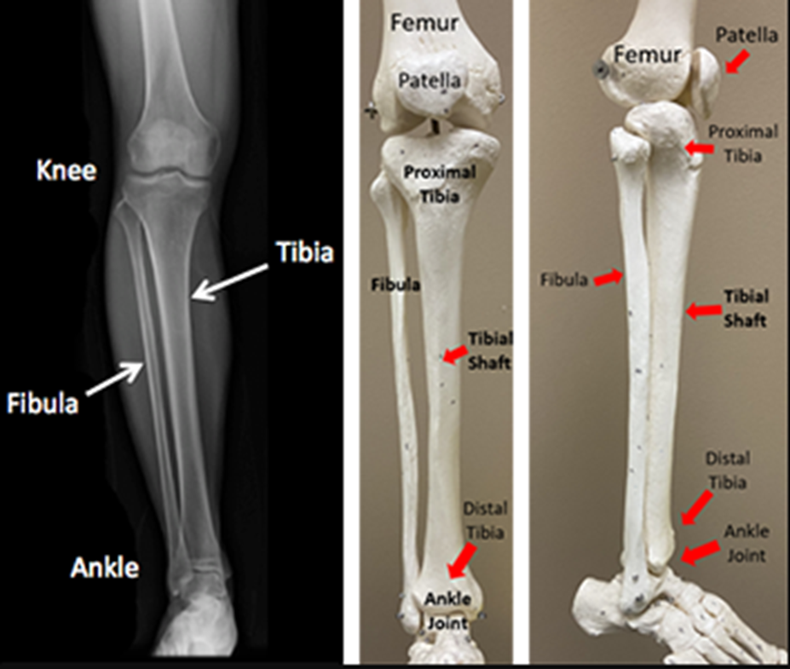
The Tibia
The upper end of the tibia is expanded as the tibial plateau.
This has an articular surface with a large medial and a smaller lateral condyle, which articulate with the condyles of the femur.
Between the condyles is the intercondylar eminence or the tibial spine. the tibial spine has medial and lateral projections – the medial and lateral intercondylar tubercles.
Anteriorly, at the upper end of the shaft of the tibia is the tibial tubercle into which the ligamentum patellae is inserted.
The anteromedial surface of the shaft of the tibia is subcutaneous.
The posterior surface of the shaft has a prominent oblique ridge – the soleal line.
The lower end of the tibia has the medial malleolus medially and the fibular notch for the inferior tibiofibular joint laterally Its inferior surface is flattened and articulates with the talus in the ankle joint

Slide 5
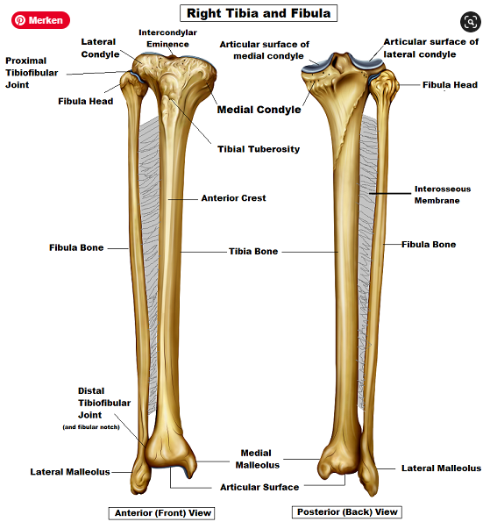
The fibula
Apart from its role in the ankle joint.
the fibula is mainly a site of origin of muscles and has no weightbearing function.
It has a head with a styloid process into which the biceps femoris is inserted, a neck, a narrow shaft and a lower end expanded as the lateral malleolus.
Proximal and distal tibiofibular joints unite it with the tibia and it articulates with the talus in the ankle joint.
The lateral malleolus is more distal than the medial malleolus The calcaneofibular ligament is attached to its tip This may be damaged in inversion injuries.
The fibula is proportionately thicker in children than in adults

Slide 6
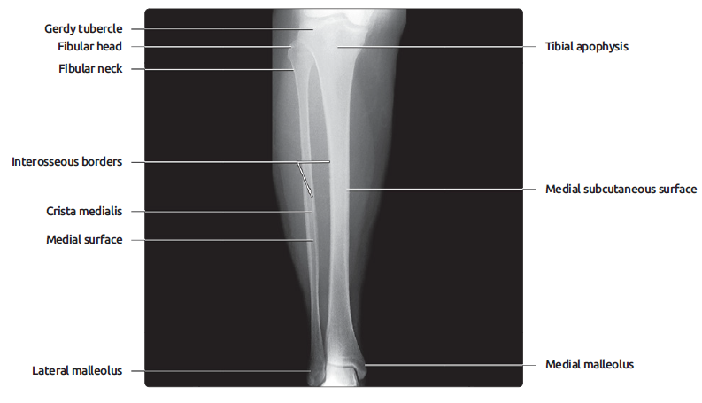
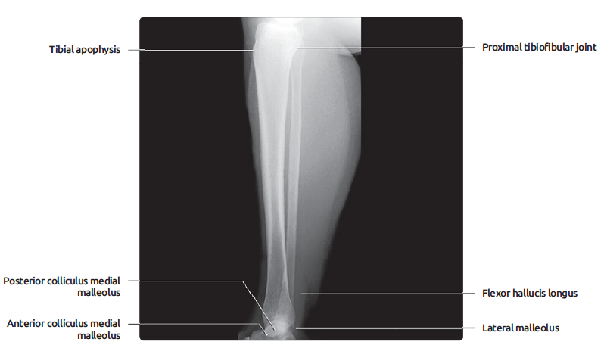
STANDARD RADIOGRAPHS OF LEG

Slide 7
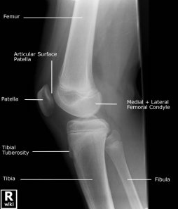
Radiological features of the tibia and fibula
The tibial tuberosity is very variable in appearance, particularly during the growth period Asymmetry and irregularity on radiographs may be quite normal Some irregularity of the tibia at the upper part of the interosseous border may simulate a periosteal reaction here

Slide 8
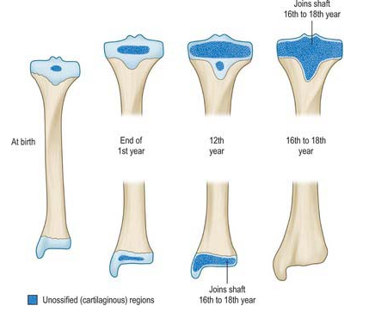
Ossification of the tibia
The primary ossification centre for the shaft of the tibia appears in the seventh fetal week.
A secondary ossification centre is present in the upper end at birth and in the lower end at 2 years.
The upper centre fuses with the shaft at 20 years, the lower sooner at 18 years

Slide 9
Ossification of the fibula
Ossification of the primary centre in the shaft begins in the eighth fetal week.
in the lower secondary centre in the first year and in the upper at 3 years.
The lower epiphysis fuses with the shaft at 16 years and the upper at 18 years

Slide 10
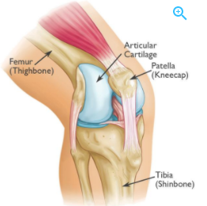
The patella
This is a sesamoid bone in the quadriceps tendon that continues at its apex as the ligamentum patellae.
The upper two- thirds of the posterior surface is covered with articular cartilage and is entirely within the knee joint.
The anterior surface is covered by the prepatellar bursa.
The lateral articular surface is usually larger than the medial surface

Slide 11
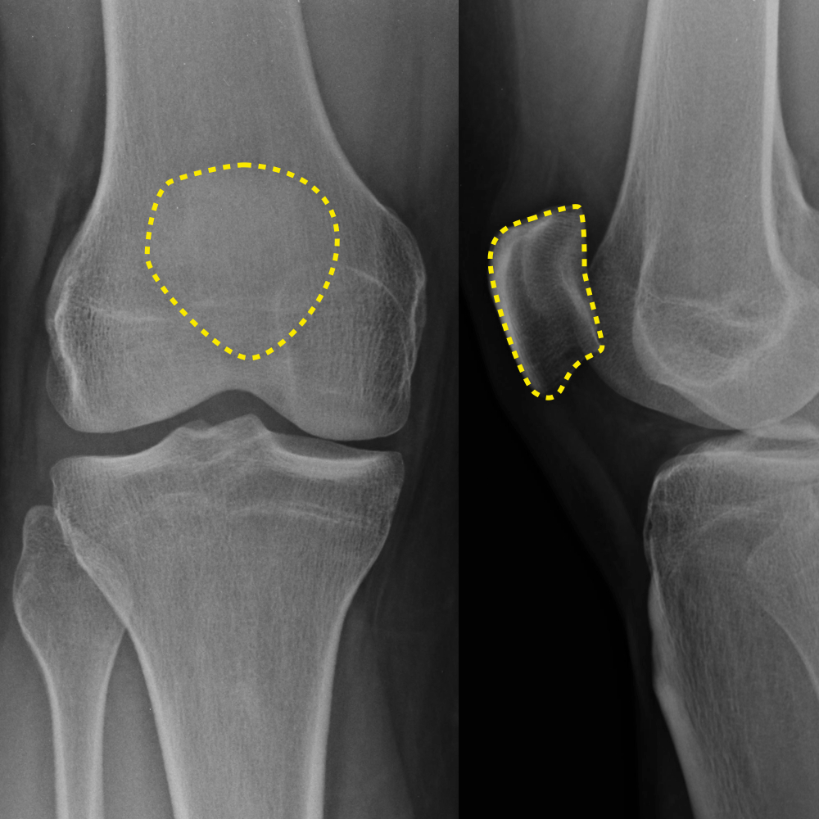
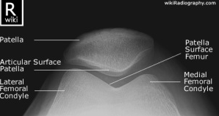
Radiological features of the patella
The outer surface of the patella as seen on tangential (skyline) views is irregular owing to the entry of nutrient vessels here

Slide 12
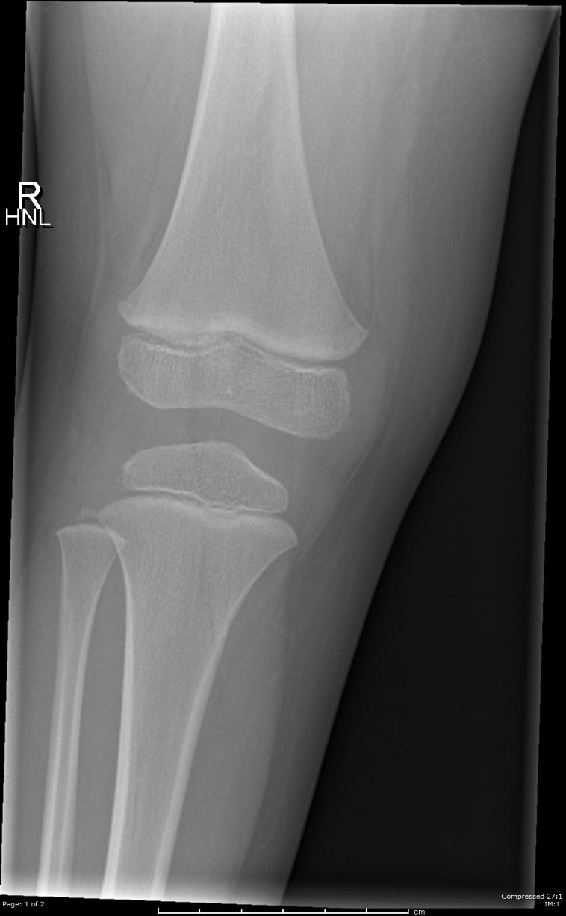
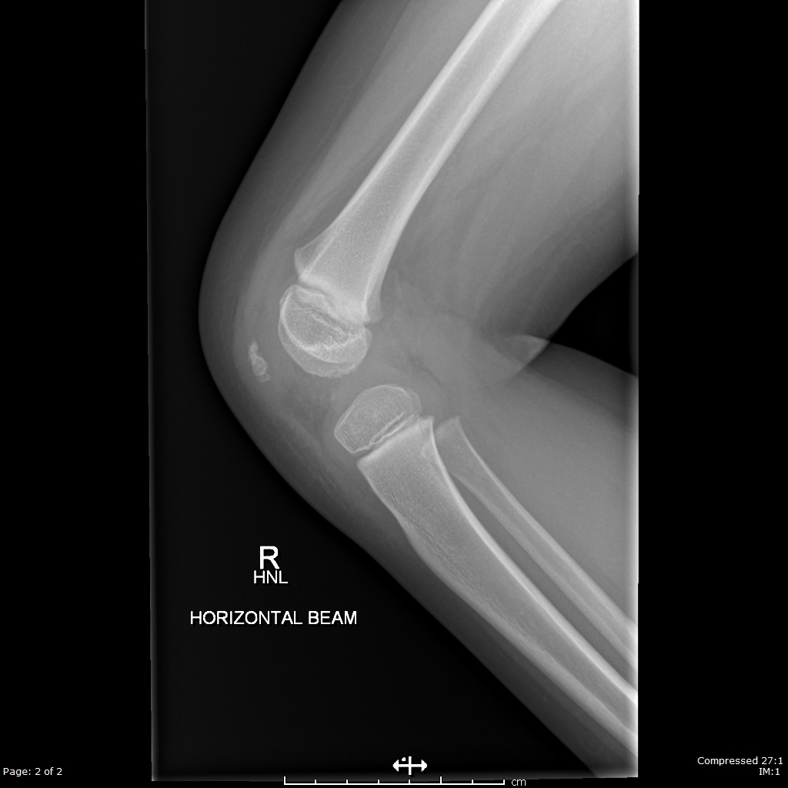
Ossification of the Patella
This begins at 3 years and is complete by puberty

Slide 13
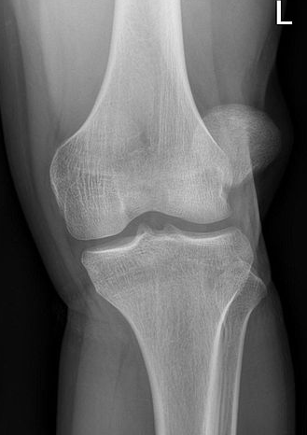
Dislocation of the patella
Lateral dislocation of the patella is more common than medial dislocation.
occurs following valgus injury with associated imposed bowstringing of the extensor mechanism over the knee joint
Anatomical structures have evolved to prevent dislocation, including relative hypertrophy of the vastus medialis muscle and overgrowth of the lateral femoral condyle

Slide 14
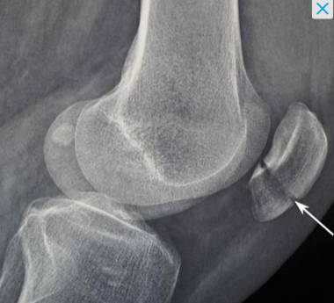
What is the abnormality?

Slide 15
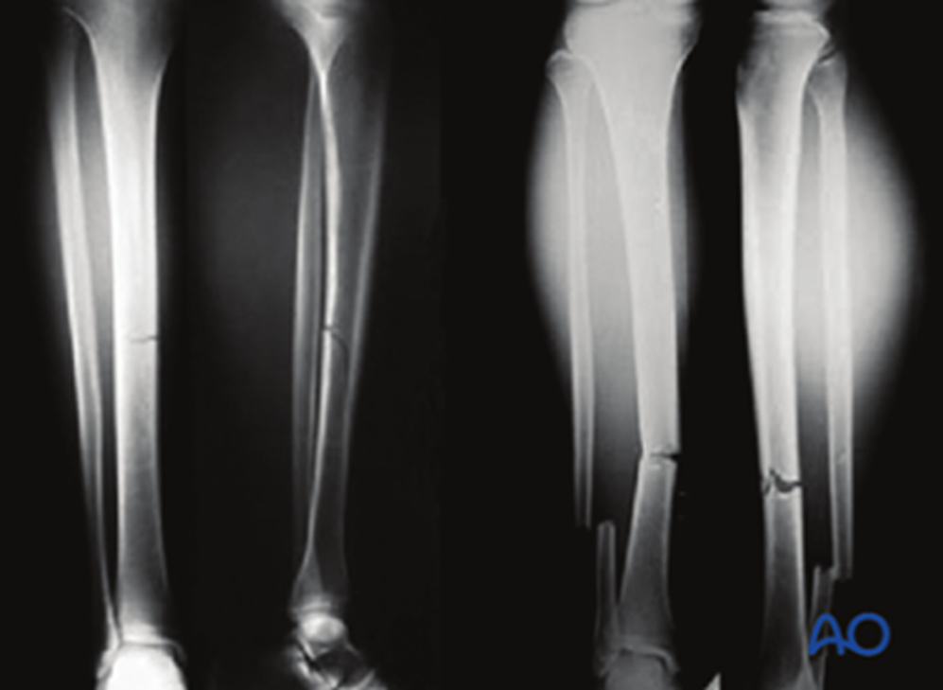
What is the abnormality?

Slide 16
Leg Muscles
Anterior Compartment
Posterior Compartment
Lateral Compartment

Slide 17
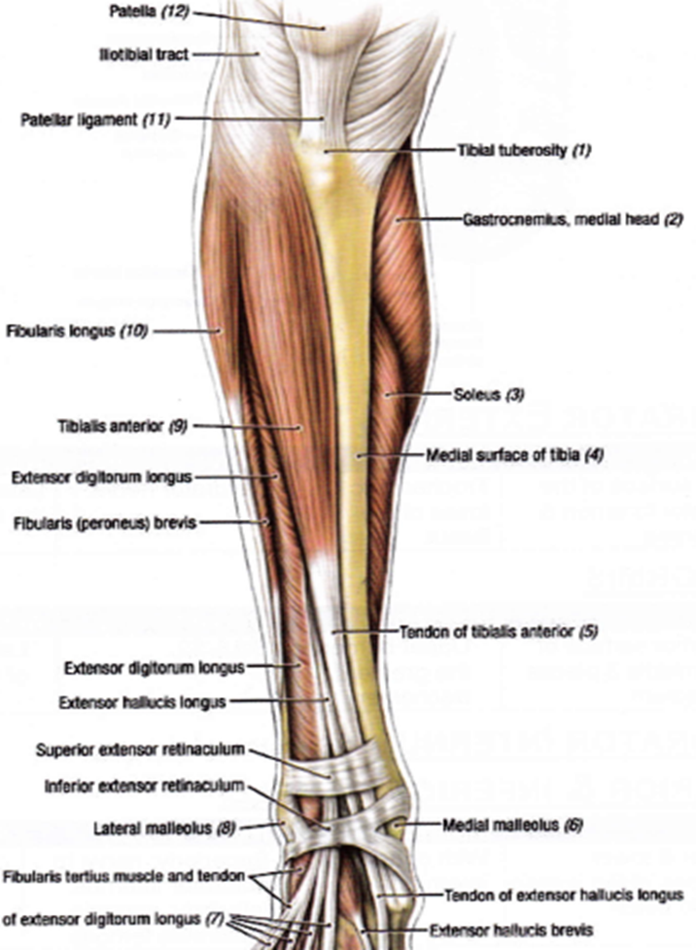
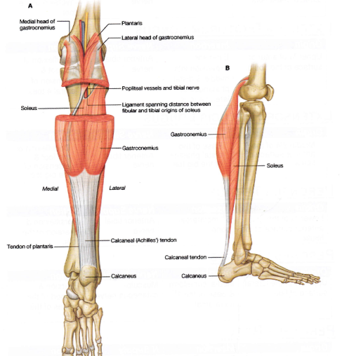

Slide 18
Main Muscles
Tibialis Anterior
Gastrocnemius
Soleus
Extensors!

