Slide 1
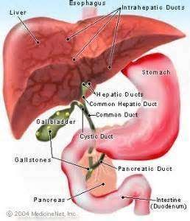
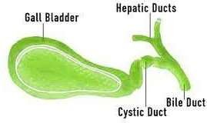
Disorders of gall bladder By
Dr. athemar MR

Slide 2
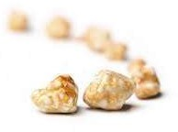
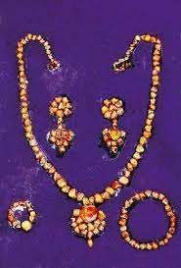
Cholelithiasis
• Affect 10-20% of adult population in developed
countries
• Clinical features:
– 70-80% are asymptomatic
–Excruciating pain localised to the right
upper quadrant or epigastric region

Slide 3
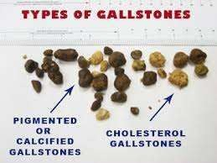
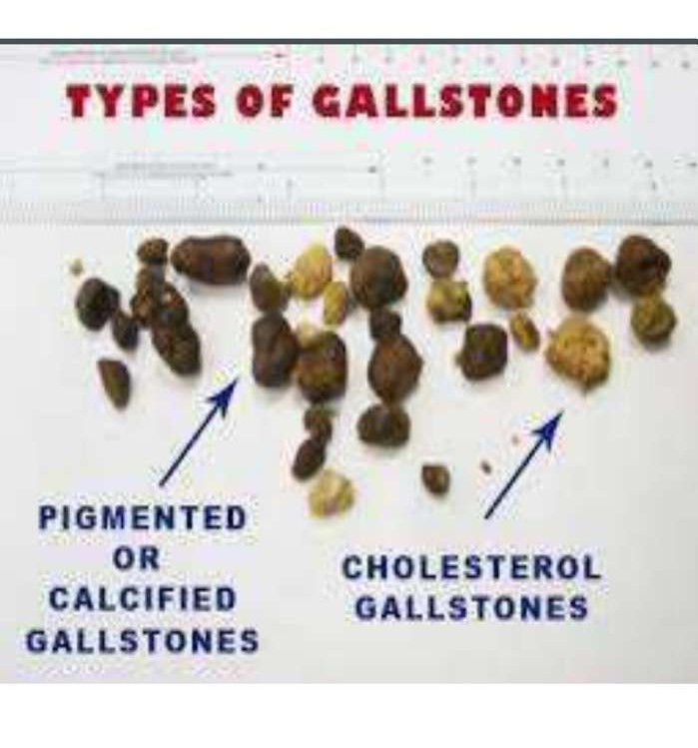
2 main types of gall stones :
  Cholesterol stones
  Pigment stones
In the West, about 90% are cholesterol stones.
Pigment gall stone is predominant in non- Western population – associated with bacterial infection of biliary tree and parasitic infestations.

Slide 4
Cholelithiasis -cont
Risk factors :
1- age
2- female gender
3- obesity and being over weight
4- hyper insulinemia
5- diet high in triglycerides and refined carbohydrate
6- genetic predisposition
7- medication ( oestrogen replacement therapy ,ceftriaxone )
– Prevalence increase with age – associated with metabolic syndrome
and obesity. More common in women (2x)
– Ethnic and geographic. Cholesterol stone is more common in Native American population, related to biliary cholesterol hypersecretion.
– Hereditary : positive family history of stones, inborn error of metabolism associated with impaired bile salt synthesis and secretion
– Environmental factors :
• Estrogenic influence ( OCP and pregnancy) - increase expression of hepatic lipoprotein receptors →stimulates HMG Co-A reductase activity →enhance cholesterol uptake and synthesis → excess biliary secretion of cholesterol.
• Clofibrate (lipid lowering agent) increase hepatic HMG Co-A reductase → reduce cholesterol 7-α hydroxylase activity → decrease conversion of cholesterol to bile acids
• Obesity, rapid weight loss also increase biliary cholesterol
secretion.
– Acquired disorders : gall bladder stasis and reduced gall bladder motility ( in pregnancy, rapid weight loss, spinal cord injury).

Slide 5
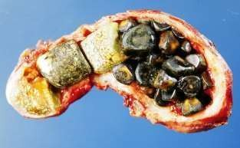
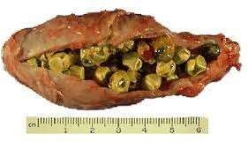
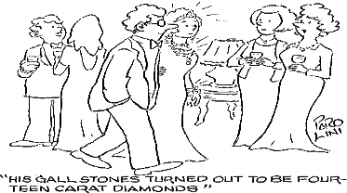
Pigment stone
Cholesterol stone
Content : Crystalline cholesterol monohydrate is predominant
Bilirubin calcium salt is predominant
Pigment stones
– Black pigment – cirrhosis,
hemolytic anemia
(hemoglobinopathy, red cell disorders)
– Brown pigment – Asian patients (infection)

Slide 6
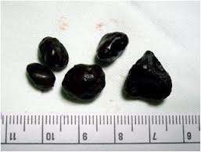
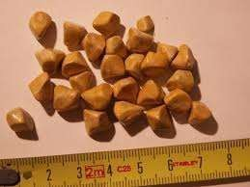
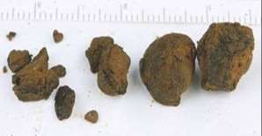
Pathology
Cholesterol stones :
Gross : pale yellow, ovoid, firm, single to multiple with faceted surfaces
Mostly radiolucent, 20% is radio opaque due to the presence of calcium carbonate content.
Pigment stones
Black stone (in sterile gall bladder bile)- small size, fragile to touch, numerous, 50-70% are radioopaque
Brown stone (in infected intrahepatic or extrahepatic ducts)- single to a few, soft, greasy, soaplike consistency due to presence of retained fatty acids released by bacterial phospholipases on biliary lecithins, radiolucent.
Stone content : calcium salts of unconjugated bilirubin, lesser amounts of other calcium salts, mucin glycoproteins and cholesterol.
:

Slide 7
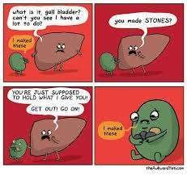
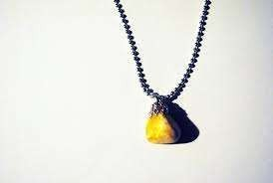
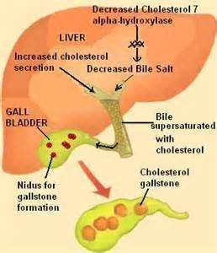
Summary :

Slide 8
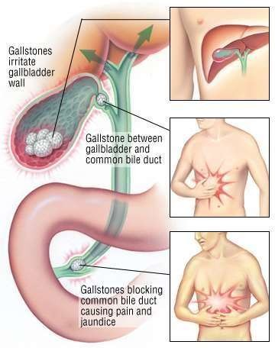
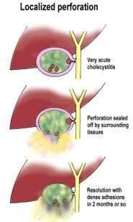
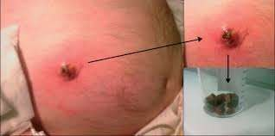
Complications :
  Inflammation of gall
bladder (cholecystitis)
  Empyema
  Perforation,
  Fistulas

Slide 9
Pathology
Cholesterol stones :
Gross : pale yellow, ovoid, firm, single to multiple with faceted surfaces
Mostly radiolucent, 20% is radio opaque due to the presence of calcium carbonate content.
Pigment stones
Black stone (in sterile gall bladder bile)- small size, fragile to touch, numerous, 50-70% are radioopaque
Brown stone (in infected intrahepatic or extrahepatic ducts)- single to a few, soft, greasy, soaplike consistency due to presence of retained fatty acids released by bacterial phospholipases on biliary lecithins, radiolucent.
Stone content : calcium salts of unconjugated bilirubin, lesser amounts of other calcium salts, mucin glycoproteins and cholesterol.
:

Slide 10
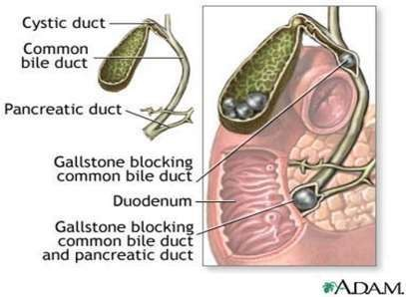
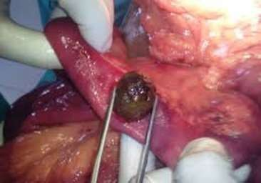
Complications-cont
  Inflammation of biliary tree (cholangitis)
  Obstructive cholestasis
  Pancreatitis
  Erode adjacent bowel and cause intestinal obstruction (gallstone ileus)

Slide 11
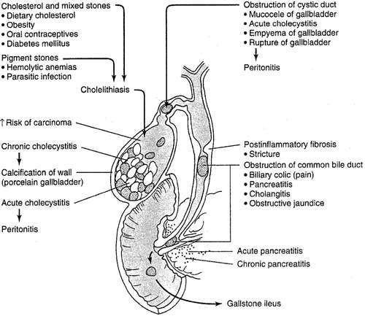
Summary:

Slide 12
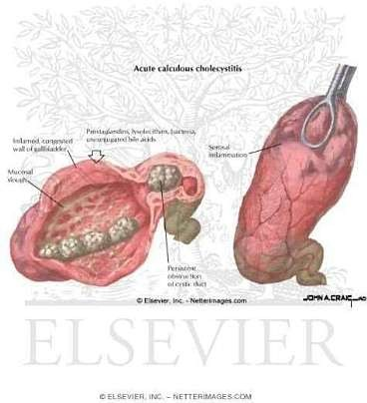
Pathology of acute cholecystitis
Gross :
  Enlarged, tense, edematous, red or violaceous colour (subserosal haemorrhage)
  Fibrinous /fibrinopurulent exudate
covering the serosa
– +- stones obstructing the neck or cystic duct
  Lumen contains blood and pus (empyema)
  Green black necrotic
Microscopic :
  acute inflammation in the wall
  mucosal ulceration.
  May be associated with abscess formation or gangrenous necrosis.

Slide 13
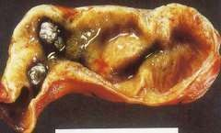
Clinical features :
–recurrent attacks of epigastric or right upper quadrant pain
  Nausea, vomiting and intolerance to fatty foods.
Pathology:
  Gross :
    smooth and glistening to dull serosa (subserosal
fibrosis)
    thickened wall, opaque gray-white appearance
    Uncomplicated cases, lumen contains clear, green,
mucoid bile and stones with normal mucosa

Slide 14
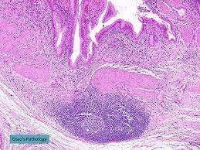
Microscopic :
  Reactive proliferation of mucosa
  Inflammation (lymphocytes, plasma cells, and macrophages in the mucosa and in the subserosal fibrous tissue). May be minimal.

Slide 15
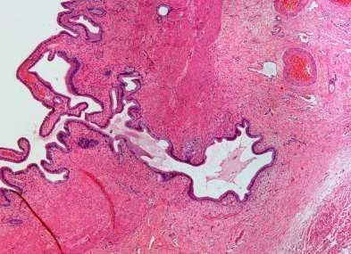
Prominent outpouching of the mucosal epithelium through the wall (Rokitansky Aschoff sinuses)
Marked subepithelial and subserosal fibrosis
– +-Superimposed acute inflammation
– +-Extensive calcification within the wall
→porcelain gall bladder →increase risk of cancer

Slide 16
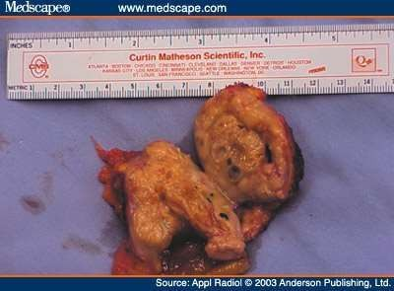
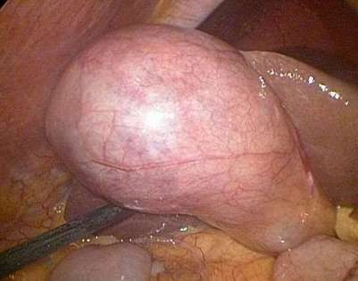
Xanthogranulomatous cholecystitis: massively thickened wall with shrunken, nodular, chronically inflamed with foci of necrosis and haemorrhage.
Hydrops of the gall bladder : atrophic, chronically obstructed gall bladder containing only clear secretion

Slide 17
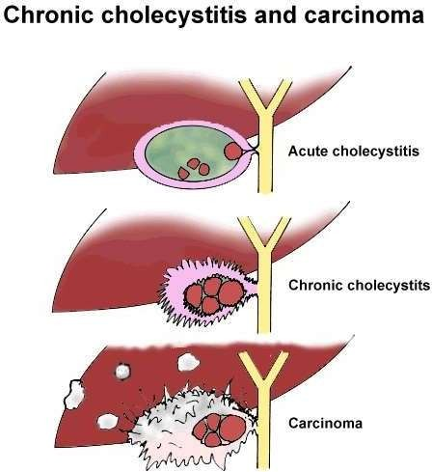
Complications of cholecystitis
Bacterial superinfection with cholangitis or sepsis
Gall bladder perforation and local abscess formation
Gall bladder rupture with diffuse
peritonitis
Biliary enteric (cholecystenteric) fistula, with drainage of bile into adjacent organs, entry of air and bacteria into biliary tree and potentially gallstone-induced intestinal obstruction (ileus)
Aggravating of preexisting medical illness, with cardiac, pulmonary, renal or liver decompensation
Porcelain gall bladder with increased risk of cancer

Slide 18
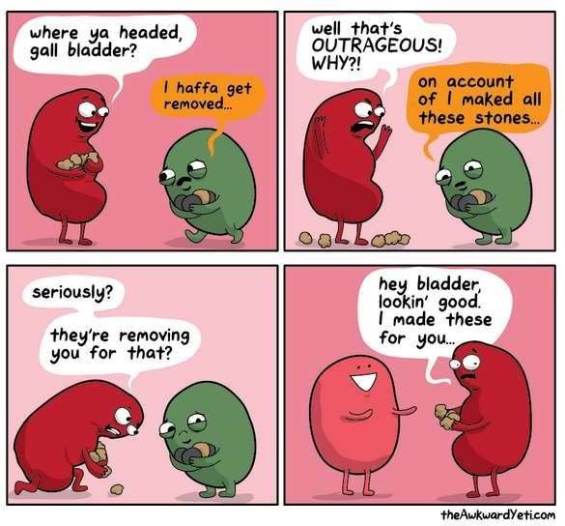
Treatment : Cholecystectomy

