Slide 1


Department of Anesthesia Techniques
Fluid management in ICU
Dr. Mohammed Sami
Mohammed.sami.hasan@uomus.edu.iq

Slide 2
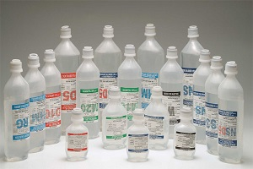

Slide 3
Fluid compartment & distribution
Fluid compartment of total body weight :
  Neonate: 75-80%
  Infant: 70-75%
  Adult male: 55-60%
  Adult female 50-55%
  Elderly 45-50%

Slide 4
Intravenous fluid administration should be considered as any other pharmacological prescription.
There are three main indications :
  • Resuscitation
  • Replacement
  • Maintenance
For maximizing benefits and minimizing harms intravenous fluid administration should follow the
Four Ds :
    Drug
    Dosing
    Duration
    De-escalation.

Slide 5
‘4 Ds’ when prescribing fluids
Drug —the indication for the fluid and what effect is being sought.
Duration of therapy —when to start and when to stop therapy.
Dosing —how much fluid to give
De-escalation —when the fluid therapy is no longer required.

Slide 6
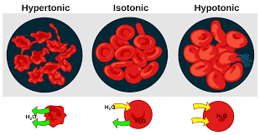
Osmolarity and Tonicity of a solution
The osmolarity of a solution = the number of osmoles per liter of solution.
Tonicity, a term that is often used interchangeably with osmolarity, refers to the Effect a solution has on cell volume.
An isotonic solution has no effect on cell volume.
Hypotonic solutions increase cell volume.
Hypertonic solutions decrease cell volume.

Slide 7
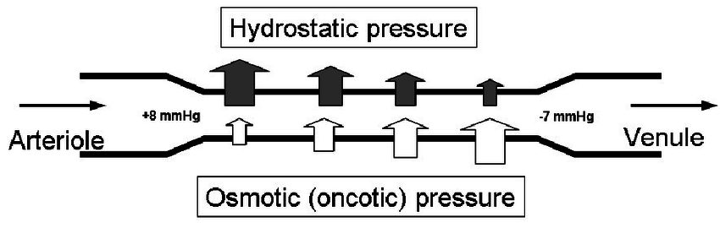

Slide 8
Fluids classification
based on their ability to diffuse through barriers separating body fluid compartments, i.e. intravascular and extravascular (interstitial) fluid compartments
  Crystalloids
  Colloids (Greek word-glue)
Crystalloids passed readily through the membrane, whereas colloids did not

Slide 9
Crystalloids and Colloids
A Crystalloid solution is an aqueous مائيsolution composed of water and small solutes such as electrolytes and glucose .
Crystalloid solutions can be further categorized as:
        Hypotonic
Isotonic
Hypertonic.
The intravascular half-life of a crystalloid solution is 20-30 min,

Slide 10
A Colloid solution
contains large MW particles such as proteins or hydroxyethyl starches (HES) suspended in a crystalloid solution.
most colloid solutions have intravascular half-lives between 3 and 6 h.

Slide 11
Crystalloids when given in sufficient amounts
1. Are effective as colloids in restoring intravascular volume
2. Replacing an intravascular volume deficit with 3-4 times the volume needed when using colloid
3. Severe intravascular fluid deficits can be more rapidly corrected using colloid solutions .
4. The rapid administration of large amounts of crystalloids (>4-5L) is associated with tissue edema.
marked tissue edema can impair oxygen transport, tissue healing, and return of bowel function following major surgery.

Slide 12
Comparison of Plasma and Crystalloid Resuscitation Fluids

Slide 13
Infusion of common fluids
Infusion of 1 L of 0.9% NaCL adds 275 mL to the plasma volume and 825 mL to the interstitial volume
Note: the total volume expansion (1100 mL) slightly greater than the infused volume.
This is the result of a fluid shift from the ICF to extracellular space, because isotonic saline is slightly hypertonic to the Plasma

Slide 14
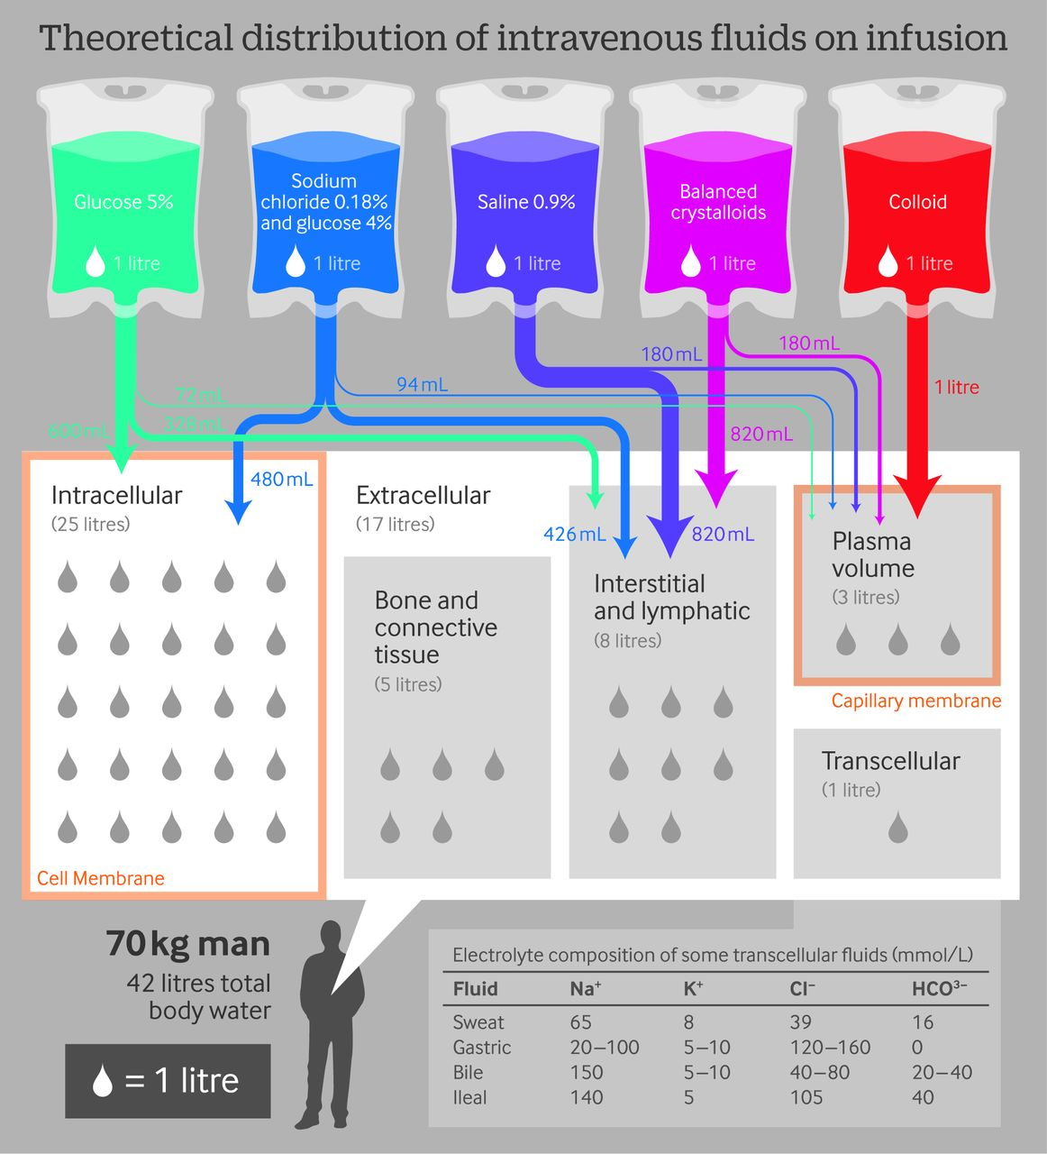

Slide 15
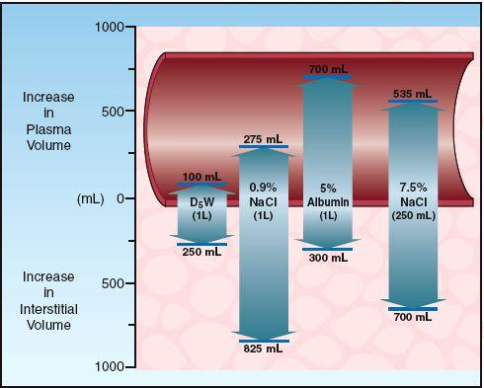
Volume Effects

Slide 16
1. 0.9% Sodium Chloride (Normal Saline)
Indications :
    1- Extracellular fluid replacement (e.g. Dehydration, hypovolemia, hemorrhage, sepsis).
    2- Treatment of metabolic alkalosis in the presence of fluid loss.
    3- Mild sodium depletion.
    4- diluents for the infusion of compatible drug additives.
    5- Used also in traumatic brain injury or any brain edema.
    6- Replacement fluid in hyperkalemia.

Slide 17
  7-preferred solution for diluting packed RBC prior to transfusion.
  8-It is used in DKA when there is severe hypovolemia and when serum sodium less than 140meq/L.

Slide 18
2. Hypertonic saline
Hypertonic 3% saline is used in therapy of severe symptomatic hyponatremia. Hypertonic 3%, 7.5% or 23.4% saline can be used in case of severe brain edema

Slide 19
3. 0.45% Sodium Chloride
Hypotonic concentrations of NaCl (0.45%) are best for parenteral maintenance fluids rather than aggressive intravascular volume repletion.

Slide 20
4. Lactated Ringer's
Ringer's solution: introduced in 1880 by Sydney Ringer (UK) who studied mechanisms of cardiac contraction.
The solution was designed to promote the contraction of isolated frog hearts, and contained Ca⁺ and K⁺ in a sodium chloride diluent.
In the 1930s Alexis Hartmann (American pediatrician) proposed the addition of sodium lactate buffer to Ringer's solution for the treatment of metabolic acidosis.
The lactated Ringer's solution is also known as Hartmann's solution

Slide 21
Lactated Ringer's uses
Have Na+, K⁺ and Cl⁻ contents similar to extracellular fluid have fewer adverse effects on acid-base balance (in case of hyperchloremic metabolic acidosis).
It is used as a replacement fluid in burn patients when BSA >20% (Parkland formula)

Slide 22
Lactated Ringer's disadvantages
  1- The calcium in lactated Ringer's can bind to certain drugs and reduce their bioavailability and efficacy e.g. Amphoterecin, Ampicillin, Thiopentone etc.
  2- Calcium binding to the citrated anticoagulant in blood products can inactivate the anticoagulant and promote the formation of clots in donor blood.
  For this reason, lactated Ringer's solution is contraindicated as a diluent for blood transfusions.

Slide 23
5. Dextrose solutions
D5% is used to prevent protein breakdown in an NPO patients after consumption of endogenous glycogen (24-48hr).
D5% (D5W) is used for replacement of pure water deficits and as a maintenance fluid for patients with hypernatremia.
D10%, D20% or D50% are used in hypoglycemia.
D20%, D25% or D50% are used in TPN
(The use of 5% dextrose solutions to provide calories is obsolete) X
When glucose gets utilized, only water remains,

Slide 24
Distribution:
<10% remains in Intravascular space
<30% in Interstitium
>50% in Intra cellular space this cause Cellular swelling
5% dextrose-in-water solution is not an effective volume expander.

Slide 25
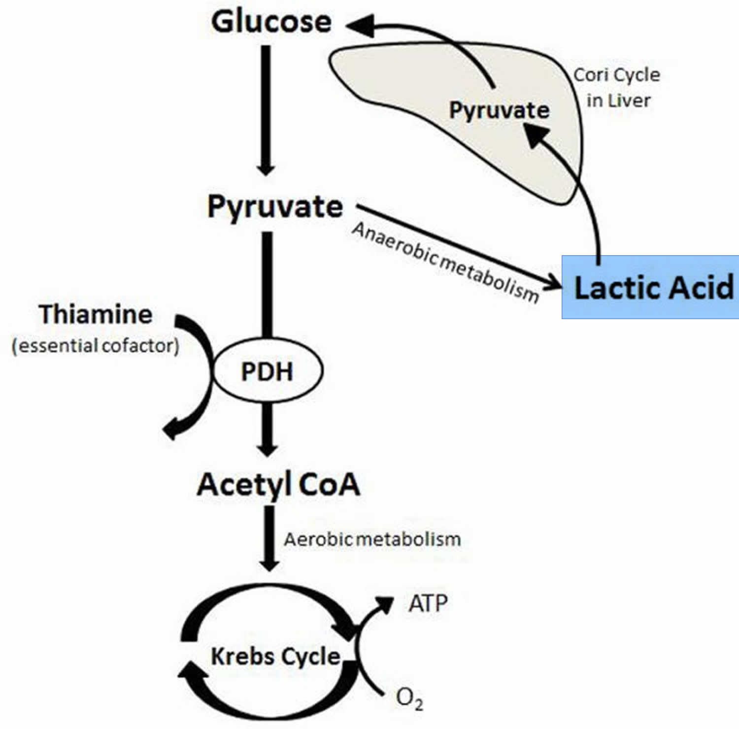
Dextrose solutions disadvantages
Lactate Production: The proportion of a glucose load that contributes to lactate formation
  5% in healthy subjects
  85% in critically ill patients
in patients with circulatory compromise, abnormal glucose metabolism can transform glucose from a source of useful energy to a source of toxin production.

Slide 26
Disadvantages of Glucose infusions
Enhanced CO₂ production (which can be a burden in ventilator dependent or COPD patients).
Hyperglycemia.
Increased risk of infection, Neuropathy.
Aggravation of ischemic brain injury.
Increased mortality in septic shock.

Slide 27
Colloids
Do not pass across diffusional barriers as readily as crystalloids.
  Natural (plasma-derived) colloids :
  Human albumin.
  Synthetic colloids :
    Dextran (e.g. dextran 40 and dextran 70).
    Gelatin (e.g. gelofusine and hemaccel).
    Starch (e.g.hydroxyethyl starch (HES)).

Slide 28
1. Albumin solution
Responsible for 75% of the oncotic pressure of plasma. Acts as buffer, antioxidant and transport protein.
Commercially is available as 5% solution or 20% solution in an isotonic saline diluent.
5% solution has colloid oncotic pressure (COP) 20 mm Hg (similar in oncotic activity to plasma).
Approximately half of the infused volume of 5% albumin stays in the vascular space.
The oncotic effects of albumin last 12-16 hours

Slide 29
2. Albumin solution 20%
COP of 70 mm Hg
Expands the plasma volume by 4 to 5 times the volume infused.
Infusion of 100 mL of 20% albumin can increase the plasma volume 400 to 500 mL.
It is intended for shifting fluid from the interstitial space to the vascular space in hypoproteinemia conditions
Should not be used for volume resuscitation in hypovolemia.

Slide 30
3. Gelatins
COP 27-34 mmHg
The cheapest colloid available.
Unlimited volume for resuscitation.
Unimpaired renal function and hemostasis.
Rapidly excreted by the kidneys (shorter duration 3-4 hr.).
Anaphylactoid reactions: direct histamine release.
Gelofusine is compatible with blood but hemaccel contains Ca⁺².
Hemaccel and gelofusine have the same concentration of sodium (154 meq/L) but gelofusine contain less chloride (120 meq/L).

Slide 31
4. Hydroxyethyl starches
COP 28 mm Hg
Long elimination half-life (17 days) but The oncotic effects of hetastarch disappear within 24 hr
The earlier HES fluids were associated with coagulation dysfunction and pruritis, but the tetrastarches used these days have no effect on bleeding times.
Renal impairment in critically ill patients is associated with osmotic nephrosis like lesions in the proximal and distal tubules

Slide 32
5. Dextrans
COP 40 mm Hg (greater increase in plasma volume).
Not used for volume expansion because of a high incidence of anaphylactic reactions
negative effects on coagulation.
Decrease in blood viscosity and inhibition of erythrocyte aggregation.
Interfere with cross-matching.

Slide 33
Comparison between Colloid

Slide 34
Indications for colloids
Fluid resuscitation in patients with severe intravascular fluid deficits (e.g. hemorrhagic shock) prior to the arrival of blood for transfusion (in conjunction with crystalloids).
2. Fluid resuscitation in the presence of severe hypoalbuminemia or conditions associated with large protein losses such as burns.
colloid solutions are prepared in normal saline (Cl-145-154 mEq/L) and thus can also cause hyperchloremic metabolic acidosis

Slide 36
Calculation of maintenance fluid
Rule of 4:2:1 (infusion per hour)
4 mL/kg/hr. for kg 1-10
+ 2 mL/kg/hr. for kg 10-20 +1 mL/kg/hr. above 20 kg
A patient who weighs 40 kilograms would require : 40 mL/hr + 20 mL/hr + 20 mL = 80 mL/hr
Shortcut formula :
body weight + 40 (= 80 mL/hr. in this example) (Working if body weight >20kg)

Slide 37
Further consideration
Once the maintenance requirements have been calculated, additional potential losses need to be considered to avoid under or over hydration, the following sources of fluid loss and the electrolyte composition of these fluids need to be appreciated:
  Nasogastric aspirates
  Vomit
  Diarrhea
  Stoma, drains, fistula etc.
  Polyuria

Slide 38
MCQ TEST
1- The fluid compartment of total body weight(which one is true)
  Neonate: 40%
  Infant: 70-75%
  Adult male: 80-85%
  Adult female 90-95%
  Elderly
2- Disadvantages of glucose infusion
  a) Decreased CO2 production
  b) Hyperglycemia.
  c) Increased risk of infection.
  d) Aggravation of ischemic brain injury.
  e) Increased mortality in septic shock.
3- Indications of normal saline(all true except one)
  a) Dehydration
  b) Hypovolemia
  c) Hemorrhage
  d) sepsis).
  e) sever sodium depletion
4- best for parenteral maintenance fluids rather than aggressive intravascular volume repletion
a) 0.9% normal saline
b) 0.45% saline
c) Dextrose 5%
d) Ringer lactate
e) Albumin

Slide 39
5- Dextran(all true except one)
  a) Not used for volume expansion
  b) high incidence of anaphylactic reactions
  c) negative effects on coagulation.
  d) Decrease in blood viscosity.
  e) Not Interfere with cross-matching.
6- Regarding disturbiution of Glucose solutions
  <30% remains in Intra vascular space
  b) <10% in Interstitium
  c) >50% in Intra cellular space
  d) More than 30% remain intravascular
  e) Less than 20% intracellular space
7- Colloid fluids(which one is true)
  Natural colloid is starch
  Rate of replacement 1:3
  Almost hypertonic
  No risk for anaphlaxsis
  Cheaper than crystalloid
  8- Hartman solution is
  a) Dextrose
  b) Dextran
  c) Ringer lactate
  d) Normal saline
  e) Dextrose saline

Slide 40
9- lactated Ringer's solution is contraindicated as a diluent for blood transfusions because of
  high Ph.
  High lactate level
  Calcium binding to the citrated anticoagulant
  Potassium binding to calcium
  Non of the above
10- Infusion of 1 L of 0.9% normal saline adds
  a) 275 mL to the plasma volume and 825 mL to the interstitial volume
  b) 275 275 mL to the interstitial volume and 825 mL to the plasma volume
  c) 825 mL to the plasma volume and 275 mL to the interstitial volume
  d) 500 mL to the plasma volume and 500 mL to the interstitial volume
  e) 800 mL to the plasma volume and 200 mL to the interstitial volume

