Slide 1


Al-Mustaqbal University
College of Science
Quantitative Analytical Chemistry
First Year Students / 2nd Semester
3rd, 4th and 5th Lecture – Ways of Concentration Expression
2024-2025
By
Prof. Dr. Naser Abdulhasan Naser

Slide 2
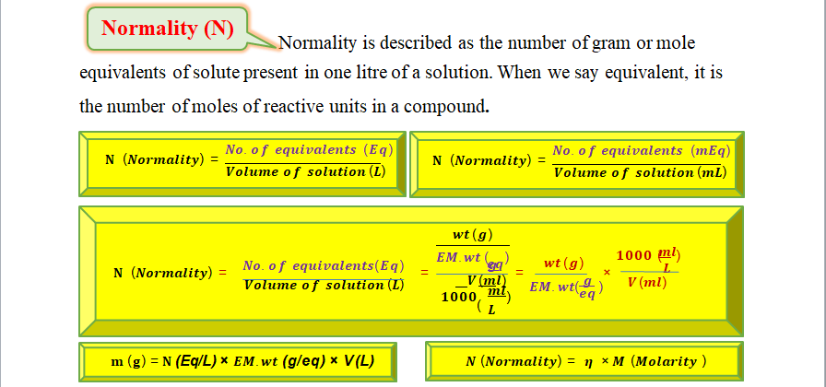

Slide 3
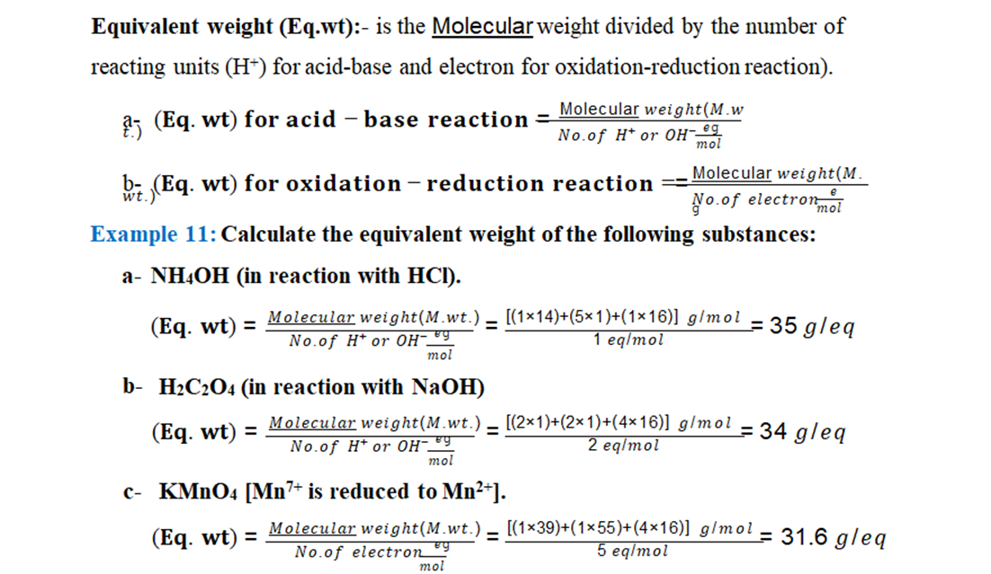

Slide 4
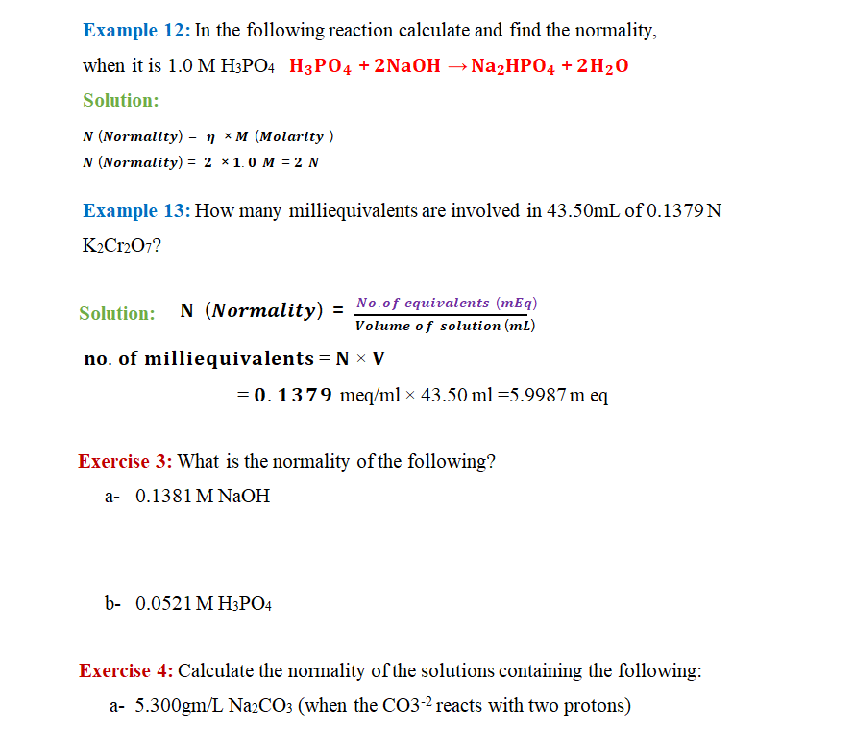
b- 5.267 gm/L K2Cr2O7 (the Cr⁶⁺ is reduced to Cr³⁺).

Slide 5
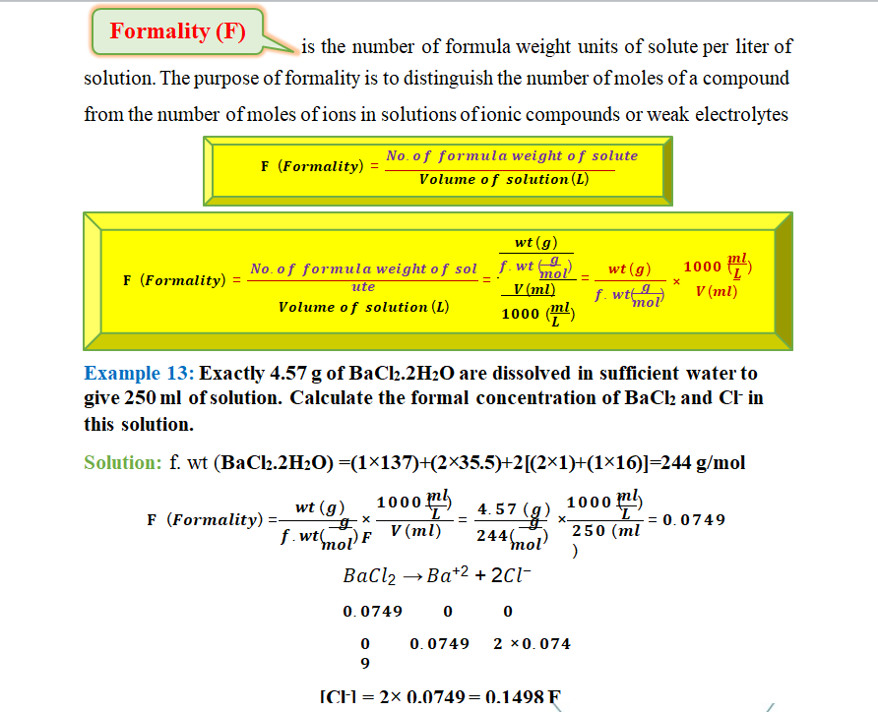


Slide 6
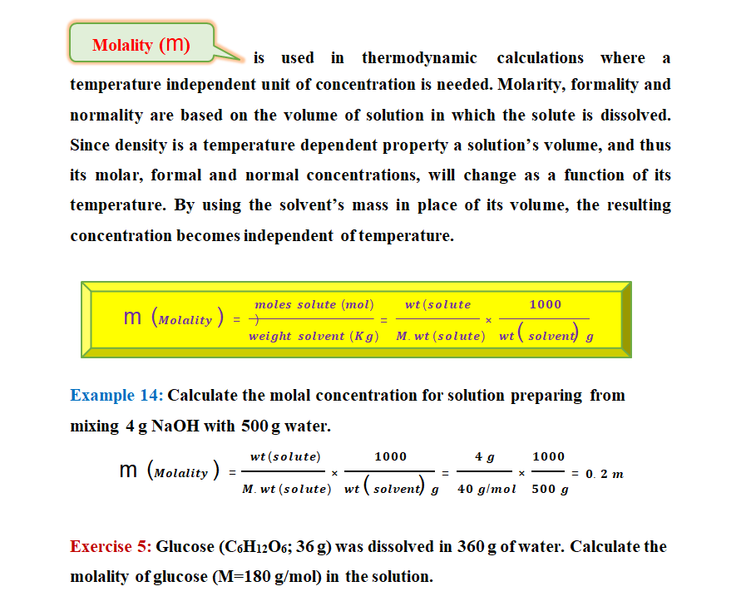

Slide 7
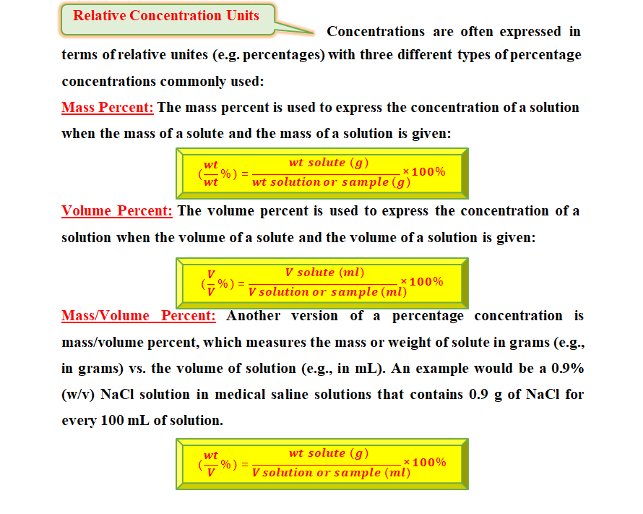

Slide 8
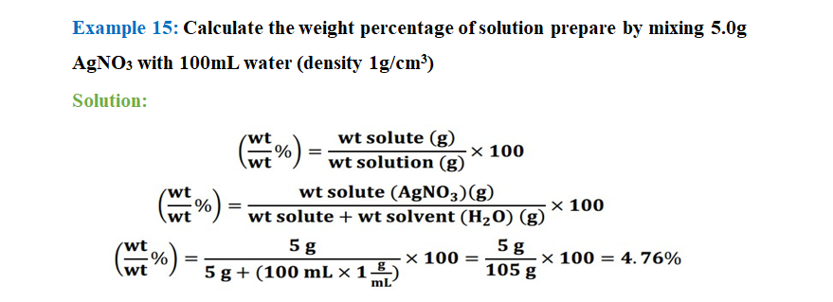
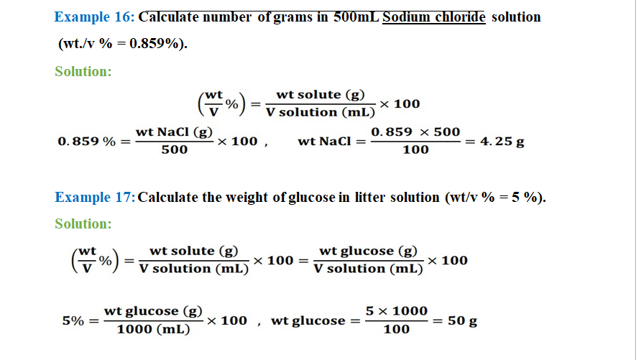

Slide 9


Slide 10

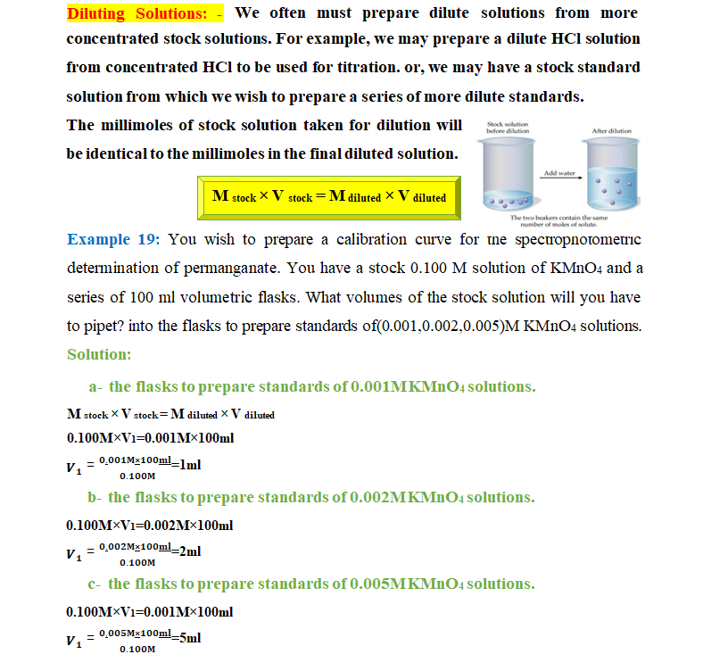

Slide 11
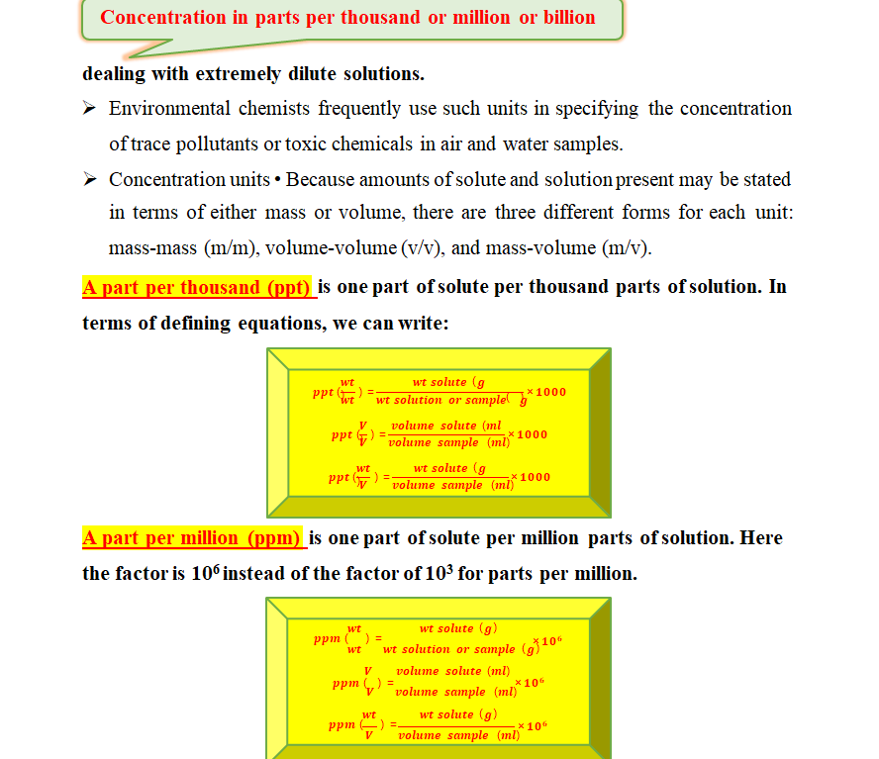

Slide 12

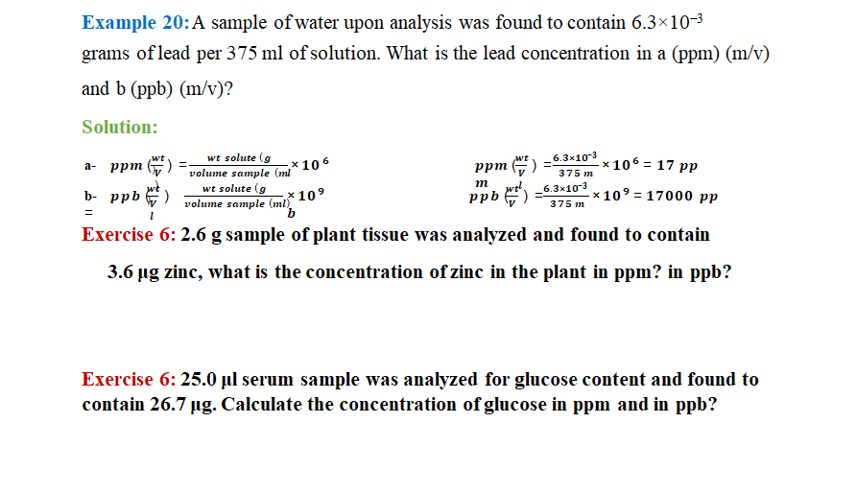

Slide 13
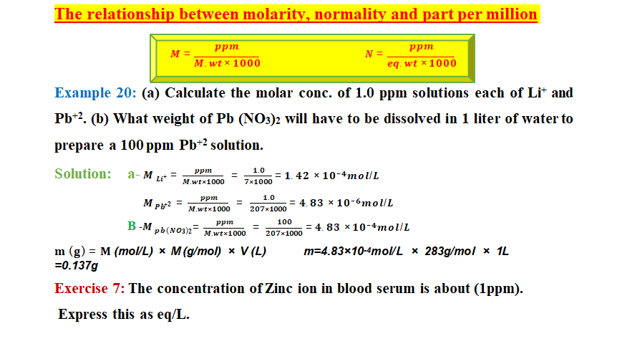

Slide 14
