Slide 1


Al-Mustaqbal University
College of Science
Quantitative Analytical Chemistry
First Year Students / 2nd Semester
1st and 2nd Lecture – Introduction and Ways of Concentration Expression
2024-2025
Biochemistry Department
By
Prof. Dr. Naser Abdulhasan Naser

Slide 2
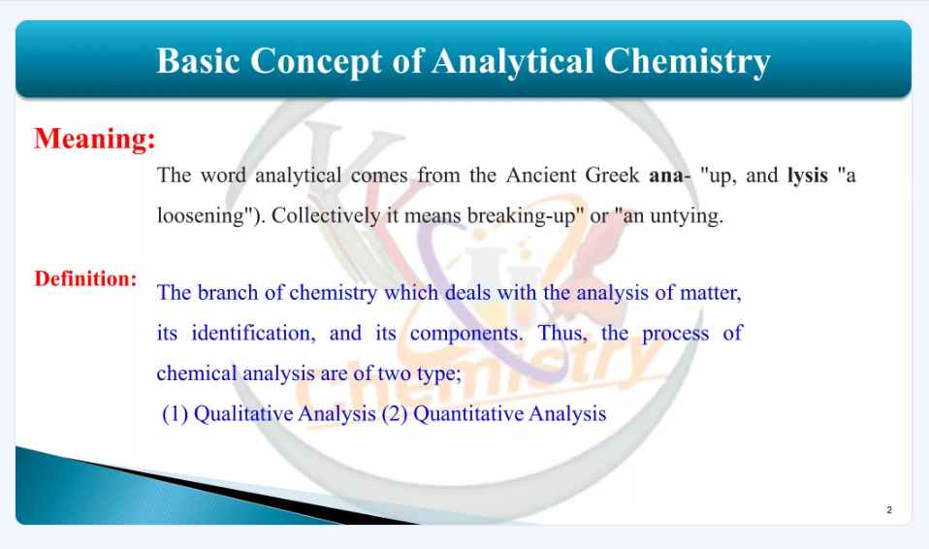

Slide 3
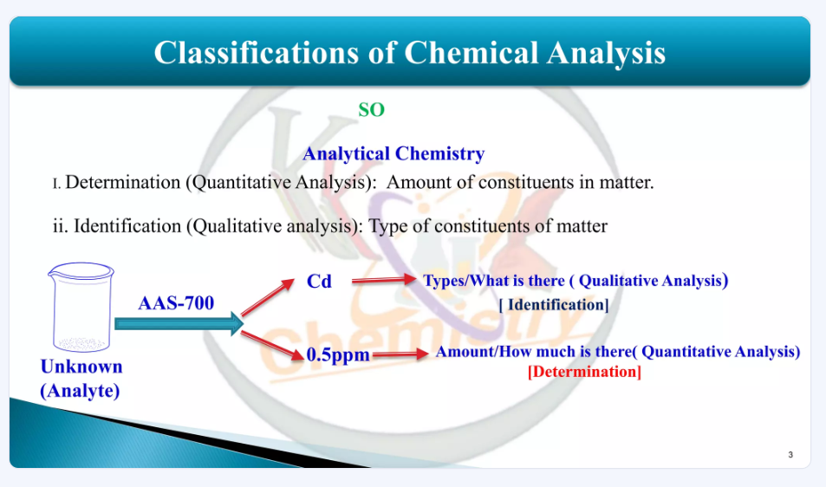

Slide 4
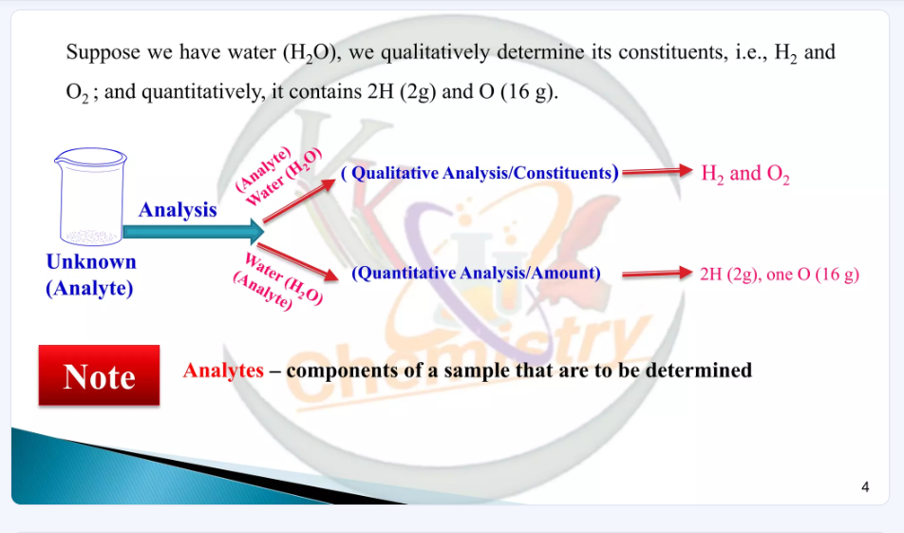

Slide 5
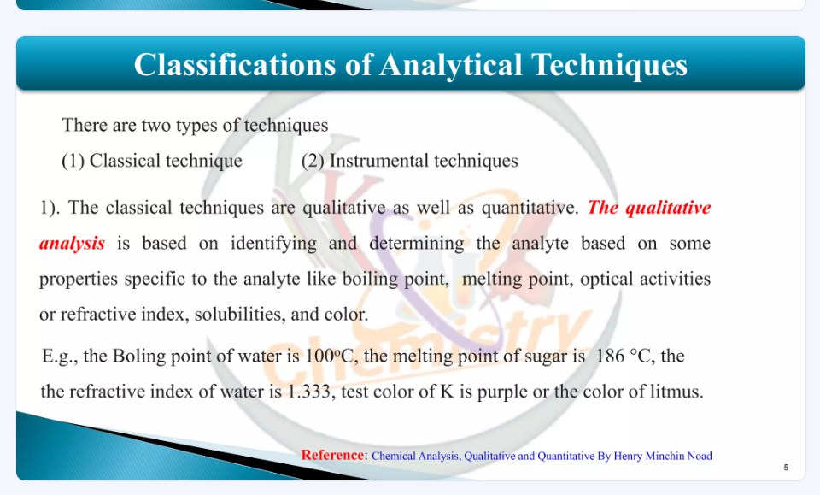

Slide 6
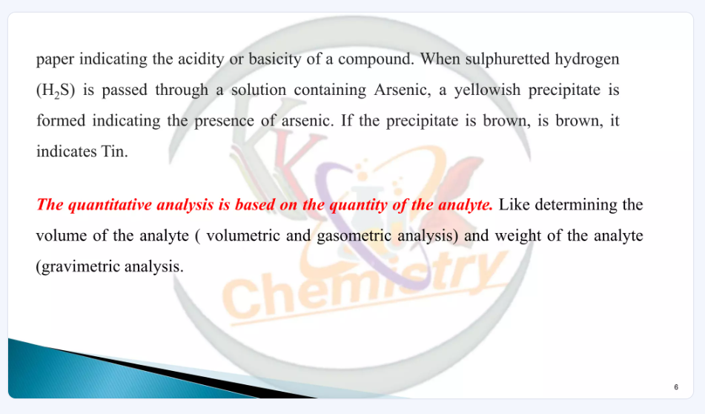

Slide 7
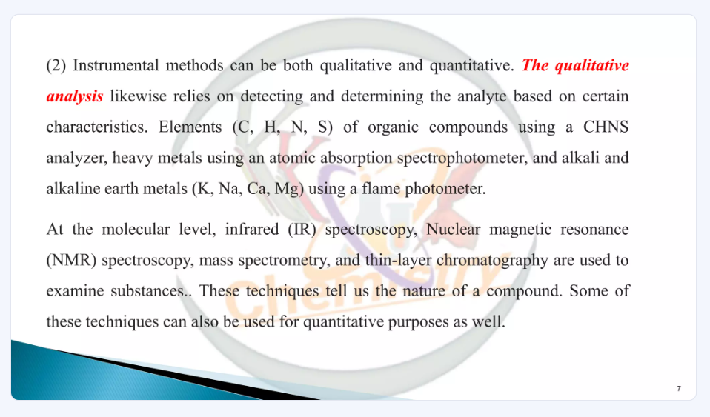

Slide 8
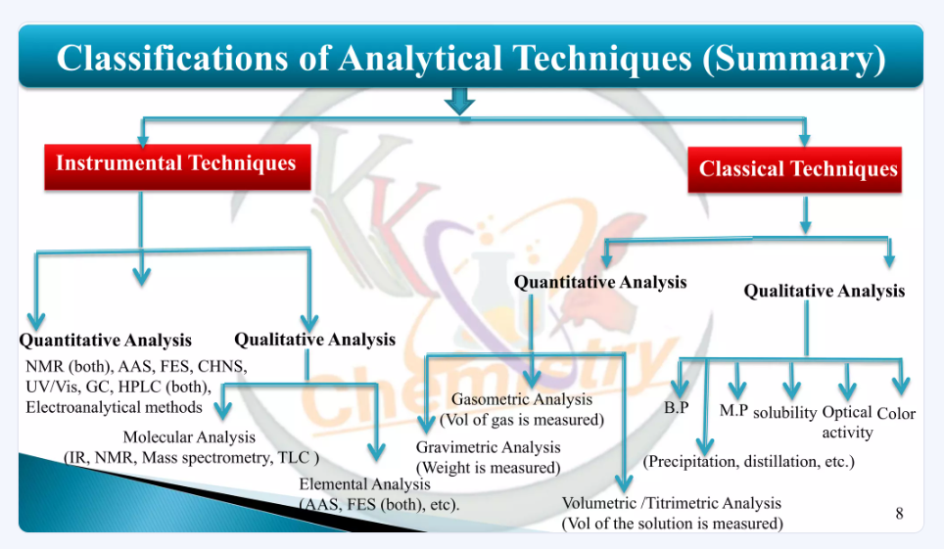

Slide 9
International system of unit SI Units
Base quantity | name of unit | symbol
Length | meter | m
Mass | kilogram | kg
Time | second | s
Electric current | ampere | A
Temperature | kelvin | K
Amount of substance | mole | mol
Luminous intensity | candela | cd

Slide 10
Prefixes used with units
Prefix
symbol meaning example
Giga | G | 10⁹ | 1 gigameter(Gm) = 1 x 10⁹ m
Mega | M | 10⁶ | 1 megamete (Mm) = 1 x 10⁶m
Kilo | k | 10³ | 1 kilometer (km) = 1 x 10^{3 m}
₁₀-1
₁₀-2
₁₀-3
₁₀-6
₁₀-9
₁₀-12
1 decimeter (dm) = 0.1 m
1 centimeter (cm) = 0.01 m
1 millimeter (mm) = 0.001 m
1 micrometer (µm) = 1 x 10⁻⁶ m
1 nanometer (nm) = 1 x 10⁻⁹ m
1 picomer (pm) = 1 x 10⁻¹² m
deci | d
centi | c
Milli | m
Micro | µ
Nano | n
Pico | p

Slide 11
The SI unit of mass is kg :
1 kg = 1 x 10³ g
gm = 1 x 10³ mg
mg = 1 x 10³ ug
um = 1 x 10³ ng
ng = 1 x 10³ pico g
The SI unit of length is m:
1m = 100 cm 1cm = 10 mm 1 cm³
1 dm³
= (1 x 10⁻² m)³ = 1 x 10⁻⁶ m³
= (1 x 10⁻¹ m)³ = 1 x 10⁻³ m³
A common unit of volum is the liter (L) 1 L = 1000 ml
= 1000 cm³
= 1 dm³
1 ml = 1 cm³

Slide 12
The Mole Concept (Avogadro's Number)
Molecules and atoms are extremely small objects - both in size and mass. Consequently, working with them in the laboratory requires a large collection of them. A standard needs to be introduced. This standard is the "mole". The mole is based upon the carbon-12 isotope.
How many carbon-12 atoms are needed to have a mass of exactly 12 g. That number is NA - Avogadro's number. Thus, NA is defined by
NA = 6.0221367x10²³.
NA x (mass of carbon-¹² atom) = 12 g

Slide 13
Gram to Mole conversion
Determine the number of moles in 88 grams of CO₂
Formula Mass CO₂
= (1 x 12) + (2 x 16)
= 44
= formula mass CO₂
= 44 grams CO₂
1 mole of CO₂
88 grams CO₂ x 1 mole CO₂ / 44 grams CO₂
= 2 moles CO₂

Slide 14
Problem
Determine the number of moles of CO₂ in 454 grams.
Solution
First, look up the atomic masses for carbon and oxygen from the Periodic Table. The atomic mass of C is 12.01 and the atomic mass of O is 16.00.
The formula mass of CO₂ is: 12.01 + 2(16.00) = 44.01
Thus, one mole of CO₂ weights 44.01 grams.
This relation provides a conversion factor to go from grams to moles. Using the factor 1 mol/44.01 g:
moles CO₂ = 454 g x 1 mol/44.01 g = 10.3 moles
Answer
10.3 moles CO₂

Slide 15
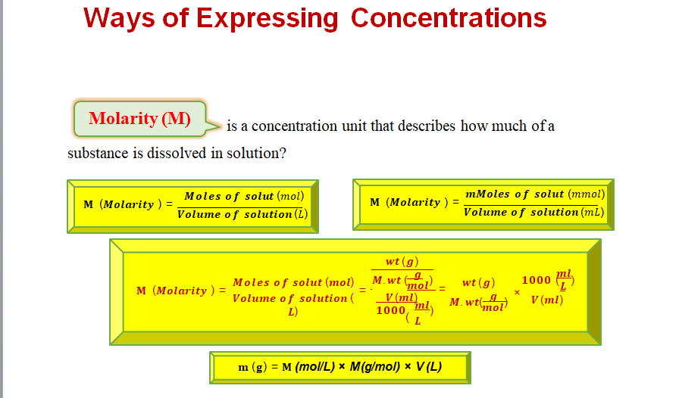

Slide 16
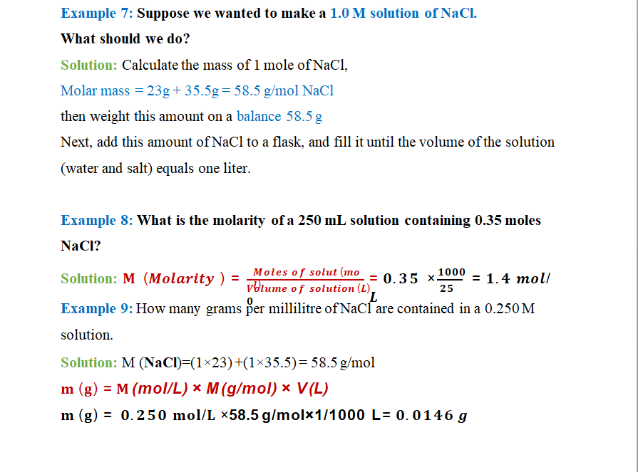

Slide 17
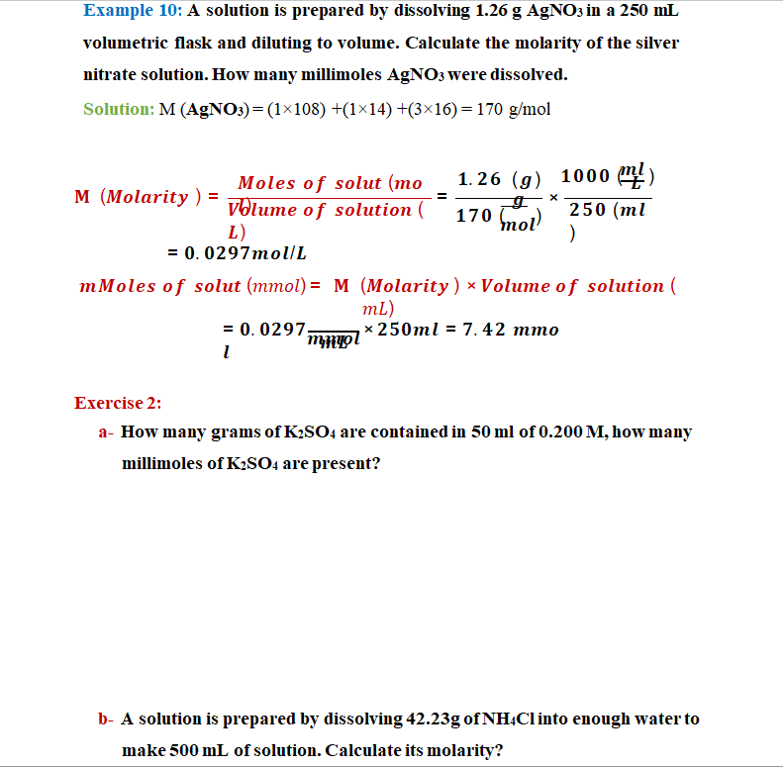

Slide 18
16
c- What is the molarity of a solution made when 66.2 g of C6H12O6 are dissolved to make 235 mL of solution?
d- suppose we ask how many moles of solute are present in 0.108 L of a 0.887 M NaCl solution. Because 0.887 M means 0.887 mol/L, we can use this second expression for the concentration as a conversion factor:
e- Determining Volume of a Solution, Given the Concentration and Moles of Solute Using concentration as a conversion factor, how many liters of 2.35 M CuSO4 are needed to obtain 4.88 mol of CuSO4 ?
f- A chemist needs to prepare 3.00L of a 0.250M solution of potassium permanganate (KMnO4). What mass of KMnO4 does she need to make the solution?

Slide 19
17
g- Using concentration as a conversion factor, how many liters of 0.0444 M CH2O are needed to obtain 0.0773 mol of CH2O?
h- a: What mass of solute is present in 1.08 L of 0.0578 M H2SO4?
b: What volume of 1.50 M HCl solution contains 10.0 g of hydrogen chloride?
i- A solution is prepared by dissolving 1.26 g AgNO3 in a 250-mL volumetric flask and diluting to volume. Calculate the molarity of the silver nitrate solution. How many millimoles AgNO3 were dissolved?
j- How many grams per milliliter of NaCl are contained in a 0.250 M
solution?
k- How many grams Na2SO4 should be weighed out to prepare 500mL of a
0.100 M solution?

