Slide 1
Thoracentesis
Thoracentesis is a procedure to remove fluid from the space between the lungs and the chest wall called the pleural space through a needle or tube.
Indication
Traumatic pneumothorax
Hemopneumothorax
Spontaneous pneumothorax
Bronchopleural fistula
Pleural effusion

Slide 2
Contraindication
Coagulation disorder
Atelectasis
Emphysema(pulmonary enlargement)
Severe cough or hiccups
COMPLICATION
Pulmonary edema
Bleeding
Respiratory distress
Infection
Air embolism
Dyspnea and cough
Cardiac tamponade(fluid build up in the space between myocardium and pericardium )
Atelectasis (lung collapse)

Slide 3
Before The Procedure
Explain the purpose,
risks/benefits, and steps of the procedure and obtain consent from the patient or appropriate legal design. R: An explanation helps orient the patient to the procedure assist in coping and provide an opportunity to ask question and verbalise anxiety
Take Medical History such as Trouble in breathing, coughing, and hiccups, Had heart disease, Smoked
Prepare Equipment
➢ Dressing set ➢ Povidone / Alcohol ➢ Abraham’s needle
➢ Local anaesthetic, e.g. lignocaine (lidocaine) 1% ➢ Connecting tubing or 2%
➢ Syringe 50ml and 5ml ➢ Formalin bottle ➢ Urine bottle x2
➢ Needles (18 and 23 ➢ C+S bottle gauge) ➢ 3-way stopcock ➢ Sterile Glove

Slide 4
Place patient upright / cardiac position and help patient maintain position during procedure. R: the upright position ensures that the diaphragm is more dependent and facilitates the removal of fluid that usually localizes at the base of the chest.
Explain that he/she will receive a local anesthetic to minimize pain during the procedure.
Clean patient skin with antiseptic to prevent infection and maintain

Slide 5
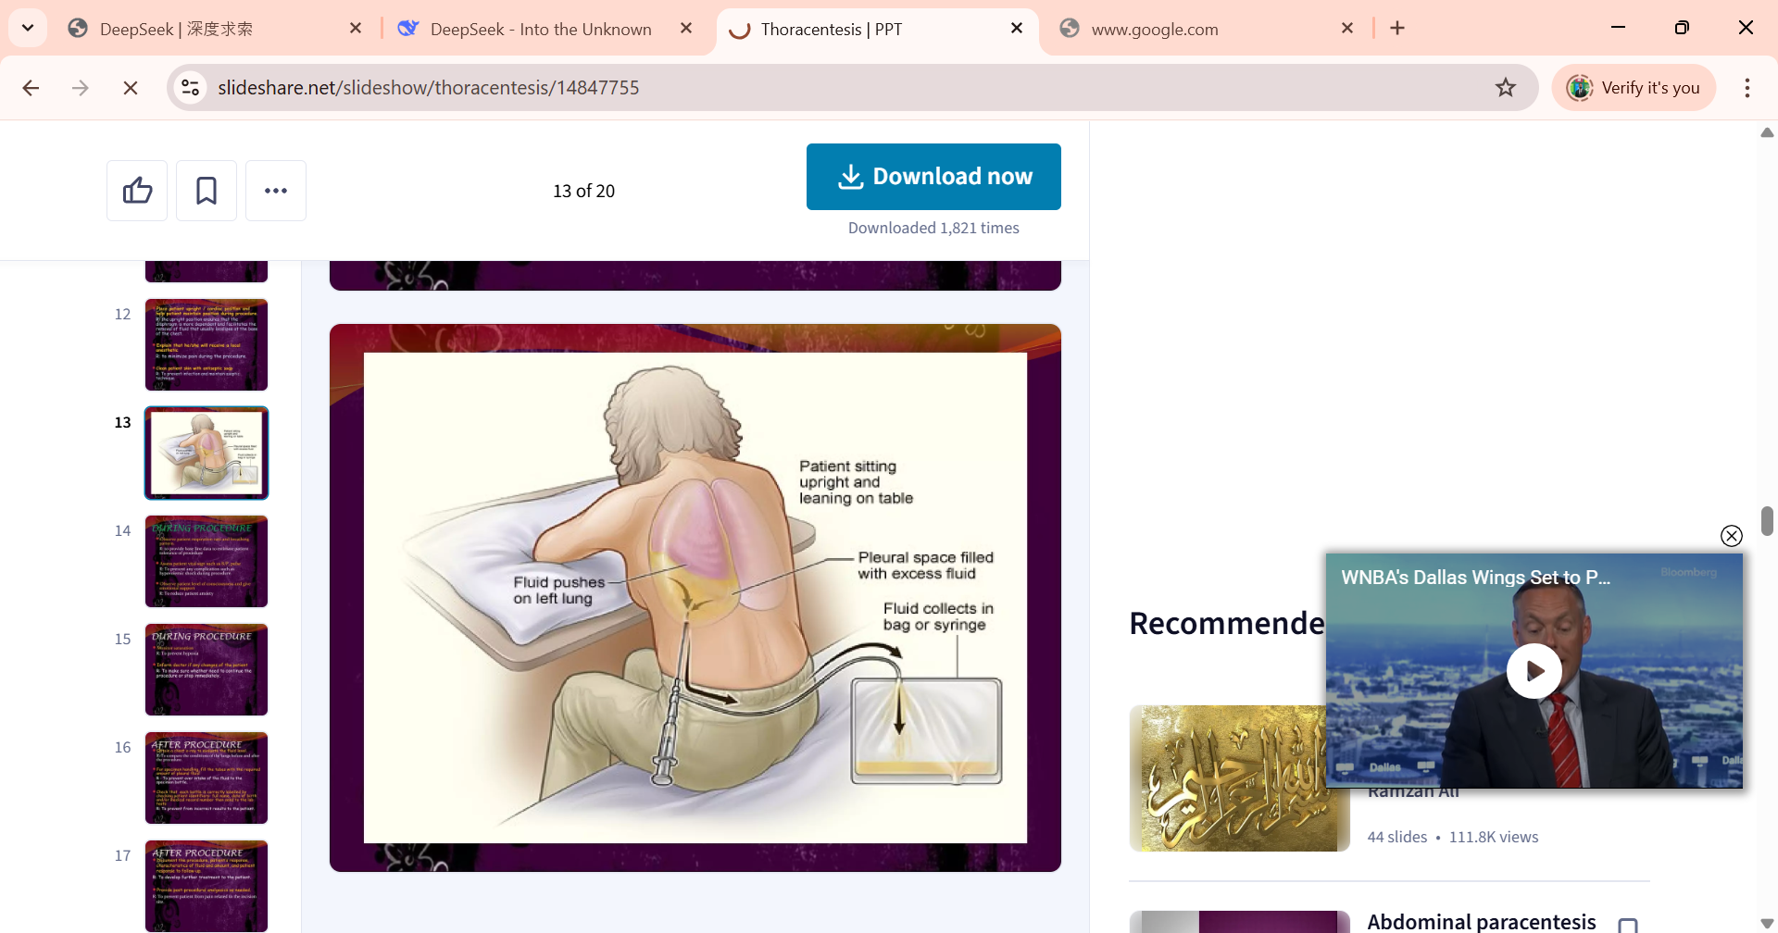

Slide 6
DURING PROCEDURE
Observe patient respiration rate and breathing pattern
Assess patient vital sign to prevent any complication such as hypovolemic shock during procedure.
Observe patient level of consciousness and give emotional support to reduce patient anxiety
Monitor saturation to prevent hypoxia.
AFTER PROCEDURE
Obtain a chest x-ray to evaluate the fluid level To compare the conditions of the lungs before and after the procedure.
Document the procedure, patient’s response, characteristics of fluid and amount, and patient response to follow-up
Provide post-procedural analgesics as needed To prevent patient from pain related to the incision site

Slide 7
Paracentesis
A sterile procedure to remove fluid (ascites) from the peritoneal cavity.
Indications
Diagnostic:
  Unexplained ascites (e.g., infection, cancer).
  Suspected spontaneous bacterial peritonitis (SBP).
Therapeutic:
  Respiratory distress due to fluid pressure.
  Abdominal pain/discomfort.

Slide 8
Contraindications
  Severe bleeding disorders.
  Bowel obstruction.
  Skin infection at puncture site.
Equipment Needed
Sterile tray: Needle,syringes, tubes.
Dressing supplies: Gauze, adhesive bandage.
Lab tubes: Culture, albumin, cell count.
IV access kit (for fluid replacement if needed).

Slide 9
Procedure Nursing Care
Patient Education: Explain steps, obtain consent.
Assessment:
  Vital signs (baseline).
  Abdominal girth, weight.
Preparation:
  Empty bladder.
  Position: Supine or slightly lateral.
Site: Midline or lateral lower quadrant (ultrasound-guided).
Aseptic technique: Chlorhexidine prep, sterile drapes.
Fluid removal:
  Diagnostic: 20–50 mL.
  Therapeutic: Up to 4–6 L (monitor for hypotension).

Slide 10
Complications
Hypotension, mild bruising.
Infection (peritonitis).
Bowel perforation.
Hemorrhage
Patient Education
Report fever, dizziness, or abdominal pain.
Limit activity for 24 hours.
Follow-up for lab results (if diagnostic).

