Slide 1

كلية العلوم
قــســــــــــم الانـــظــــمــــة الــــطـبـيـة الـــذكــــــيـــة
Intelligent Medical Systems Department
Subject: English Language
Class: Second
Lecturer: MSC. Sakina Hussain Alsuwaydi
Lecture: ( 2 )
Present Simple and Preposition
Study Year: 2024-2025

Slide 2
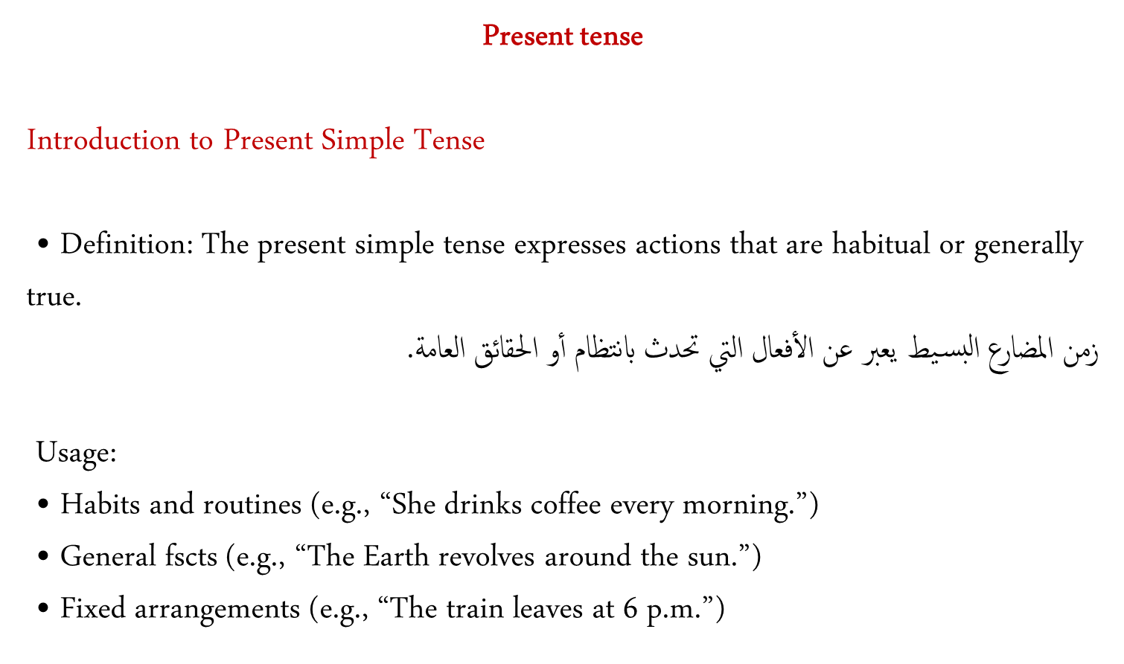

Slide 3
Sentence Structure
Affirmative Sentences:
Structure: : القاعدة
Subject + verb (add ‘s’ or ‘es’ for third person singular) + comp.
“He reads books.”
Subject + base verb + comp.
“I read books.”
Negative Sentences:
Structure:
Subject + do/does + not + base verb + comp.
Examples:
“They do not (don’t) play soccer.”
“She does not (doesn’t) play soccer.”
(He, She, It)
(I, We, They, You)
P.S.
Do: They, we, I, you.
Does: He, she, it.

Slide 4
Forming Questions
Yes/No Questions:
Structure:
Do/Does + subject + base form of the verb?
Examples:
“Do you like pizza?”
“Does he like pizza?”
Wh- Questions:
Structure: Wh- word + do/does + subject + base form of the verb?
Examples:
“Where do they live?”
“What does she do?”

Slide 5
Rules for Third Person Singular
General Rule: Add ‘s’ to the base form (e.g., “run” → “runs”)
Exceptions:
Verbs ending in -o, -ch, -sh, -ss, -x, -z: add ‘es’ (e.g., “go” → “goes”)
Verbs ending in consonant + y: change ‘y’ to ‘ies’ (e.g., “fly” → “flies”)

Slide 6
Prepositions
What Are Prepositions?
Definition:
A preposition is a word that shows the relationship between a noun (or pronoun) and other parts of a sentence.
Key Idea:
Prepositions often tell us about place, time , or direction.
Examples:
1. The book is on the table.
2. She is sitting beside her friend.
3. He went to the park.

Slide 7
Types of Prepositions
1. Prepositions of Place: Shows where something is.
Examples: The keys are in the bag.
The painting is on the wall.
He is standing under the tree.
2. Prepositions of Time: Shows when something happens.
Examples: We met on Monday.
The movie starts at 7 PM.
They arrived in the morning.
3. Prepositions of Direction: Shows movement toward a specific direction.
Examples:
He is going to the market.
She walked into the room.
They moved toward the exit.

Slide 8
Common Mistakes and Tips
Mistakes to Avoid:
1. Using the wrong preposition:
Incorrect: She depends in her brother.
Correct: She depends on her brother.
2. Omitting the preposition:
Incorrect: I am good English.
Correct: I am good at English.
Tips:
• Memorize common phrases with prepositions.
• Practice prepositions in context (e.g., sentences).
• Remember that prepositions are often followed by a noun or pronoun.
P.S. The preposition used in the examples are dependent prepositions. There are prepositions that follow certain verbs, adjectives, or nouns, forming fixed expressions.

Slide 9
Thank you

