Slide 1

كلية العلوم
قــســــــــــم الانـــظــــمــــة الــــطـبـيـة الـــذكــــــيـــة
Intelligent Medical Systems Department
Subject: English Language
Class: Second
Lecturer: MSC. Sakina Hussain Alsuwaydi
Lecture: ( 5)
Language focus Compare the Use of Tenses,
Reading and speaking
Study Year: 2024-2025

Slide 2
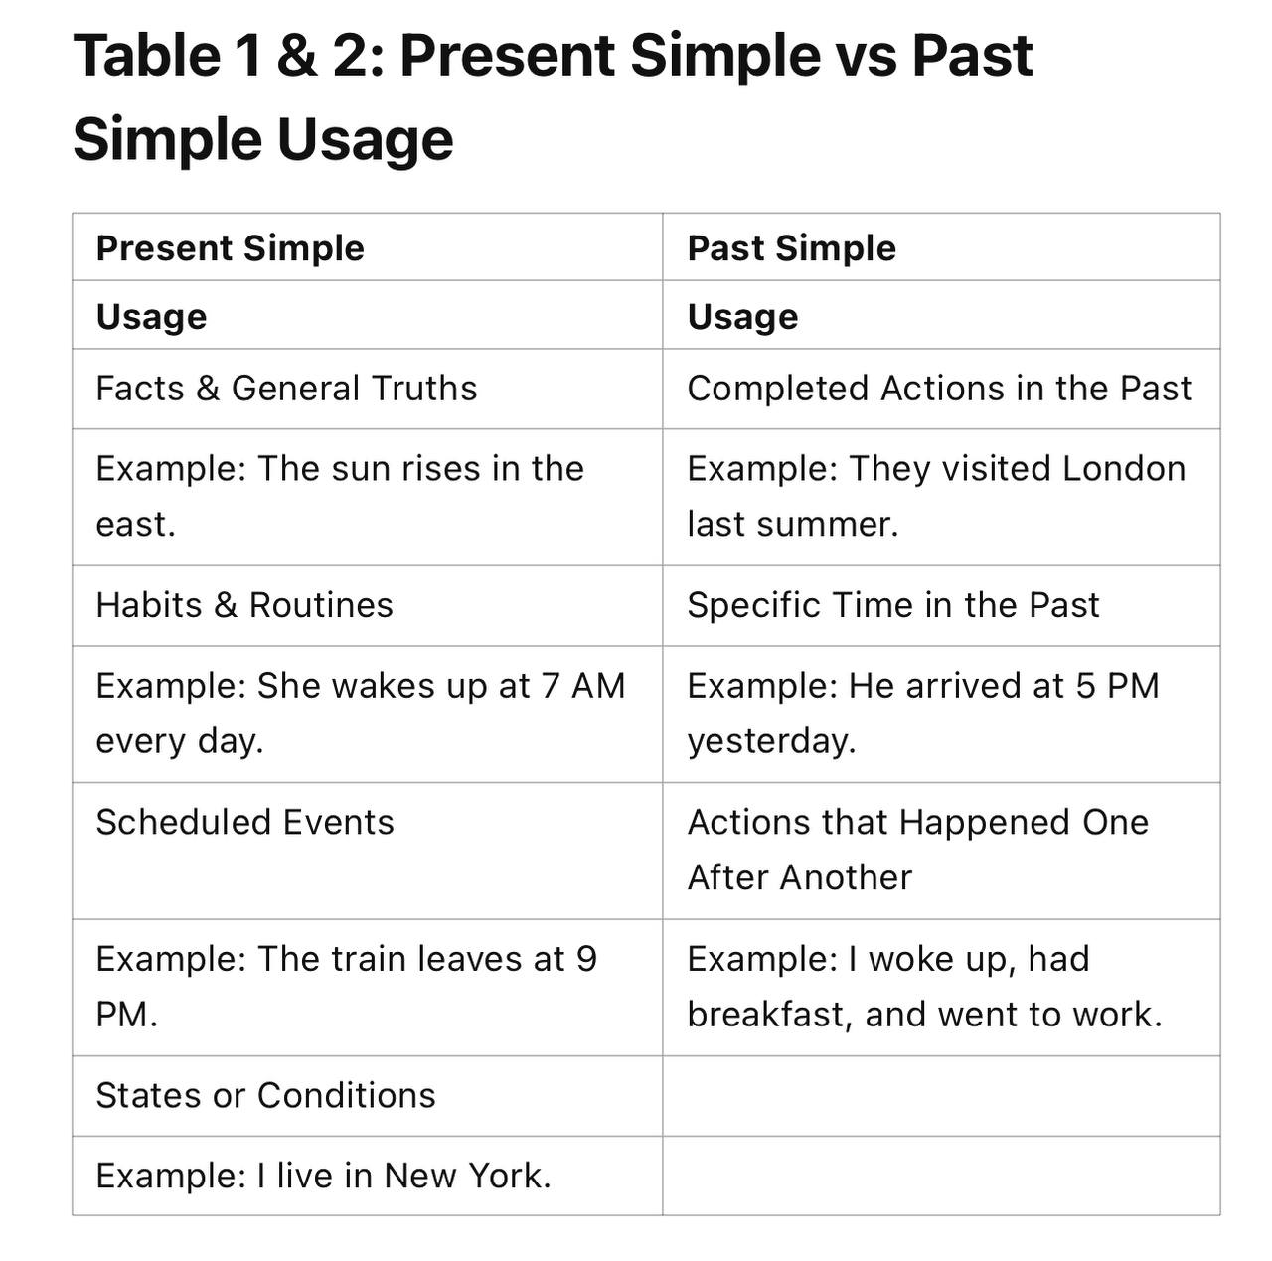

Slide 3
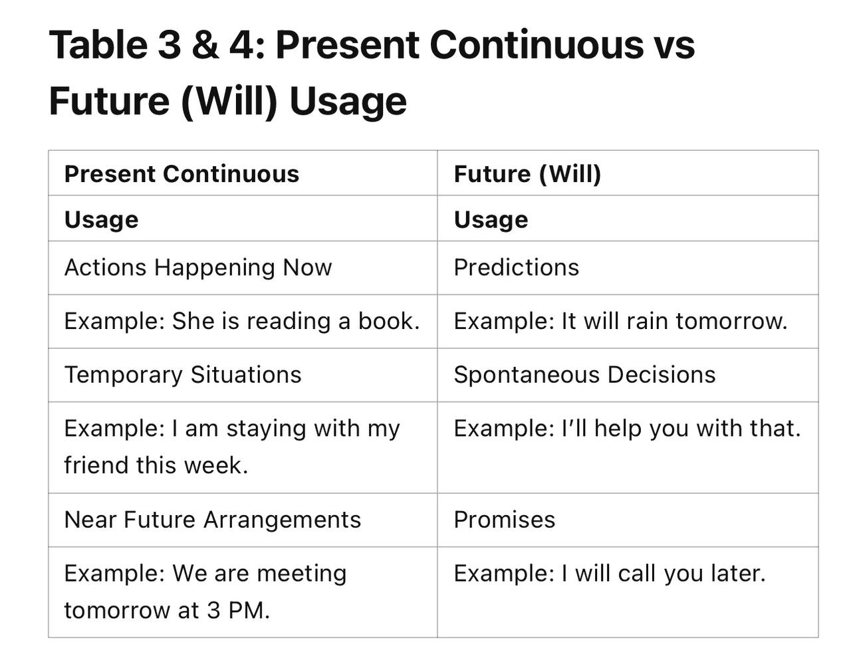

Slide 4
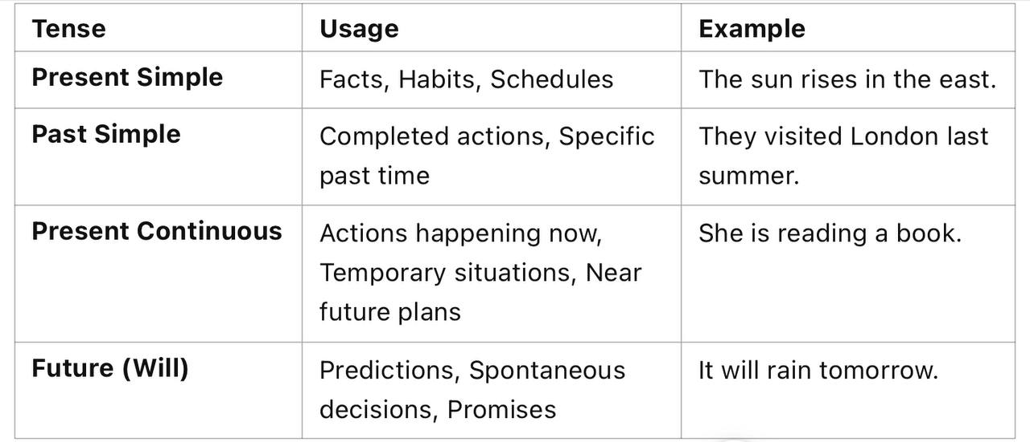

Slide 5
The Mysterious Door
While walking home from school, Ali noticed a small wooden door in the wall of an old building. He had never seen it before. Curious, he touched the handle, and the door slowly creaked open. Inside, he saw…
Discussion Questions:
What do you think Ali saw inside?
Would you open the door if you were him? Why or why not?
Can you create a different ending for this story?

Slide 6
The Forgotten Letter
Sara was cleaning her grandmother’s attic when she found an old, yellowed envelope with her name on it. She opened it and read:
“Dear Sara, if you are reading this, it means you have discovered the truth…”
Discussion Questions:
What do you think the letter said?
Why was it hidden in the attic?
How would you react if you found a letter like this?

Slide 7
Discussion Topics:
Do you think AI and Technology will control people?

Slide 8
Thank You

