Slide 1


Medical Microbiology
M.S.c Amna shaker
Lecture FOUR
Almustaqbal university
Department of Medical Biotechnology

Slide 2
Laboratory diagnosis of Enteric fever; Cholera, Salmonella: shigella, E.coli
Enteric fever also known as typhoid fever, is a common infectious disease in low and middle income countries. It is the commonest bacterial cause of fever .About 14 million people are affected annually, mainly in low and middle income countries .
How is it diagnosed?
Enteric fever is mainly a clinical diagnosis based on history and examination. A gradual onset of fever, particularly with one or more abdominal symptoms.

Slide 3
The laboratory diagnosis for Enteric Fever (Typhoid and Paratyphoid) :
1-Blood Culture: Gold standard for early diagnosis; detects Salmonella Typhi or Paratyphi.
2- Widal Test: Serological test detecting antibodies against Salmonella antigens (O and H). Limited by false positives/negatives.
3- Bone Marrow Culture: More sensitive than blood culture, especially in treated cases.
4- PCR: Detects Salmonella DNA; highly specific and sensitive.

Slide 4
The laboratory diagnosis for Cholera
Stool Culture: Confirms Vibrio cholerae; uses selective media like TCBS agar.
Rapid Diagnostic Tests (RDTs): Detect cholera antigens in stool; useful in outbreaks.
Dark-Field Microscopy: Observes motile vibrios in fresh stool samples.
PCR: Identifies cholera toxin genes.

Slide 5
The laboratory diagnosis for Salmonella :
Stool Culture: Primary diagnostic method; isolates Salmonella from feces.
Blood Culture: Used in systemic infections.
Serotyping: Identifies specific Salmonella serovars.
Molecular Tests: PCR for rapid detection.

Slide 6
The laboratory diagnosis for Shigella:
1- Stool Culture: Gold standard; isolates Shigella species.
2- Microscopy: Detects pus cells and red blood cells in stool.
3- PCR: Confirms Shigella DNA; useful in outbreaks.
4- Serotyping: Differentiates Shigella specie

Slide 7
The laboratory diagnosis for E. coli (Pathogenic Strains) :
Stool Culture: Identifies pathogenic strains like EHEC, ETEC, etc.
PCR: Detects virulence genes (toxin in EHEC).
Serotyping: Differentiates pathogenic from commensal strains.
ELISA: Detects toxin in stool sample.

Slide 8
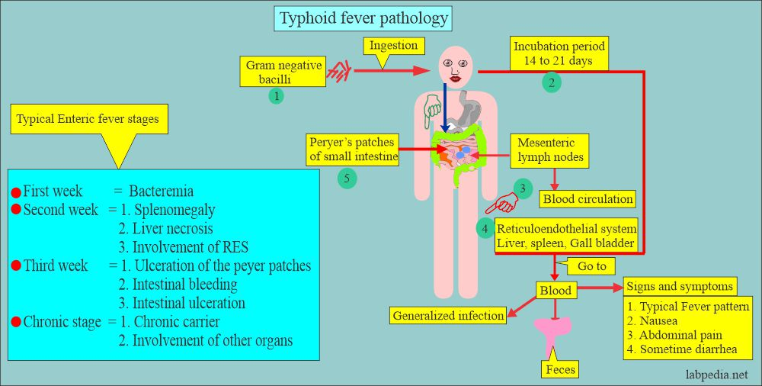

Slide 9


Slide 10
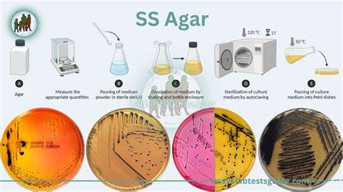

Slide 11
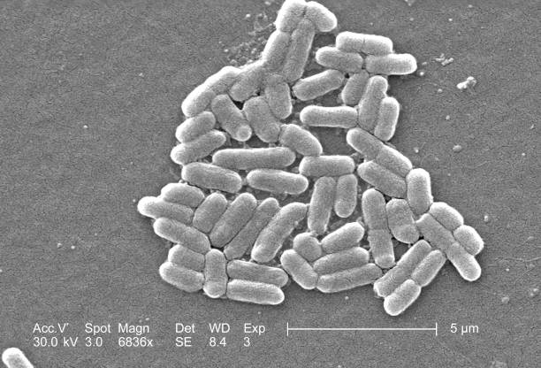
E. Coli

Slide 12
Thank
You

