Slide 1
Renal artery occlusion
Causes:
1-atheromatous Plaque
2-aortic dissection
3-emboli
4-traumatic avulsion
In acute stage following complete arterial occlusion the affected kidney may be normal in size and have normal reflectivity.
Some time slight increase in size may be demonstrated.

Slide 2
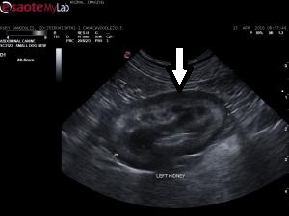
In some patients a sub capsular ‘halo’ or rim of echo poor tissue can be seen which correspond to edematous tissue.
In the longer term the affected kidney slowly shrinks with smooth margins

Slide 3
Renal artery stenosis
up to 5% of patients with hypertension caused by renal artery stenosis .
22% of the patients seen with renal artery stenosis of >60% diameter reduction

Slide 4
Causes of renal artery stenosis
1-atheroma
2-fibromuscular dysplasia of the vessel wall.
3-aortic aneurysm
4- arteritis
5- emboli
6-neurofibromatosis
7-trauma

Slide 5
Renal artery stenosis
In a patient with unilateral renal artery stenosis the affected kidney is usually of
normal shape and size.
If the stenosis is greater than 60% small
size kidney may be found.

Slide 6
Normal and abnormal Urinary bladder
Indications for UB ultrasound:
1- Dysuria or frequency of micturition.
2- Haematuria
3- Recurrent infection (cystitis)
4- Pelvic mass.
5- Retention of urine.
6- Pelvic pain.

Slide 7
Preparation of the patient
The bladder must be full. Give 4 or 5 glasses of fluid and examine after one hour.
Some time we can fill the bladder through a urethral catheter with sterile normal saline
Avoid catheterization if possible because of the risk of infection.

Slide 8
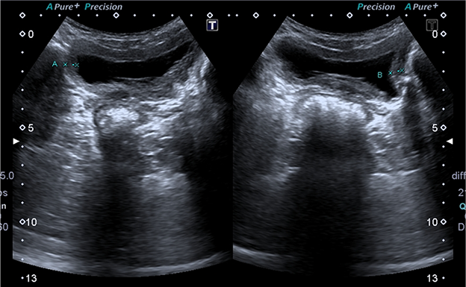
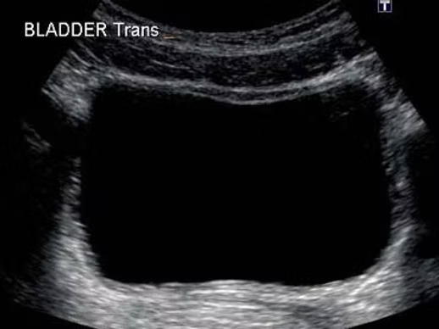
Normal bladder
full urinary bladder appears as a large, echo-free area
empty bladder full bladder

Slide 9
Wall thickness
Start by assessing the smoothness of the interior wall of the bladder and its symmetry
It should always be approximately the same all around the bladder
When distended, the normal bladder wall is less than 4 mm thick.

Slide 10
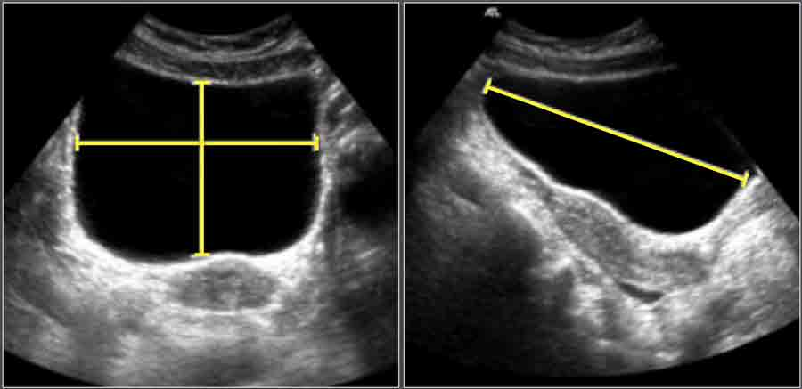
Residual urine calculation
After scanning, the patient should empty the bladder. Normally, there should be no residual urine: if there is, the quantity should be estimated
T x L x AP x 0.52

Slide 11
Thank you

