Slide 1



Vital Signs (Temperature and Pulse Measurement)
Presented by : prof. Dr. Fadhil Sahib .
Lecturer in Almustaqbal University
Faculty of Health and Medical Techniques

Slide 2
Vital Signs
Definition: Procedure that takes the sign of basic physiology that includes temperature , pulse, respiration and blood pressure. If any abnormality occurs in the body, vital signs change immediately
Purpose:
To assess the client’s condition
To determine the baseline values for comparisons
To detect changes and abnormalities in the condition of client.

Slide 3
What are the Vital signs?
1.Body temperature 2.Pulse
3. Respiration
4. Blood pressure .

Slide 4
Times to Assess Vital Signs:
On admission.
When a client has a change in health status such as chest pain or faint.
Before and after surgery or an invasive procedure.
Before and after the administration of a medication .
Before and after any nursing intervention that could affect the vital signs

Slide 5
Equipment
Vital sign tray
Stethoscope
Sphygmomanometer
Thermometer
Second hand watch
Vital sign sheet
Cotton swab
Disposable gloves if available

Slide 6
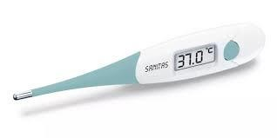
Body Temperature

Slide 7
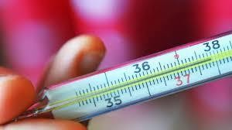
1-Body Temperature
Body temperature reflects the balance between the heat produced and the heat lost from the body

Slide 8
Factors that affect body temperature are the following:
Age.
Diurnal variations.
Exercise.
Hormones.
Stress.
Environment.

Slide 9
The normal range for Body Temperature in adults between (36°C and 37.5°C) .
Pyrexia:- is a body temperature above the normal range (38°C – 40.9° ).
Hyperpyrexia:- A very high fever, such as 41°C and more.
Hypothermia is a body temperature below ( 36°C)

Slide 10
The most common sites for measuring body temperature: 1 -Oral. (2-3) minute.
  Rectal. (2) minute (-0.5)
  Axillary. (5-6) minute (+0.5)
  Skin/temporal artery.
  Tympanic.
Normal temperature
Oral ; 37 c
Axillary ; 36.5 c
Rectal ; 37.6 c

Slide 11
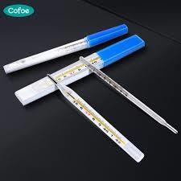
Types of Thermometer
1- Glass mercury thermometer :- (Orally)
2- Electronic thermometer:- ( Axillary )

Slide 12
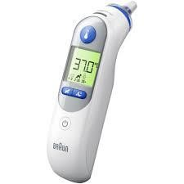
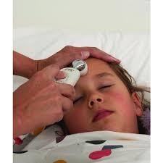
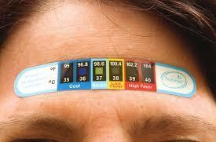
3 - Tympanic Thermometer
4 - Temporal artery thermometer
5 - A temperature sensitive skin tape

Slide 13
Contraindication for oral temperature
1-Child under age 3 years
Old age people
Unconscious patient
Mental ill patient
Oral surgery, lesion or ulcer
Nasal obstruction
Patient has cough
Patient has nasogastric (NG) Tub

Slide 14
Contraindication for rectal temp
Rectal surgery
Diarrhea
Rectal disorder ( bleeding )

Slide 15
Procedure to checking temperature:
Wash your hands.
Prepare all required equipment’s.
Introduce your self and explain procedure to client.
Provide for client privacy.
Place the client in the appropriate position
Place the thermometer.
Wait the appropriate amount of time.
Remove the thermometer .
Read the temperature and record it on your worksheet.

Slide 16
2- Pulse
The pulse is a wave of blood created by contraction of the left ventricle of the heart. number of times the heart beats in 1 minute.
The rate of the pulse is expressed in beats per minute (beats/min)

Slide 17
Factors Affecting the Pulse
Age
Sex.
Exercise
Fever
Medications.
Hypovolemia/dehydration.
Stress
Position and sleep.
Pathology

Slide 18
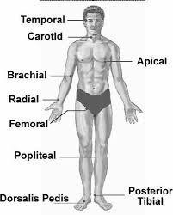
Pulse Sites :
Radial
Temporal
Carotid
Apical ( central )
Brachial
Femoral
Popliteal
Dorsalis Pedi’s
Posterior tibial

Slide 19
1- Rate
Pulse Assessment
Normal ( 60 ---100) beat/ Minute
2- rhythm
* Regular Irregular
3- Volume -Strength
Bounding or strong pulse
Normal pulse
* weak or threatening pulse
Absent of pulse

Slide 20
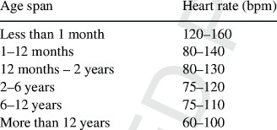

Slide 21

Variances in Pulse Rate
Tachycardia: pulse rate more than 100 bpm (beat per minuet)
Bradycardia: pulse rate less than 60 bpm
Dysrhythmia (arrhythmia): irregular rhythm

Slide 22
Procedure to checking pulse rate:
1-Wash your hands.
Prepare all required equipment’s.
Introduce your self and explain procedure to client.
Provide for client privacy.
Select the pulse point. Normally, the radial pulse is taken.
Assist the client to a comfortable resting position.
Assess the pulse rhythm and volume for 1 minute.
Document the pulse rate, rhythm, and volume and your actions in the client record.

Slide 23


