Slide 1
Mitral Valve
Prepared by:
M.Sc.N: Ali Jassim

Slide 2
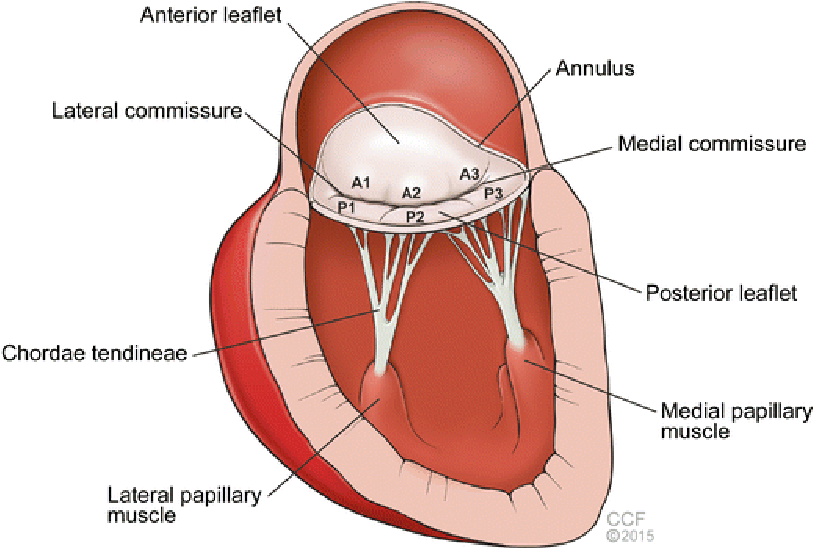

Slide 3
Introduction
The function of normal heart valves is to maintain the forward flow of blood from the atria to the ventricles and from the ventricles to the great vessels.
Valvular damage may interfere with valvular function by stenosis or by impaired closure that allows backward leakage of blood (valvular insufficiency, regurgitation, or incompetence).

Slide 4
Valvular Disorders
Mitral stenosis
Mitral regurgitation
Aortic stenosis
Aortic regurgitation

Slide 5
Mitral Stenosis
Mitral Stenosis: is an obstruction of blood flowing from the left atrium into the left ventricle.
It is most often caused by rheumatic endocarditis, which progressively thickens the mitral valve leaflets and chordae tendineae. The leaflets often fuse together. Eventually, the mitral valve orifice narrows and progressively obstructs blood flow into the ventricle.

Slide 6
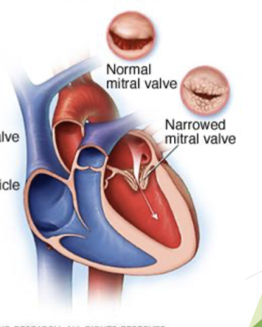

Slide 7
Pathophysiology
Normally, the mitral valve opening is as wide as the diameter of three fingers.
In cases of marked stenosis, the opening narrows to the width of a pencil.
Difficulty moving blood from left atrium into the ventricle because of the increased resistance of the narrowed orifice.
Left atrium is stretches and hypertrophies (thickens)because of the increased blood volume it holds.
The pulmonary circulation becomes congested.
The right ventricle become congested with blood and eventually fails.

Slide 8
Clinical Manifestations
Dyspnea on exertion (due to pulmonary venous hypertension) as the first symptom
Paroxysmal nocturnal dyspnea (PND)
Orthopnea
Dry cough or wheezing
Hemoptysis (expectorate blood )
Progressive fatigue (result of low cardiac output)
Palpitation (because of atrial fibrillation)
Apical diastolic murmur
Repeated respiratory infections.

Slide 9
Assessment and Diagnostic Findings
1. Assess the vital signs:
• The pulse is weak and often irregular because of atrial fibrillation (caused by the strain on the atrium).
• A low-pitched, rumbling, diastolic murmur is heard at the apex.
2. Echocardiography is used to diagnose and quantify the severity of mitral stenosis
3. Electrocardiography (ECG)
4. Exercise testing
5. Cardiac catheterization with angiography are used to determine the severity of the mitral stenosis.

Slide 10
Medical and Surgical Management
1 . Anticoagulants (if showing signs of atrial fibrillation) e.g: Heparin.
2. Beta blockers: decrease the force contractions of the heart muscles, and reduce blood vessel contraction e.g: Bisoprolol .
3. Calcium channel blockers: are prescription medications that relax blood vessels and increase the supply of blood and oxygen to the heart while also reducing the heart workload e.g: Amlodipine.
4. Diuretics e.g: Lasix
5. Digoxin only for end-stage heart failure.

Slide 11
Surgical Management
Surgical intervention
It is consists of :
• commissurotomy to open or rupture the fused commissures of the mitral valve.
• Percutaneous transluminal valvuloplasty
• Mitral valve replacement .

Slide 12
Prevention
Minimizing risk of and treatment for bacterial infections
Prevention of acute rheumatic fever depends on effective antibiotic treatment of group A streptococcal infection
Antibiotic prophylaxis for recurrent rheumatic fever with rheumatic carditis may require 10 or more years of antibiotic coverage (e.g., penicillin G intramuscularly every 4 weeks)

Slide 13
Mitral Regurgitation
Mitral regurgitation: involves blood flowing back from the left ventricle into the left atrium during systole. Often, edges of mitral valve leaflets do not close completely during systole because leaflets and chordae tendineae have thickened and fibrosed.

Slide 14
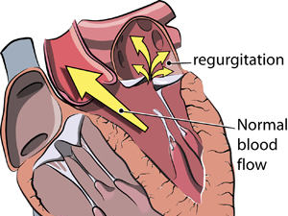

Slide 15
Causes of Mitral Regurgitation
1- Rheumatic heart disease
2- Degenerative changes (e.g., mitral valve prolapse)
3- Ischemia of the left ventricle
4- Infective endocarditis (causing leaflet perforation or scarring)
5- Collagen vascular diseases (e.g., systemic lupus erythematosus)
6- Cardiomyopathy

Slide 16
Pathophysiology
Valve Damage: Issues with leaflets, chordae tendineae, annulus, or papillary muscles cause mitral regurgitation
Blood Backflow: Blood leaks into the left atrium during systole.
Left Atrium Enlargement: The atrium stretches, hypertrophies, and dilates.
Lung Congestion: Backflow reduces atrial blood flow, causing lung congestion and right ventricular strain.
Heart Failure: Volume overload leads to ventricular hypertrophy, dilation, and eventual systolic heart failure.

Slide 17
Clinical Manifestation
Chronic mitral regurgitation is often asymptomatic.
Acute mitral regurgitation (e.g., that resulting from a myocardial infarction) usually manifests as severe congestive heart failure.
Dyspnea, fatigue, and weakness (first) are the most common symptoms.
Palpitations, shortness of breath on exertion, and cough from pulmonary congestion also occur.

Slide 18
Assessment and Diagnostic Findings
1-A systolic murmur is a high-pitched, blowing sound at the apex that may radiate to the left axilla
2- The pulse may be regular or irregular as a result of extra systolic beats or atrial fibrillation.
3- Echocardiography is used to diagnose and monitor the progression of mitral regurgitation

Slide 19
Medical Management
Patients with mitral regurgitation benefit from afterload reduction(arterial dilation) by treatment with
- Angiotensin converting enzyme inhibitors (ACE) such as captopril (Capoten),
- Angiotensin receptor blockers (ARBs) such as valsartan (Diovan); and beta-blockers, such as carvedilol (Coreg)
- patient needs to restrict their activity level to minimize symptoms.
surgical intervention by mitral valvuloplasty (i.e., surgical repair of the valve) or valve replacement

Slide 20


