Slide 1
Sampling design in quantitative study
Mahdi Al-Anawy

Slide 2
Population and sample
A population: Refers to all the members of a particular group.
A sample is a subset of population elements.
In nursing research, the elements (basic units) are usually humans.
Researchers work with samples rather than populations for practical reasons.

Slide 3
What is Sampling
Sampling is defined as a procedure to select a sample from individual or from a large group of population for certain kind of research purpose.

Slide 4
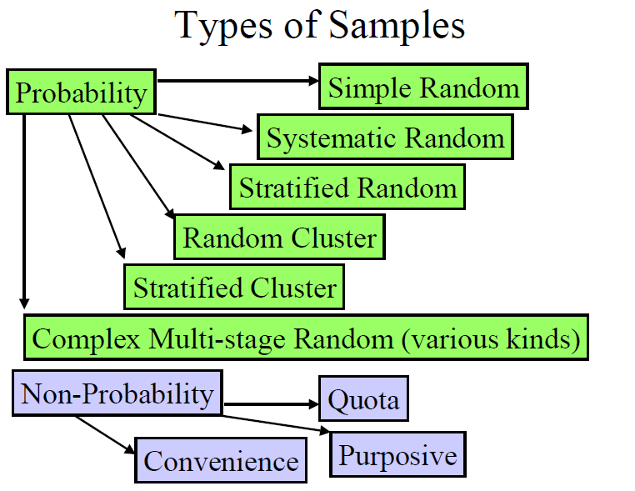

Slide 5
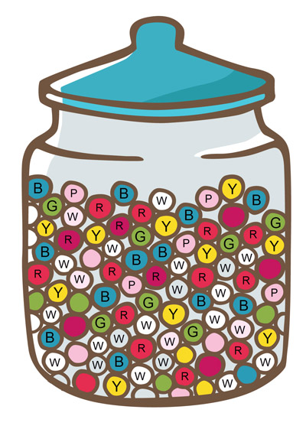
A- Probability sampling
In this type of sampling, there is an equal chance of each member of the population of being selected in the sample.

Slide 6
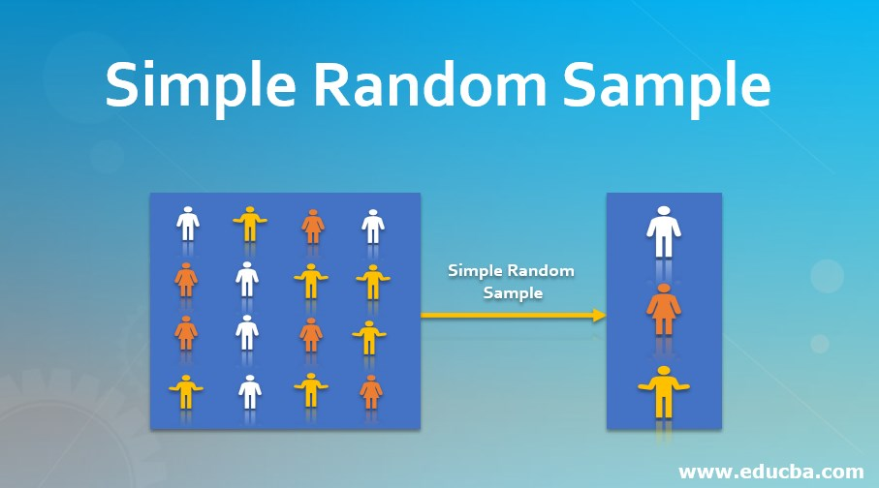

Slide 7
Stratified random sampling
In this method, the population is first divided into subgroups or who all share a similar characteristic (strata).
For example, in a study of stroke outcomes, we may stratify the population by sex, to ensure equal representation of men and women. The study sample is then obtained by taking equal sample sizes from each stratum

Slide 8
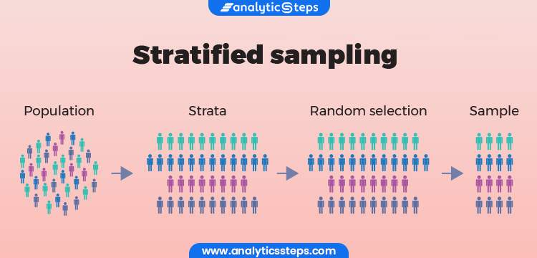

Slide 9
Systematic sampling:
Is a method in which sample members from a larger population are selected according to a random starting point but with a fixed, periodic interval. This interval, called the sampling interval, is calculated by dividing the population size by the desired sample size.

Slide 10
The sample interval (k) is decided by dividing the
population size (N) by the sample size (n).
EX:
If you had a list of 900 patients (your target population) and you wanted to survey 300 of them, your interval would be 3. This means that you would sample every 3th person in your list of 900 customers.
900 / 300 =3

Slide 11
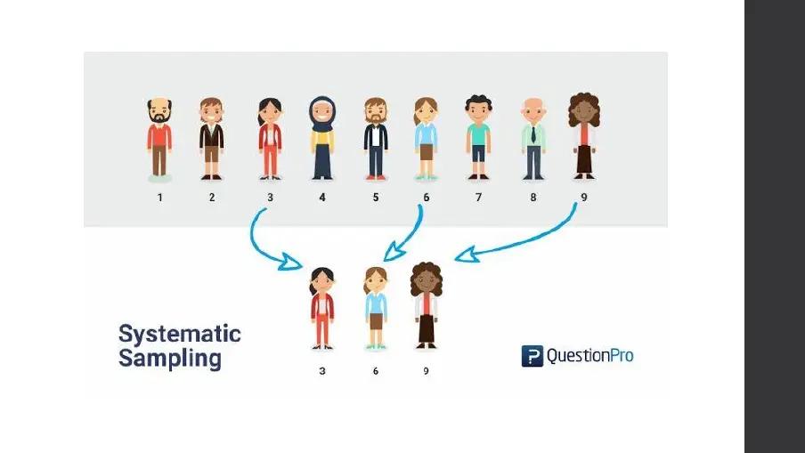

Slide 12
Cluster sampling
where researchers divide a large population up into smaller groups known as clusters, and then select randomly among the clusters to form a sample.

Slide 13
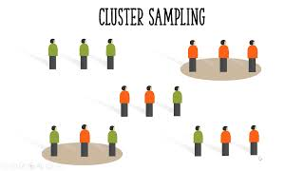

Slide 14
Multistage sampling
In this, each cluster of samples is further divided into smaller clusters and the members are selected from each smaller cluster randomly.
It is a complex form of cluster sampling

Slide 15
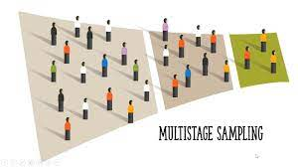

Slide 16
B- Non-probability Samples
Nonprobability sampling is a type of sampling where each member of the population does not have known probability of being selected in the sample.

Slide 17
    Types of Nonprobability samples:
    1- Convenience
    2- Purposive
3- Quota

Slide 18
1- Convenience sampling
Selecting the members of a sample on the basis of their convenient accessibility is called convenience sampling. This is used in pilot testing more commonly.

Slide 19


Slide 20
2- Purposive sampling
In this type of sampling, according to the purpose of the study, the members for a sample are selected.

Slide 21


Slide 22
3- Quota sampling
In this kind of sampling, members are selected on the basis of some specific characteristics chosen by the researcher. These specific characteristics serve as a quota for selection of the members of the sample.

Slide 23


Slide 24
Thank you

