Slide 1
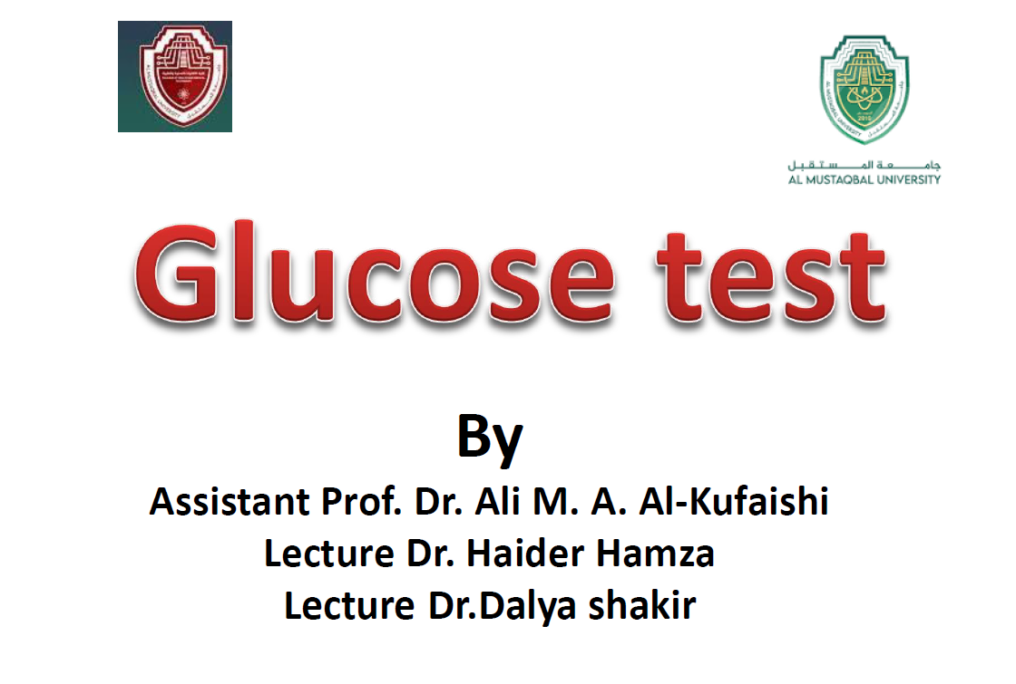
1

Slide 2
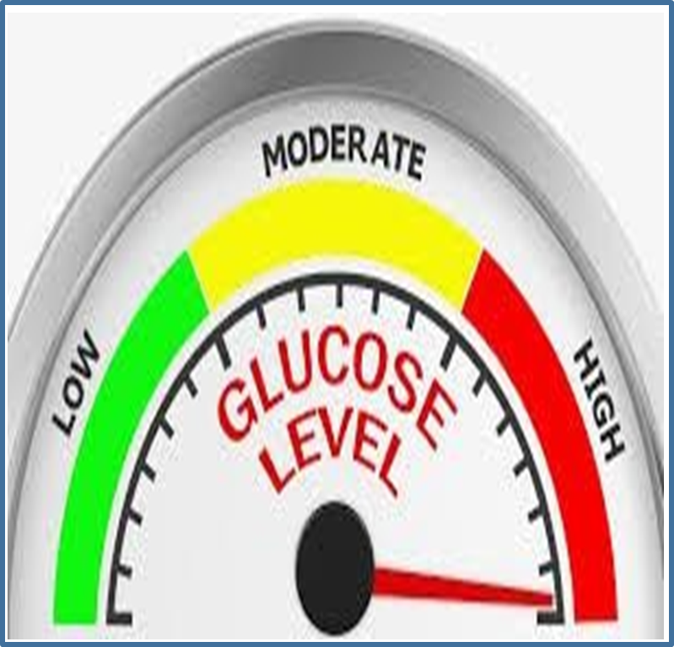
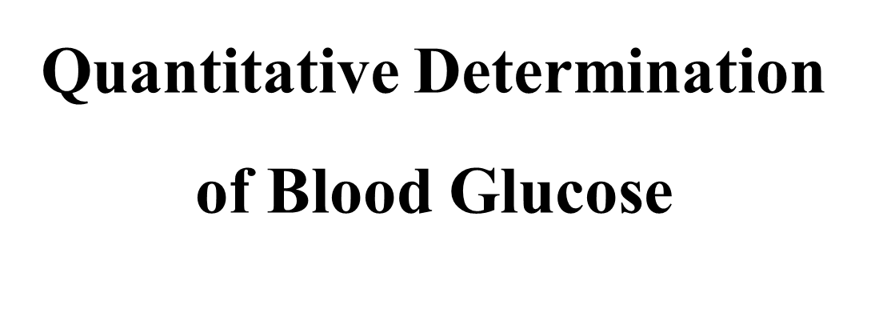

Slide 3
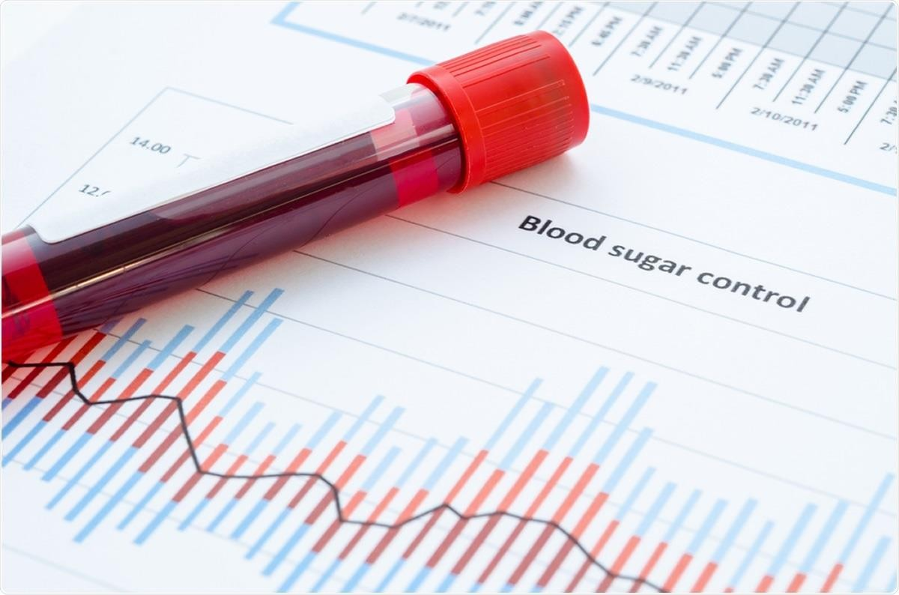
Quantitative Determination of Blood Glucose
Introduction
Quantitative Determination of Blood Glucose is considered one of the most commonly performed procedures in clinical biochemistry laboratory. It used for the diagnosis and treatment or management of many diseases such as Diabetes Mellitus. The collected blood specimen should be whole blood or serum or plasma without hemolysis and should obtained from the patient in one of the conditions below:
Fasting State: No food or drink for 8-12 hours.
Postprandial State: 2 hours after the meal.

Slide 4
Quantitative Determination of Blood Glucose
Clinical Significance
Glucose is a major carbohydrate present in the blood and serves as a primary source of energy. It is usually obtained from ingested starch and sugar. The glucose concentration is normally maintained at a constant level. Excessive glucose is stored as inactive glycogen mainly in the liver and little in the muscles. Elevated blood glucose levels are found in diabetes mellitus, hyperthyroidism, hyperadrenalism and certain liver disease. While, decreased levels are found in Insulinoma, hypothyroidism and hypopituitarism.
Sample Handling
Samples for glucose analysis should be delivered to the laboratory as soon as possible after being drawn from the patient because glucose concentration will be affected by glycolysis that caused by enzymes of RBC’s. That’s why the blood sample must be separated within 30 minutes. It’s better to use sodium fluoride tubes to avoid glycolysis because they can preserve glucose well.

Slide 5
Quantitative Determination of Blood Glucose
Principle
Glucose is determined after enzymatic oxidation in the presence of glucose oxidase. The hydrogen peroxide formed reacts, under catalysis of peroxidase (POD), with phenol and 4-Aminophenazone to form a red – violent quinoneimine dye as indicator.
Glucose + O2 + H2O
GOD
Gluconic acid + H2O2 Quinonimine + 4H2O
2 H2O2 + Phenol + 4-Aminophenazone
POD
Reagents
Glucose Reagent: Buffer Solution [Tris Buffer 92mmol/L at PH = 7.4, Phenol 0.3mmol/L, Glucose oxidase (GOD) 15000U/L & 4-Aminophenazone 2.6mmol/L].
Standard Concentration Solution of Glucose (100 mg/dL).
Reagent Preparation
Working Reagent Solution was prepared and ready to use.

Slide 6
Quantitative Determination of Blood Glucose
Procedure
Collect blood specimen from patients in serum blood tubes and leave it to coagulate for 20 minutes.
Separate serum sample from the blood by centrifuging at 3000-4000 RPM for 10-20 minutes.
Collect the serum in labeled tubes.
Three sets of tubes were prepared as below:
Tubes Solutions | Blank | Standard | Serum
Working Reagent | 1 mL | 1 mL | 1 mL
Standard | - | 10 μL | -
Sample (Serum) | - | - | 10 μL
All tubes were mixed well by vortex and incubated them for 10 minutes at 37ºC.
The absorbance (A) of the serum samples and standard were measured against the blank at wave length 500nm by using cuvette of 1 cm light path of Sepctrophotometer.
** Advantage of Blank Tube is to zero the instrument and eliminate all the effects of light (like refraction, diffraction, ..etc), measurement tube material and all other compounds in the solution except the target compound.

Slide 7
Quantitative Determination of Blood Glucose
Calculations
A (Sample)
Level of glucose (mg/dL) =
x N
A (Standard)
Where: N = Concentration of glucose in standard solution = 100 mg/dL.
Reference Range
Normal Glucose Level in Serum = 70 – 105 mg/dL.

