Slide 2
LEARNING OBJECTIVES
The functions of Cardiovascular system
The structure of cardiac muscle and contractile cardiomyocytes
Conducting system that distributes electrical impulses through the heart.

Slide 3
Cardiovascular physiology is the study of the functions of the heart, blood vessels.
The cardiovascular system consists of the heart, blood vessels, and blood.
Its primary function is to transport nutrients and oxygen-rich blood to all parts of the body and to carry deoxygenated blood back to the lungs.

Slide 4
Cardiovascular system consists of the following organs and tissues:
• The heart: A muscular pump that forces blood around the body.
• A closed system of blood vessels include:
◦ Arteries: Vessels that carry blood away from the heart.
◦ Veins: Vessels that bring blood back to the heart.
◦ Capillaries: Tiny vessels that branch off from arteries to deliver blood to all body tissues

Slide 5
Structure of the heart
The heart consists of four chambers two on either side:
Two receiving chambers “atria” and two pumping chambers “ventricles.” A wall or “septum” separates the atria and ventricles. Valves control the flow of blood in the heart.
The right atrium receives the blood retuning from the body tissues. This blood is low in oxygen, carried by veins
2. The right ventricle pumps the blood received from the right atrium and sends it to the lungs.
3. The left atrium receives blood which is high in oxygen as it returns from the lungs.
4. The left ventricle, which has the thickest walls of all, pumps oxygenated blood to all parts of the body through the arteries.

Slide 7
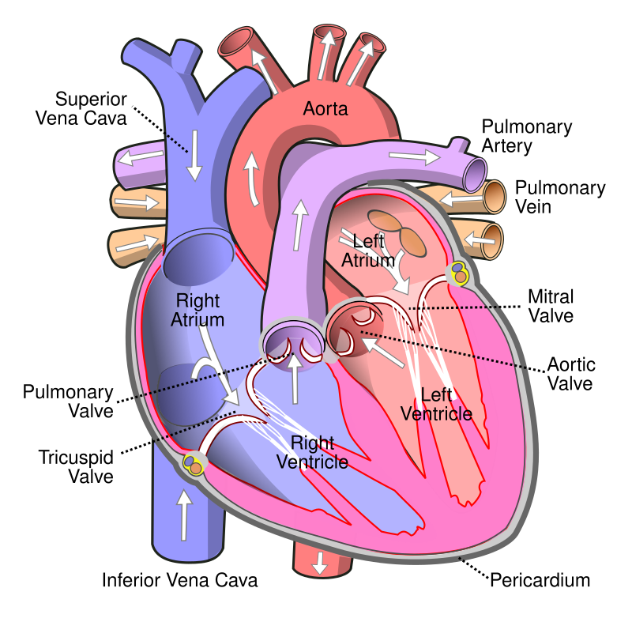

Slide 8
There are two blood circulatory systems in the body:
The systemic circulatory system. This is the main blood circulatory system that transports blood to the organs, tissues, and cells throughout the body.
The pulmonary circulatory system. This circulatory system moves blood between the heart and lungs

Slide 9
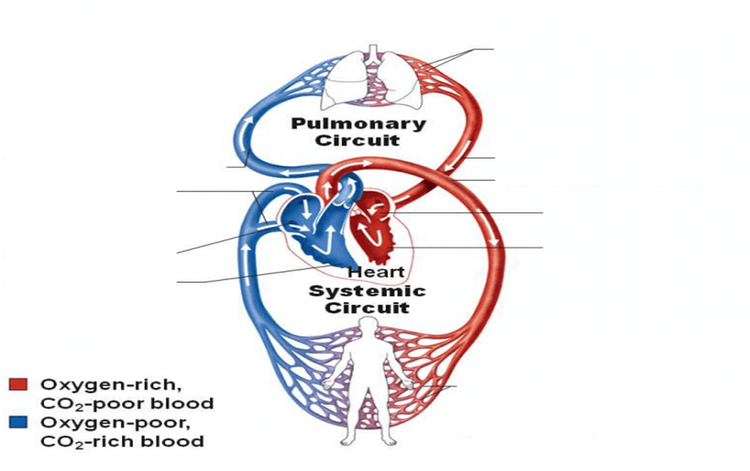
Pulmonary artery
Pulmonary vein
Superior and inferior vena cava
aorta
Left atrium
Right atrium
Left ventricle
Right ventricle

Slide 10
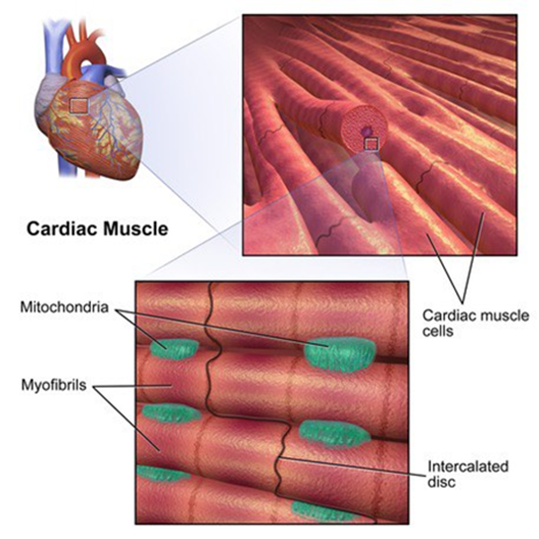
Cardiac cells
There are two major types of cardiac cells:
1. Contractile cells (99%) called cardiomyocytes
2. Conducting cells.

Slide 11
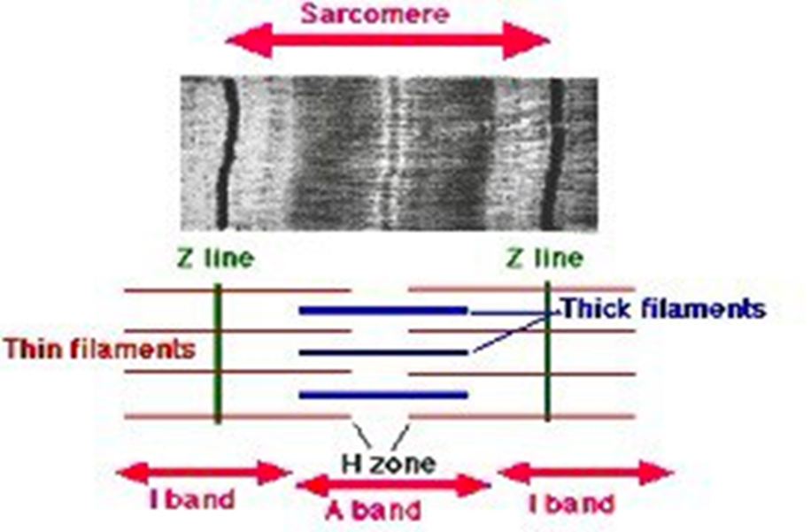
Myocardial contractile cells (99%) called Cardiomyocytes:
Cardiac muscle cells or cardiomyocytes are the muscle cells that make up the heart muscle. Cardiomyocytes go through a contraction-relaxation cycle that enables cardiac muscles to pump blood throughout the body.
Its characteristics :
short and have small diameter
involuntary contraction
striated
These striations are caused by
lighter I bands (actin)
darker A bands (myosin).

Slide 12
Each myocyte contains a single nucleus
surrounded by a cell membrane known as the sarcolemma.
The sarcolemma of cardiac muscle cells contains voltage-gated calcium channels
The functional unit of cardiomyocyte contraction is the sarcomere
Each cardiomyocytes contains chain of sarcomeres which are composed of long proteins that organize into myofilaments:
1. Thin myofilaments contain the protein actin.
2. Thick myofilaments contain the protein myosin.
The myofilaments slide past each other as the muscle contracts and relaxes.

Slide 13
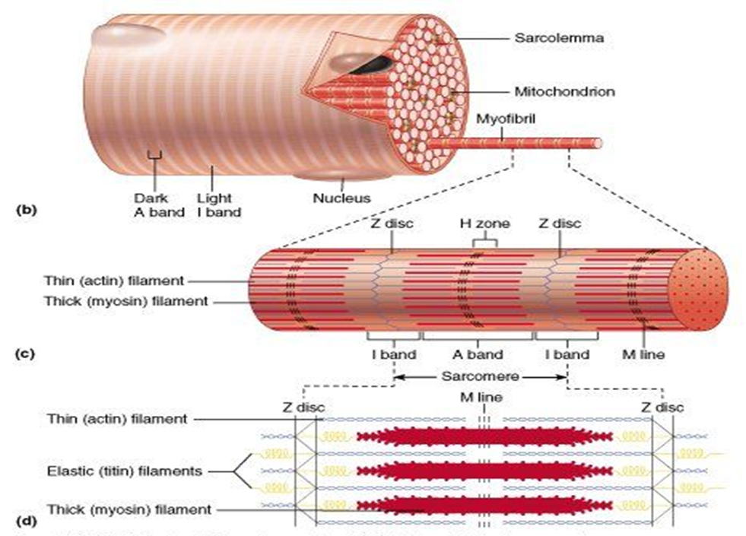

Slide 14
Diseases of the heart muscle known as cardiomyopathy, they are very important and include ischemic conditions caused by restricted blood supply to the muscle from coronary arteries such as angina and myocardial infarction

Slide 15
Myocardial conducting cells, Pacemaker cells:
Specialized modified cardiomyocytes known as pacemaker cells has the ability to initiate an electrical potential at a fixed rate that spreads rapidly from cell to cell to trigger the contractile mechanism. This property is known as autorhythmicity
Pacemaker cells carry the impulses that are responsible for the beating of the heart.
The highest concentration of pacemaker cells is in the sinoatrial (SA) node, the natural and primary pacemaker, and the resultant rhythm is a sinus rhythm.

Slide 16
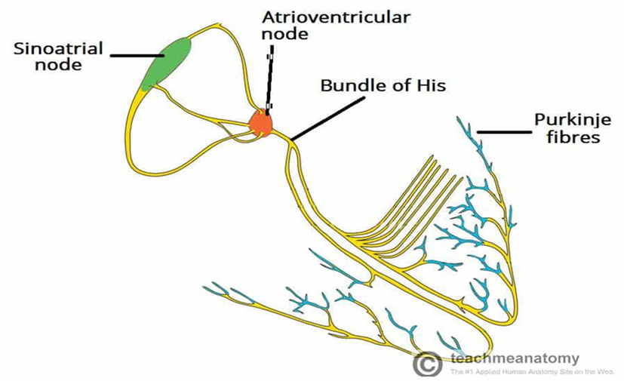

Slide 17
Conducting System of the Heart
The heartbeat originates in a specialized cardiac muscle cells (cardiac conducting system) and spreads via this system to all parts of the myocardium.
Parts of conducting system:
1. Sinoatrial (SA) node is located in the right atrium
2. Atrioventricular (AV) node
3. Bundle of His: located in the interventricular septum and divided into right and left branches.
4. Purkinje fibers
**A heart block refers to an interruption in the normal conduction pathway like left or right bundle branch block

Slide 18
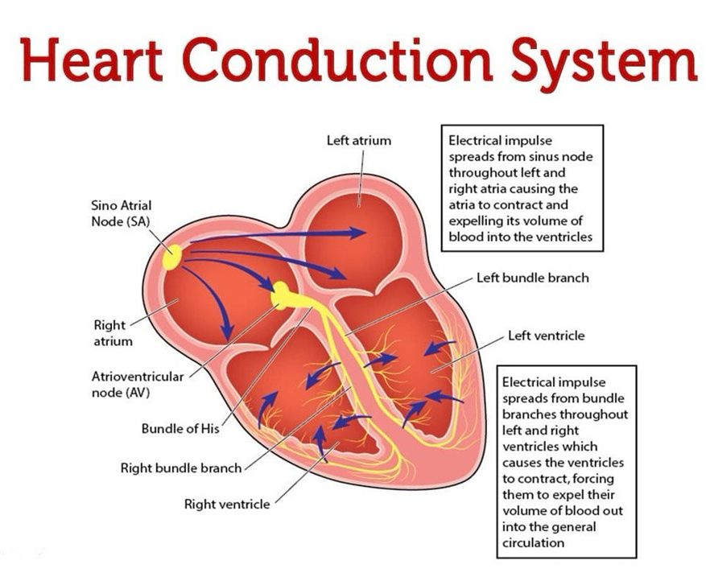

Slide 19


