Slide 1


Mechanism Of Breathing,
Lung Volumes
& Lung Capacity
Department of Anesthesia techniques
Dr. Zahraa Tariq
Dr. Rawaa Awaad
Dr.Ferqad Jewad
Lec 7
فسلجة نظري

Slide 2
Mechanism of Breathing
What is Breathing?
Breathing is the process in which air moves in and out of the lungs .
The breathing mechanism involves two processes:
Inspiration
Expiration
The air that we breathe in and out of the lungs varies in its pressure. So basically, when there is a fall in air pressure in the alveolar spaces, the air enters the lungs (inspiration).
Expiration occurs when air is forced out of the lungs due to an increase in alveolar pressure over atmospheric pressure.

Slide 3
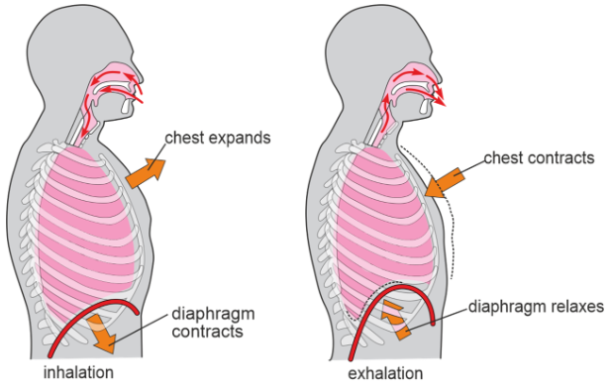

Slide 4
Lung Volumes (Respiratory Volumes)
Lung volumes are the static volumes of air breathed by an individual.
The lung volumes are of four types:
1. Tidal volume (TV)
The amount of air that enters and exits the lungs during
a single , quiet breathing.
Normal value = 500 mL (0.5 L).

Slide 5
2. Inspiratory reserve volume (IRV)
Is the extra air volume that can be forcefully inspired after
the end of normal inspiration.
Normal value = 3300 mL (3.3 L).
3- Expiratory reserve volume (ERV)
Is the extra amount of air that can be forcefully expelled
after normal expiration.
Normal value = 1000 mL (1 L).

Slide 6
4. Residual volume (RV)
is the volume of air remaining in the lungs even after forced expiration.
Normally, lungs cannot be emptied completely even by forceful expiration. Some quantity of air always remains in the lungs even after the forced expiration.
Normal value = 1200 mL (1.2 L).

Slide 7
Lung Capacity
It refers to the combination of two or more lung volumes.
Lung capacities are of four types:
1. Inspiratory capacity (IC)
Inspiratory capacity is the maximum volume of air that is inspired after normal expiration.
It includes tidal volume and inspiratory reserve volume.
IC = TV + IRV = 500 + 3300 = 3800 mL.

Slide 8
2. Vital Capacity (VC)
It's the amount of air that can be forcefully expelled after a deep (maximal) inspiration.
Vital capacity includes tidal volume, inspiratory reserve volume and expiratory reserve volume.
VC = TV + IRV + ERV = 500 + 3300 + 1000 = 4800 mL.

Slide 9
3-Functional Residual Capacity (FRC)
It is the volume of air remaining in the lungs after normal expiration (after normal tidal expiration).
Functional residual capacity includes expiratory reserve volume and residual volume.
FRC = ERV + RV = 1000 + 1200 = 2200 mL.

Slide 10
4. Total lung capacity (TLC)
Total lung capacity is the volume of air present in the lungs after a deep (maximal) inspiration. It includes all the volumes.
TLC = IRV + TV + ERV + RV = 3300 + 500 + 1000 + 1200 = 6000 mL.

Slide 11
