Slide 1


Department of Anesthesia Techniques
Thrombocyte & Blood Coagulation
Dr. Zahraa Tariq
Dr. Rawaa Awad
Dr.Farqad Jewad
Lec3
المرحلة الاولى

Slide 2
Platelets
The platelets (Thrombocytes) are small, granulated bodies that aggregate at sites of vascular injury. They lack nuclei and are 2-4 m in diameter .
Normal range of platelets 150000-400000 cell/mm³
Platelets are generated in the bone marrow and have a life span about (8-12 day) then destroyed by macrophages in the spleen.

Slide 3
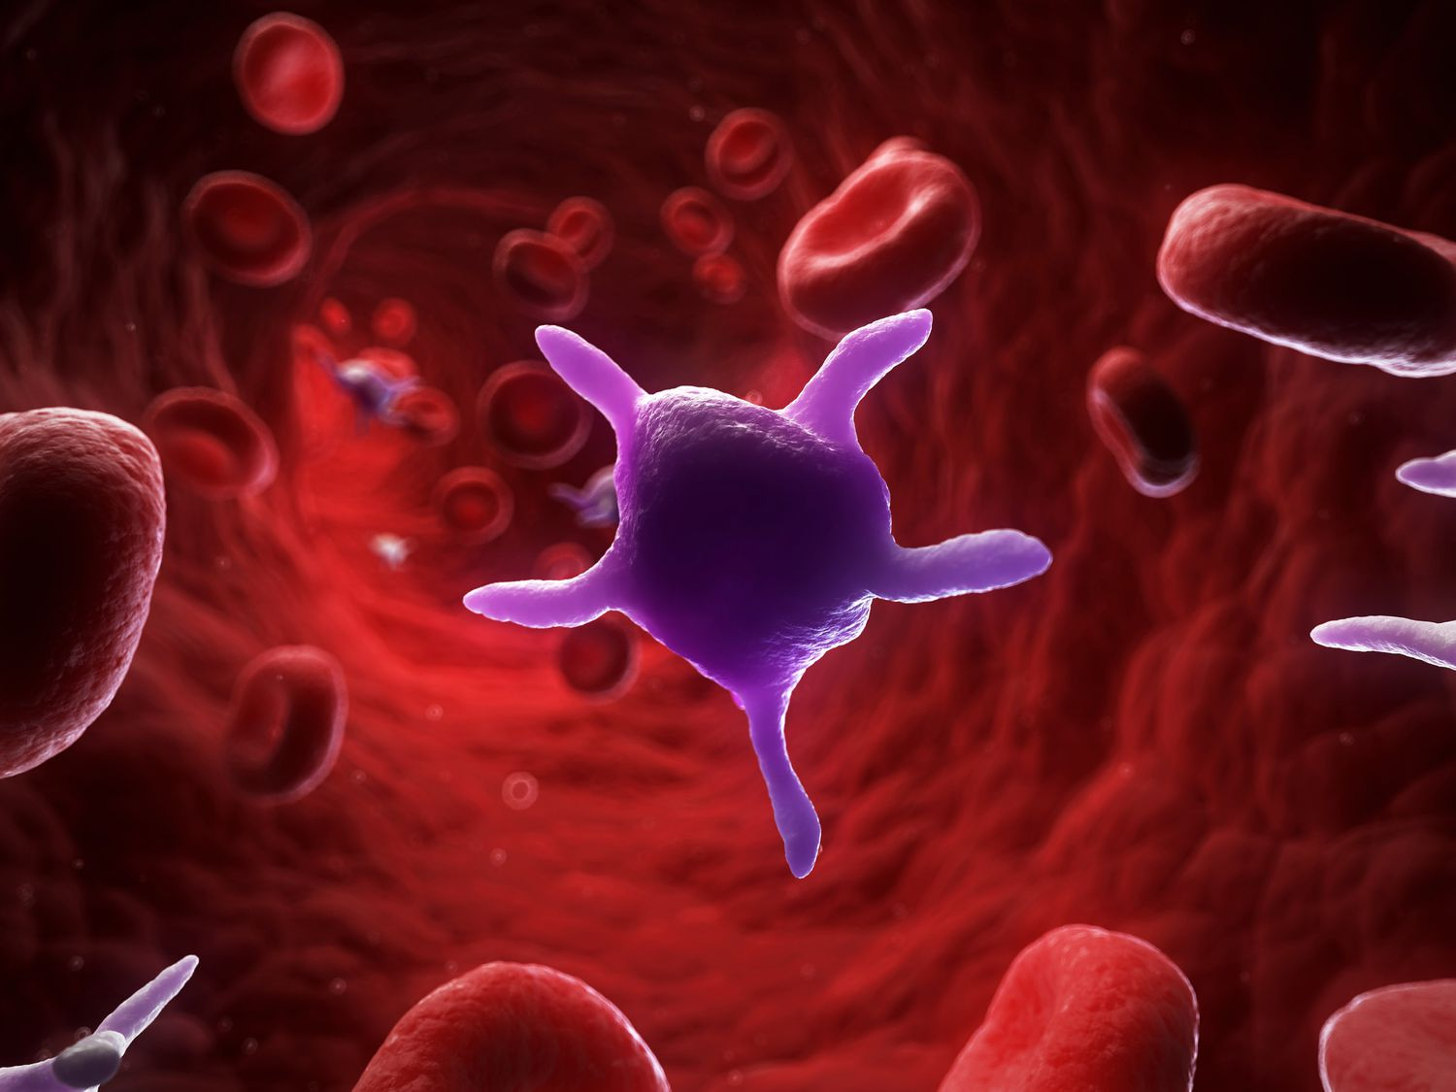
Function of Platelets
The main function of platelets is to initiate clotting by converting Prothrombin into thrombin.

Slide 4
Hemostasis
Hemostasis is the process of forming clots in the wall of an injured blood vessel and preventing blood loss.
The Steps of Hemostasis
Vascular spasms (vasoconstriction at injured site).
Platelet plug formation (plugging the wound).
Formation of a blood clot (blood coagulation).
Growth of fibrous tissue into the blood clot to close the hole in the vessel permanently.

Slide 5
Vascular Spasms:
Vasoconstriction is the first reaction to vascular damage,
reduces blood flow from the site of injury and it is
mediated by:
a) Sympathetic reflex.
b) Released chemicals by traumatized tissues and blood platelets.
The spasm can last for many minutes to hours.

Slide 6
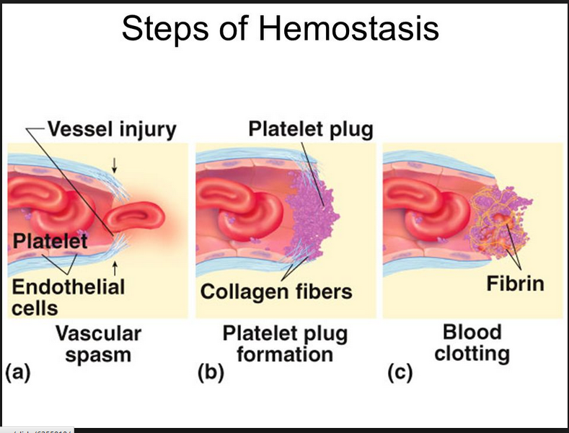

Slide 7
Formation of the Platelet Plug
After damage to endothelium of vessel:
Platelets adhere to the collagen of the injured vessel (enhanced by Von Willebrand factor) and become activated.
Activated platelets release ADP and thromboxane A2, that activate the surrounding platelets and causing platelet plug formation.
Von Willebrand Factor: is a glycoprotein made by bone marrow and endothelial cells, it functions as a bridge between platelet and collagen fibrils of damaged tissue

Slide 8
Formation of a blood clot (blood coagulation) Coagulation of blood occur through a series of reaction due to activation of a group of substance called clotting factors.
Clotting factors : are circulating plasma proteins, the majority of which are produced in the liver, some are produced in the endothelial cells.

Slide 9
Clotting Factor
1.Factor I - Fibrinogen
2. Factor II - Prothrombin
3. Factor III - Tissue Factor.
4. Factor IV - Ionized Calcium ( Ca++ )
5. Factor V - Labile Factor
6. Factor VI - Unassigned
7. Factor VII - Stable Factor
8. Factor VIII - Antihemophilic Factor
9. Factor IX – Christmas Factor
10. Factor X - Stuart-prower Factor
11. Factor XI - Plasma Thromboplastin Antecedent
12. Factor XII - Hageman Factor
13. Factor XIII - Fibrin-stabilizing Factor

Slide 10
Coagulation (Blood Clotting)
Coagulation is the loss of fluid content in the blood, resulting in a jelly-like substance.
It is occur through a series of reactions:
Formation of Prothrombin Activator
2. Conversion of Prothrombin To Thrombin.
3. Conversion of Fibrinogen To Fibrin

Slide 11
Prothrombin Activators: are a group of substances which convert prothrombin to thrombin in two ways:
Extrinsic Pathway: (the main pathway to initiate coagulation) The process is started when injured endothelial cells produce tissue factor (factor III), which activates factor VII.
Intrinsic Pathway: (which promotes coagulation) involves the activation of factors XII, XI, IX, and factor VIII.
The prothrombin activator converts prothrombin to thrombin in the presence of enough ionic Ca++ from platelets.

Slide 12
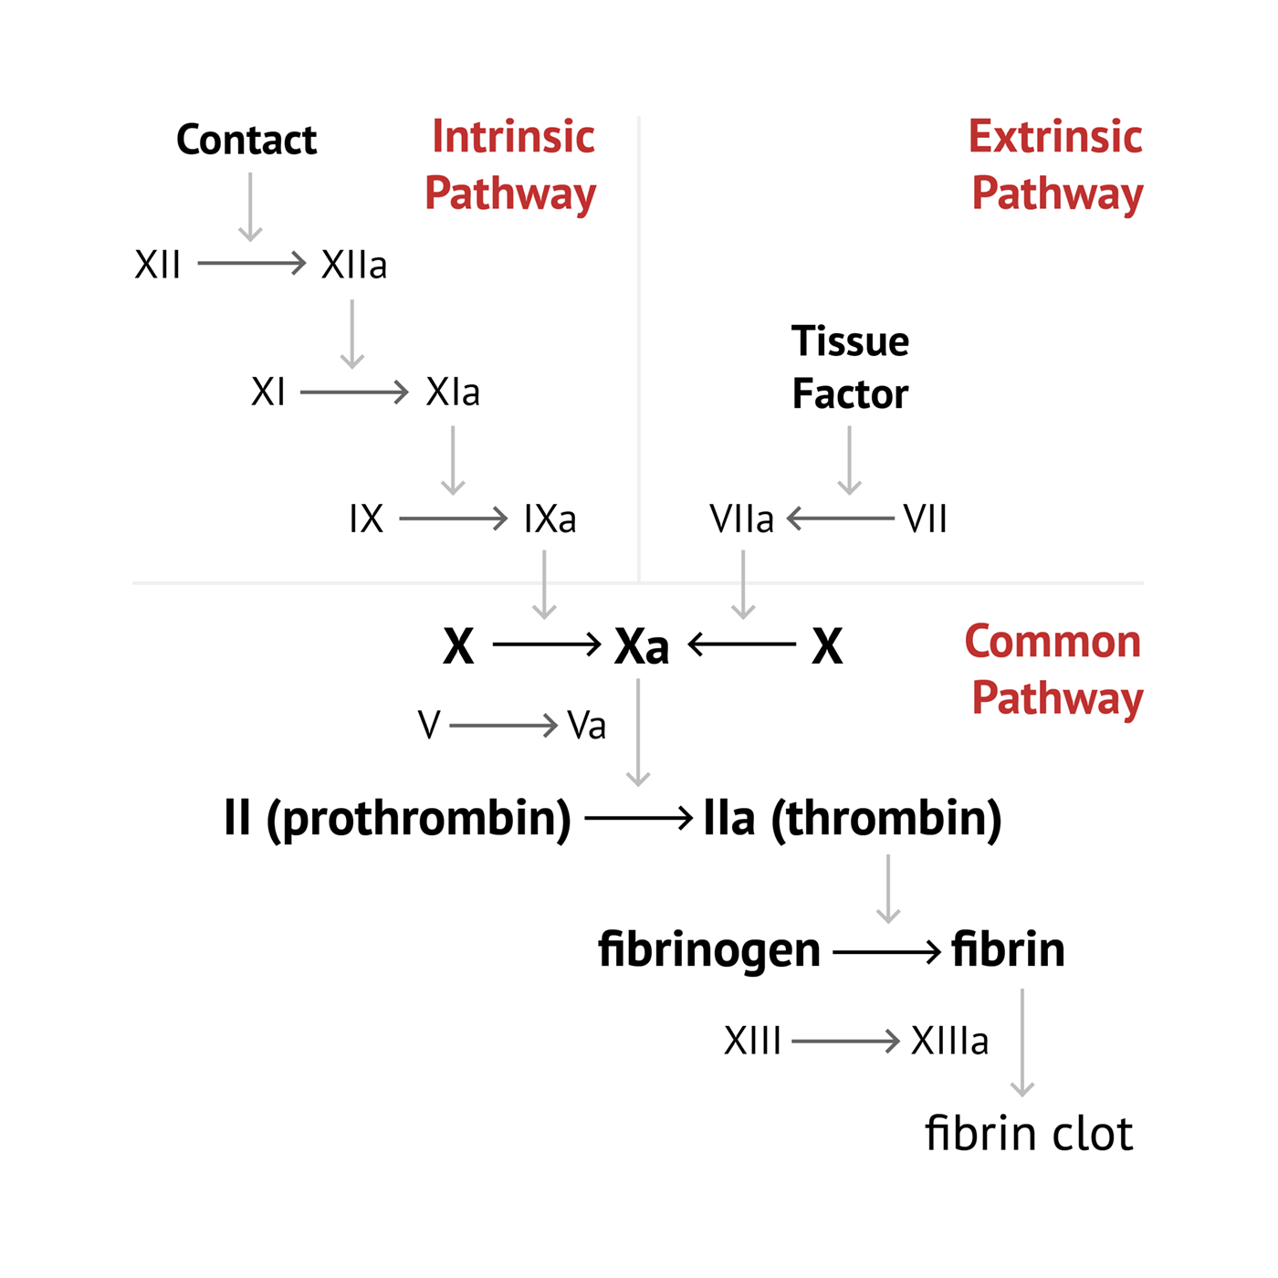

Slide 13
Blood Clot : is composed of a meshwork of fibrin fibers running in all directions and entrapping blood cells, platelets, and plasma.
The fibrin fibers also adhere to damaged surfaces of blood vessels; therefore, the blood clot becomes adherent to any vascular opening and thereby prevents further blood loss

Slide 14
