Slide 1

كلية العلوم
قــســــــــــم الانـــظــــمــــة الــــطـبـيـة الـــذكــــــيـــة
Intelligent Medical Systems Department
Subject: English Language
Class: Third
Lecturer: MSC. Sakina Hussain Alsuwaydi
Lecture: ( 1 )
Grammar Essentials: Tenses, WH Questions, Parts of Speech
Study Year: 2024-2025

Slide 2
What Are Tenses?
Definition: Tenses indicate the time of an action.
There are three main categories:
1. Past (Actions that happened before now)
2. Present (Actions happening now or regularly)
3. Future (Actions that will happen later)

Slide 3
1. Past simple
Use: To describe actions or events that started and finished in the past.
Form
Regular Verbs) Add -ed to the verb. (walk → walked)
Subject + regular verb (ed) + object + comp.
Examples
I visited Paris last year.
She finished her homework.
Irregular Verbs: The verb changes form. (go → went)
Subject + irregular verb + object + comp.
She went to the store last night.
Signs of past simple: Yesterday, last week, two years ago, in 1999.

Slide 4
2-The Present Tense
The present tense is used to describe actions, events, or situations happening now, regularly, or as general facts.
Present Simple
Use:
To describe habitual actions
To express general truths or facts
To talk about schedules
Form:
Subject + base verb + comp.
Examples
I go to school every day.
The sun rises in the east.
She plays the piano often.
Singular subject::
Plural subject
p.s. if the subject is singular we use third person singular
(he, she, it)
(they, we, you, I)
Signs of present tense: always, often, every day :

Slide 5
3-The Future Tense
The future tense is used to talk about actions or events that will happen after the present time.
Future Simple
Use:
To describe decisions made at the moment of speaking
To talk about predictions.
To express promises, offers, or future facts
Form
Subject+ will + base verb.
Examples
I will call you tomorrow.
It will rain soon.
Future simple tense signs: tomorrow, soon

Slide 6
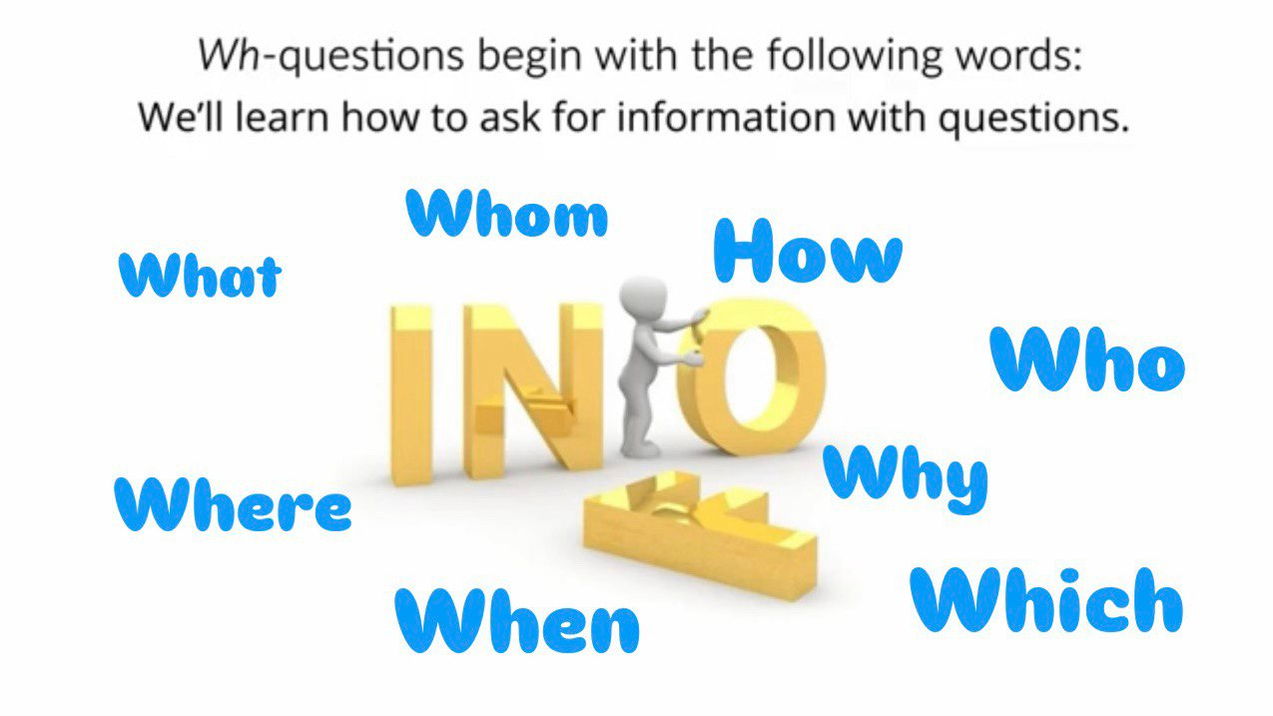

Slide 7
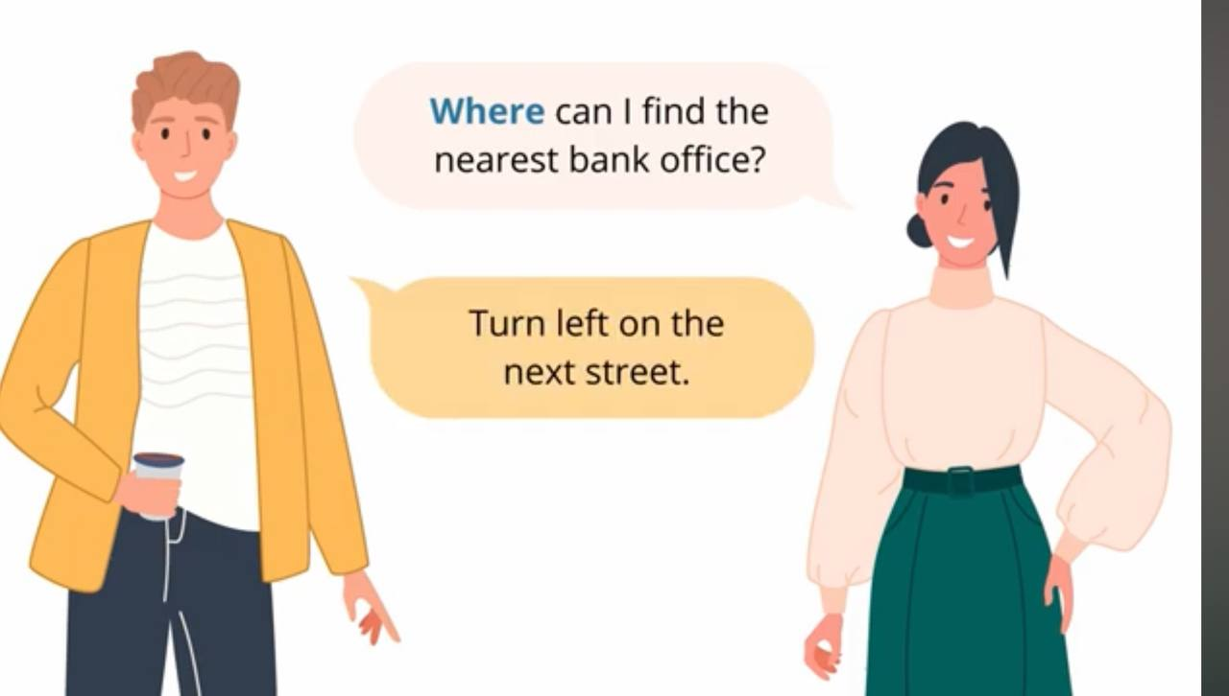
You can not answer with yes or no,
When someone asks you a question using Wh questions, he or she expect you to give information, in the bellow case , it is expected to have information about the bank office.

Slide 8
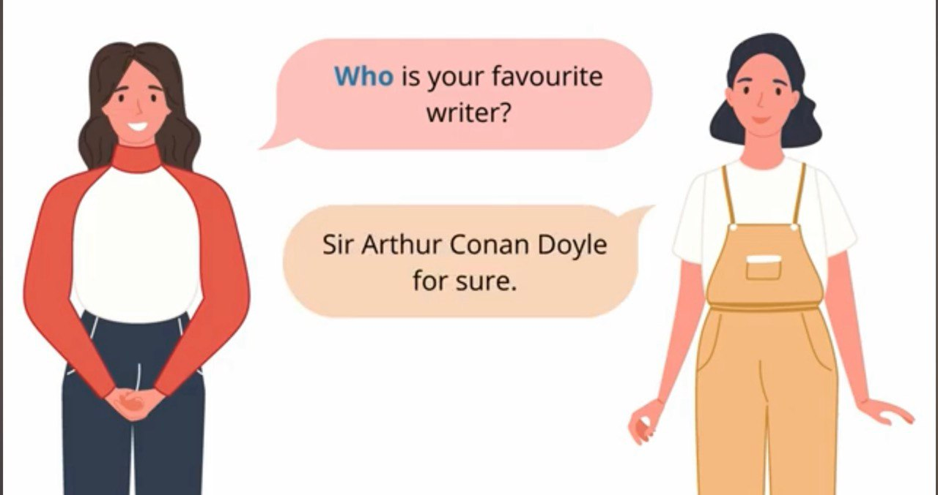

Slide 9
What are WH-Questions?
WH-Questions are used to ask for specific information about something, such as people, places, times, reasons, or methods. These questions start with “WH” words.
Common WH Words .
1-What :
Use: To ask about things or information.
Examples
What is your name?
What are you doing?
2-Who :
Use: To ask about a person or people.
Examples
Who is your teacher?
Who called you?

Slide 10
3. Where :
Use: To ask about a place.
Examples
Where do you live?
Where is the book?
4-When
Use: To ask about time.
Examples
When is your birthday?
When will the meeting start?
5-Why
Use: To ask about reasons.
Examples:
Why are you late?
Why is he crying?
6-How
Use: To ask about methods or conditions.
Examples:
How are you?
How did you solve the problem?

Slide 11
Other WH Forms
Which :
Use: To ask about a choice between
options.
Examples
Which color do you like?
Which is your favorite book?
2-Whose
Use: To ask about possession.
Examples :
Whose bag is this?
Whose turn is it?
3-What time
Use: To ask about a specific time.
Examples
What time is the meeting?
What time does the train leave?

Slide 12
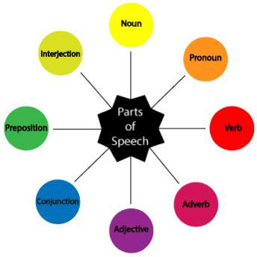

Slide 13
Parts of Speech أجزاء الكلام
Parts of speech refer to the categories that words belong to, based on their operate in a sentence. There are 8 main parts of speech in English.
1-Noun
Definition : A noun is a word that names a person, place, thing, or idea.
Examples
Person: teacher
Place: park
Thing: book
Idea: freedom
Example Sentence: The book is open.

Slide 14
2. Pronoun :
Definition : A pronoun is a word that replaces a noun to avoid repetition.
Examples
I, he, she, it, we, they, you
Example Sentence
Sara is kind. She helps everyone.
3-Verb
Definition: A verb shows an action, or occurrence.
Examples
Action: run
Occurrence: happen
Example Sentence: She writes a letter.

Slide 15
4. Adjective :
Definition: An adjective describes or modifies a noun or pronoun.
Examples
Big, beautiful, interesting
Example Sentence: The tall man is my teacher.
5-Adverb:
Definition: An adverb modifies a verb, adjective, or another adverb. It tells how, when, where, or to what extent.
Examples
Quickly, yesterday, very
Example Sentence: She speaks softly.
He went to the super market yesterday. She is very polite.

Slide 16
6. Preposition
Definition: A preposition shows the relationship between a noun (or pronoun) and other words in a sentence.
Examples
In, on, at, under
Example Sentence: The book is on the table.
7-Conjunction
Definition: A conjunction connects words, phrases, or clauses.
Examples
And, but, because
Example Sentence: I like tea and coffee.

Slide 17
Exercise
Once upon a time, there was a kind girl named Sarah. She lived in a small house near the forest. Sarah loved her cat, Misty, who always purred happily when Sarah hugged her.
One sunny morning, Sarah decided to take Misty to the park. She walked slowly and enjoyed the fresh air. Misty ran beside her playfully.
At the park, Sarah saw a boy and a girl playing with a ball. They invited her to join, so Sarah played while Misty rested under a tree.
At the end of the day, Sarah and Misty returned home, feeling tired but happy.

Slide 18
Once upon a time, there was a kind girl named Sarah (noun). She lived (verb) in a small house (adjective + noun) near the forest (preposition). Sarah loved her cat (pronoun + noun), Misty, who always purred happily (adverb) when Sarah hugged (verb) her.
One sunny morning (adjective + noun), Sarah decided to take Misty to the park (preposition). She walked slowly (verb + adverb) and enjoyed the fresh air (adjective + noun). Misty ran (verb) beside her playfully (adverb).
At the park, Sarah saw a boy and a girl (noun + conjunction + noun) playing with a ball. They invited her to join, so (conjunction) Sarah played while Misty rested under a tree (preposition).
At the end of the day, Sarah and (conjunction) Misty returned home, feeling tired but happy (adjective + conjunction + adjective).

Slide 19
Summary Table
Part of Speech:
Noun: Names a person, place, thing, or idea cat.
Pronoun: Replaces a noun.
Verb: Shows action, state, or occurrence run.
Adjective: Describes a noun or pronoun tall.
Adverb: Modifies a verb, adjective, or adverb quickly.
Preposition: Shows relationship between words.
Conjunction: Connects words, phrases, or clauses.

Slide 20
Thank you

