Slide 1

كلية العلوم
قــســــــــــم الانـــظــــمــــة الــــطـبـيـة الـــذكــــــيـــة
Intelligent Medical Systems Department
Subject: English Language
Class: Third
Lecturer: MSC. Sakina Hussain Alsuwaydi
Lecture: ( 5)
Future intentions: going to and will:
How to talk about future plans and decisions.
Study Year: 2024-2025

Slide 2
Why Do We Talk About the Future?
We use future tenses to discuss:
1. Plans and intentions.
2. Predictions about the future.
3. Promises and spontaneous decisions.

Slide 3
Introduction to Future Forms
There Two common ways to talk about the future:
“Going to” → for planned actions
“Will” → for spontaneous decisions and predictions
Example:
-I’m going to buy a new phone next week. (Planned)
-I will help you with your bags. (Decided now)

Slide 4
“Going to” – When to Use It?
Use “going to” for:
1. Future plans (I’m going to study Spanish.)
2. Future intentions (She is going to start a business.)
3. Predictions based on evidence (Look at the clouds! It’s going to rain.)

Slide 5
“Going to” – Sentence Structure
Formula:
Subject + am/is/are + going to + base verb
Examples:
-She is going to travel next year.
-We are going to move to a new city.

Slide 6
“Will” – When to Use It?
Use “will” for:
1. Instant decisions (I’m thirsty. I will get some water.)
2. Promises (I will always be your friend.)
3. Predictions without evidence (I think it will snow tomorrow.)
4. Offers and requests (I will help you with your homework.)

Slide 7
“Will” – Sentence Structure
Formula:
Subject + will + base verb
Examples:
-She will call you later.
-They will win the match.

Slide 8
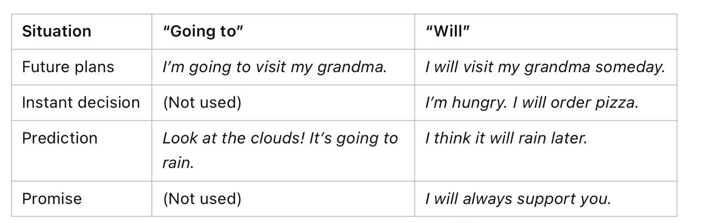

Slide 9
Negative Forms
“Going to”: She is not going to study tonight.
“Will”: He will not (won’t) come to the party.
Examples:
-I am not going to eat junk food.
-She won’t forget your birthday.
-Image: A red “X” over a calendar.

Slide 10
Question Forms
“Going to”: Are you going to watch the movie?
“Will”: Will she be here tomorrow?
Examples:
-Is she going to travel next year?
-Will you help me with my homework?

Slide 11
Common Mistakes
-Incorrect: She will going to study tonight.
-Correct: She is going to study tonight.
-Incorrect: He will to call you later.
-Correct: He will call you later.
.

Slide 12
Predictions – “Going to” vs. “Will”
Use “going to” when there is evidence that something will happen.
-Example: Look at those dark clouds! It’s going to rain.
(You can see the clouds, so you have evidence.)
Use “will” when making a general guess or assumption about the future without clear evidence.
-Example: I think she will be a great doctor one day.
(There’s no proof, it’s just an opinion or belief.)

Slide 13
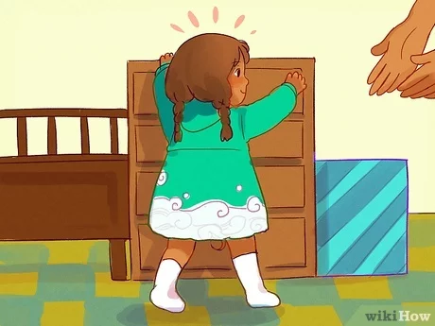
What do you think will happen?
Should we use “going to” or “will”?

Slide 14
A Baby Trying to Walk
-Going to: Look! The baby is standing up and taking small steps. He is going to walk soon!
(We can see the baby trying, so there is evidence.)
-Will: One day, this baby will run very fast.
(This is just a general prediction without immediate evidence.)

Slide 15
Interactive Exercise – Fill in the Blanks
Complete the sentences:
1. Look at that car! It __ (crash) into the wall. (Going to or will?)
2. I feel sick. I __ (call) the doctor.
3. She __ (study) medicine next year.

Slide 16
Speaking Activity – Future Plans
-Use “going to” for personal plans.
-Use “will” for promises or spontaneous decisions.
Example:
A: What are you going to do next summer?
B: I’m going to visit my cousins.
A: Oh! That’s nice. think I will take a short trip too!

Slide 17
Conclusion & Final Activity
Summary:
-Use “going to” for plans & evidence-based predictions.
-Use “will” for instant decisions, predictions, and promises.

Slide 18
Thank you

