Slide 1


Al-Mustaqbal University
College of Science
Qualitative Analysis: application to forensic science
First Year Students / 8th Lecture
2024-2025
By
Prof. Dr. Naser Abdulhasan Naser

Slide 2
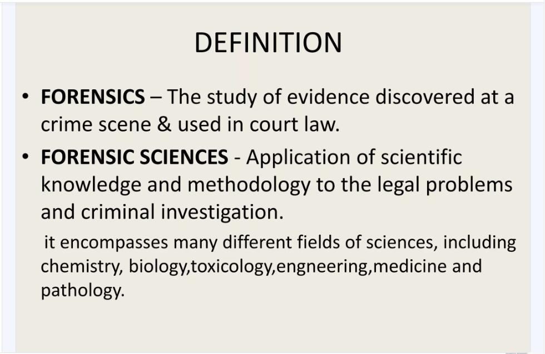

Slide 3
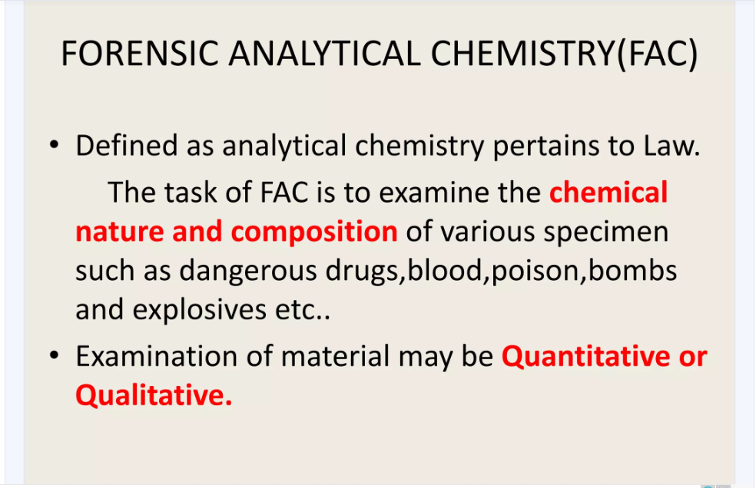

Slide 4
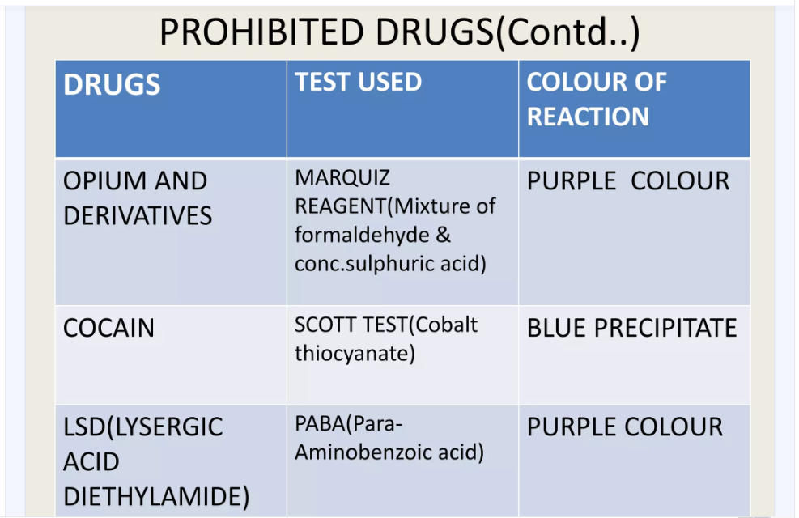

Slide 5
Marquis reagent is used as a simple spot-test to presumptively identify alkaloids as well as other compounds.
It is composed of a mixture of formaldehyde and concentrated sulfuric acid, which is dripped onto the substance being tested. The United States Department of Justice method for producing the reagent is the addition of 100 mL of concentrated (95–98%) sulfuric acid to 5 mL of 40% formaldehyde.
Different compounds produce different color reactions. Methanol may be added to slow down the reaction process to allow better observation of the colour change.
Used for detection MDMA and MDA with dark violet color
2C-B of yellow to green color

Slide 6
Chen- Kao Reagent Test
Preparation of Reagent:
Reagent 1: This is prepared by adding 1 ml of Glacial Acetic Acid in 100 ml of Water, i.e., 1% (V/V) aqueous Acetic Acid solution.
Reagent 2: This is prepared by dissolving 1 gm of Copper (II) Sulphate in 100 ml of Water, i.e., 1% (W/V) aqueous CuSO4 solution.
Reagent 3: This is prepared by dissolving 8 gm of Sodium Hydroxide in 100 ml of Water, i.e., 2N aqueous Sodium Hydroxide solution.
A violet color indicates presence of ephedrine or pseudoephedrine

Slide 7
Cobalt Thiocyanate Test(Scott’s Test)
This test is a presumptive field test for illegal drugs.
The test reagent is a 2% aqueous solution of Cobalt (II) Thiocyanate which is mixed with a small amount of sample.
Scott test is a simple, rapid, and low-cost preliminary test used extensively to suggest the presence of cocaine in drug seizures due to the development of a blue color.
Cobalt(II) thiocyanate is an inorganic compound with the formula Co(SCN)₂.The anhydrous compound is a coordination polymer with a layered structure. The trihydrate, Co(SCN)₂(H₂O)₃, is a isothiocyanate complex, used in the cobalt thiocyanate test (or Scott test) for detecting cocaine.

Slide 8
Mayer’s Reagent Test
Preparation of Reagent: Potassium Mercury Iodide prepared by dissolving 1.357 gm. of Mercuric Chloride HgCl2 and 5 gms of Potassium Iodide KI in 100 mL of water.
This test is performed for the detection of Nicotine. The dried residue of extract is acidified with Acetic Acid followed by addition of 2 drops of reagent. A white or yellowish precipitate is obtained.

