Slide 1


Al-Mustaqbal University
College of Science
Qualitative Analysis: application to forensic science(continued)
First Year Students / 9th Lecture
2024-2025
By
Prof. Dr. Naser Abdulhasan Naser

Slide 2
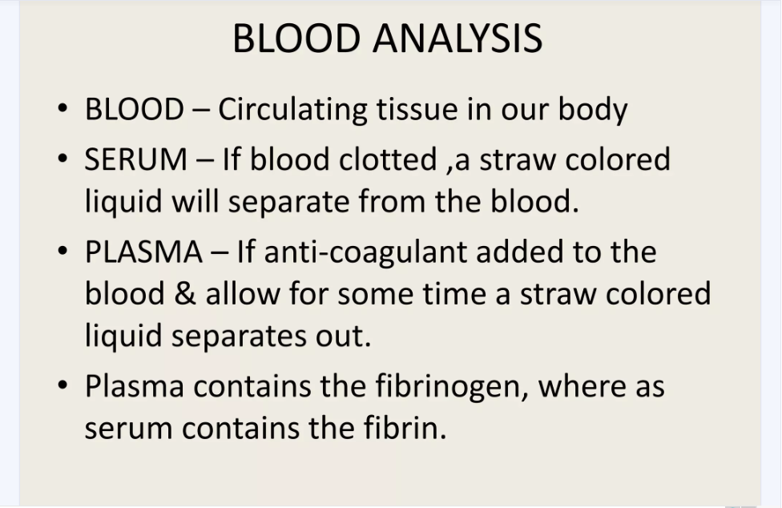

Slide 3
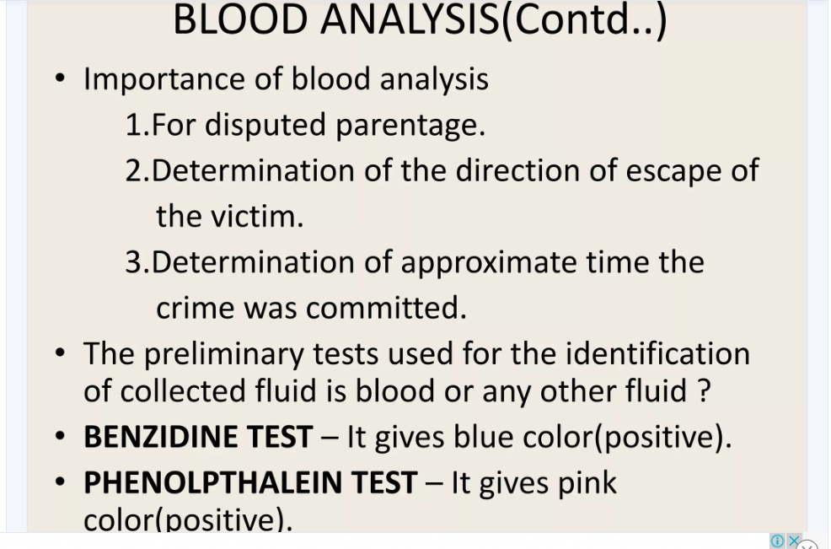

Slide 4
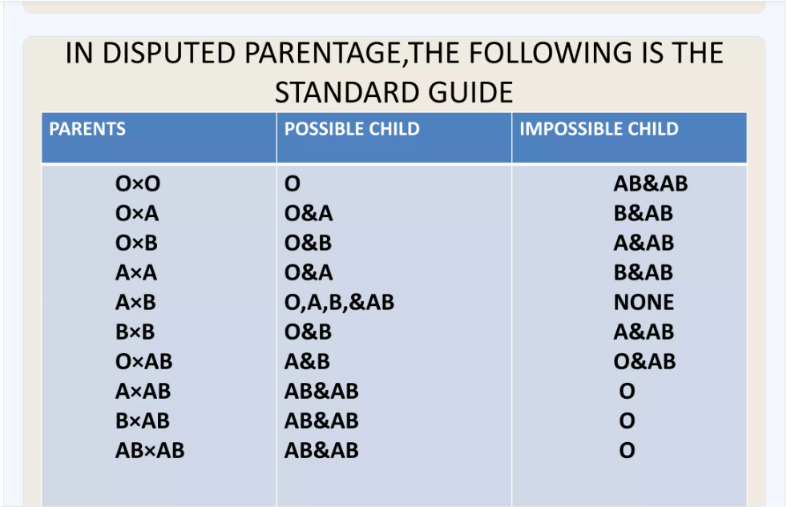

Slide 5
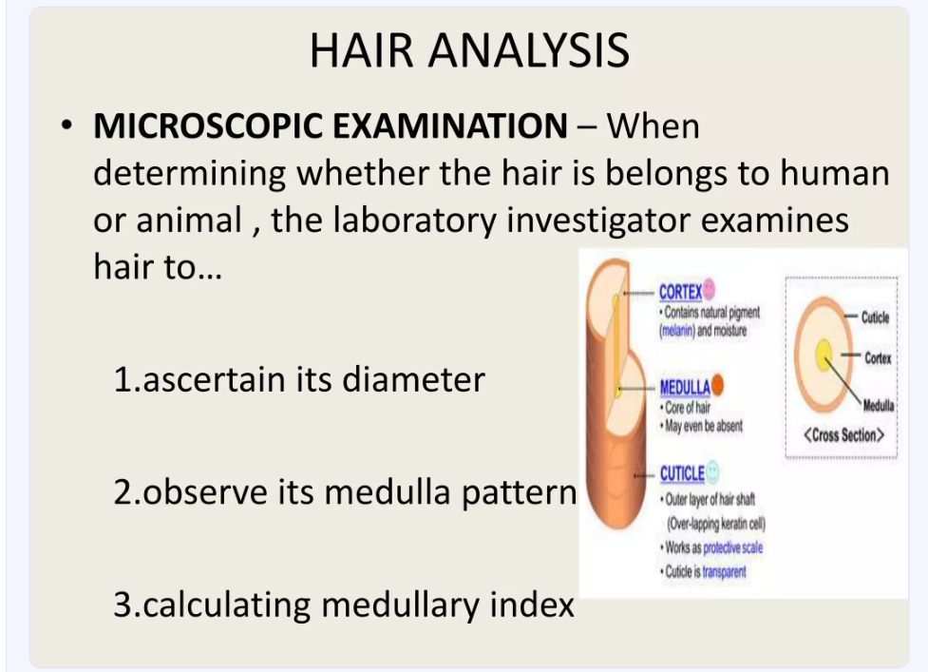

Slide 6
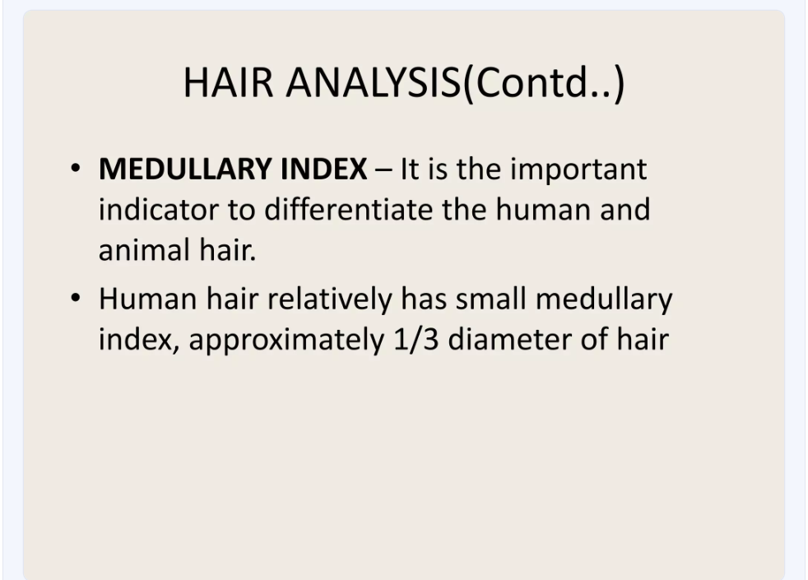

Slide 7
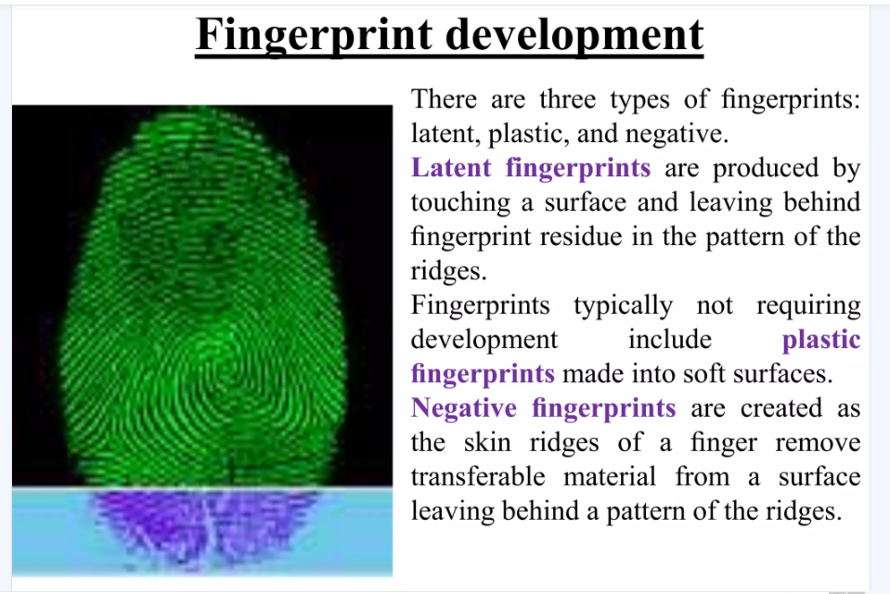

Slide 8
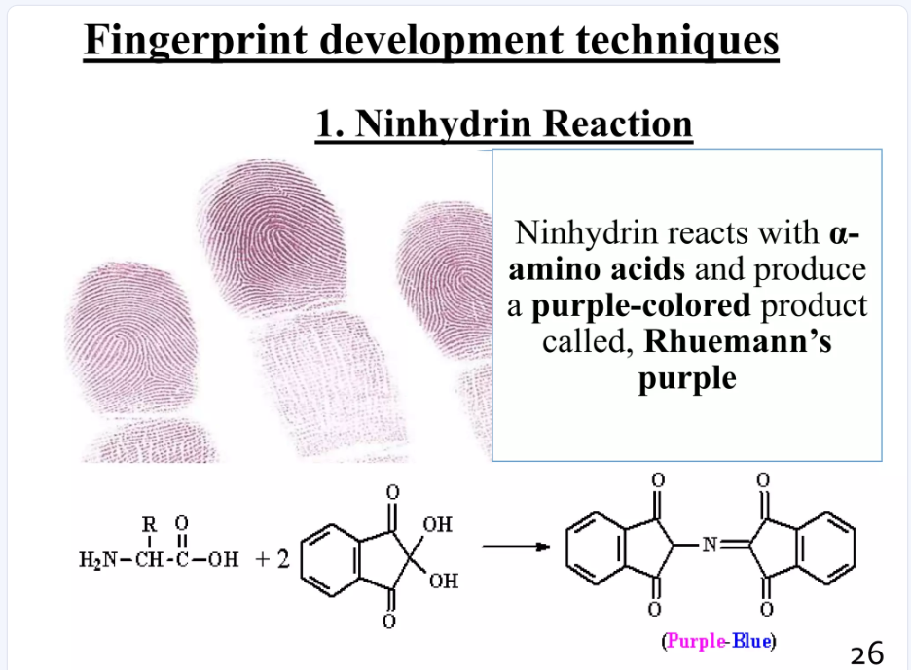

Slide 9
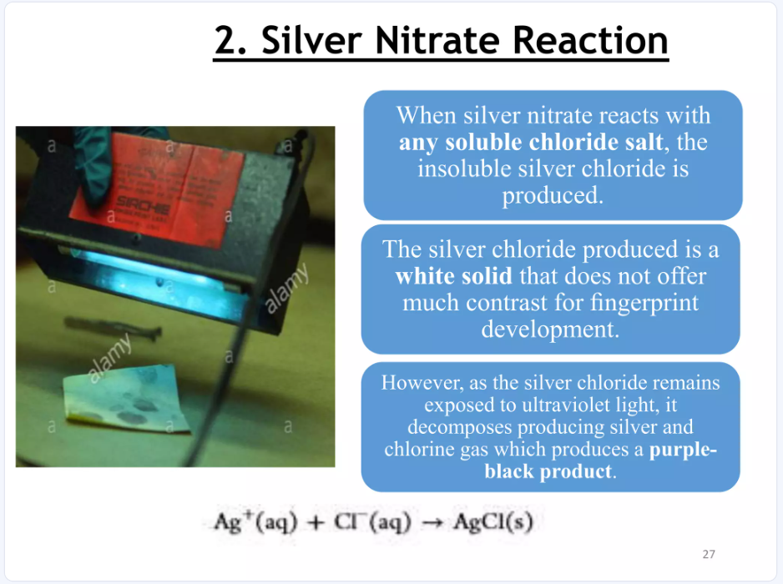

Slide 10
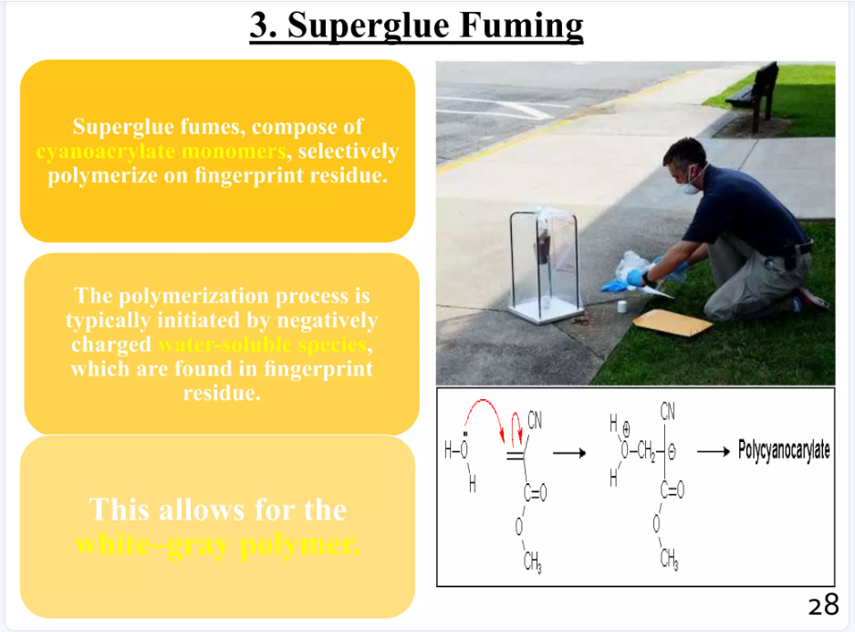

Slide 11
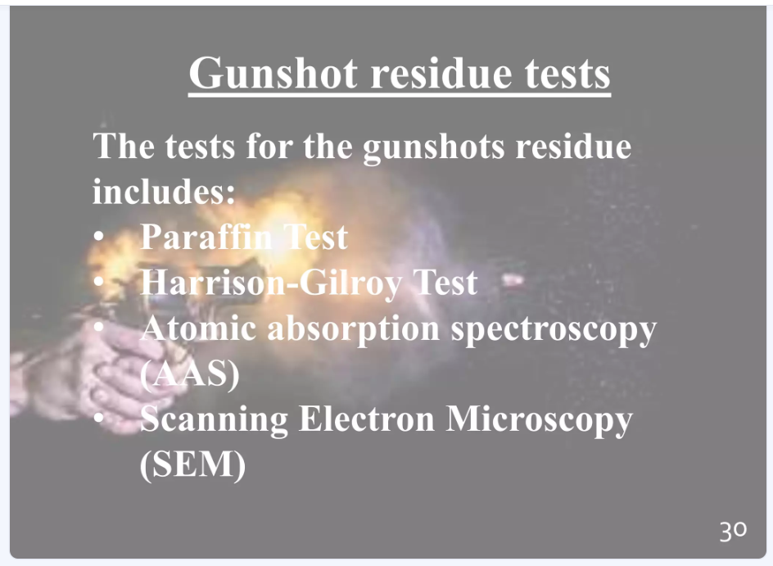

Slide 12
