Slide 1


Department of biology
ENGLISH
Second stage
Lecture Four
By
RAQIB ABBAS

Slide 2
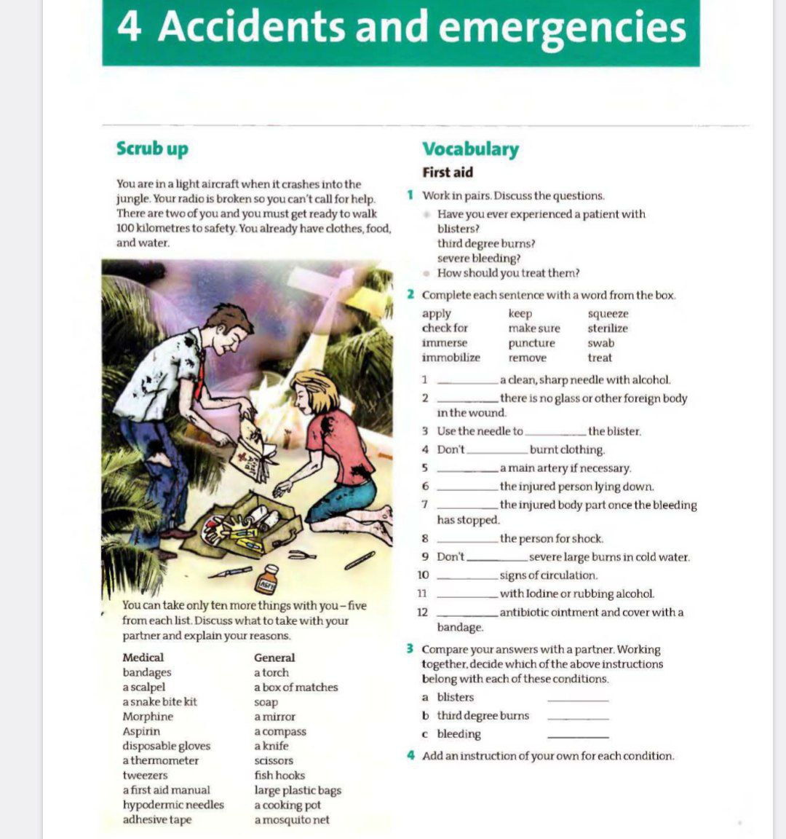

Slide 3
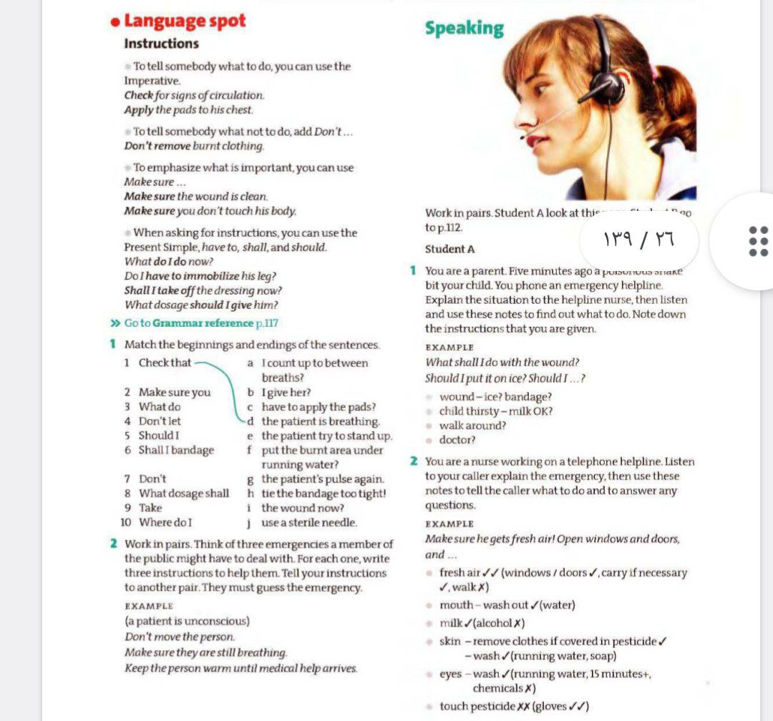

Slide 4
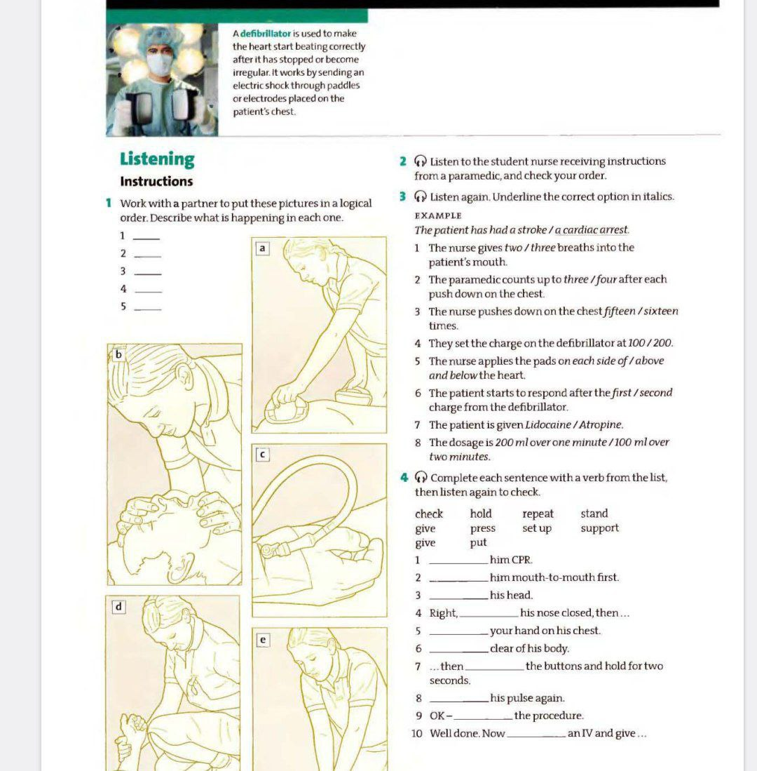

Slide 5
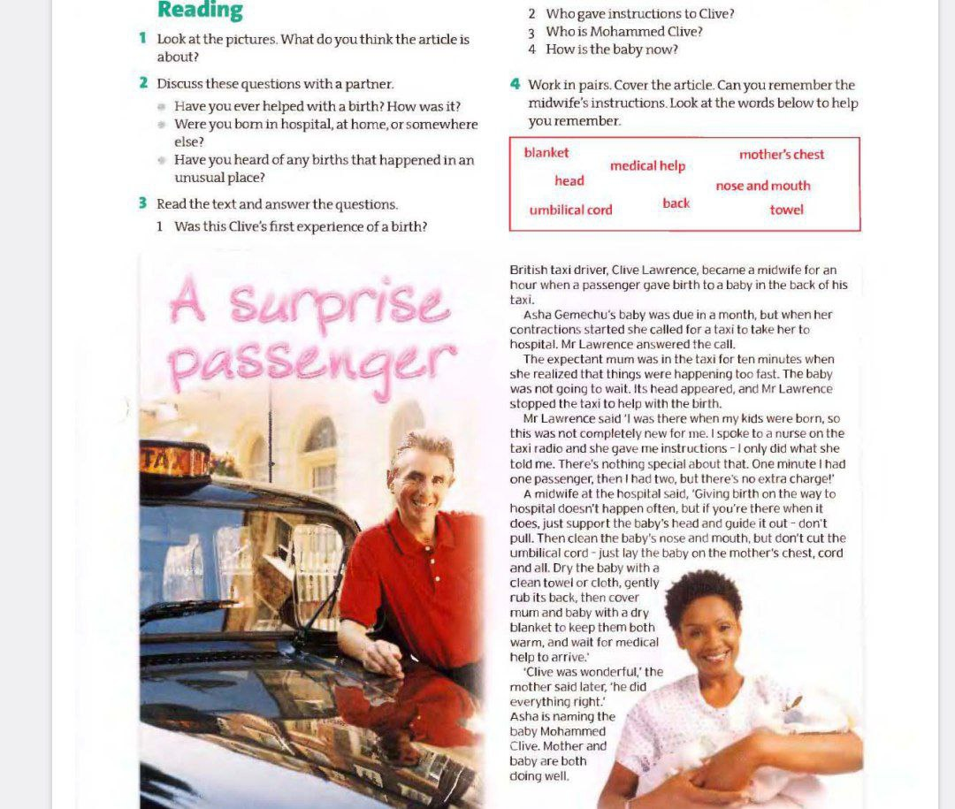

Slide 6
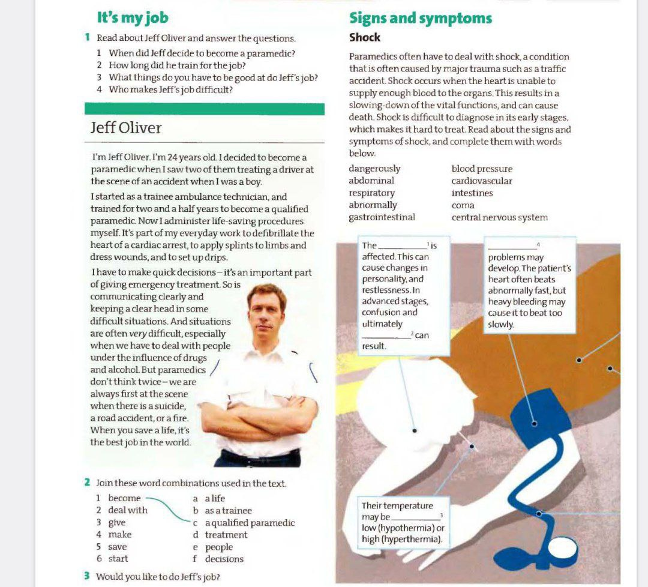

Slide 7
