Slide 1


Analogue Electronic
Ammar karem
1st semester

Slide 2
Chapter 4
Transistor
Lecture 8

Slide 3
Transistor
The transistor is the most important element in the world of electronics. It can be used as an amplifier for signals and can also be used as a switch.
There are two categories of transistors:
1. Bipolar Junction Transistor (BJT)
2. Unipolar Junction Transistor (UJT)
This type has three parties:
1. Base
2. Collector
3. Emitter

Slide 4
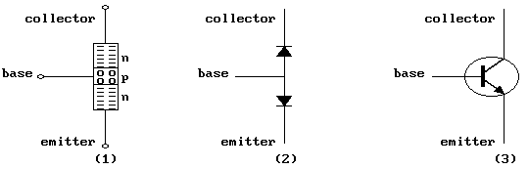
When this transistor is made up of a layer of P-type, surrounded by two layers of type n (as shown below), it is called the npn transistor,
Materials of n and p types can be obtained by adding impurities to semiconductor materials.
The shape “1" symbolizes the electrons, and the shape “2" symbolizes the gaps (1).
Part 3 shows the BJT transistor as shown in the circuit diagrams and the outward arrow symbolizes that this is the npn and indicates the direction of the conventional current.
The three semi-conductive classes behave as opposite Diodes (2)

Slide 5
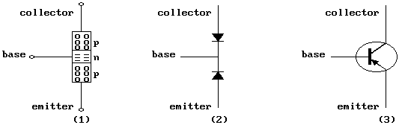
The following figure shows a pnp transistor where a type n layer is placed between two layers of type p in (1) and can be considered a Diode connected face to face. 2 The arrow inside the transistor symbol shows the traditional current path (3)
Silicon transistors (silicon-like materials) are better than their germanium counterparts, where they can work at higher temperatures, efforts, frequencies, and lower leakage rates.

Slide 6
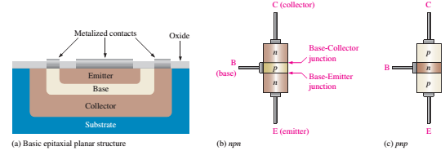
Structure of the Bipolar Junction Transistor (BJT)
The BJT is constructed with three doped semiconductor regions separated by two pn junctions, as in Figure 1(a). Physical representations of the two types of BJTs are shown in Figures 1(b) and (c).
One type consists of two n regions separated by a p region (npn), and the other type consists of two p regions separated by an n region (pnp).
The term bipolar refers to the use of both holes and electrons as current carriers in the transistor structure.
This mode of operation is contrasted with unipolar transistors, such as field-effect transistors, in which only one carrier type is employed (electron or hole, ex.: diode).
Figure1:
Basic BJT
construction.

Slide 7
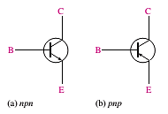
The pn junction joining the base and emitter regions is called the base-emitter junction.
The pn junction joining the base and collector regions is called the base-collector junction.
A wire lead connects to each of the three regions.
These leads are labeled E for the emitter, B for the base, and C for the collector. The base region is lightly doped and very thin compared to the heavily doped emitter and the moderately doped collector regions.
Figure 2 shows the symbols for the npn and pnp bipolar junction transistors.
Figure 2: Standard BJT symbols.

Slide 8
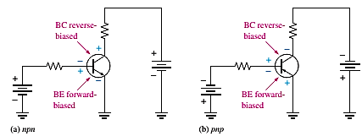
    BJT Biasing
In order to a BJT to operate properly as an amplifier, the two pn junctions must be correctly biased with external dc voltages.
Figure 3 shows a bias arrangement for both npn and pnp BJTs for operation as an amplifier.
In both cases, the base-emitter (BE) junction is forward-biased, and the base-collector (BC) junction is reverse-biased. This condition is called forward-reverse bias.
For the npn type shown, the collector is more positive than the base, which is more positive than the emitter.
For the pnp type, the voltages are reversed to maintain the forward-reverse bias.
Figure 3:
Forward-reverse
bias of a BJT.

Slide 9
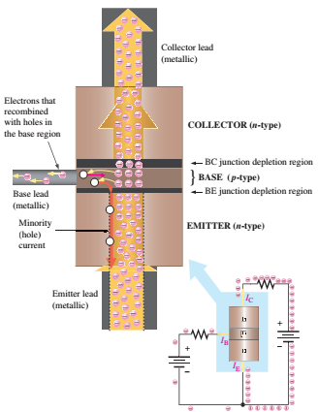
The heavily doped n-type emitter region has a very high density of conduction-band (free) electrons, as indicated in Figure below.
These free electrons easily diffuse through the forward-biased BE junction into the lightly doped and very thin p-type base region.
The base has a low density of holes,
which are the majority carriers,
as represented by the white circles.
Figure: BJT operation showing
electron flow.

Slide 10
1- A very little free electron recombines with holes in the base and moves as valence electrons through the base region and into the emitter region as hole current.
The valence electrons leave the crystalline structure of the base, become free electrons in the metallic base lead, and produce the external base current.
2- The majority of free electrons move toward the reverse-biased BC junction and are swept across into the collector region by the attraction of the positive collector supply voltage.
The free electrons move through the collector region, into the external circuit, and then return into the emitter region along with the base current.

