Slide 1


Analogue Electronic

Slide 2
Chapter 5
Amplifiers
Lec. 10

Slide 3
Amplifier Operation
DC Quantities use upper case Roman subscripts. Example: V_{CE} (The second letter in the subscript indicates the reference point).
AC Quantities and time-varying signals use lowercase subscripts. Example: V_{ce}. Instantaneous quantities are represented by lowercase letters and subscripts such as I_{c}, I_{e}, I_{b}, and V_{ce}.
Internal transistor resistances are indicated as lowercase quantities with a prime and an appropriate subscript. An example is the internal ac emitter resistance (ŕ_{e}) .
External resistances are indicated as capital R with either a capital or lowercase subscript, depending on if it is a DC or AC resistance. Examples: R_{C} and R_{c}.

Slide 4
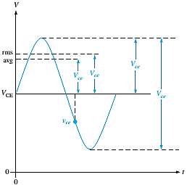
The Figure 1 shows an example of a specific waveform for the collector emitter voltage.

Slide 5
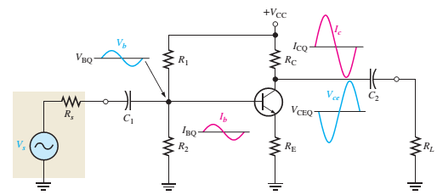
Linear Amplifier
A linear amplifier amplifies a signal without distortion, so the output signal is an exact amplified replica of the input signal.
A voltage-divider-biased transistor with a sinusoidal AC source capacitive coupled to the base through C₁ and a load capacitive coupled to the collector through C₂ is shown in Figure 2.
For the amplifier shown, notice that the voltage waveform is inverted between the input and output but has the same shape.
Figure 2

Slide 6
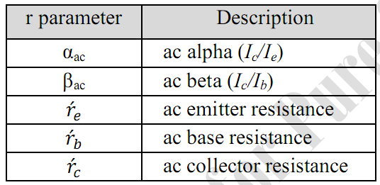
Transistor AC Models
To assume the operation of a transistor in an amplifier circuit, representing the device by a model circuit is often useful.
A transistor model circuit uses various internal transistor parameters to represent its operation. Transistor models are described in this section based on resistance or r parameters.
Another system of parameters is called h parameters. The five r parameters commonly used for BJTs are given in the following.
Table 1. The lowercase letter r with a prime denotes resistances internal to the transistor.

Slide 7
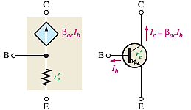
To explain this model circuit in terms of a transistor’s AC operation as follows:
A resistance (ŕ_{e}) appears between the emitter and base terminals. This is the resistance “seen” looking into the emitter of a forward-biased transistor. The collector effectively acts as a dependent current source of α_{ac}I_{e} or, equivalently, β_{ac}I_{b}, represented by the diamond-shaped symbol; these factors are shown in Figure 3.
Figure 3: Relation of transistor symbol to r-parameter model.
It is also temperature-dependent and is based on an ambient temperature of 20°C.

Slide 8
    H.W
H.W 1: Determine the (ŕ_{e}) of a transistor that is operating with a DC emitter current of 2 mA.
H.W 2: What is IE if (ŕ_{e}) = 8Ω?

