Slide 1


Analogue Electronic
1st semester

Slide 2
Chapter 4
Transistor
Lecture 9

Slide 3
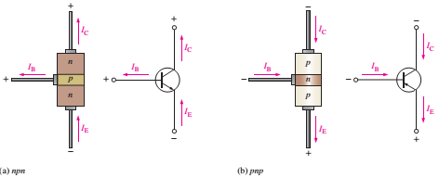
Transistor Currents
The conventional current flows toward the arrow on the emitter terminal. The emitter current (I_{E}) is the sum of the collector current (I_{C}) and the small base current (I_{B}).
That is, IE = IC + IB
IB is very small compared to IE or IC. The capital-letter subscripts indicate DC values.
The voltage drop between the base and emitter is V_{BE}, whereas the voltage drop between the collector and base is called V_{CB}.
Figure:
Transistor currents.

Slide 4
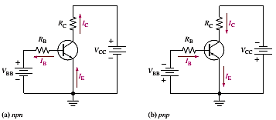



BJT Characteristics and Parameters
Two important parameters, β_{DC} (DC current gain) and α_{DC} are used to analyze a BJT circuit.
When a transistor is connected to DC bias voltages, as shown in Figure below for both npn and pnp types,
V_{BB} forward-biases the base-emitter
junction, and V_{CC} reverse-biases
the base-collector junction.
Figures of transistor DC bias circuits.
The collector current is directly proportional to the base current.
I_{C} ∝ I_{B}
The β_{DC} of a transistor is the ratio of the DC collector current (I_{C}) to the DC base current (I_{B}).
This equation explains the amplification of current.
The ratio of the DC collector current (I_{C}) to the DC emitter current (IE) is the (α_{DC}).
is always less than 1

Slide 5
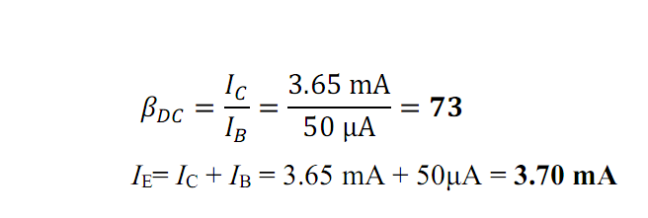
Example
Determine the dc current gain β_{DC} and the emitter current IE for a transistor where I_{B}=50μA and I_{C}= 3.65 mA.
Solution

Slide 6
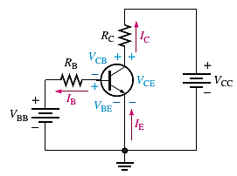
BJT Circuit Analysis
Consider the basic transistor bias circuit configuration in the Figure below. Three transistor DC currents and three DC voltages can be identified.
I_{B}: DC base current
I_{E}: DC emitter current
I_{C}: DC collector current
V_{BE}: DC voltage across the base-emitter junction
V_{CE}: DC voltage across collector-emitter junction
V_{CB}: DC voltage across collector-base junction
Figure 4: Transistor currents and voltages.

Slide 7

When the base-emitter junction is forward-biased,
It is like a forward-biased diode and has a forward voltage drop of V_{BE}≅0.7 V
The voltage at the collector concerning the grounded emitter is
V_{CE}=V_{CC} – I_{C}R_{C} (I_{C}R_{C}=V_{RC} )
The current across I_{B} is
The voltage across the reverse-biased collector-base junction is
V_{CB}=V_{CE} – V_{BE}

Slide 8
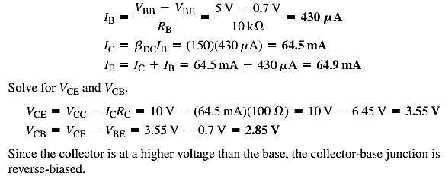
Example: Determine I_{B}, I_{C}, I_{E}, V_{BE}, V_{CE}, and V_{CB} in the circuit of the following Figure. The transistor has a β_{DC} = 150.
Solution:
VBE≅ 0.7 V, Calculate the base, collector, and emitter currents as follows:
Since the collector is at a higher voltage than the base, the CB junction is reverse-biased.

Slide 9
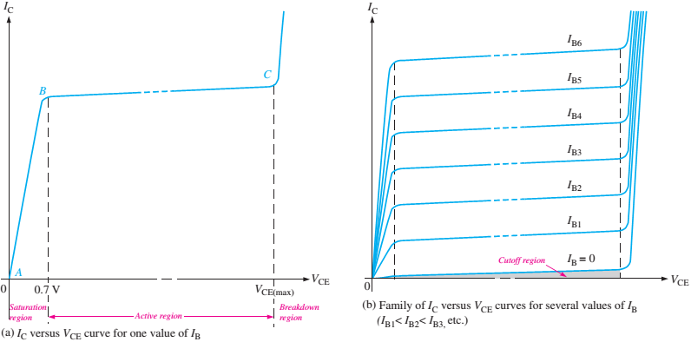
Collector Characteristic Curves
The collector characteristic curves show three modes of operation of the transistor. The collector current I_{C} variation varies with the V_{CE} for a specified value of base current I_{B}.
Assume that V_{BB} is set to produce a certain value of I_{B}, V_{CC} is zero, and V_{CE} is zero. As V_{CE} is increased, IC increases until I_{B} becomes constant.
When both BE, and BC junctions are forward biased, and the transistor is in the saturation region.
Figure : Collector
characteristic curves.

Slide 10
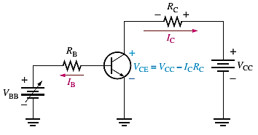
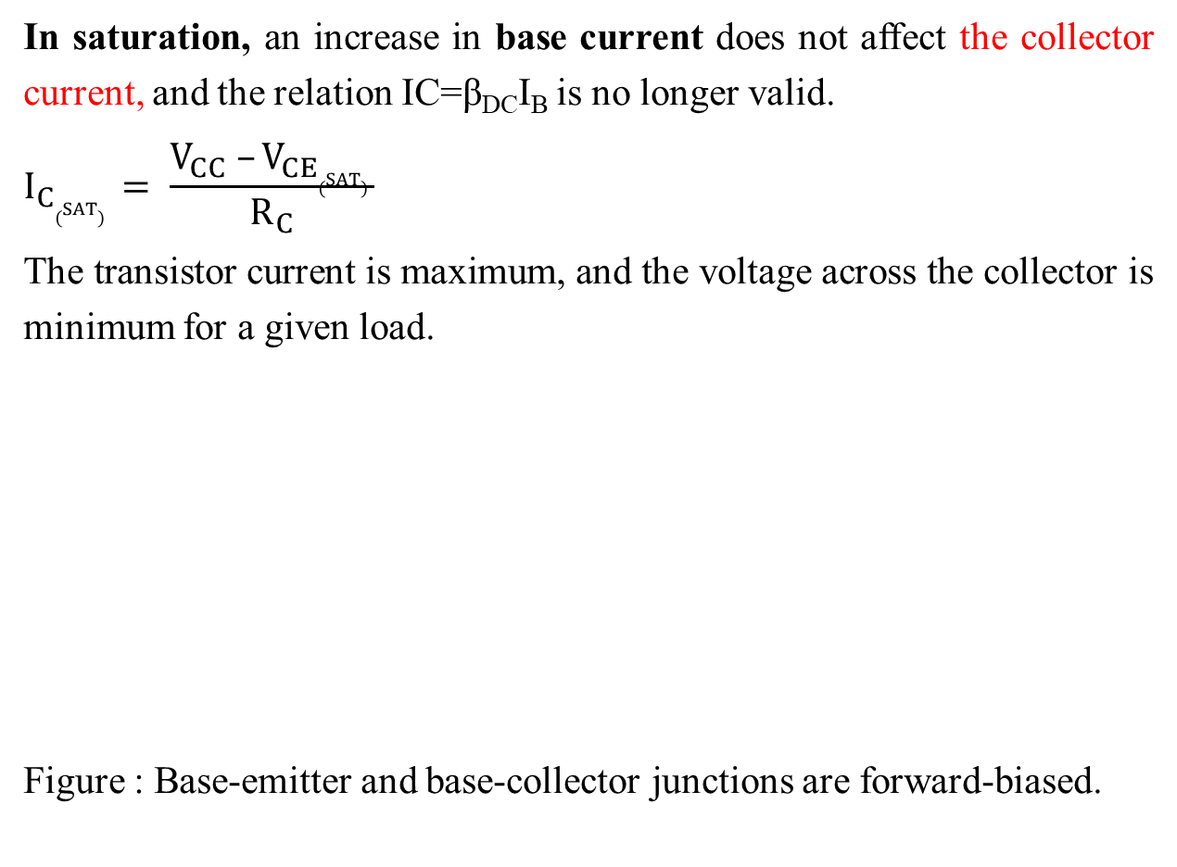
In saturation, an increase in base current does not affect the collector current, and the relation IC=β_{DC}I_{B} is no longer valid.
$$I_{C(SAT) }= \frac{V_{CC} –V_{CE(SAT) }}{R_{C}}$$
The transistor current is maximum, and the voltage across the collector is minimum for a given load.
Figure : Base-emitter and base-collector junctions are forward-biased.

Slide 11
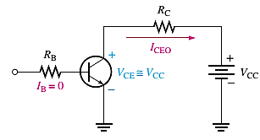
When V_{CE} is increased further and exceeds 0.7 V, the base-collector junction becomes reverse-biased, and the transistor goes into its operation's active, or linear, region.
I_{C} levels off and remains essentially constant for a given value of I_{B} as V_{CE} continues to increase. The value of I_{C} is determined only by the relationship expressed as I_{C}=β_{DC}I_{B}.
A family of collector characteristic curves is produced when I_{C} versus V_{CE} is plotted for several values of I_{B}, as illustrated in Figure below. It can be read from the curves. The value of β_{DC} is nearly the same wherever it is read in the active region. In a BJT, the cutoff is the condition of no base current (I_{B}=0), which results in only an extremely small leakage current (I_{CEO}) in the collector circuit.
The subscript CEO represents collector to emitter with the base open. For practical work, this current is assumed to be zero. In cutoff, neither the BE junction nor the BC junction is forward-biased.
Figure: Cutoff: Base-emitter and
base-collector junctions are reverse-biased.

Slide 12
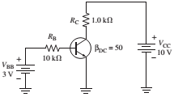
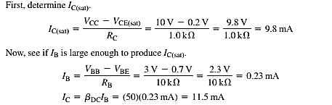
Example:
Determine whether or not the transistor in the following figure is in saturation. Assume V_{CE}(sat)= 0.2V.
Solution:
This shows that with the specified β_{DC}, this base current can produce an I_{C} greater than I_{C}(sat). Therefore, the transistor is saturated.

Slide 13
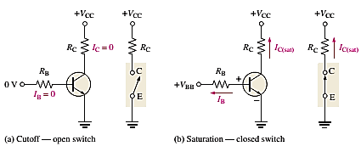
The BJT as a Switch
A BJT can be used as a switching device in logic circuits to turn on or off the current to a load. As a switch, the transistor is normally in either cutoff (load is OFF) or saturation (load is ON).
Figure: Switching action of an ideal transistor.

