Slide 1


Analogue Electronic

Slide 2
Chapter 3
Special-Purpose Diodes
Lec. 7

Slide 3
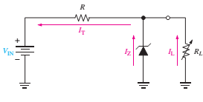
  Zener Regulation with variable load
  Figure 1 shows a zener voltage regulator with a variable load resistor across the terminals.
  The zener diode maintains a nearly constant voltage across R_{L} as long as the zener current is greater than I_{ZK} and less than I_{ZM}.
  Figure 1: Zener regulation with a variable load.

Slide 4
When R_{L}=∞ (open-cut), the load current is zero, and all the current passes through the Zener diode.
The current is divided between the Zener diode and R_{L}, when RL is connected. The total current through R remains constant as long as the Zener is regulated.
As R_{L} decreases, I_{L} increases, and I_{Z} decreases. The Zener continues to regulate the voltage until I_{Z} reaches its minimum value.
Now, the load current is maximum, and a full-load condition exists.

Slide 5
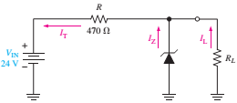
    Example:
Determine the minimum and the maximum load currents for the Zener diode in Figure 3 will maintain regulation. What is the minimum value of R_{L} that can be used? V_{Z}= 12 V, I_{ZK}= 1 mA and I_{ZM}= 50 mA. Assume an ideal Zener diode where Z_{Z}= 0 Ω and V_{Z} remains a constant 12 V over the range of current values.
Solution
When I_{L}=0, (R_{L}=∞), I_{Z}=I_{Zmax}= I_{T}
I_{(Z(max))}= I_{T}= (V_{IN} -V_{Z})/R= (24-12)/470= 25.5 mA
R_{L} can be removed without disturbing regulation if this value is less than 50 mA.
I_{L(min)} = 0 A
I_{L(max)} occurs when I_{Z} is minimum (I_{Z} = I_{ZK})
I_{L(max)} = I_{T}−Iz_{(min)} = 25.5 mA −1 mA = 24.5 mA
The minimum value of R_{L} is
R_{(L(min))} =V_{Z}/I_{(L(max))} = 12 V/ 24.5 mA= 490 Ω
Regulation is maintained for any value of R_{L} between 490 Ω and infinity.

Slide 6
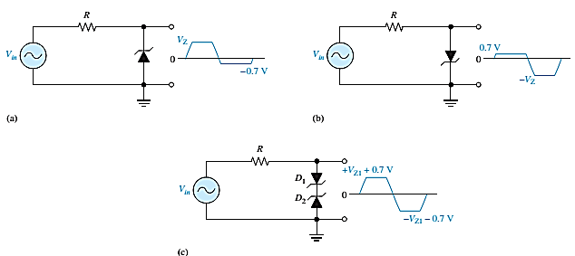
    Zener Limiter
Zener diodes can be used as limiters. Figure 4 shows three basic ways the limiting action of a Zener diode can be used.
During the negative alternation, the Zener acts as a forward-biased diode and limits the negative voltage to 0.7V, as in part (A).
When the Zener is turned around, as in part (B), the negative peak is limited by Zener action, and the positive voltage is limited to +0.7V. Two back-to-back Zeners limit both peaks to the Zener voltage ± 0.7V, as shown in part (C).
Figure 4: Basic Zener limiting action with a sinusoidal input voltage.

Slide 7
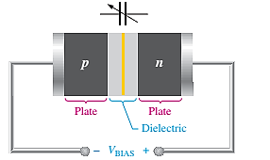
Varactor Diode
A varactor diode is a special-purpose diode operated in reverse bias to form a voltage-controlled capacitor rather than traditional diodes.
The applied voltage controls the capacitance and hence the resonant frequency. The width of the depletion region increases with reverse bias.
These devices are commonly used in communication systems.
Varactor diodes are also referred to as tuning diodes.
Figure 5: The reverse-biased varactor diode acts as a variable capacitor.

Slide 8
    Optical Diodes
This section introduces three types of optoelectronic devices: the light-emitting diode, quantum dots, and the photodiode.
The Light-Emitting Diode (LED)
Light Emitting Diodes (LEDs), diodes can be made to emit light electroluminescence or sense light.
When the device is forward-biased, electrons cross the pn junction from the n-type material and recombine with holes in the p-type material.
The free electrons are in the conduction band and at a higher energy than the holes in the valence band.
The difference in energy between the electrons and the holes corresponds to the energy of visible light.
When recombination takes place, the recombining electrons release energy in the form of photons.

Slide 9

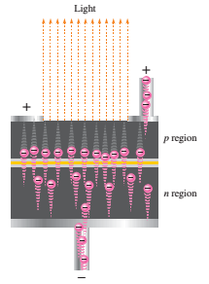
    Conduction Electrons and Holes
The emitted light tends to be monochromatic (one color) depending on the band gap (and other factors). A large exposed surface area on one layer of the semiconductive material permits the photons to be emitted as visible light. This process, called electroluminescence, is illustrated in Figure 6. LEDs vary widely in size and brightness–from small indicating lights and displays to high-intensity LEDs used in traffic signals, outdoor signs, and general illumination.
Figure 6 A: Symbol for an LED. When forward-biased, it emits light.
Figure 6 B: Electroluminescence
in a forward-biased LED.

Slide 10
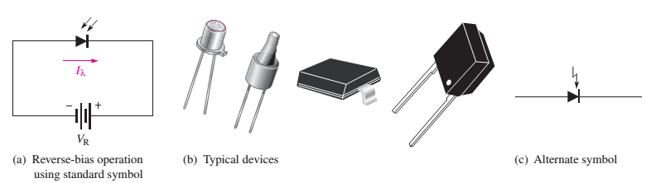
    The Photodiode
The photodiode is a device that operates in reverse bias, as shown in Figure 13,
where is I_{λ} the reverse light current.
The photodiode has a small transparent window that allows light to strike the pn junction.
A photodiode differs from a rectifier diode in that the reverse current increases with the light intensity when its pn junction is exposed to light. When there is no incident light, the reverse current, I_{λ}, is almost negligible and is called the dark current.
Figure 13:Photodiode.

Slide 11

You are less likely to encounter several types of diodes as a technician. Among these are the laser diode, the Schottky diode, the pin diode, the step-recovery diode, the tunnel diode, and the current regulator diode.
The Laser Diode
Laser light is monochromatic, meaning it consists of a single color, not a mixture of colors, compared to incoherent light, which consists of a wide band of wavelengths.
The laser diode normally emits coherent light,
whereas the LED emits incoherent light.
Figure 14: Symbol for a Laser Diode.

