Slide 1
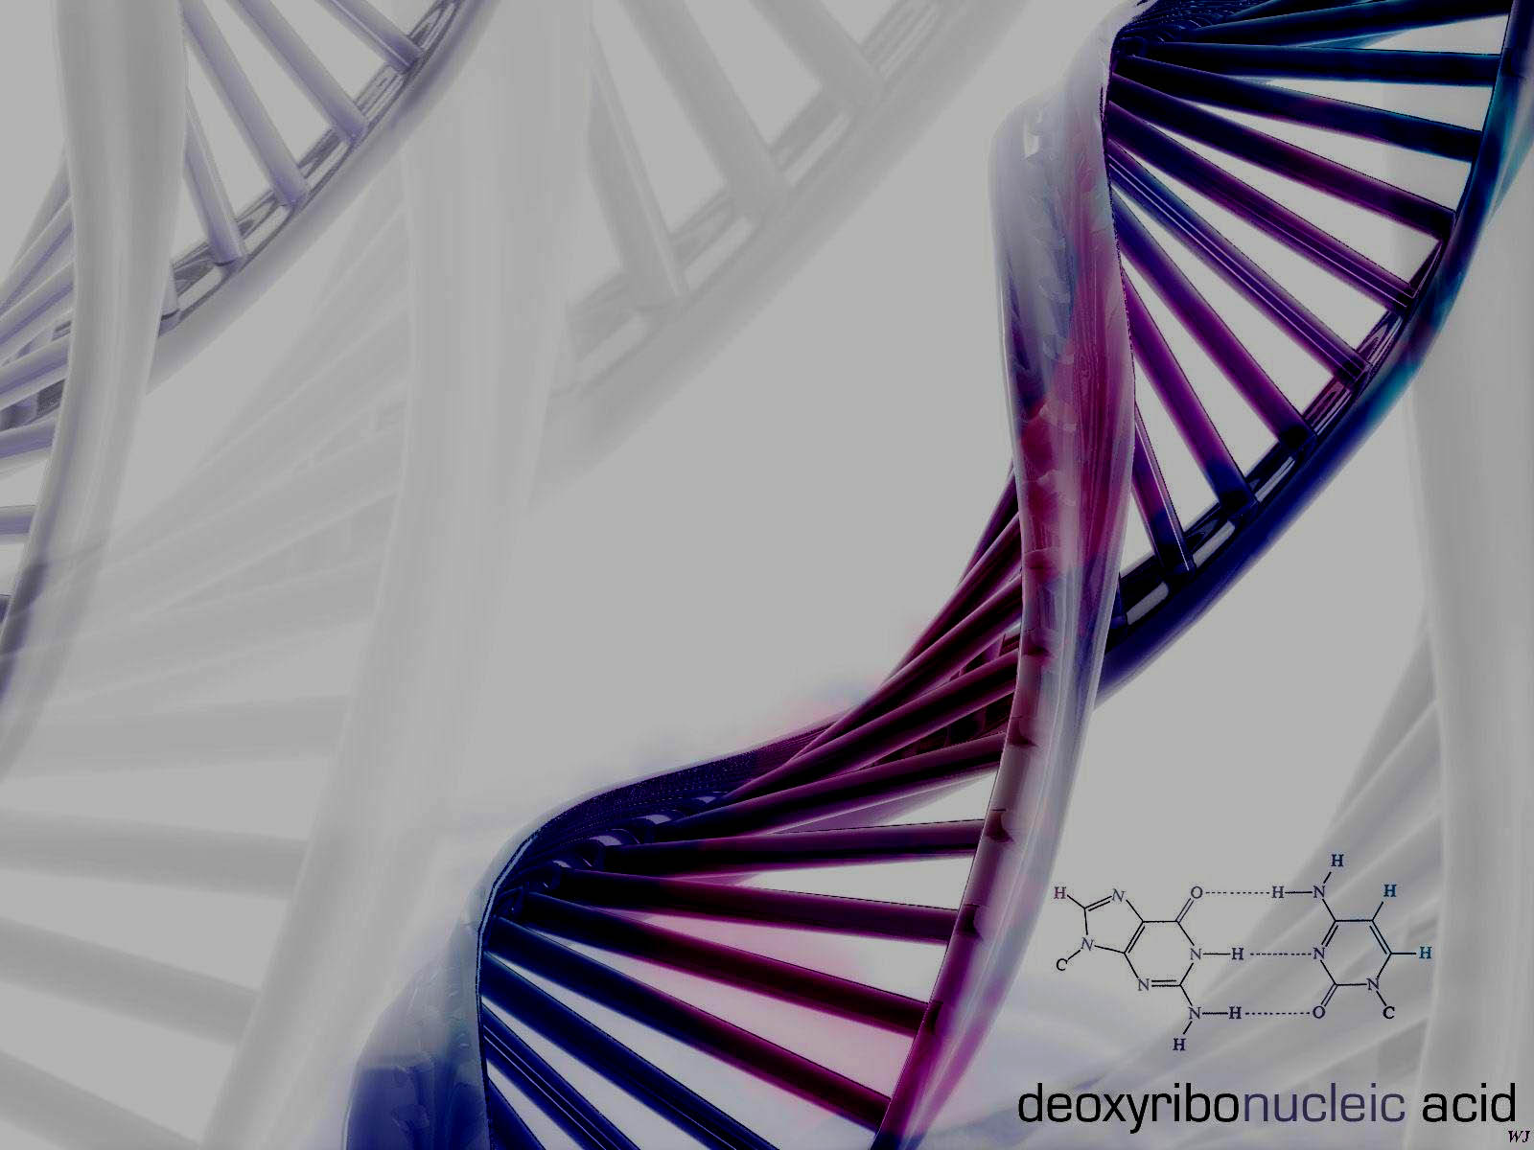
DNA
Structure

Slide 2
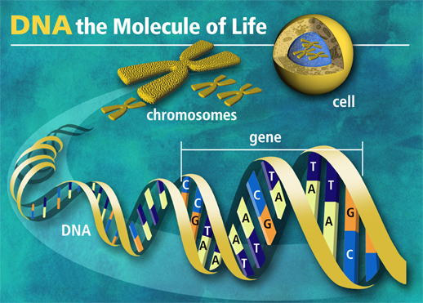
DNA stands for
Deoxyribonucleic acid

Slide 3
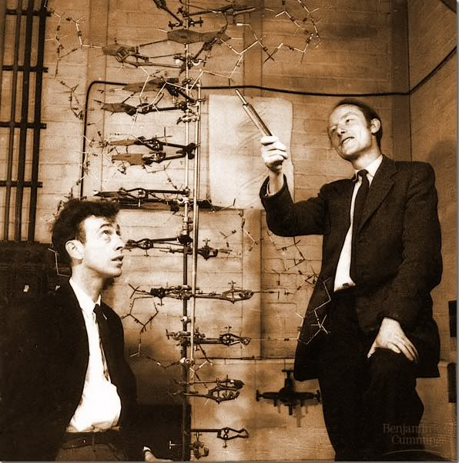
DNA Structure
DNA consists of two molecules that are arranged into a ladder-like structure called a Double Helix.
A molecule of DNA is made up of millions of tiny subunits called Nucleotides.
Each nucleotide consists of:
  Phosphate group
  Pentose sugar
  Nitrogenous base

Slide 4
Nucleotides
Phosphate
Nitrogenous
Base
Pentose
Sugar

Slide 5
Nucleotides
The phosphate and sugar form the backbone of the DNA molecule, whereas the bases form the “rungs”.
There are four types of nitrogenous bases.

Slide 6
Nucleotides
A
T
Adenine
Thymine
C
G
Cytosine
Guanine

Slide 7
Nucleotides
Each base will only bond with one other specific base.
Adenine (A)
Thymine (T)
Cytosine (C)
Guanine (G)
Form a base pair.
Form a base pair.

Slide 8
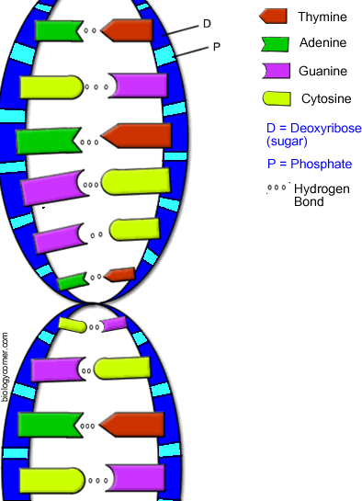
Base-Pair Rule
Adenine <==> Thymine
Guanine <==> Cytosine
The sides of the DNA ladder are phosphate & sugar held together by hydrogen bonds

Slide 9
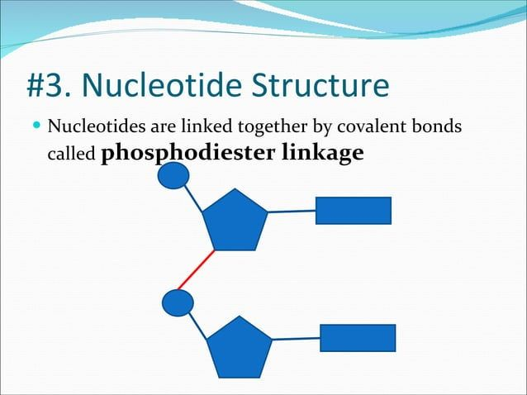

Slide 10
DNA Structure
Because of this complementary base pairing, the order of the bases in one strand determines the order of the bases in the other strand.

Slide 11
A
T
C
G
T
A
C
G
A
T
G
C
T
A

Slide 12
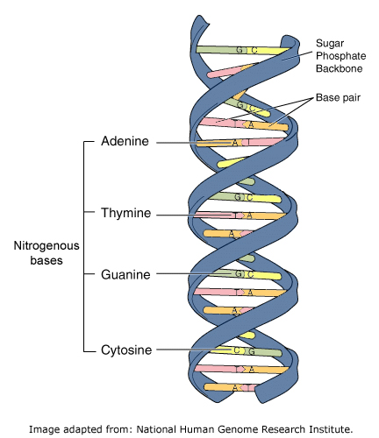
Base Pair Rule
One side: A T A T C A T G C G G G
Other side:

Slide 13
DNA Structure
To crack the genetic code found in DNA we need to look at the sequence of bases.
The bases are arranged in triplets called codons.
A G G - C T C - A A G - T C C - T A G
T C C - G A G - T T C - A G G - A T C

Slide 14
DNA Structure
A gene is a section of DNA that codes for a protein.
Each unique gene has a unique sequence of bases.
This unique sequence of bases will code for the production of a unique protein.
It is these proteins and combination of proteins that give us a unique phenotype.

Slide 15
Let's Review What We Know About DNA
1. DNA stands for: De _____ ribo ______ acid
2. What is the shape of DNA? _______________
3. Adenine always pairs with _______________
4. The sides of the DNA ladder are deoxyribose and _____
5. Guanine always pairs with _____________
6. What is the complimentary sequence: A A T G C A
7. The two sides of DNA are held together by _______ bonds.
8. DNA is composed of repeating subunits called ______________________
9. What are the 4 bases that make up the rungs of the DNA ladder? _______________________________________

