Slide 1


Energy and membrane biology
M.S.c Amna shaker
Lecture two
Almustaqbal university
Biochemistry department

Slide 2
Structure and Composition of Biological Membranes
Biological membranes are fundamental components of living cells, acting as barriers that define the boundaries of the cell and its various compartments. The main components of biological membranes are proteins, lipids, and carbohydrates.
Carbohydrates account for less than 10% of the mass of most membranes and are generally bound either to the lipid or protein components.

Slide 3
components of biological membranes :
Lipid Bilayer:
  Phospholipids: The most abundant type of lipids in cell membranes, consisting of a hydrophilic (water-attracting) head and two hydrophobic (water-repelling) tails. They arrange themselves into a bilayer, with heads facing outward towards the water inside and outside the cell, and tails facing each other.
  Cholesterol: Interspersed within the phospholipid bilayer, cholesterol molecules help modulate the fluidity and stability of the membrane.
  Glycolipids: These are lipids with carbohydrate chains attached and are found on the extracellular surface of the cell membrane, playing a role in cell recognition and communication.

Slide 4
2- Proteins:
Integral Proteins: These are embedded within the lipid bilayer and can span the entire membrane (transmembrane proteins). They function as channels, carriers, or receptors.
Peripheral Proteins: These are attached to either the outer or inner surface of the lipid bilayer. They help in various functions like signaling and maintaining the cell's shape

Slide 5
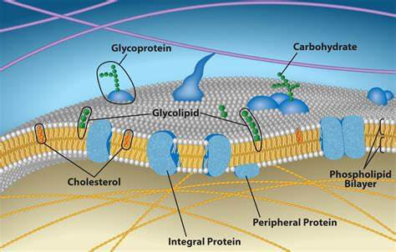

Slide 6
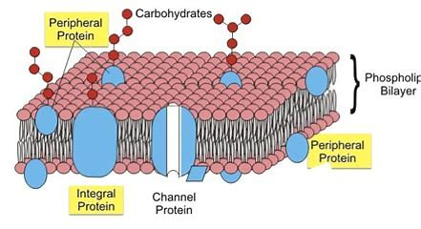

Slide 7
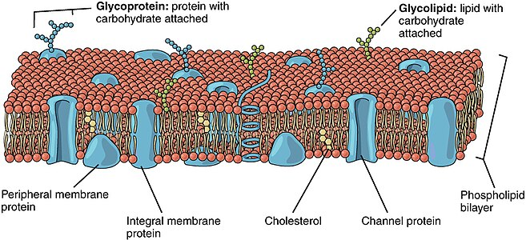

Slide 8
3- carbohydrates: Carbohydrate groups are present only on the outer surface of the plasma membrane and are attached to proteins, forming glycoproteins, or lipids, forming glycolipids.
Generally found on the extracellular surface and make up the glycocalyx.
The pattern and complexity of carbohydrate molecules vary depending on the cell type and its specific functions.
Carbohydrates are covalently linked to proteins (glycoproteins) or lipids (glycolipids) and also an important part of cell membranes, and function as adhesion and address loci for cells.

Slide 9
The Fluid Mosaic Model describes membranes as a fluid lipid bilayer with floating proteins and carbohydrates.
Membrane carbohydrates are chemically bound to glycolipids and glycoproteins.
However, some membrane carbohydrates are part of proteoglycans that insert their amino acid chain among the lipid fatty acids.
Although some carbohydrates can be found associated with intracellular membranes, most of them are located in the outer monolayer of the plasma membrane, facing the extracellular space.

Slide 10
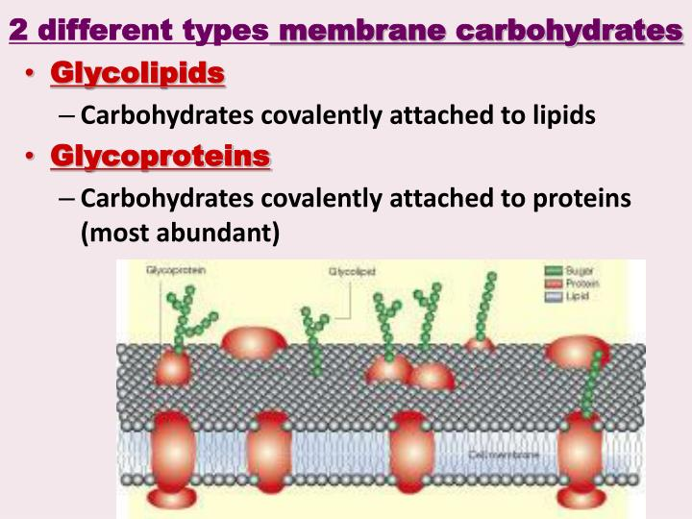

Slide 11
Function of the membrane
1-Barrier: Separates the internal environment of the cell from the external environment.
2-Transport: Regulates the passage of substances in and out of cells and organelles.
3-Communication: Contains receptors that allow cells to receive signals from the external environment.
4- Adhesion: Helps cells stick to each other and to the extracellular martial

Slide 12
DUTIES
ANSWER THE FALLOWING
Numerate Function of the cell membrane ?
Numerate Proteins type ?

Slide 13
Thank
You

