Slide 1


Medical Microbiology
M.S.c Amna shaker
Lecture Three
Almustaqbal university
Department of medical Biotechnology

Slide 2
Laboratory diagnosis of Gram-positive bacteria Staphylococci and Streptococci
The laboratory diagnosis of Gram-positive bacteria AND Staphylococci and Streptococci
Staphylococci diagnosis
involves several steps to identify and differentiate these bacteria.
Staphylococci Sample Collection: Samples are collected from the site of infection (e.g., skin, nasal swabs).
*Gram Staining: Staphylococci appear as Gram-positive cocci in clusters
*Culture Techniques: Blood agar and Mannitol Salt Agar (MSA) are commonly used. S. aureus produces yellow or golden colonies on MSA due to mannitol fermentation

Slide 3
Biochemical Tests:
1-Catalase Test: Positive (distinguishes staphylococci from streptococci).
2-Coagulase Test: Positive for S. aureus (differentiates it from coagulase-negative staphylococci).
3-Novobiocin Sensitivity Test: Differentiates S. epidermidis (sensitive) from S. saprophyticus (resistant).

Slide 4
gram stain
Gram staining is a technique used to differentiate bacterial species into two groups based on the physical and chemical properties of their cell walls
The two groups are:
1- Gram-positive bacteria: These bacteria retain the crystal violet stain and appear purple under a microscope. They have a thick peptidoglycan layer in their cell walls.
2-Gram-negative bacteria: These bacteria do not retain the crystal violet stain but take up the counterstain (usually safranin) and appear red or pink. They have a thinner peptidoglycan layer and an outer membrane.

Slide 5
Streptococci diagnosis :
Sample Collection: Samples are collected from the site of infection (e.g., throat swabs, blood)
*Gram Staining: Streptococci appear as Gram-positive cocci in chains or pairs.
Culture Techniques: Blood agar is used to observe hemolysis patterns.
Hemolysis on Blood Agar: Alpha (partial), Beta (complete), or Gamma (none).

Slide 6
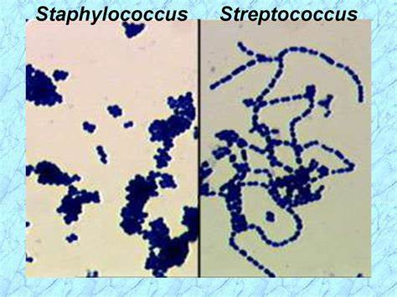

Slide 7
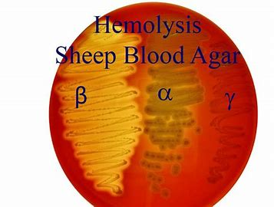

Slide 8
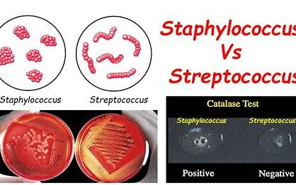

Slide 9
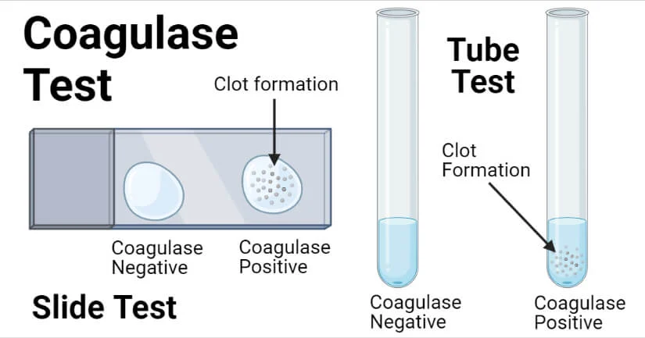

Slide 10
Thank
You

