Slide 1

Ministry of Higher Education and Scientific Research
Al-Mustaqbal University
Radiology Techniques Department
Radiographs of Upper limbs
مختبر تقنيات التصوير الشعاعي
المرحلة الثانية
Mustafa K. Alhussainy

Slide 2
Fingers _ PA projection
1- Film size : 8 * 10 , no Bucky
2-Place palmar aspect of fingers on cassette , separate the fingers slightly
3-Minimum SID_ 40 inches (100 cm )

Slide 3
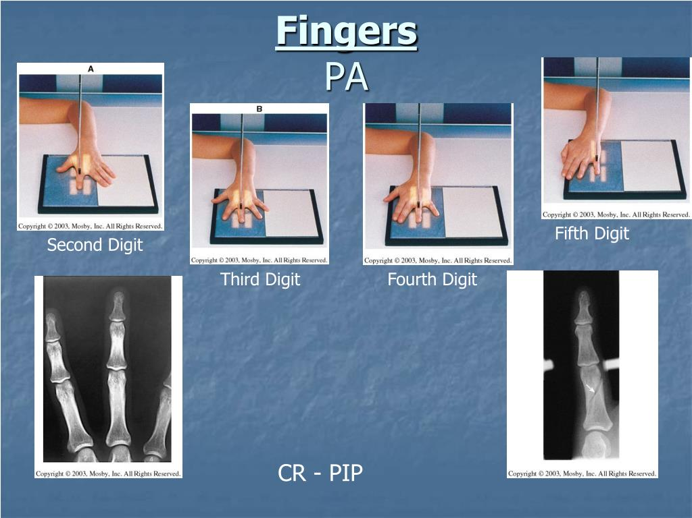

Slide 4
Fingers _ lateral projection
1- Film size : 8 * 10 , no Bucky
2- Extend finger , close rest fingers into a fist
3-Minimum SID_ 40 inches (100 cm )

Slide 5
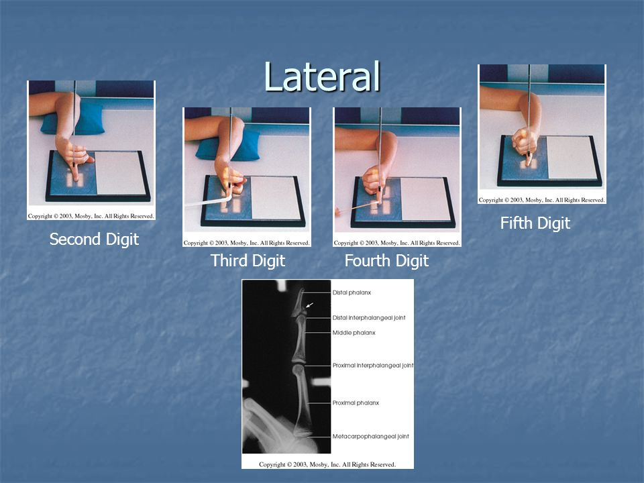

Slide 6
PA oblique projection fingers
1- Film size : 8 * 10 , no Bucky
2- Rotate the pronated hand externally & separate the digits
3-Minimum SID_ 40 inches (100 cm )
4- the hand is rotated approximate 45° (thumb side up)

Slide 7
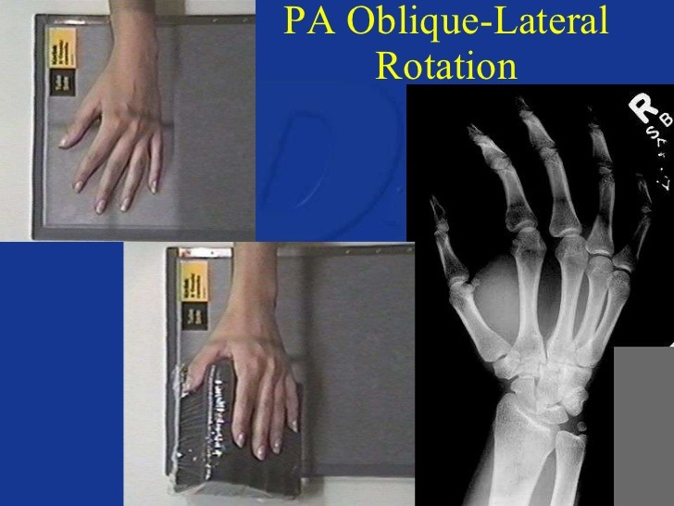

Slide 8
Thumb_ AP view
1- Film size : 8 * 10 , no Bucky
2- Extend hand , wrist & forearm
3- Rotate arm until the posterior aspect of thumb is resting on film
4- Minimum SID_ 40 inches (100 cm )
resting on film

Slide 9
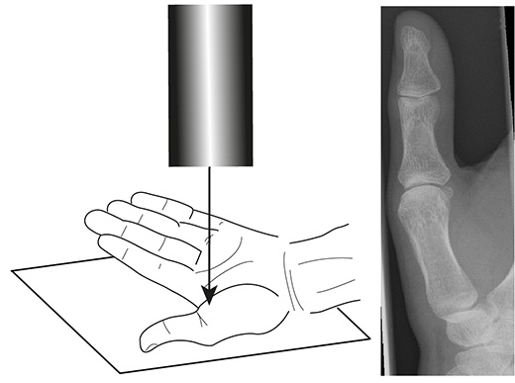

Slide 10
Thumb _ lateral view
1- Film size : 8 * 10 , no Bucky
2- Extend hand , wrist & forearm
3- Place the palmar aspect of the hand on the film the palm of the hand until the thumb is in true lateral position
4- Minimum SID_ 40 inches (100 cm )
resting on film

Slide 11
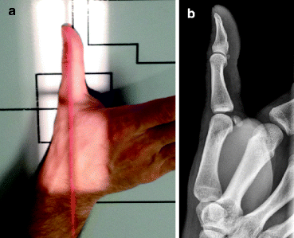

Slide 12
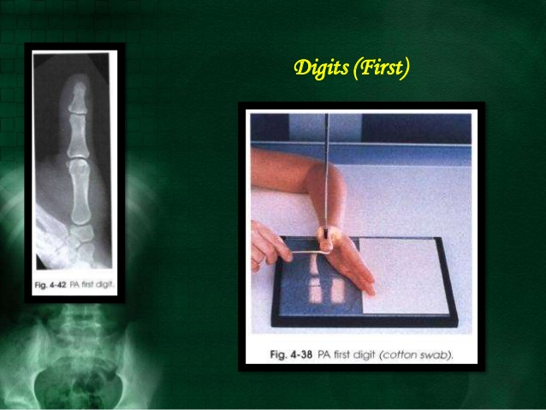
Thumb _ PA view

Slide 13
Hand _ PA projection
1- Film size : 10 * 12 , no Bucky
2- Rest the forearm on table & place the hand on cassette with palmar surface down , spread fingers
3-CR to 3rd metacarpal joint
4- Minimum SID_ 40 inches (100 cm )
resting on film

Slide 14
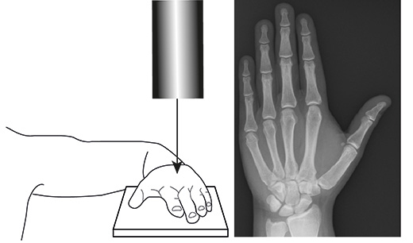

Slide 15
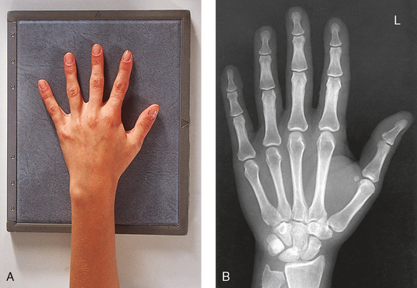

Slide 16
Hand _ AP oblique projection
1- Film size : 10 * 12 , no Bucky
2- Extend the hand , wrist & forearm in a straight line
3- place palm of hand on film including the wrist
4-Raise the thumb un l palm is 45 degree with IR
4- Minimum SID_ 40 inches (100 cm )
resting on film

Slide 17
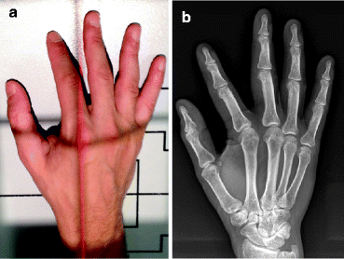

Slide 18
Lateral view of hand
1- Film size : 10 * 12 , no Bucky
2- Extend the digits & extend the thumb at right angle with palm
3- Place palmar surface perpendicular to film
4- Minimum SID_ 40 inches (100 cm )
resting on film

Slide 19
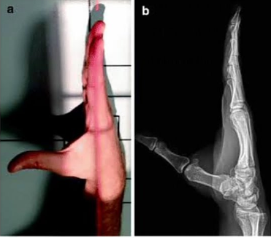

Slide 20
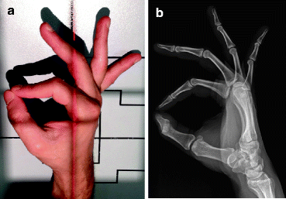
Hand lateral (fan)

Slide 21
PA view of wrist
1- Film size : 8 * 10 , no Bucky
2- CR is vertical to metacarpal area
3- The carpal interspaces are better demonstrated in AP position
4- Minimum SID_ 40 inches (100 cm )
resting on film

Slide 22
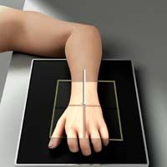

Slide 23
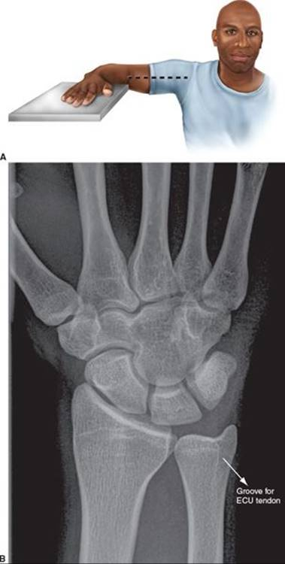

Slide 24
Lateral view of wrist
1- Film size : 8 * 10 , no Bucky
2- Rest the arm & forearm on table
3- Centre the film to carpals & adjust the hand so that the wrist is in a true lateral position with medial surface of hand touching the film
4- CR is vertical to wrist joint
5- This position is used to demonstrate displacement in fractures

Slide 25
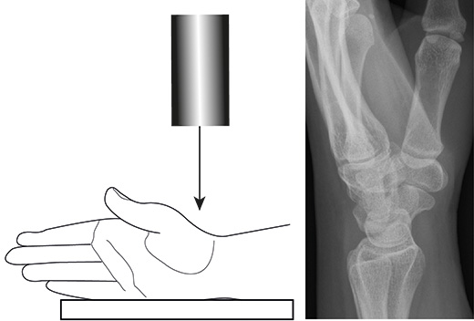

Slide 26
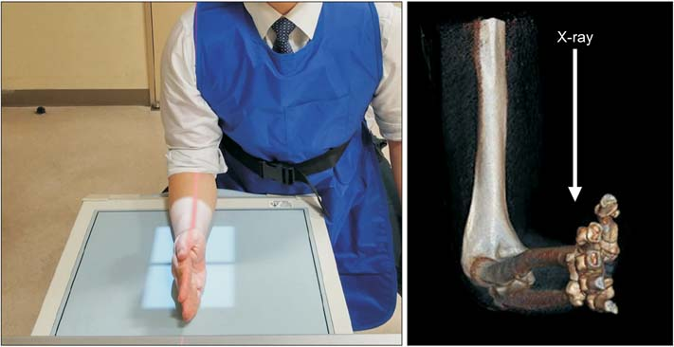

Slide 27
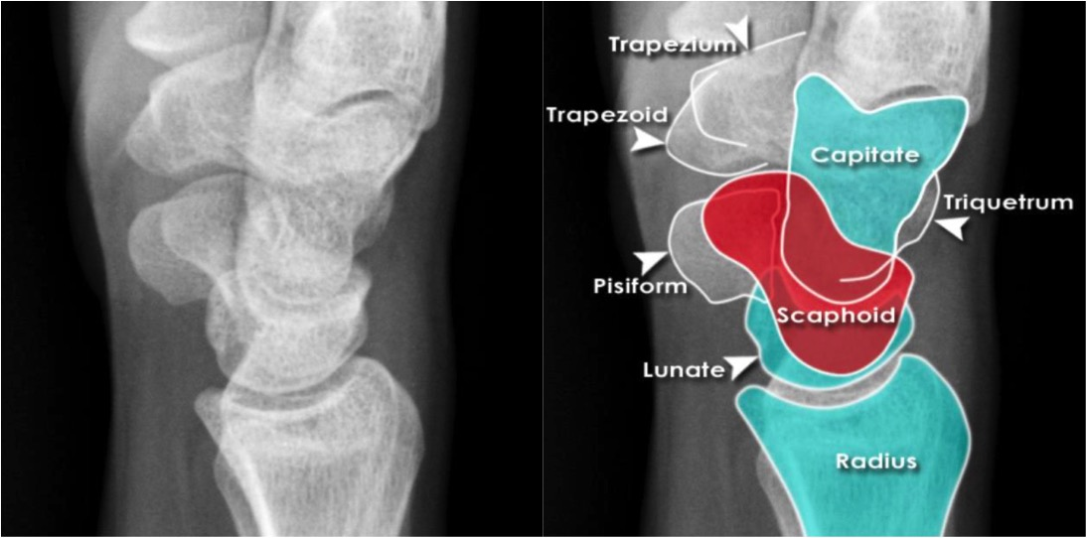

Slide 28
Wrist for scaphoid
1- Film size : 8 * 10 , no Bucky
2- Position the wrist for a PA position
3- Turn the hand outwards until the wrist is in extreme ulnar flexion
4- CR to scaphoid (10 _ 15 degree proximal or distal angulation may be needed )

Slide 29
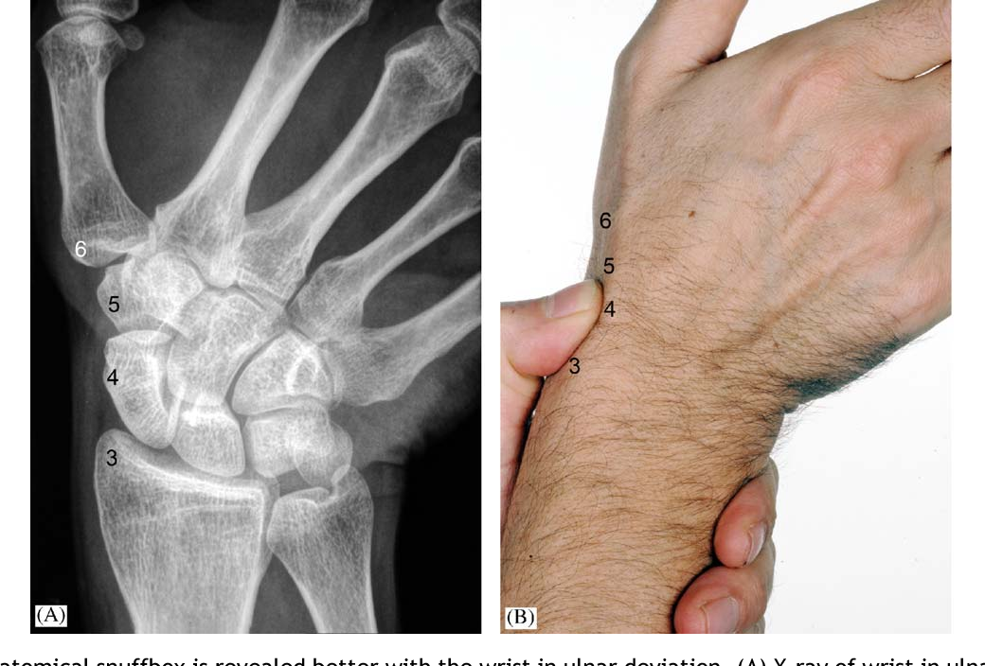

Slide 30
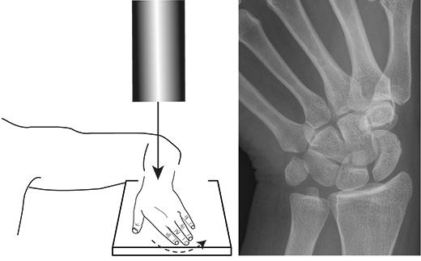

Slide 31
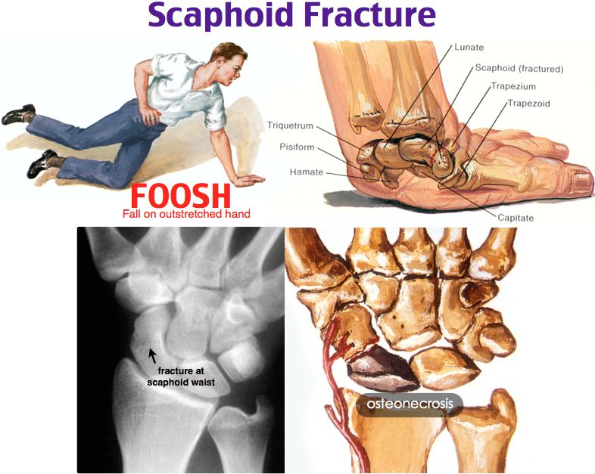

Slide 32
Forearm AP view
1- Film size : 10 * 12 or 11 * 14 according to the length of forearm ( including wrist & elbow ) take 2 views on the same film , no Bucky
2- Seat the patient with the forearm supinated & elbow extended
3- CR is vertical to midpoint of forearm ( midway between the wrist & elbow )

Slide 33
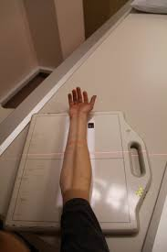

Slide 34
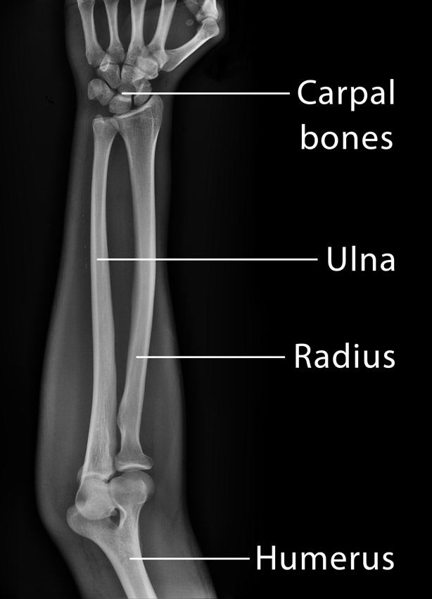

Slide 35
forearm lateral view
1- Film size : 10 * 12 or 11 * 14 according to the length of forearm ( including wrist & elbow )
2- Flex elbow 90 degree , adjust the forearm in a true lateral position ( with the thumb side up )
3- CR is vertical to midpoint of forearm

Slide 36
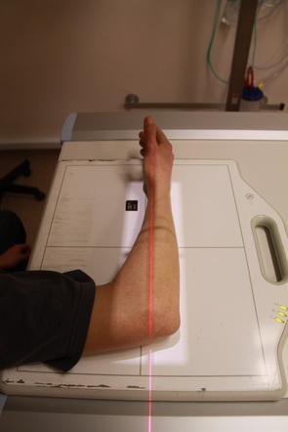

Slide 37
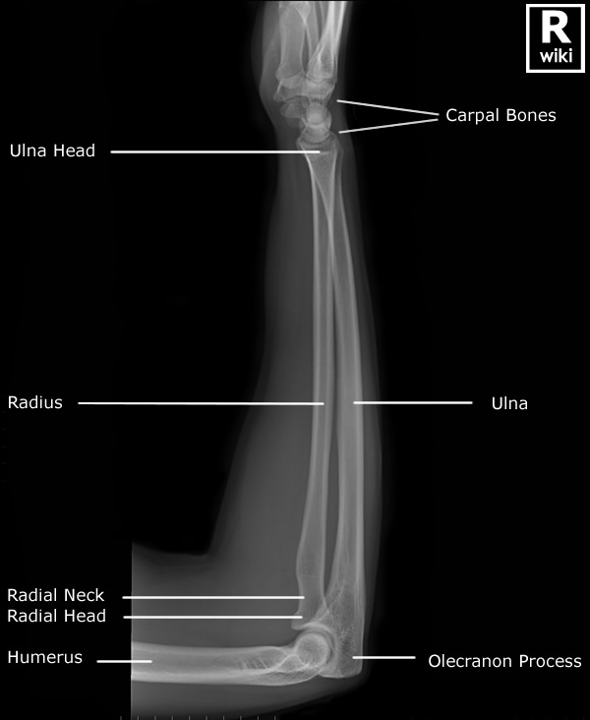

Slide 38
Elbow AP view
1- Film size : 8 * 10 , no Bucky
2- Seat the patient so that the elbow & shoulder are in the same plane
3- Extend the elbow , supinate the hand
4- CR is perpendicular to the elbow (2.5 cm distal to a line joining the humeral epicondyles)

Slide 39
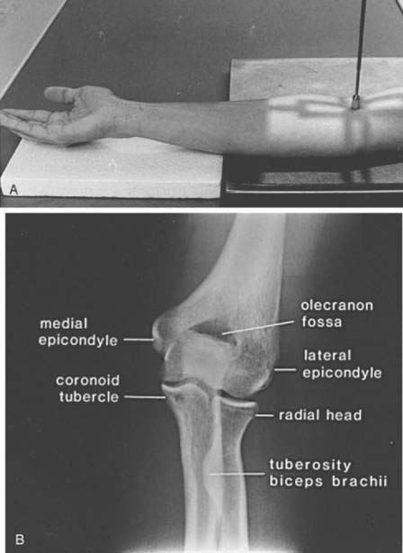

Slide 40
Elbow lateral view
1- Film size : 8 * 10 , no Bucky
2- This view will demonstrate the olecranon & the elbow fat pads
3- From the AP view , ex the elbow to 90 degrees (the hand in lateral position with thumb uppermost & the humeral epicondyles are perpendicular to film)
4- CR is vertical to elbow
5- In injury , this view is taken first
6-When soft tissue injury is suspected , flex the joint to 30 _35 degrees so as not to compress or stretch soft tissues

Slide 41
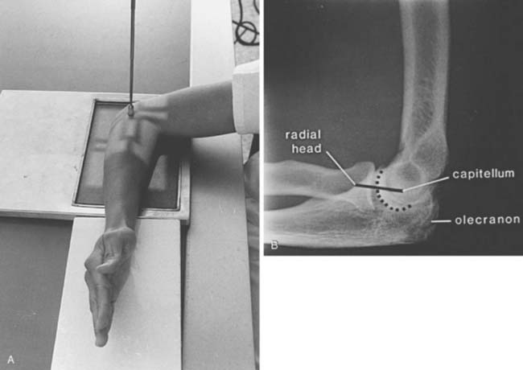

Slide 42
Humerus AP & Lateral views (erect)
1- Film size 11*14 or 14*17 with Bucky
2- The coronal plan passing the epicondyles will be parallel with plane of film in AP view & perpendicular to film in lateral view
3- CR midway between the elbow & shoulder

Slide 43
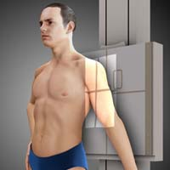

Slide 44
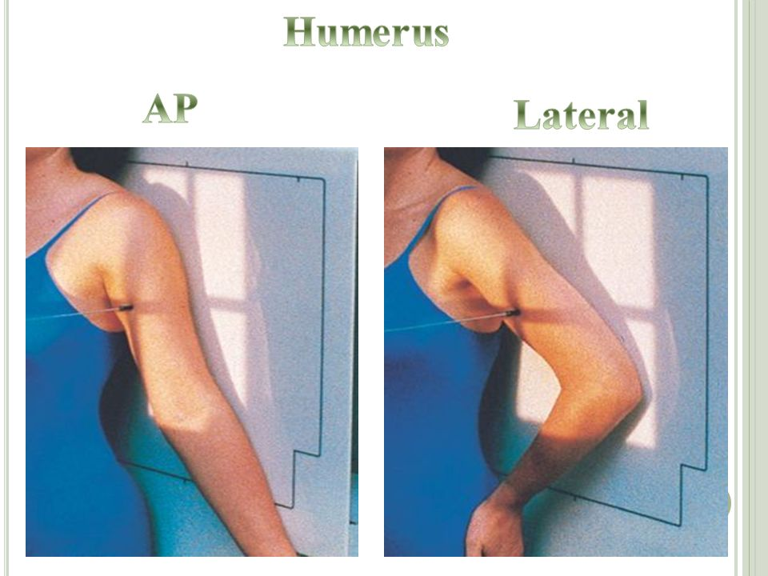

Slide 45
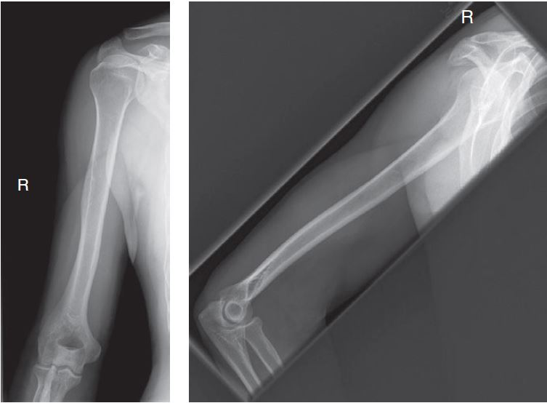

Slide 46
Shoulder AP view
1- Film size 10 * 12 with Bucky
2- Erect or supine , put the cassette center under the coracoid , rotate the patient to place the scapula parallel to film
3- Take a view external rotation , with a neutral position & with internal rotation
4- CR is directed to a point 1 inch inferior to the coracoid process

Slide 47
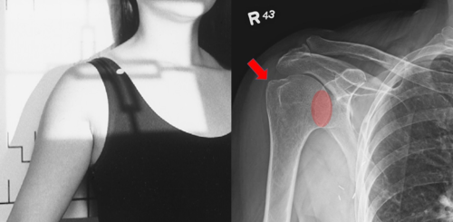

Slide 48
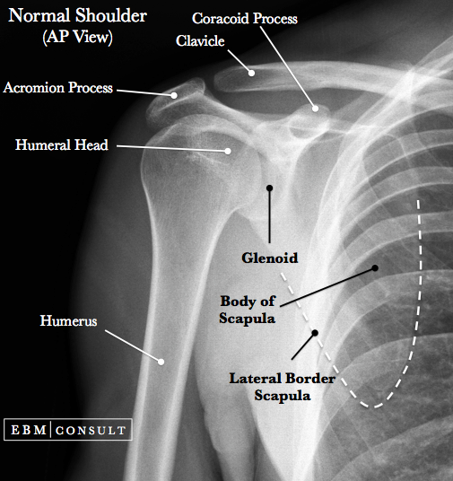

Slide 49
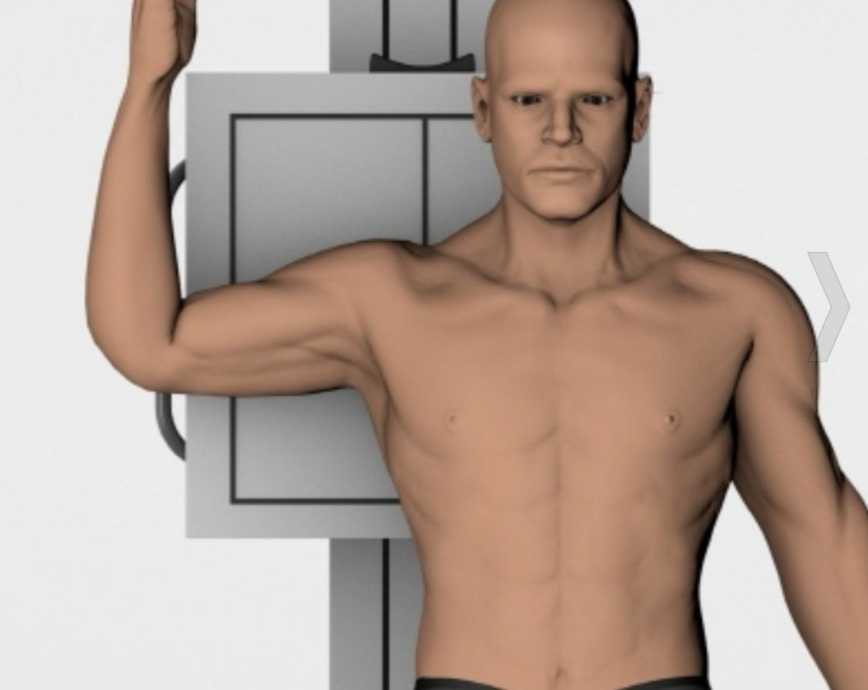
Shoulder lateral

Slide 50
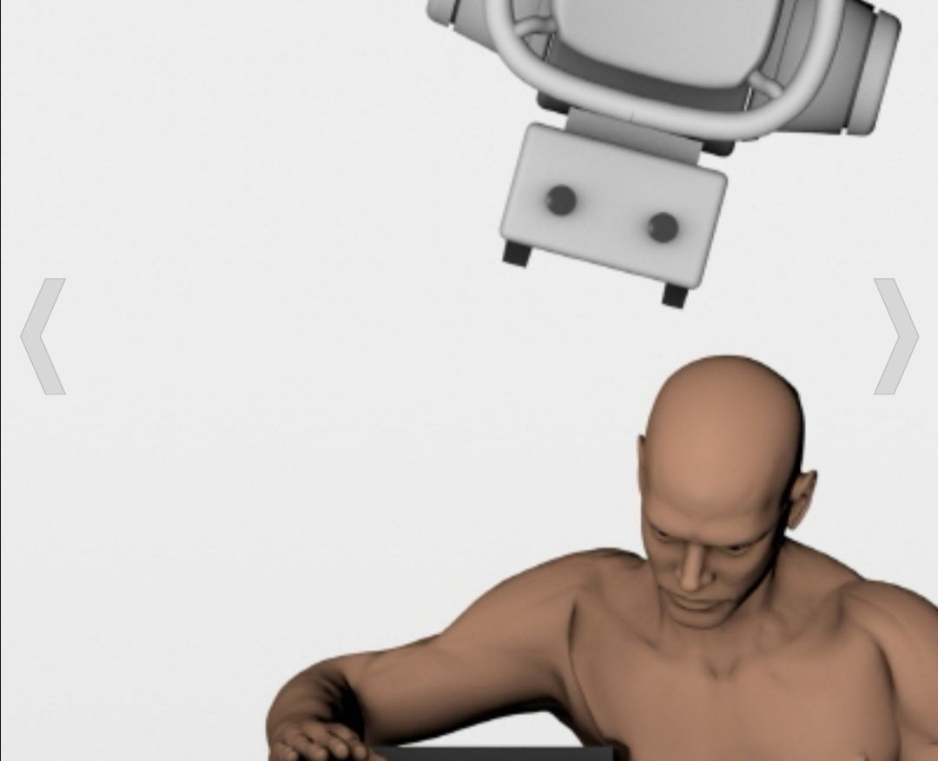
Shoulder Axial

Slide 51
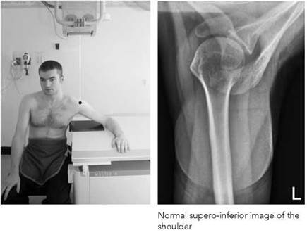

Slide 52
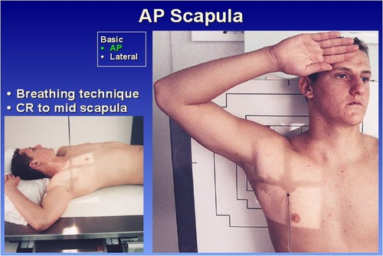

Slide 53
